Slide 1
New York State Stroke Designation Program
The Office of Quality and Patient Safety
Marcus Friedrich, MD, MBA, FACP
Chief Medical Officer
Jeanne Alicandro, MD, MPH
Medical Director
George Stathidis, MPH
Associate Health Planner
Lauren Orciuoli, MBAH
Associate Health Planner
Greg Young, MD, FACEP
Associate Commissioner, Western Region

Slide 2
Agenda
Stroke Service Regulation Overview
Transition Period
Overview of Designation Process
  Certification
  Designation
  Notification
Systems of Care
Sample FAQs
  Transfer Agreement
  Reporting Requirements
  Guidance Document
Q&A

Slide 3
Regulation Overview

Slide 4
Goal of Stroke Designation Program
Establish a system of stroke care in New York State that ensures all patients with signs and symptoms of stroke receive the most appropriate and timely medical treatments possible.
Establish a framework to support regional operationalization of transport processes for suspected stroke.
Continue full reporting of data for evaluation and monitoring of systems of stroke care.

Slide 5
Stroke Services Regulation
Title 10 NYCRR Section 405.34: Stroke Services
  Voluntary program that establishes:
    Tiered stroke designation program;
    Framework to support regional operationalization of transport processes for suspected stroke patients;
    Evaluation and monitoring through data reporting;
    Supports continued collaboration of care between hospitals and EMS within the framework established in Article 30 of the PHL:
    Transition period for existing stroke centers.
Effective Date of Stroke Services Regulation: March 20, 2019

Slide 6
Transition Period

Slide 7
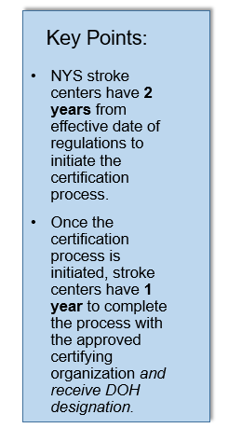
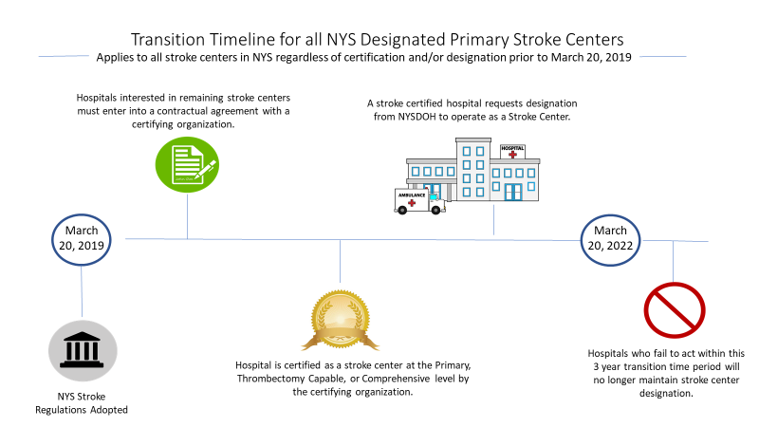
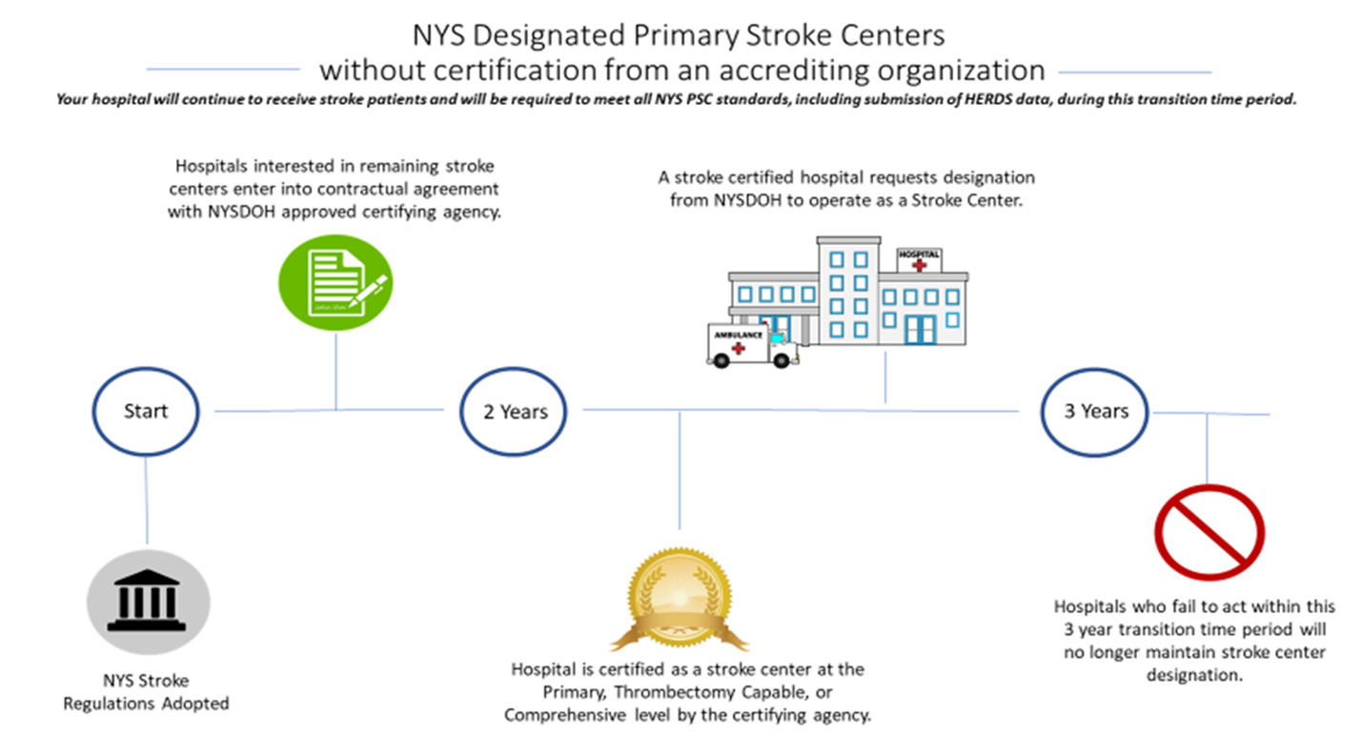
Transition Timeline

Slide 8
Transition Timeline (continued)
All hospitals wishing to maintain designation or become designated at a higher level must take action during the transition period.
Existing stroke centers that have not completed the certification process and received designation within 3 years of the effective date of the regulations will lose designation as a NYS stroke center.
Hospitals may still apply to become a stroke center after the transition period.
The transition time period applies only to hospitals seeking to maintain designation achieved prior to the regulated stroke program.
During the transition period, all currently designated stroke centers will continue to receive suspected stroke patients from EMS.

Slide 9
Pathway to Stroke Designation
NYS PSC designated before March 20, 2019 without independent certification
Receive certification as either PSC, TSC or CSC from a certifying organization between March 20, 2019-March 20, 2022
Request Designation from NYSDOH before March 20, 2022
NYS PSC with independent certification at any level before March 20, 2019
Request Designation from NYSDOH at any time
Receive certification as either PSC, TSC or CSC from a certifying organization at any time
Hospitals without designation or certification before March 20, 2019

Slide 10
Transition Period Recommendations
All hospitals are encouraged to research the approved Certifying Organizations (see webpage) and engage with an approved Certifying Organization as early as possible;
  Costs vary among Certifying Organizations;
  Certifying Organizations may have standards that exceed the NYSDOH baseline;
Existing Thrombectomy Capable and Comprehensive Stroke Centers should speak with their Certifying Organizations about the potential for reviews to be completed on an accelerated timeline;
  This is not a requirement but may be possible if desired by the hospital.

Slide 11
Certification Overview

Slide 12
Certification Process
All hospitals who seek to retain or achieve recognition as a NYS Stroke Center must engage with a NYS-approved certifying organization and receive disease specific certification at the Primary, Thrombectomy Capable or Comprehensive level.
Comprehensive Stroke Center
Thrombectomy Capable Stroke Center
Acute Ischemic Stroke; IV tPA comprehensive supportive care
Large vessel occlusion; Intracranial Endovascular Intervention
Subarachnoid and Intracerebral Hemorrhage; Neurosurgical Services; Intracranial Endovascular Intervention
Primary Stroke Center

Slide 13
Certifying Organizations
The following are Department approved accrediting organizations with authority to certify stroke centers in NYS:
  Healthcare Facilities Accreditation Program (HFAP)
  The Joint Commission (TJC)
  Center for Improvement in Healthcare Quality (CIHQ)
  Det Norse Vertias Healthcare (DNV-GL)
Contact information for all certifying organizations is available on the Department webpage. (https://www.health.ny.gov/diseases/cardiovascular/stroke/designation/)

Slide 14
Certification Standards
The Department, in collaboration with the NYS Stroke Advisory Group, the American Heart Association, and the American Stroke Association has developed stroke center requirements. These requirements are outlined in the ‘NYS Stroke Center Guidance Document’ and available on the Department’s webpage.
Baseline Standards set minimum expectations by level of care across several important program areas.
All certifying organizations must use these criteria as a baseline when certifying NYS hospitals but may also include additional standards that exceed this baseline in their certification process.

Slide 15
Designation Overview

Slide 16
Designation Process
Upon successful completion of the certification process, a hospital must request designation as a stroke center from the New York State Department of Health.
  A request for designation form is published on the NYSDOH webpage.
  The request for designation form must be submitted with verification of stroke center certification. The certification date must be after March 20, 2019.
  The Department will review all materials and issue designation.
  A hospital is only considered a designated stroke center for purposes of inclusion in the statewide system of care once they receive notification from the Department of designation.

Slide 17
Maintenance of Designation
Stroke centers must:
  Maintain certification, which includes re-certification per the requirements of your certifying organization.
  Report all required data to a stroke registry
  Engage in Quality Initiatives of the Department
  Comply with all state and federal laws

Slide 18
Notification Process
For all new/updated Stroke Center Designations, the New York State Department of Health will notify the following:
  REMAC and REMSCO
  Health Profiles
The Designated hospital is responsible for notifying local EMS agencies.
The Department will maintain a list of designated stroke centers on the stroke center webpage.

Slide 19
Systems of Care

Slide 20
Purpose of Stroke System of Care
Stroke systems of care should ensure patients receive care according to their needs
2018 AHA/ASA guidelines for acute ischemic stroke recommend that regional systems of stroke care should be developed and should consist of the following:
  (a) Healthcare facilities that provide initial emergency care, including administration of IV tPA, and,
  (b) Centers capable of performing endovascular stroke treatment with
comprehensive periprocedural care to which rapid transport can be arranged when appropriate.
The benefit of bypassing the closest stroke hospital for direct transport to a higher level of care is uncertain at this time.

Slide 21
Regional Engagement
Designated hospitals will work with EMS at the regional and state level to establish regional and state stroke center destination protocols.
Ongoing monitoring of regional systems is essential to ensure timely access to appropriate level of care
  Most patients will present to the closest facility
  Transfer agreements should incorporate region-specific strategies to minimize delays to definitive care
  Evidence is unclear at this time for bypass of primary center to higher level centers
  There is currently insufficient evidence at this time for prehospital assessment tools

Slide 22
Regional Engagement (continued)
Designated hospitals are encouraged to engage with their regional EMS councils and Regional Emergency Medical Advisory Committees.
  Attendees can introduce topics of interest.
Information on these agencies can be found on the Bureau of EMS webpage.

Slide 23
Sample of FAQs
to Date

Slide 24
Transfer Agreement
Designated hospitals will be required to communicate and collaborate with one another to provide appropriate access to care for all suspected stroke patients through a coordination/transfer agreement.
Key points for the transfer agreement: (this is not exhaustive)
  Transfer agreements must be written
  Target timeframes for transfer must be included into the agreement
  Ability to effect a transfer 24/7
  Clinical criteria for transfer
  Expectations and criteria for advanced imaging, including CTA/CTP
  Delineation of responsibility for CTA/CTP (sending vs. receiving)
  Triage and transport of patients with suspected emergent large vessel occlusion (ELVO)
*Transfer agreements may reference existing policies that address requirements related to transfer agreements.

Slide 25
Reporting Requirements
The Department has provided a list of performance measures and time targets in the NYS Stroke Center Guidance Document that are designed to measure stroke center and stroke system processes outcomes.
All stroke centers will be required to collect and report these data to a stroke registry (ex. GWTG).
  Hospitals should speak to their Certifying Organization about policies for reporting of new measures during initial reviews (i.e. NIHSS post procedure)
The stroke center must give the Department express permission to access their stroke registry data for the purpose of QI.
Certifying organizations may have varying requirements related to reporting.

Slide 26
Guidance Document Requirements
The Department maintains the most updated version of the NYS Stroke Center Guidance Document on the webpage;
The requirements within the document serve as a baseline only;
All Certifying Organizations are viewed equally by the NYSDOH. A certification from any of the approved Certifying Organizations will be accepted.
However, Certifying organizations may have standards that exceed those within the guidance document;
  For example, NYSDOH requires a PSC to have a stroke coordinator but does not specify credentials. One or more Certifying Organizations require a stroke coordinator to be a nurse.

Slide 27
Guidance Document Requirements (continued)
Because Certifying Organizations may have different requirements beyond the NYSDOH baseline in the NYS Stroke Center Guidance Document, hospitals must contact Certifying Organizations to inquire if there are any differences above the baseline;
Contact information and webpages for the approved Certifying Organizations may also be found on the NYSDOH webpage;
Any questions about the NYS standards and requirements should be sent to the NYSDOH at OQPS-OMD@health.ny.gov;
Questions about measure specifications should be sent to the appropriate measure steward identified in the Measure Specifications Background section.

Slide 28
Questions?

