Slide 1
Division of ACF & Assisted Living Surveillance
Introduction to the Home Care Worker Registry
for Enhanced Assisted Living Residences

Slide 2
Home Care Worker Registry

Slide 3
What is the Home Care Worker Registry?
The Home Care Worker Registry (HCWR) maintains information related to all Personal Care Aides (PCAs), Home Health Aides (HHAs), and Advanced Home Health Aides (AHHAs). The HCWR shows if an aide is:
Certified; Employed; and
For AHHA, has completed In-Service Training.
The HCWR is required by Chapter 594 of the Laws of 2008 and Chapter 471 of the Laws of 2016.

Slide 4
Why is the HCWR needed?
To prevent fraud and protect the health and safety of New York’s most vulnerable residents.
The HCWR provides information to the public via a web-based registry, allowing individuals and families to make an informed decision when choosing home health and personal care providers.

Slide 5
Who Uses the HCWR? – Enhanced Assisted Living Residences (EALRs)
The EALR is now defined as a “home care services entity” for HCWR purposes.

Slide 6
Who Uses the HCWR? - Employers
Employers use the HCWR to verify if potential employees are certified and employable.
Always search the HCWR to access the aide’s information prior to the aide initiating home care services.
An aide who successfully completed a DOH or SED approved training program in a class that started on or after September 25, 2009, will not provide services unless the aide’s training and personal information has been posted to the HCWR by the training program.

Slide 7
EALR Use of the HCWR

Slide 8
Location
Internal: Health Commerce System -> Home Care Registry
Public: https://apps.health.ny.gov/professionals/home_care/registry/home.action

Slide 9
EALR Implementation
Effective July 1, 2019, EALRs are responsible for the maintenance of HHA, PCA, and AHHA information within the HCWR.
EALRs must be compliant with this requirement by December 31, 2019.

Slide 10
EALR Use of the HCWR – LHCSA Employed Aide
If the HHA, PCA, or AHHA is employed by a Licensed Home Care Services Agency, the EALR shall review the individual’s eligibility via the HCWR; document such verification; and monitor.

Slide 11
EALR Use of the HCWR – EALR Employed Aide
If the HHA, PCA, AHHA is employed by the EALR, the EALR shall be responsible for the employee information within the database.
Note: To maintain active certification, an HHA must work at least one day within a two-year period for an agency licensed under Article 36 or 40 of Public Health Law.

Slide 12
HCWR Access

Slide 13
Required Roles via the Health Commerce System
The following Health Commerce System (HCS) roles have access to the HCWR:
Home Care Registry Agency Updater;
Home Care Registry Agency Viewer;
Home Care Registry Certification Form Printer;
Home Care Registry Training Program Updater; and
Home Care Registry Training Program Viewer.
Only individuals within these roles will have access to the HCS HCWR.

Slide 14
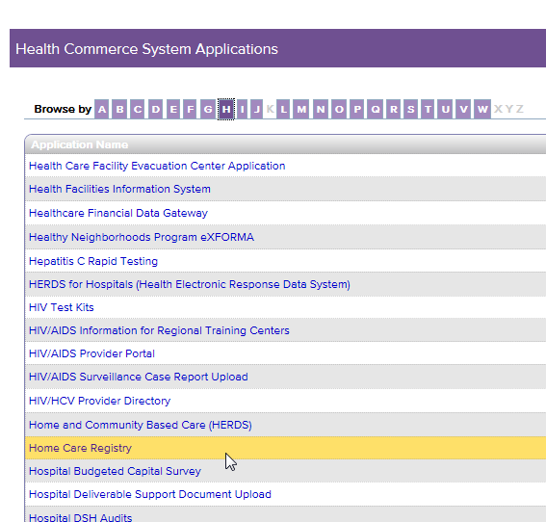
Where is the HCWR Application?
To add the HCWR Application:
Log onto the HCS.
Click on “My Content.”
From drop down box click on “All Applications.”
Select Letter H.
Select “Home Care Registry.”
Save as Favorite.
Note: By clicking the green plus sign next to “Home Care Registry,” you can add this application to your “My Applications” toolbar so it will be available on your Homepage.

Slide 15
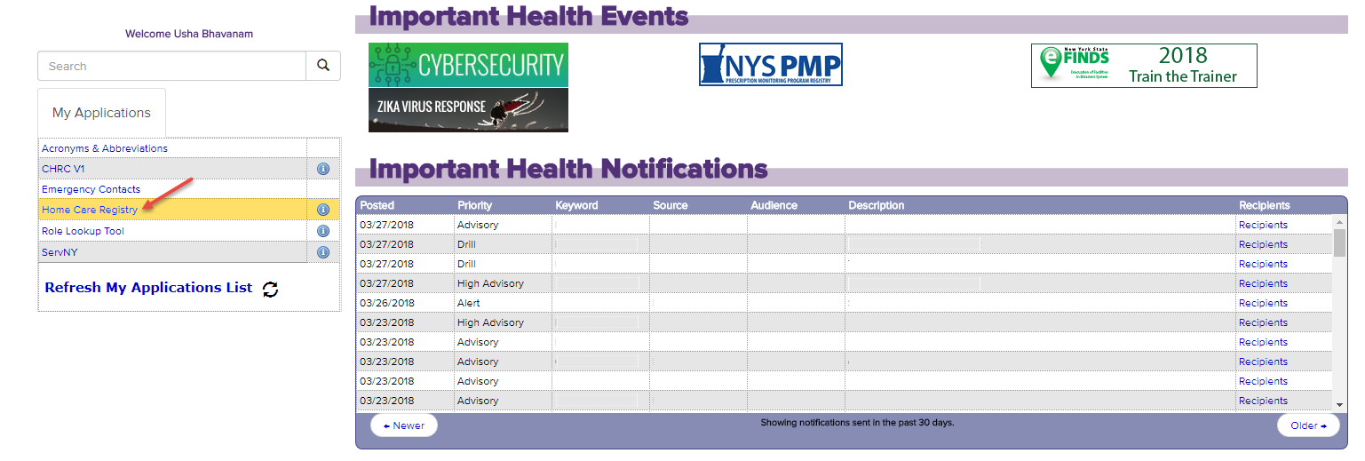
Where is the HCWR Application? (cont.)
Now, when you log into HCS, you will see Home Care Registry under My Applications on the home screen.

Slide 16
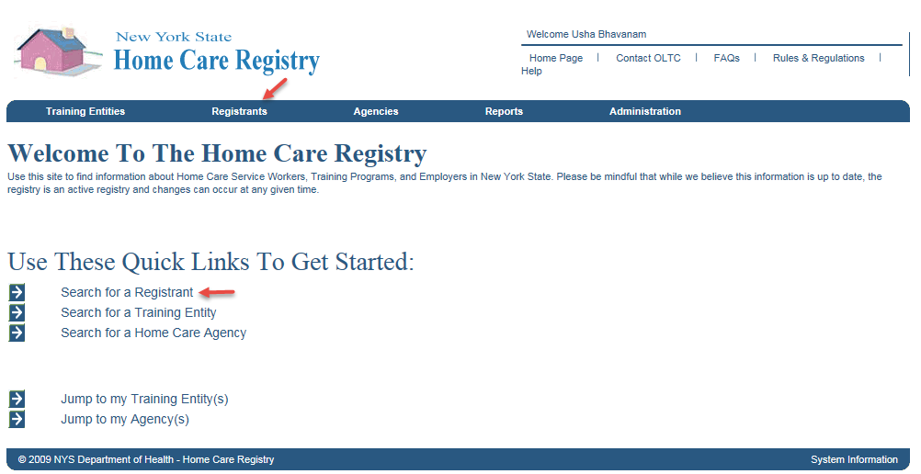
To Review a Prospective Employee
First, select Search for a Registrant.

Slide 17
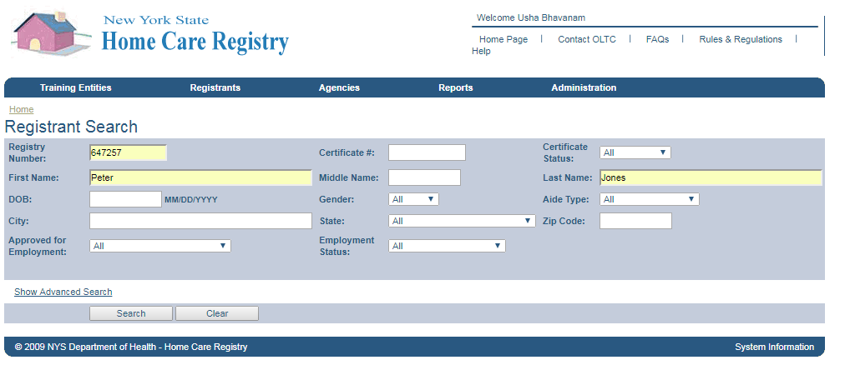
To Review a Prospective Employee (cont.)
Enter Registry Number or First Name or Last Name of the prospective employee.
Click Search.
Note: User must enter at least one parameter to initiate the search. Users can click the Show Advanced Search link to see more search options.

Slide 18
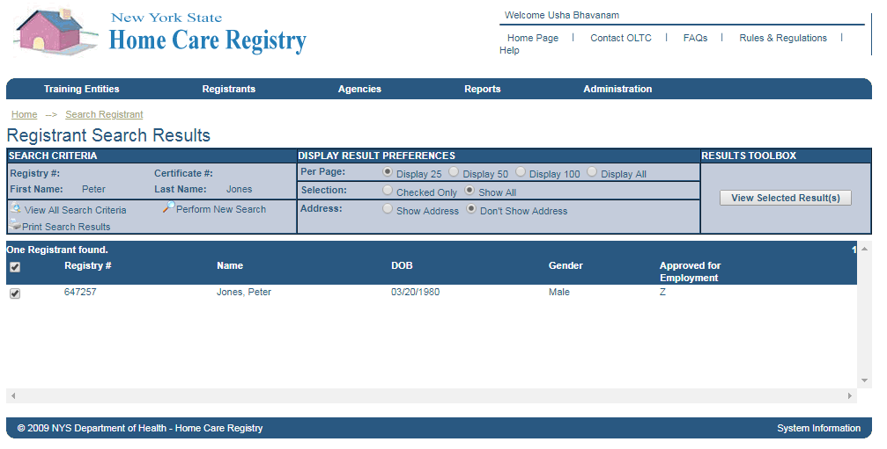
To Review a Prospective Employee (cont.)
The System will query the HCWR database to find a match.
Select the Registrant and click the View Selected Results(s) button to view the Registrant profile.

Slide 19
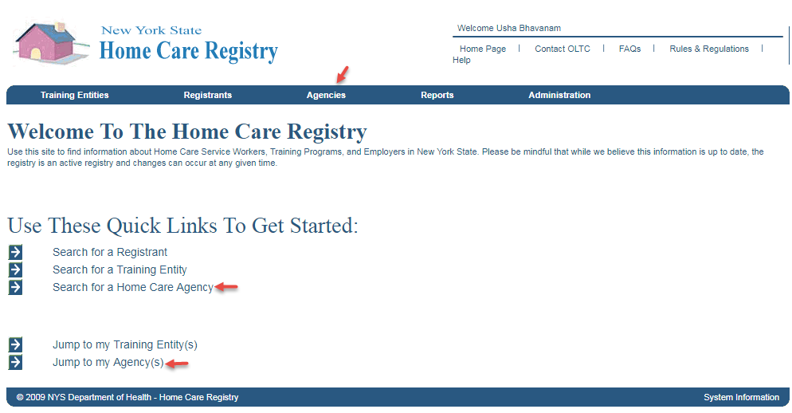
To Add an Employee
Users will have access to the following links on the Home page to navigate to their Agency:
Jump to my Agencies;
Search for a Home Care Agency; and
Agencies (from the main navigation bar).

Slide 20
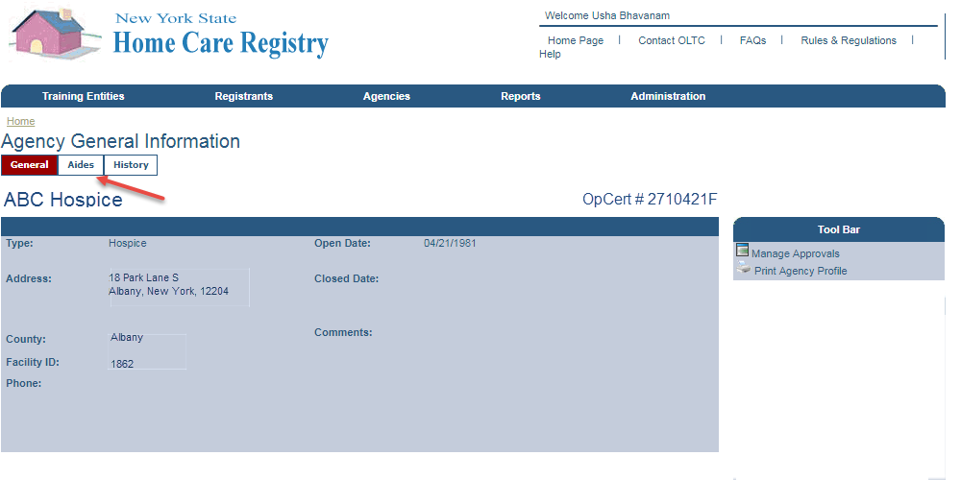
To Add an Employee (cont.)
After the User selects the ‘Jump to my Agencies’ link, they will be presented with this screen, the Agency General Information screen.
Select the Aides tab.

Slide 21
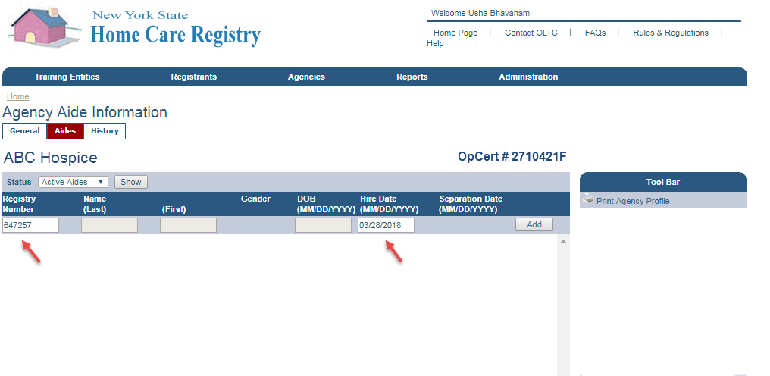
To Add an Employee (cont.)
Add Aide Information:
Enter Aide Registry Number and Hire Date, or
Enter Aide First Name, Last Name, DOB, and the Hire Date
Click Add

Slide 22
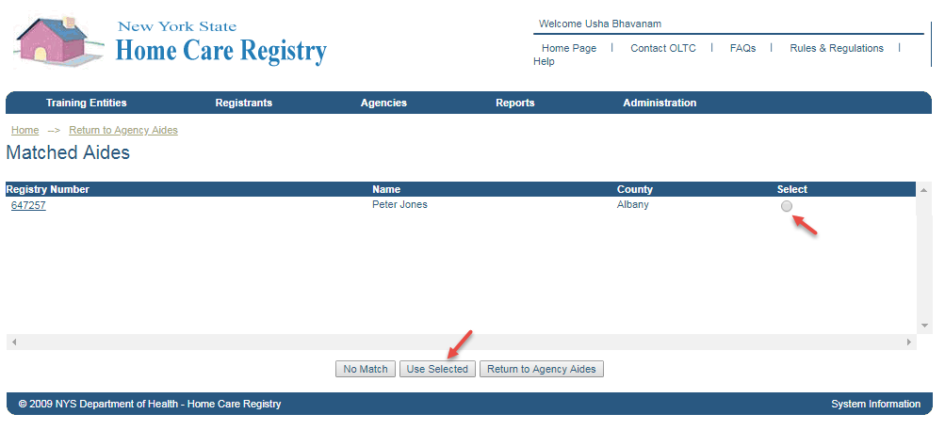
To Add an Employee (cont.)
The System will find a match for the entered Registry Number and will display the Aide record if found.
Choose Select and click Use Selected button.
Note: In the rare case that no match is found, simply click the No Match button to add a new Aide to the HCWR.

Slide 23
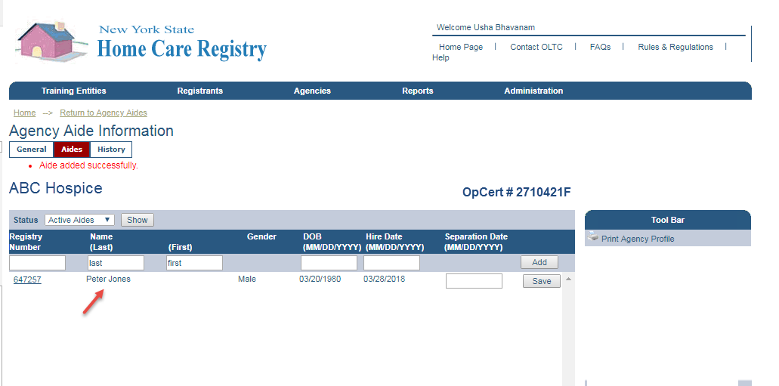
To Add an Employee (cont.)
Once selected, the Aide is added to the Agency.
System will display a confirmation for the User.

Slide 24
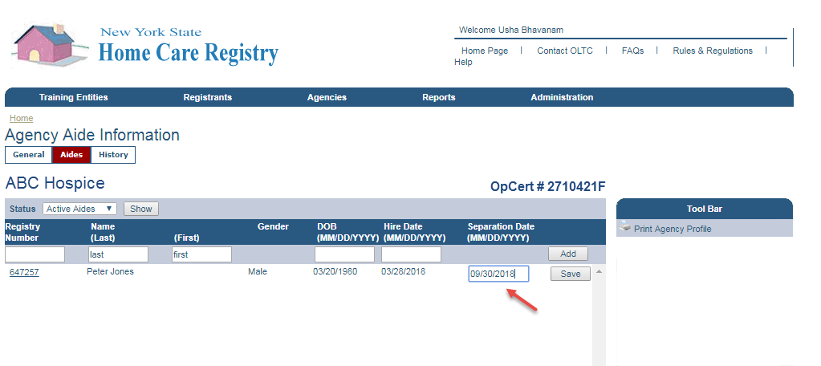
To Enter Employment End Date
The Agency can indicate employment has ended by entering a Separation Date.
If entered, the Aide will be removed from the Agencies Active Aides list on the date entered.

Slide 25
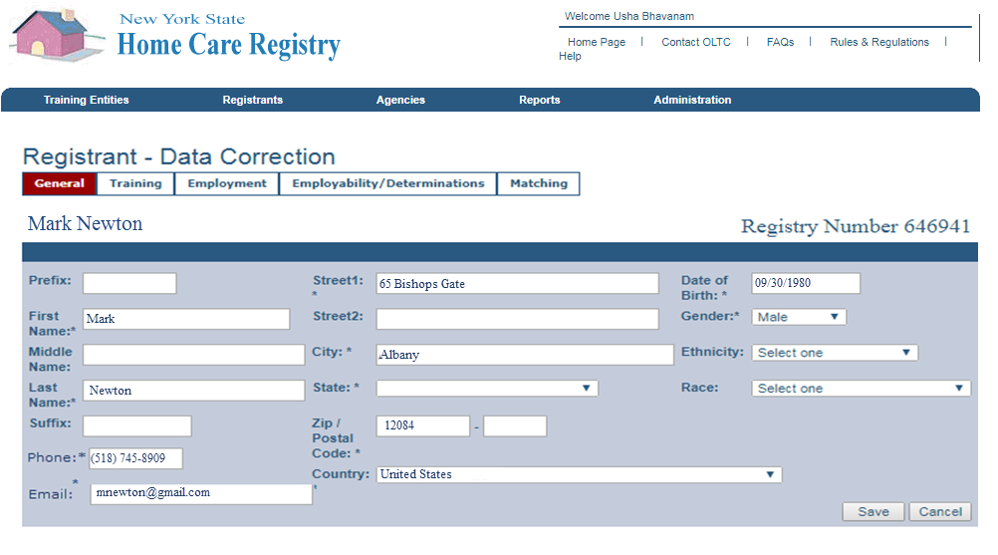
Registrant Data Correction
Employers are responsible to ensure Aide contact information is current.

Slide 26
Advanced Home Health Aide (AHHA)

Slide 27
EALRs & Use of the HCWR
EALRs who employ an Advanced Home Health Aide (AHHA) to provide advanced tasks must meet all applicable AHHA requirements, including listing of the AHHA on the HCWR.

Slide 28
AHHA In-Service Information
All aides with AHHA status must complete 18 hours of In-Service training annually to maintain their AHHA certification status on the HCWR.
The anniversary date is the date the Medication Aide Certification Examination® was successfully passed will be used as the anniversary date. The 18-hour In-Service must be completed within a year’s time between anniversary dates.
If an aide does not complete the In-Service training within the 12 month period their AHHA certification status in the HCWR will be removed and they will be left with their original HHA designation.
An AHHA can complete the required 18 hours of In-Service training from various organizations/employers.
**Only employers will have the ability to enter in-service training hours earned under
their supervision, or add hours earned from other sources with required training
documentation obtained from the aide/source.**

Slide 29
AHHA In-Service Information (cont.)
Prior to submitting in-service training hours, the employer will be presented with an attestation explaining that they understand the importance of accurate data and the consequences if the reported hours are inaccurate.
In-service training hours cannot be entered with future dates.
The employer will not be able to edit in-service training data once they’ve agreed with the attestation and saved the information to the HCWR.

Slide 30
AHHA In-Service Information (cont.)
This screen show a record for Melissa Jones, she has two employers who have each entered hours on her behalf. To
add additional hours her employer would need to select the “Add In-Service Training” from the tool bar on the right side of the screen. There is also a note in red showing the expiration date along with the total number of hours needed to satisfy the 18 hour requirement.

Slide 31
AHHA In-Service Information (cont.)
This screen is simply used to enter training hours. After the user selects “Save” they will be presented with the attestation prior to the data being saved in the database.

Slide 32
Questions

Slide 33
Contacts
For questions regarding the HCWR: hcreg@health.ny.gov
For questions regarding PCA: pcatp@health.ny.gov
For questions regarding HHA: hhatp@health.ny.gov
For questions regarding AHHA: ahhatp@health.ny.gov
For questions regarding EALR: acfinfo@health.ny.gov

