Slide 1
Public Health 2018 and Beyond
Brad Hutton, MPH
Deputy Commissioner, Office of Public Health

Slide 2
Outline
In the Office of Public Health we are addressing traditional public health threats and emerging challenges, including substance abuse
The Prevention Agenda and the new effort to implement Health Across all Policies have helped us focus on the health of communities, on the prevention (rather than treatment) of disease, and on the social determinants of health, and we can report some significant success.
Evidence based interventions, policy and environmental change are our best strategic opportunities
Partnerships between public health and health systems at the state and local level provide important opportunities to address key challenges
Investments in public health do not match the need
Health care systems can invest in evidence based interventions, policy and environmental change that improve the health of their employees, patients and the communities they serve
Role of PHHPC in public health: PHHPC can provide strong voice and bully pulpit for the public health enterprise, for the Prevention Agenda and attention to the social determinants of health.
PHHPC should advocate for strong public health system partnerships and consider
requiring health systems to increase their investments in prevention.

Slide 3

Public Health Challenges 2017
Infection control and antibiotic resistance
HIV, STD and Hepatitis C
Obesity and diabetes
Tobacco
Cancer
Reproductive health
Preparedness
Clean Water
Opioid Abuse

Slide 4
Prevention Agenda Dashboard demonstrates significant progress to achieve statewide public health goals, but more work needs to be done:
As of June 2017:
28 indicators show progress (22 with significant improvement)
Preventable Hospitalizations Rate
Asthma Related Hospitalizations
Hospitalizations due to falls
Exclusive Breastfeeding in hospitals
Number of insured adults & children
48 not met and staying the same
17 not met and going in wrong direction
https://health.ny.gov/preventionagendadashboard
Notes:
The Prevention Agenda includes 96 metrics of public health and prevention ranging from preventing chronic disease to promoting policies that result in healthy women, infants, and children.
Conditions such as obesity reflect deeply embedded behaviors and in many cases also reflect barriers to improvement caused by poor Social Determinants of Health. For these reasons, we don’t expect all of these measures to improve overnight. But 28 of the indicators in the Prevention Agenda have shown significant improvement over the last five years with more modest progress in six others.
The next five years of the Prevention Agenda will continue to include ambitious goals and we think the cumulative effect of the Gov.’s health transformation policies will result in significant progress in the next cycle.

Slide 5
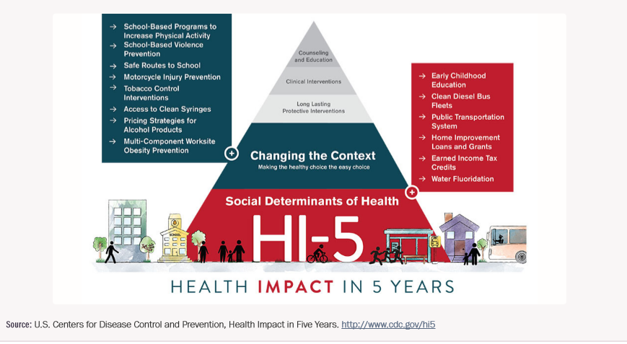
To make additional progress, we need to implement evidence based interventions, policy and environmental change
Notes:
Implement Nutrition standards for healthy food and beverage procurement
Expand Healthy Corner Store initiative and other opportunities to buy healthy food
Implement Complete Streets policies
Support Signage, worksite policies, social support and joint use agreements that support increased physical activity opportunities
Implement Breastfeeding policies
Decrease availability of tobacco and increase price, increase minimum sales age for all tobacco products from 18-21
Increase adoption of smoke free policies in publicly and privately operated housing

Slide 6
To make additional progress,
public health and health systems need to partner at state level
Example:
Public Health and Health Planning Council focus on Maternal Mortality and Women’s Health
Partnership for Maternal Health: NYS and NYC Health Departments, ACOG NY, GNYHA, HANYS, NYAM and others working together to identify and implement collaborative opportunities to decrease maternal mortality and morbidity and the importance of focusing on preconception care
Notes:
N=167 hospitals
57 hospitals submitted joint plans with 33 LHDs (31 joint plans total)
110 individual hospitals covered in 71 CSPs
N=58 LHDs
25 LHDs submitted their own CHA/CHIP
33 LHDs submitted joint plans with hospitals
In the last round, one county submitted a joint report i.e. Monroe. This time, we had 31 joint submissions because the guidance encouraged it.

Slide 7
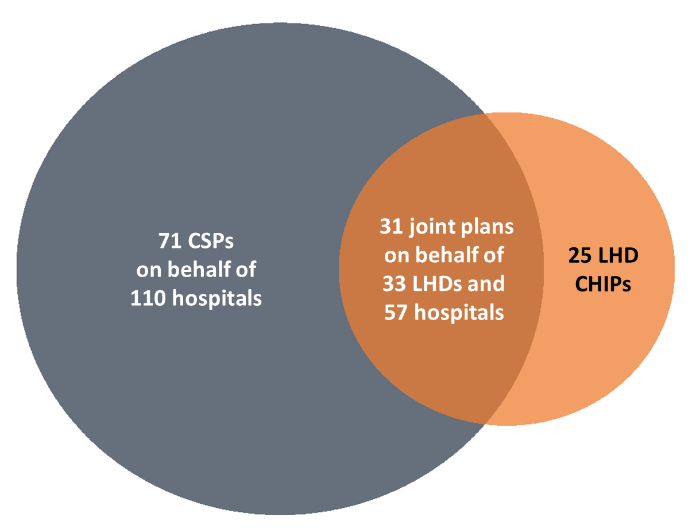
…and at Local level
2016-2018 Prevention Agenda Community Health Improvement Partnerships
127 plans by 58 LHDs and 167 Hospitals
Notes:
N=167 hospitals
57 hospitals submitted joint plans with 33 LHDs (31 joint plans total)
110 individual hospitals covered in 71 CSPs
N=58 LHDs
25 LHDs submitted their own CHA/CHIP
33 LHDs submitted joint plans with hospitals
In the last round, one county submitted a joint report i.e. Monroe. This time, we had 31 joint submissions because the guidance encouraged it.

Slide 8
Discrepancy between health determinants and health spending
$3 Trillion
Prevention 3%
Health Behaviors
30%
Clinical Care
20%
Medical Services
97%
Social and Economic Factors
40%
Physical Environment 10%
Determinants of Health
National Health Expenditures
Source: Booske BC, Athens JK, Kindig DA, Park H, Remington PL. County Health Rankings working paper: different perspectives for assigning weights to determinants of health. University of Wisconsin Population Health Institutes. 2010. Available at: http://uwphi.pophealth.wisc.edu/publications/other/different-perspectives-for-assigning-weights-to-determinants-of-health.pdf (Accessed September 20, 2016).
Source: National health expenditure accounts: methodology paper, 2014 definitions, sources, and methods. Centers for Medicare & Medicaid Services. 2014. Available at: https://www.cms.gov/Research-Statistics-Data-and-Systems/Statistics-Trends-and-Reports/NationalHealthExpendData/downloads/dsm-14.pdf (Accessed September 20, 2016).

Slide 9
Role for Public Health and Health Planning Council
Advocate for health systems to partner with public health to implement evidence based non-clinical interventions to improve community health
Consider requiring specific spend on community health improvement tied to community benefit and/or CON

Slide 10
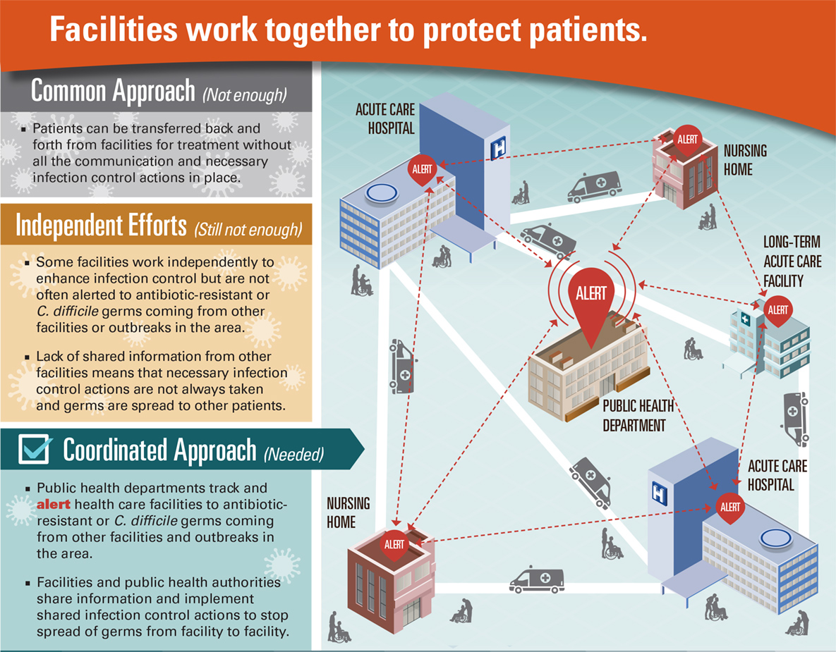
Example: Antibiotic Resistance

Slide 11
Example: Chronic Disease
Phase out sale of all sugar sweetened beverages in retail dining, vending, catering, on site food vendors and patient food service operations
Adopt and use food standards and procurement policies that increase access to healthy food
Use influence in community to advance public health policies that increase access to physical activity (e.g. Complete Streets), limit tobacco (e.g. smoke free housing) and increase access to community based diabetes and asthma self management programs.

Slide 12
Discussion
Carol Smith, Ulster County Commissioner of Health
Sue Ellen Wagner, Vice President Community Health, HANYS
Clare Bradley, Chief Medical Officer, IPRO
Ana Garcia, Director, Government and Community Affairs, New York-Presbyterian

