Slide 1
Maternal Mortality Update
Public Health Committee
June 26, 2023

Slide 2
Public Health Committee White Paper
Published 2016
Maternal Mortality Recommendations for Action
Data:
NY Ranks 47 out of 50 states
Rates were at 17.9 per 100,000 births
Disparities between Black and White birthing people

Slide 3
Opportunities for Change
Integrate preconception and interconception care into routine outpatient care for all women of reproductive age
Assess and address pregnancy planning and prevention of unintended pregnancy among women in general and especially those with serious chronic conditions and risk factors
Institute systems and protocols for early identification and management of high­-risk pregnancies
Notes:
The white paper identified opportunities for three change. I will share some data about what we have seen related to these three areas. Then I will share new, additional quantitative and qualitative data that became available since this white paper. You will see the Department’s work to support these three opportunities woven through the presentation along with new areas focuses based on additional data.

Slide 4
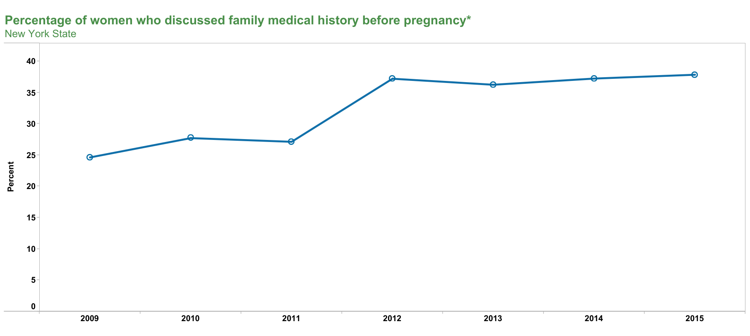
PRAMS data

Slide 5
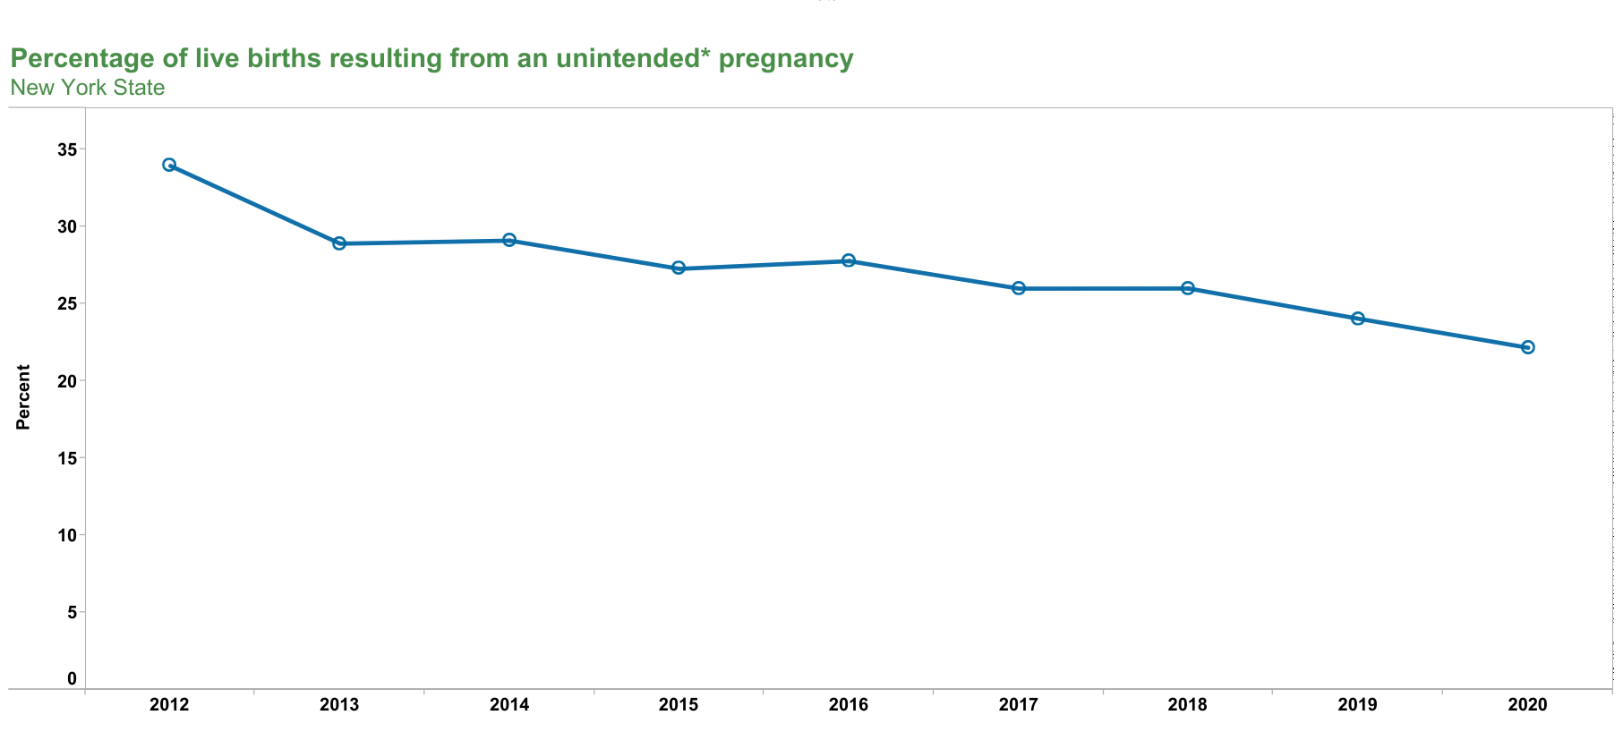
PRAMS data
Notes:
We have also seen teen pregnancy decline significantly.

Slide 6
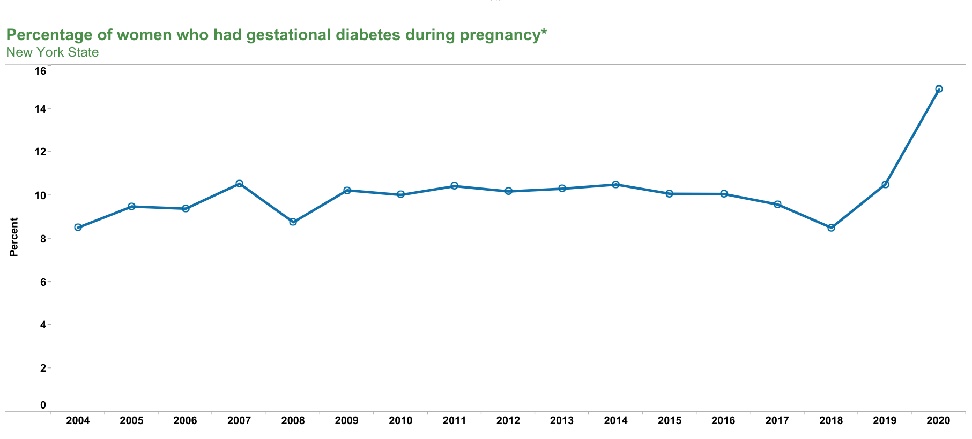
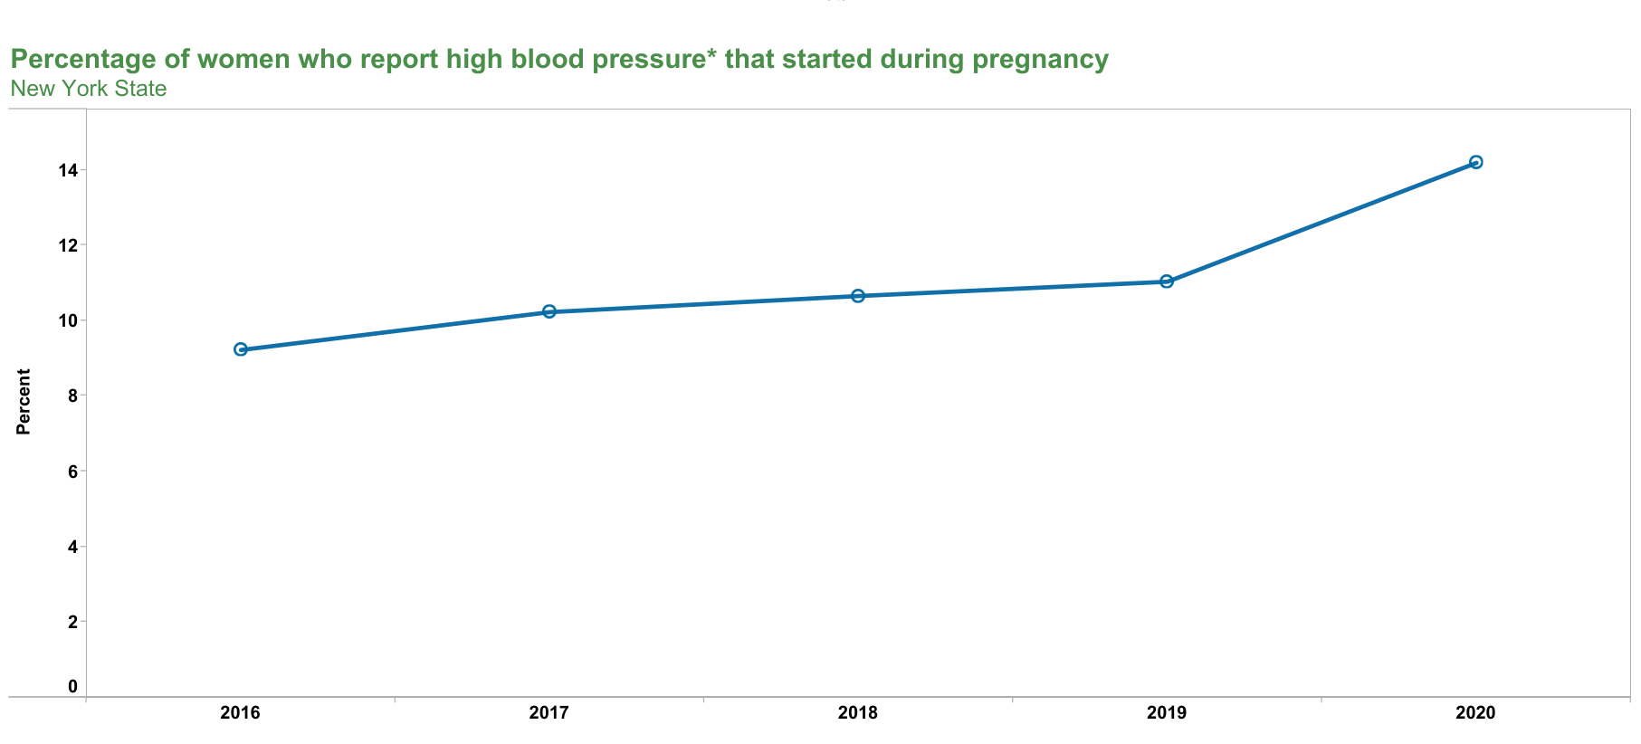
PRAMS data

Slide 7
NYS Ranking Maternal Mortality
Publication Year | Rank | Source
2010 | 46th | National Women’s Law Center (no longer available online)
2018 | 30th | America’s Health Rankings
2020 | 23rd | America’s Health Rankings
2022 | 15th | America’s Health Rankings

Slide 8
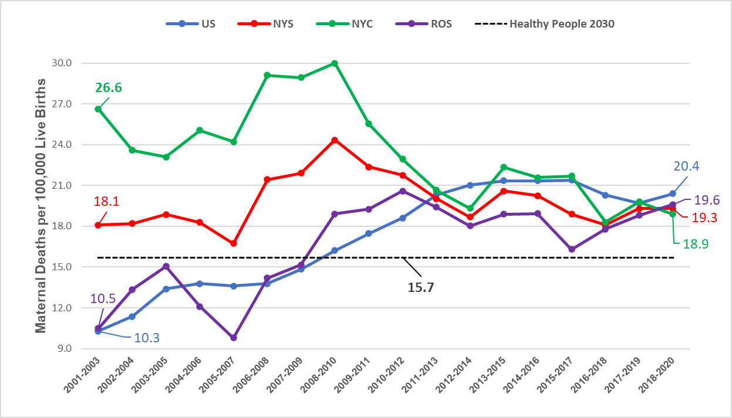
Trends in Maternal Mortality as Reported in Vital Records*
*Causes of death from death records A34, O00-O95,O98-O99 (within 42 days of the end of pregnancy)
Data Source: National Data from CDC Wonder database and NY data from NYS Vital Statistics.

Slide 9
Trends in Maternal Mortality as Reported
in Vital Records* by Race
*Causes of death from death records A34, O00-O95,O98-O99 (within 42 days of the end of pregnancy)
Data Source: National Data from CDC Wonder database and NY data from NYS Vital Statistics

Slide 10
Pregnancy-related Mortality Ratio (PRMR)
by Race/Ethnicity, NYS 2018
Data source: NYS Maternal Mortality Review

Slide 11
Pregnancy-related Mortality Rate by Race/Ethnicity
and Insurance Type, NYS 2018
Source: NYS MMR and NYS Vital Statistics
Note: Due to the small number of cases in the cohort, rates may be unstable and must be cautiously interpreted.

Slide 12
Pregnancy-related Mortality Rate by
Race/Ethnicity and Education Level, NYS 2018
Source: NYS MMR and NYS Vital Statistics
Note: Due to the small number of cases in the cohort, rates may be unstable and must be cautiously interpreted.

Slide 13
Pregnancy-Related Mortality Rate by Race/Ethnicity
and Pre-pregnancy BMI, NYS 2018
Source: NYS MMR and NYS Vital Statistics
Note: Due to the small number of cases in the cohort, rates may be unstable and must be cautiously interpreted.

Slide 14
Pregnancy-related Mortality Rate by
Race/Ethnicity and Delivery Method, NYS 2018
Source: NYS MMR and NYS Vital Statistics
Note: Due to the small number of cases in the cohort, rates may be unstable and must be cautiously interpreted.

Slide 15
Voice Your Vision
NYSDOH partnered with community-based organizations in 2018
Actively recruited people who are Black and who recently gave birth to share stories
Common sentiments:
Feeling disrespected by providers.
Not getting their questions answered and their concerns addressed.
Insufficient time with the provider, and not receiving individualized care.
Not receiving enough information to make proper decisions.
Feeling pressure to agree to certain medical procedures.
Lack of social support during the prenatal and postpartum periods
Suggestions:
Increase health care professional awareness of racial disparities in health outcomes.
Train health care professionals on the impact of implicit bias on health care outcomes.
Increase provider support during the postpartum period.
Increase availability of social support for example, birthing classes, group prenatal care, doulas, midwives, community health workers and parenting classes.
Increase availability of community services and resources, for example, community health worker services, home visiting services
Notes:
In partnership with the NYS DOH Maternal and Infant Community Health Collaboratives (MICHC) programs, listening sessions were conducted in seven communities: Buffalo, Syracuse, Albany, Bronx, Brooklyn, Harlem and Queens. The MICHC grantees were invaluable in organizing the Voice Your Vision – Share Your Birth Story Community Listening Sessions and engaged other community-based partners to recruit participants and to help facilitate the discussions. This series of participant led discussions engaged a total of 244 women, including recently and currently pregnant women and families, and women who have experienced an adverse birth outcome. With a structure loosely defined around issues related to family planning, pregnancy, childbirth, and postpartum care, participants were allowed the opportunity to drive the conversation themselves, identifying the unique themes and issues that resonated with them and their communities.

Slide 16
Department Initiatives: OPH
Office of Public Health Initiatives:
Perinatal Quality Collaborative: Hemorrhage, OUD-NAS, Birth Equity Improvement Project
Home Visiting Programs
Perinatal Regionalization System and Regulations
Maternal Mortality and Morbidity Advisory Council
Maternal Mortality Review Board
Postpartum Depression Study
Education and Training
Reproductive Health investments

Slide 17
NYS Perinatal Quality Collaborative
Improve Widespread Adoption of Patient Safety Bundles & Policies
NYS Obstetric Hemorrhage Project (Nov. 2017 - June 2021)
Outcomes: Among patients with an obstetric hemorrhage, transfer to higher care, including the Intensive Care Unit or a higher-level hospital (e.g., the Regional Perinatal Center), decreased 64% and hysterectomies decreased 29%.
Optimize Treatment of Pregnant & Postpartum Women with Mental Health Conditions/Substance Use Disorders
NYS Opioid Use Disorder in Pregnancy & Neonatal Syndrome Project (current)
Outcomes: Most recent project data shows that 85-90% of maternity patients with OUD have existing or newly initiated referral/linkage to Medication Assisted Treatment or other treatment of opioid use at time of discharge.

Slide 18

NYSBEIP Project Goal
All New York State birthing hospitals and centers will identify how individual and systemic racism impacts birth outcomes at their facility and will take actions to improve both the experience of care and perinatal outcomes of Black birthing people in the communities they serve.
January 2021 Project Launch
73 NYS birthing facilities participating (73% of NYS births)

Slide 19
Key Strategies
Organizational Commitment to Anti-racist Efforts through Leadership & Governance
Accountability
Respectful Patient Partnership with Black Birthing People
Stratification of Perinatal Outcome Data by Race, Ethnicity, Gender Identity & Language to Drive Improvement

Slide 20
NYS Birth Equity Improvement Project
Learning collaborative framework based on the NYS Perinatal Quality Collaborative (NYSPQC) structure
Equity curriculum emphasizes structural and systems change within participating facilities to promote equitable care
Participating facilities are collecting and using patient experience data stratified by race and ethnicity
Receive monthly reports on progress to tailor their efforts

Slide 21
Home Visiting Programs
Improve Access to Care
Perinatal and Infant Community Health Collaboratives (new initiative started 7/1/22) (anticipate up to 128 CHWs).
Also funding PICHC Data Management Information System, and Center for Community Action (Training and TA)
Reauthorization of the federal Maternal, Infant, and Early Childhood Home Visiting (MIECHV) Program in December 2022 will support enhancements to evidence-based home visiting programs such as Healthy Families New York and Nurse-Family Partnership for the next six years. These programs:
provide education, screening, and referrals to at-risk families in low-income households
assist families in maintaining health insurance coverage and receiving recommended prenatal, postpartum, and well childcare

Slide 22
Maternal Mortality & Morbidity Advisory Council
Working collaboratively with the MMRB to review findings and address structural and social determinant factors that impact maternal health outcomes
Members from across NYS from many different disciplines including community members, perinatal network professionals, midwives, doulas, home visitors, physicians, nurses, social workers
The Advisory Council is currently developing its own recommendations on policies, best practices, and strategies to prevent maternal mortality and morbidity.
12 meetings over last year
Recommendations are expected this fall.

Slide 23
Maternal Mortality Review Board (MMRB)
Meets 4-6 times/year to review cases and make recommendations
Biennial reports – report of 2018 maternal death cohort released in 2022; next report is in progress and will include 2018, 2019, and 2020
Will develop updated recommendations
Issue brief on mental health completed; currently working on one for substance use disorder
Naloxone brochures were developed for the person using substances and their family; recommended by Board

Slide 24
MMRB Recommendations: Facility
Facility Level
Hospitals should implement the AIM bundle to reduce cesarean delivery rates (32% working on it; 56% in place)
Hospitals should ensure that anesthesiologists and obstetricians follow a standard protocol for massive transfusion in hemorrhage during pregnancy, delivery and postpartum period (94% working on it; 5% in place)
All facilities should implement screening for venous thromboembolism and chemoprophylaxis during intrapartum and postpartum care (75% working on it; 20% in place)
All facilities should implement universal systems for quantification of blood loss and anesthesia involvement during delivery and postpartum (86% working on it; 13% in place)
Notes:
Committees proposed total of 236 recommendations
155 recommendations were identified for pregnancy-related deaths
Executive Committee and MMRB members proposed 14 key recommendations for NYS 2018 death cohort

Slide 25
MMRB Recommendations: Provider
Provider Level
The Department, ACOG, and partners, should develop a cardiac bundle to assist with provider education (Working with ACOG on educational presentation)
The Department, ACOG, and partners should develop a communication brief on the importance of involvement of multidisciplinary specialists in chronic care management during antenatal, intrapartum and postpartum care (Brief on perinatal mental health completed; SUD in progress)
Obstetricians and other providers should utilize a multi-disciplinary approach for collaborative chronic care management of obstetrical patients including the postpartum period
The Office of Mental Health, ACOG and partners should develop materials to educate providers on behavioral health evaluation, treatment and understanding of patient barriers to seeking care
Obstetrical providers and hospitals should engage community resources during prenatal and hospital discharge planning (e.g., doula, visiting nurses, community health workers/patient navigators, telehealth, and remote monitoring) to help support and link high risk mothers with chronic conditions and difficult access (e.g., rural areas) to follow-up care and community resources
Notes:
Committees proposed total of 236 recommendations
155 recommendations were identified for pregnancy-related deaths
Executive Committee and MMRB members proposed 14 key recommendations for NYS 2018 death cohort

Slide 26
MMRB Recommendations: System
System Level
The Department should implement a maternity medical home model of care and convene a multi-stakeholder group to develop standard guidance about additional psychosocial services and coordination of care which includes trauma and social determinants of health
The Department and partners should develop a systemic approach to reduce structural racism (NYS Birth Equity Project)
The Department should expand Medicaid coverage to include one year postpartum (Implemented March 2023)
The Department, ACOG DII, and partners should develop an emergency room bundle for the care of pregnant women
NYS should offer all families at least one home visit from a nurse or paraprofessional within 2 weeks postpartum to educate patients and families about signs and symptoms of potential complications
Notes:
Committees proposed total of 236 recommendations
155 recommendations were identified for pregnancy-related deaths
Executive Committee and MMRB members proposed 14 key recommendations for NYS 2018 death cohort

Slide 27
Strengthen the NYS Perinatal System
Impact of proposed regulations (published in State Register for comment May 31, 2023):
Expanded the regionalized system in New York State to incorporate birth centers, including midwifery birth centers as the first level of care
Formalized a relationship with the Regional Perinatal Center (RPC) for training, consultation and quality improvement through an affiliation agreement
Strengthened the requirement for transfer agreements with higher level perinatal hospitals
Strengthened the requirements for all levels including birthing centers to improve maternal and neonatal outcomes

Slide 28
Maternal Mental Health
Current Postpartum Depression Screening Protocols and Tools: A Review of Evidence on Adequacy and Equity
NYSDOH and Office of Mental Health are collaborating on a study of postpartum depression screening tools, their validity and potential issues when used with racial and ethnic minority populations
Mandated by Senate Bill 7753, the study also examines screening related to social determinants of health that may affect PPD
Project TEACH Maternal Mental Health
Support and promote OMH’s Project TEACH’s Maternal Mental Health Program, a teleconsultation program connecting perinatal care providers with mental health expertise
In 2022, consultations were made to providers caring for 128 pregnant and postpartum patients

Slide 29
Additional Actions
Improve provider training:
DOH contracted with Association of Women’s Health, Obstetrical and Neonatal Nurses (AWOHNN) to provide the POST-BIRTH Warning Signs Education Program for all NYS birthing hospitals. DOH is also contracting with AWHONN in 2023 to support in-depth training for perinatal nursing through the Perinatal Orientation and Education Program.
NYSPQC, ACOG District II, and Project TEACH hosted four webinars focused on maternal mental health access, integrating mental health into OB/GYN practices, and the impact of social determinates of health on maternal mental health.
Improve Public Education and Awareness:
DOH implemented the CDC’s Hear Her Campaign to increase awareness of serious pregnancy-related complications and their warning signs, empower women to speak up, encourage women’s support systems to have important conversations, and provide tools to facilitate conversations for women and providers.
DOH conducted a Perinatal Mood and Anxiety Disorder Campaign

Slide 30
Reproductive Health Investments
Expanded the state’s Family Planning Program (FPP)
34 FPP contracts were amended in 2022 to add value and extend length of contract.
3 new contracts were awarded to organizations that applied in the 2021 FPP procurement but were not awarded initially because there was no funding remaining.
These contracts represent 9 additional family planning sites located in Erie County, Queens, Manhattan, and the Bronx
New funding for abortion access
Total Awarded: $24.1M awarded to 51 organizations with 127 clinics

Slide 31
Department Initiatives: OHIP
Office of Health Insurance’s Medicaid Initiatives:
Doula Coverage: Effective January 1, 2024, Medicaid will expand coverage of doula services for all pregnant, birthing, and postpartum Medicaid-enrolled individuals through 12-months postpartum
Midwifery Services: As of July 2022, increased reimbursement rate from 85% to 95% of the physician fee schedule, and across the board increases in 2023
Community Health Worker Coverage: Medicaid will soon cover stablishing coverage for community health workers serving the perinatal population
Nutrition Counseling: Medicaid will expand coverage to include nutrition counseling provided by Certified Dieticians/Nutritionists provided within their scope of practice.
Lactation Counseling: Effective August 1, 2022, Medicaid expanded the list of allowable lactation certifications of licensed medical professionals to be eligible for reimbursement for lactation counseling
Prenatal testing expansion: non-invasive prenatal trisomy screening, Spinal Muscular Atrophy, third trimester Syphilis screening
Remote Patient Monitoring: Effective October 1, 2022, an additional monthly reimbursement is available to cover the cost of remote patient monitoring devices
Perinatal Care Standards: Effective August 1, 2022, Medicaid released updated Perinatal Care Standards for all Medicaid providers serving pregnant and postpartum individuals to support improved access to and quality of maternal care
Increased reproductive health services reimbursement: family planning and abortion

Slide 32
Midwife-Led Birth Centers
Law
Senate and Assembly bills (S.1414-A and A.259-A)
Public Health Law Subdivision 11 of section 2803
Amend the public health law, in relation to the operation of midwifery birth centers and to accreditation, approval, and operation of midwifery birth centers
Regulations: 10 NYCRR 795
Part of the regulations posted for public comment on May 31, 2023 (referenced above under work to strengthen perinatal system)
Presented to PHHPC on February 9
Purpose of Updates:
Require transfer and affiliate agreements, to ensure critical patients are transferred to the appropriate level of care.
Increase patient access to ancillary services
Increase facility access to expertise of the Regional Perinatal Center
Alignment of MBC staffing and ancillary services with physician-led birth centers as appropriate
Outline requirement for accreditation and establishment
Notes:
Office of Primary Care and Health Systems Management and the Office of Public Health’s Division of Family Health working together

Slide 33

Questions?

