Slide 1
Emergency Room Wait Times
Public Health and Health Planning Council
Health Planning Committee
Summary of Workgroups 1 and 2

Slide 2
Workgroup 1 – Behavioral Health Patients in the Emergency Department
May 4, 2023

Slide 3
Highlights
Commissioner Ann Sullivan, detailed three key issues affecting ED boarding:
Difficulty getting the right assessment in the ED and appropriate workforce to conduct the assessment.
Complex patients in the ED.
Access to psych beds.

Slide 4
Additional Issues
Other issues identified by Commissioner Sullivan include:
Workforce and workforce training.
Connecting patients with care after discharge.
Payment from both Medicaid and commercial insurers.

Slide 5
Key Takeaways and Next Steps
Questions received from committee – in progress.
Explore role of FQHCs, urgent care and primary care.
Enhancing workforce - attracting new and retaining existing providers.
Increasing overall capacity.

Slide 6
Workgroup 2 – Dental/Oral Health in the Emergency Department
June 8, 2023

Slide 7
Highlights
Speakers:
Dr. Eni Obadan-Udoh, Associate Professor and Director, Dental Public Health Postgraduate Program at University of California San Francisco School of Dentistry
Dr. Dionne Richardson, NYS Department of Health, Dental Director, Office of Public Health, Center for Community Health
Jean Moore, Director, Center for Health Workforce Studies, School of Public Health, University at Albany

Slide 8
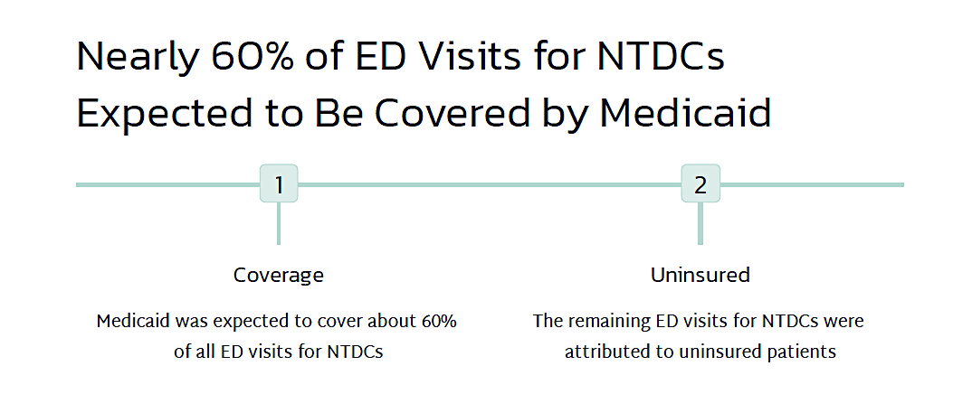
Notes:
Adults>Children
Medicaid/uninsured> commercially insured
Native Americans/African American>Whites
Rural> urban

Slide 9
Measure 1 Number of ED visits for ambulatory care sensitive nontraumatic dental conditions per 100,000 member-months for adults
Measure 2 The percentage of ambulatory care sensitive nontraumatic dental condition ED visits among adults ≥ 18 y in the reporting period for which the member visited a dentist within 7 d and within 30 d of the ED visit

Slide 10
Division of Family Health Oral Health Initiatives/Strategies
Community Water Fluoridation
School-based Prevention Programs
Oral Health Education and Promotion
Perinatal oral health collaborative
Sugar sweetened beverage social media campaigns
Learning collaboratives: early childhood caries
Public Health Detailing in Local Health Departments
New Evidence-based Practice/Therapeutics
Fluoride Varnish
Tele-dentistry Uses in Oral Health
Dental Considerations During Public Health Emergencies
Medical Dental Integration
Interprofessional practice
Oral Health is Cross-cutting
Notes:
This is a list of initiatives and strategies that are the Division’s strategies for achieving oral health
DFH Oral Health activities over the past several years about 7-10 years. L
MCH supports CWF and SBHC programs through staffing, funding contracting and other grants
We partner with internal and external stakeholders to support the other activities listed and we’ll talk a bit more about these activities
--Miscellaneous Category if it was there would include things like a request for data or data usage or support for assessing oral health needs by county.
We could spend more time discussing that and what we think the needs are and where we have data sources to support those needs
Where is dental public health headed and focused in current time is toward Medical Dental Integration ---

Slide 11
ED Diversion Programs
Divert 911 Calls
Divert Patients
Provide Definitive Dental Treatment
Connect to a Dental Home
Mobile Dental Van
Co-located Dental Office (Urgent Care)
Referral and Care Coordination
Tele-dentistry Triage Platform

Slide 12
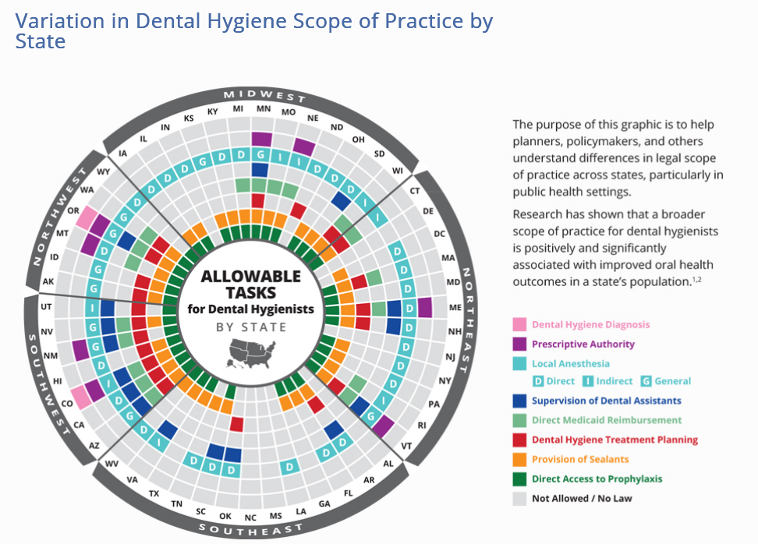

Slide 13
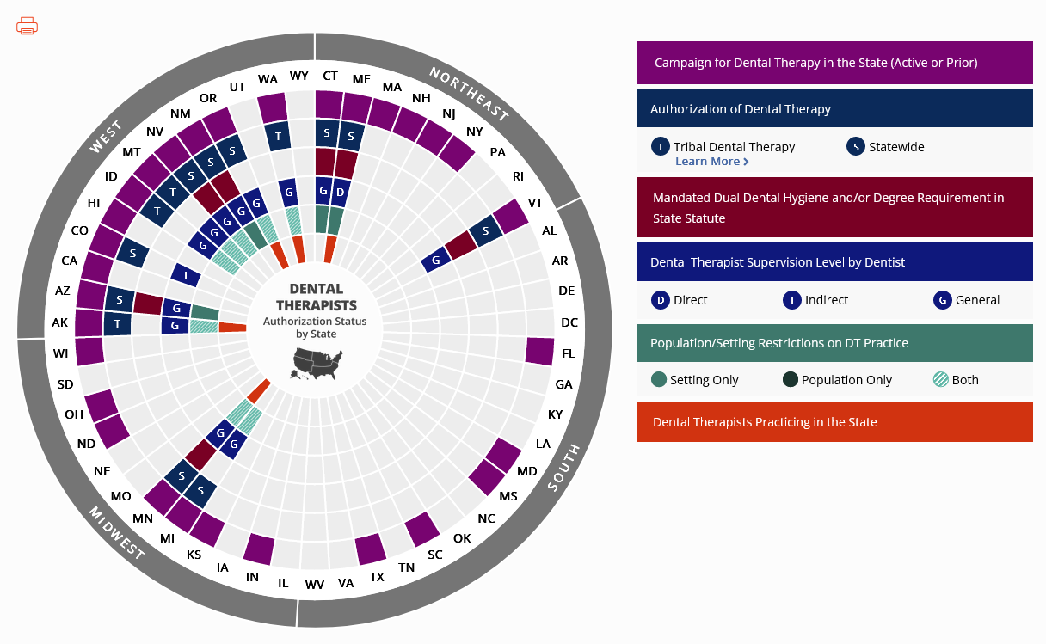
Authorization Status of Dental Therapists By State

Slide 14
Key Takeaways and Next Steps
Tele-dentistry;
Mobile dental units
Midlevel dental providers; dental therapists.
Communication between medical home, dental home and care coordination models.
Develop rubric of problems and possible solutions;
Determine timeline for various proposed solutions and categorize as short term, mid term, long term.
Schedule future educational sessions.

