Slide 1
911 Nurse Navigation:
Changing the EMS Paradigm

Slide 2
Current System Challenges
Nurse Navigation developed from challenges
Resources tied up on low acuity calls and unavailable for emergencies
Only available treatment pathway didn’t fit every patient
The community was disconnected from care options
Providers overworked and didn’t have time for training
Improved Patient Outcomes
Reduced Cost of Care
Improved Provider Experience
Improved Community Access
Can’t stop patients from calling 9-1-1 (and we don’t want to)

Slide 3
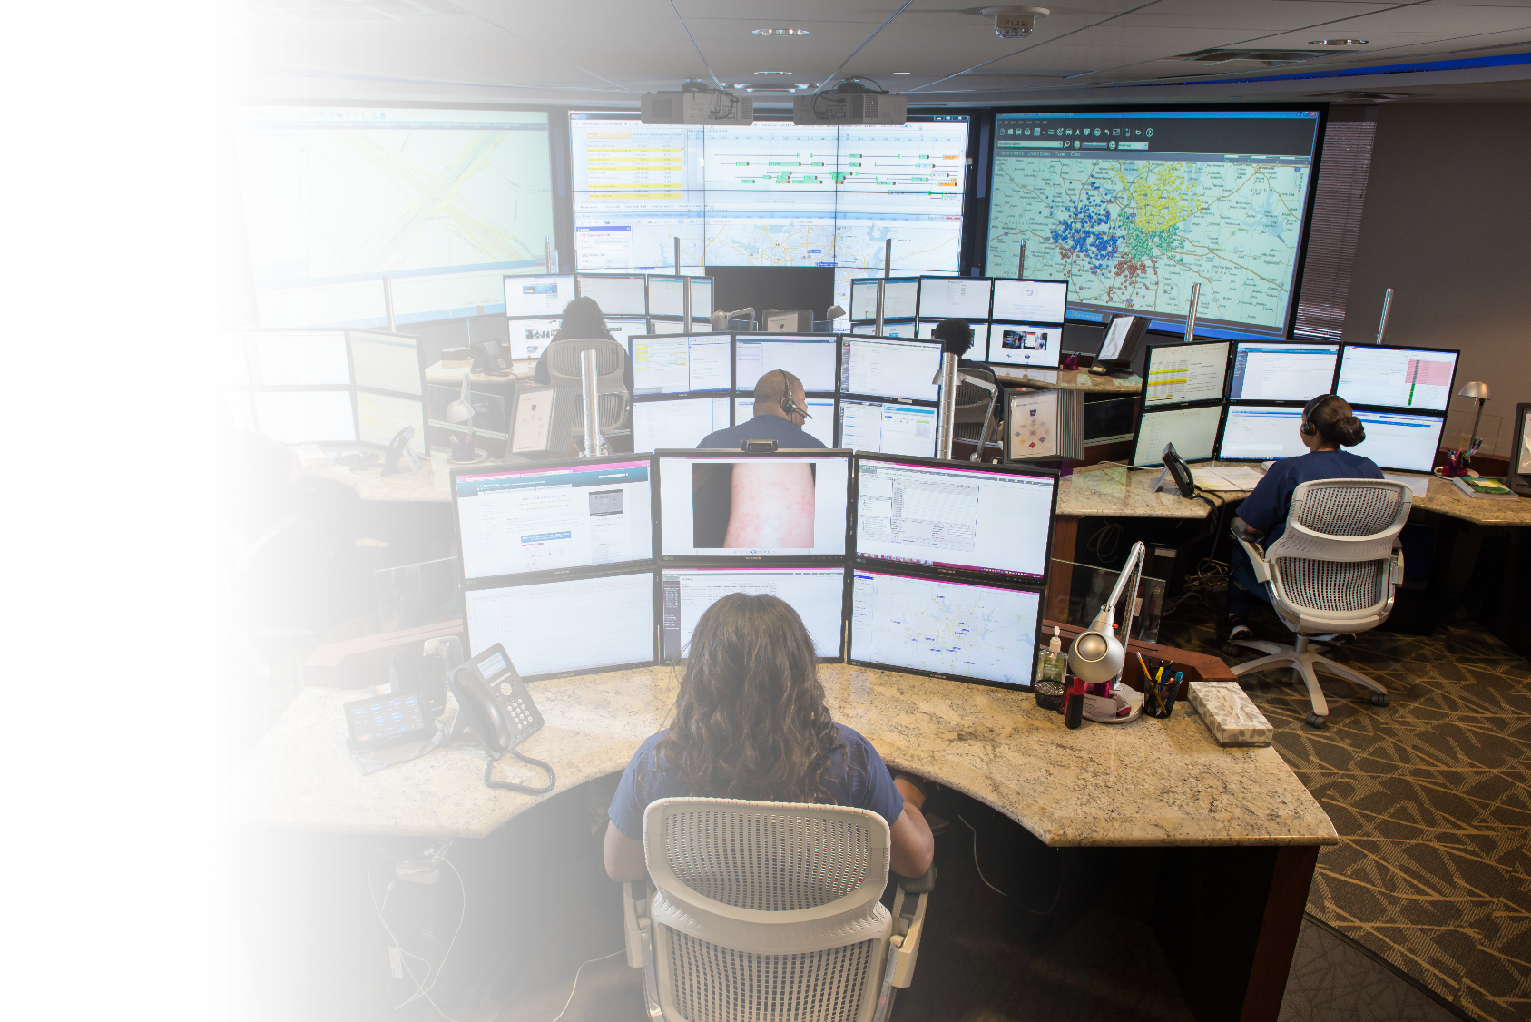
Nurse Navigation:
Scalable and Sustainable Solution
Proven solution ensures 911 callers with low acuity complaints can be managed outside of the traditional EMS response system to:
Keep
Keep critical first responder & ED resources available for life threatening emergencies
Improve
Improve operational efficiencies - reduce costs / staffing
Deliver
Deliver quality outcome data & reporting metrics
Expand
Expand access to care for underserved populations while keeping patients in-network and ensuring equity of care
Localize
Localize to community, support local healthcare resources, white label experience

Slide 4






Nurse Navigation
TRADITIONAL MODEL
Timeframe
Emergency
Resource Need
Ambulance (ALS)
911 call
EMD
EMS response
Transport to ED
NURSE
NAVIGATION
MODEL
Time Options
Emergency
< 1 hour
2 – 4 hours
12+ hours
24+ hours
48+ hours
Resource Options
Referral to stat ALS
Referral to scheduled BLS
Referral to telehealth
Referral to alt. destination
Referral to primary care
Self care instructions
Needs
Matched
Time
Appropriate
Resources
Allocation
(E + 1 – 5)
Not Triage.
Proprietary
closed-ended
protocols to ensure consistency and patient safety.
Nurse Navigator

Slide 5
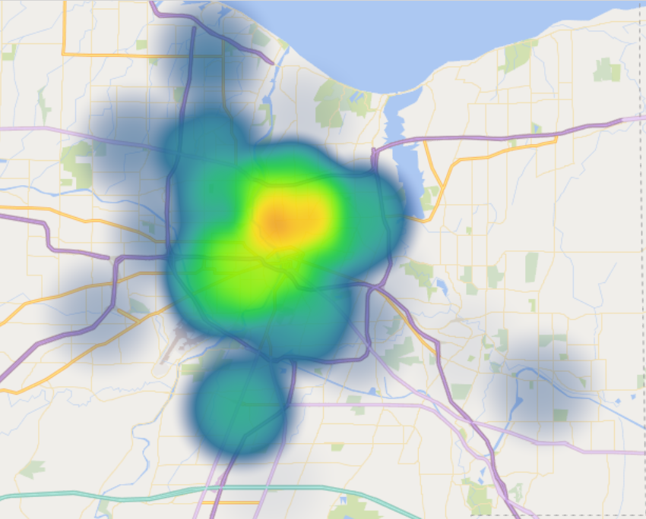
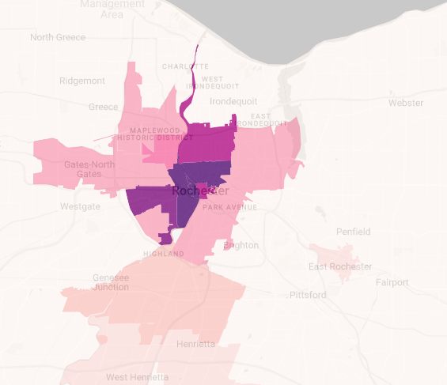

Community Based and Patient Centered
Each Nurse Navigation program is configured to support the needs of the host community
Types of calls referred (dispatch determinants)
Payer-appropriate navigation options and referral networks
Participation by field ambulance crews / community paramedicine programs
Engagement with other programs (behavioral health, etc.)
Diverse team of multicultural nurses
Referral network developed to support areas of need
Language line access for non-English speakers
Optional ride-share program with Lyft:
  Nurse can coordinate roundtrip transport to
  alternative destinations and pharmacies
  Options for non-smart phones
  Costs included in program – no additional cost to
  participants
The program supports improving healthcare equity in traditionally underserved communities
Nurse Navigation Lyft utilization – Rochester, NY
Income below poverty level by neighborhood – Rochester, NY

Slide 6





Navigation Pathways
Each system sets their own goals for the percentage of total EMS call volume that flows to Nurse Navigation
50% of patients:
ED is the most appropriate location for care
Ambulance transport can often be scheduled or downgraded to BLS
50% of patients:
911 EMS response not required
Patient can be appropriately cared for in non-emergent settings
30% can get care at home

Slide 7




Patient Experience
Exceptional Survey Scores:
Nurses call the patient back 24 hours after the initial call
Ensure needs were met (patients can be re-navigated if necessary)
Assess patient satisfaction with nurse, clinic (if applicable), transport (if applicable)
National average score: 4.5 out of 5
New York Program average 4.6 out of 5 outperforming the National Average
Do you feel like the nurse understood your problem?
How satisfied are you with the care you received by phone?
How satisfied are you with the amount of time you spent waiting for a [clinic, tele-consult, etc.]?
How satisfied are you with the care you received from [clinic, tele-consult, etc.]?
How satisfied are you with the transportation you received?
Any other feedback?
Questions can be customized for the system

Slide 8
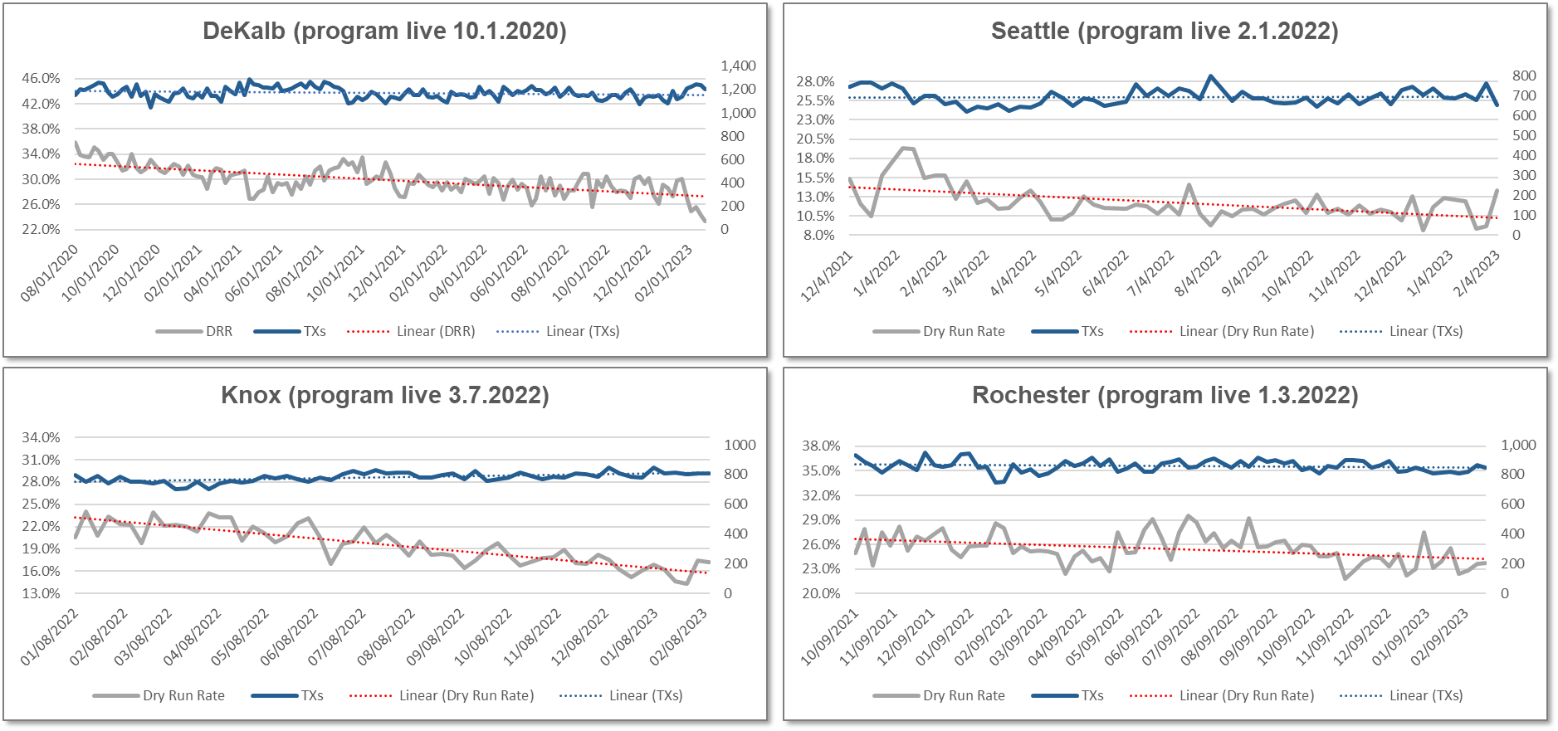
Operational Impact
CONFIDENTIAL – DO NOT DISTRIBUTE WITHOUT PERMISSION OF GMR
Reduce non-productive runs:
Mature programs average 15%+ reduction in non-transport dry run rate.
No significant drop in overall transport volume.
Analysis: Patients who need the ED still go to the ED.
EMS responses reduced for patients who do not require tx.
System | Nurse Nav Go-Live | Baseline DRR | Current DRR | Variance
DeKalb | October 2020 | 36.53% | 27.23% | -25.47%
Rochester | January 2022 | 26.66% | 23.87% | -10.46%
Seattle | February 2022 | 15.46% | 11.42% | -26.14%
Knoxville | March 2022 | 21.17% | 14.78% | -30.19%
Syracuse | May 2022 | 31.97% | 28.75% | -10.07%
AVERAGE | -- | 26.36% | 21.21% | -19.54%

Slide 9



Active Programs
13 States
25 Systems
7 million lives covered
100,000+ calls navigated
911 Nurse Navigation Innovators
2018
  Washington, DC
2020
  Alexandria, VA
  DeKalb County, GA
2021
  Sumter, FL
2022
  Rochester, NY
  Seattle, WA
  Wake County, NC
  Knoxville, TN
  Onondaga County, NY
  Henry County, GA
  Pueblo, CO
  Buffalo, NY
  Boulder, CO
  Longmont, CO
  Aurora, CO
  Teller County, CO
  Fremont County, CO
2023
  El Cajon, CA
  Waco, TX
  Santa Rosa County, FL
  Shawnee County, KS
  Oneida County, NY
  Vancouver, WA
2023 Scheduled
  Spokane, WA
  Jackson, MS
  Snohomish County, WA
Seattle, WA
Snohomish Cty, WA
Vancouver, WA
Spokane, WA
Rochester, NY
Buffalo, NY
Oneida Cty, NY
Boulder, CO
Onondaga Cty, NY
Longmont, CO
Teller Cty, CO
Shawnee Cty, KS
Knoxville, TN
Washington, DC
Fremont Cty, CO
Aurora, CO
Alexandria, VA
Pueblo, CO
DeKalb Cty, GA
Wake County, NC
El Cajon, CA
Waco, TX
Jackson, MS
Henry Cty, GA
Santa Rosa Cty, FL
Sumter, FL

