Slide 1
Bureau of Emergency Medical Services
& Trauma Systems
EMS System and Regulatory Overview

Slide 2
OUTLINE
PHHPC Planning Committee EMS Presentation
Statutory & Regulatory Overview
State Emergency Medical Services Council Roles & Responsibilities
Regional Emergency Medical Services Council Roles & Responsibilities
State Trauma Advisory Committee
Emergency Medical Services for Children Advisory Committee
Department of Health Roles and Responsibilities
EMS System Overview
Emergency System
911 Public Safety Answering Points (PSAP)
First Response
Ambulance Response
Interfacility Patient Transportation System
EMS Funding Overview
Fee-for-Service
Municipal Contracts

Slide 3
EMS REGULATORY ROLES & RESPONSIBILITIES
Governing Laws
PUBLIC HEALTH LAW - ARTICLE 30
Emergency Medical Services
PUBLIC HEALTH LAW - ARTICLE 30-A
Emergency Medical Service Personnel Training Act
Establishes Public Access Programs
(AED, EPI-Pen, CPR Equipment, Rescue Inhalers)
Establishes State and Regional EMS Councils
Establishes Ambulance and First Response Services
Establishes Minimum Staffing Standards
Establishes Quality Improvement Program
Establishes the State EMS Task Force
Establishes Authorities, Roles, and Responsibilities
Establishes EMS Personnel Training Programs
Establishes EMS Personnel Training Fund
Establishes Reporting Requirements
Establishes a Public Service Recruitment Campaign
PUBLIC HEALTH LAW - ARTICLE 30-B
Emergency Medical, Trauma and Disaster Care
PUBLIC HEALTH LAW - ARTICLE 30-C
Emergency Medical Services for Children
Establishes State and Regional Trauma Advisory Committees
Establishes the Hospital Trauma Designation Program
Establishes Quality Improvement Program for Trauma Care
Establishes the Comprehensive Emergency Medical and Trauma Plan
Establishes Interfacility Transport Coordination System
Establishes System for Coordination of Medical Disaster Programs
Establishes Authorities, Roles, and Responsibilities
Establishes the State Emergency Medical Services for Children Advisory Committee
Establishes Facility Pediatric Readiness Recognition Programs
Establishes Pediatric Emergency Medical Training Programs
Establishes Authorities, Roles, and Responsibilities

Slide 4
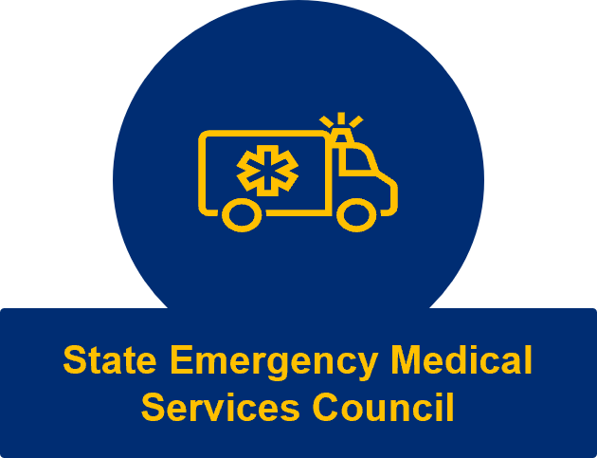
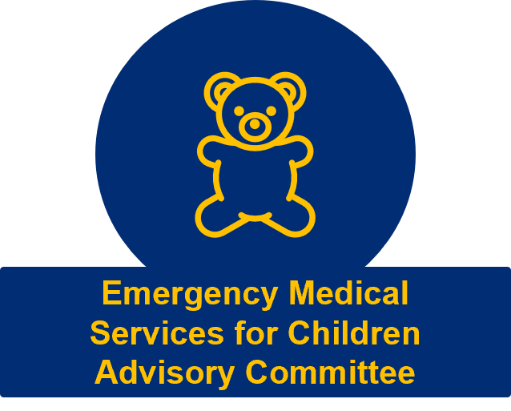
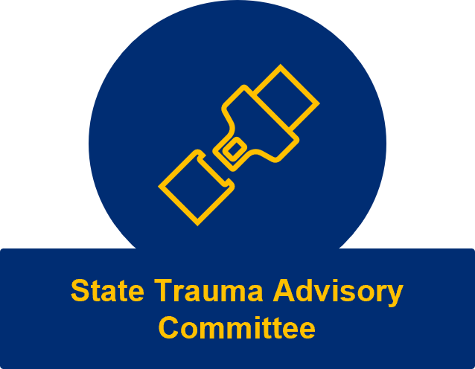
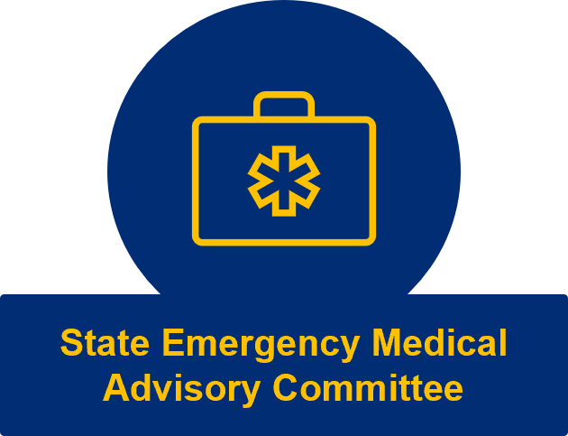
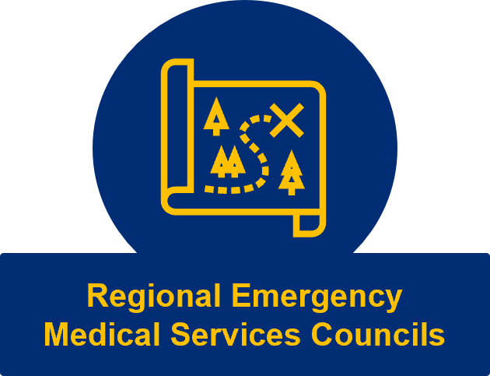
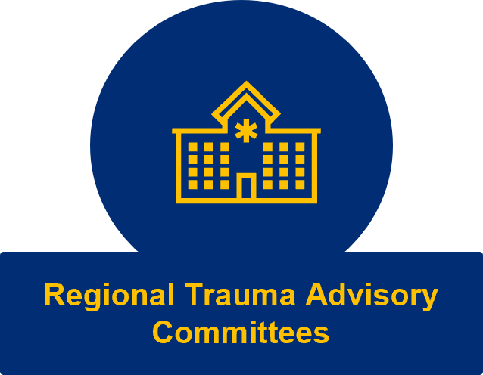
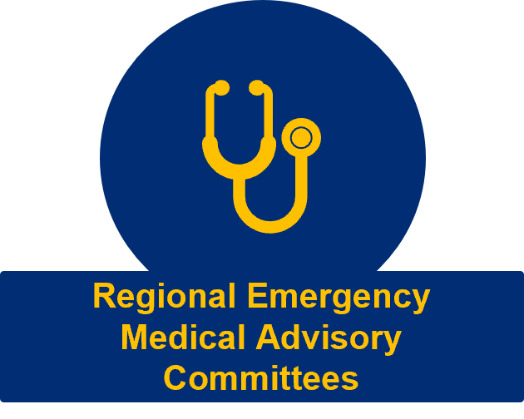
EMS REGULATORY ROLES & RESPONSIBILITIES
EMS Regulatory Council Structure
New York State Department of Health
Bureau of EMS and Trauma Systems

Slide 5
EMS REGULATORY ROLES & RESPONSIBILITIES
State Emergency Medical Services Council (SEMSCO)
Advise and assist the Commissioner on issues related to the provision of emergency medical service, specialty care, designated facility care, and disaster medical care including recommendation, revision, and application of rules and regulations; appropriateness review standards; treatment protocols; workforce development; and quality improvement standards
Subject to approval by the Commissioner, the SEMSCO may amend and repeal rules and regulations establishing minimum standards for ambulance services; ambulance service certification; advanced life support first response services; the provision of prehospital emergency medical care; public education; the development of a statewide emergency medical services system; the provision of ambulance services outside the primary territory specified in the ambulance services’ certificate; and training, examination, and certification of certified first responders, emergency medical technicians, and advanced emergency medical technicians.
Provide information and recommendations to the trustees of SUNY regarding the offering of credit and noncredit courses which would satisfy the educational requirements for certification and recertification of emergency medical technicians and advanced emergency medical technicians.
Provide consultation to the Department for the development of a continuing medical education recertification program for emergency medical technicians and advanced emergency medical technicians.
Amend, modify and reverse determinations of the regional councils related to the determination of public need for additional ambulance services.
Provide an annual estimate of the amount of funding needed to provide adequate funding for emergency medical services training.

Slide 6
EMS REGULATORY ROLES & RESPONSIBILITIES
State Emergency Medical Advisory Committee (SEMAC)
Develop and recommend to the SEMSCO statewide minimum standards for medical control; treatment, transportation and triage protocols, including protocols for invasive procedures and infection control; the use of regulated medical devices and drugs by emergency medical services personnel; and may issue advisory guidelines in any of these areas.
Advise the SEMSCO prior to the issuance of any guidelines.
Review protocols developed by regional emergency medical advisory committees for consistency with statewide standards.
Assist the Department and the Commissioner in the development, periodic revision, and application of appropriateness review standards and quality improvement guidelines for emergency medical care and emergency departments and emergency services under article 28 and 30 of Public Health Law

Slide 7
EMS REGULATORY ROLES & RESPONSIBILITIES
Regional Emergency Medical Services Council (REMSCO)
Advise the SEMSCO and the Department on such issues as the SEMSCO or the Department may require related to the provision of emergency medical service, specialty care, designated facility care, and disaster medical care.
Carry out duties to assist in the regional coordination of emergency medical service, specialty care, designated facility care, and disaster medical care as outlined by the SEMSCO with approval from the Department.
Undertake or cause to be undertaken plans, surveys, analyses and studies necessary, convenient or desirable.
Fix and collect reasonable fees, rent, and other charges for the use of its equipment and the provision of its services.
Recommend to the Department the approval of training course sponsors within its region.
Develop, promulgate, and implement annually an EMS training plan which addresses the needs of its region.
Approve regional emergency medical advisory committee (REMAC) nominees.
Provide focused technical assistance and support to voluntary ambulance services operating under staffing exemptions.
Coordinate emergency medical services training programs within its region.
Make determinations of public need for the establishment of additional emergency medical services and ambulance services.

Slide 8
EMS REGULATORY ROLES & RESPONSIBILITIES
Regional Emergency Medical Advisory Committee (REMAC)
Develop policies, procedures, triage, treatment, and transportation protocols which are consistent with the standards of the SEMSCO and which address local conditions.
Approve physicians to provide on-line medical control.
Coordinate the development of regional medical control systems.
Participate in quality improvement activities addressing system-wide concerns.
Nominate a physician with demonstrated knowledge and experience in emergency medical services to serve on the SEMAC.
Emergency Medical Services for Children Advisory Committee (EMSC)
Advise the Department, the Commissioner, the SEMSCO, the SEMAC, and the State Trauma Advisory Committee (STAC) regarding all aspects of emergency medical services for children, including pediatric emergency medical, trauma, and disaster care, and the early care of maltreated children and children with special health care needs.

Slide 9
EMS REGULATORY ROLES & RESPONSIBILITIES
State Trauma Advisory Committee (STAC)
Advise the Department and the Commissioner regarding trauma and disaster care within the state, including the development, periodic revision, and application of statewide appropriateness review standards and quality improvement guidelines for:
  Trauma and disaster care
  Trauma systems
  Trauma centers
  Trauma stations
Regional Trauma Advisory Committees (RTAC)
Advise the STAC, the Department, and the Commissioner regarding trauma and disaster care within the state, including the development, periodic revision, and application of statewide appropriateness review standards and quality improvement guidelines for:
  Trauma and disaster care
  Trauma systems
  Trauma centers
  Trauma stations

Slide 10
EMS REGULATORY ROLES & RESPONSIBILITIES
Department of Health Bureau of EMS and Trauma Systems
Facilitate, develop, and revise appropriateness review standards for emergency medical and trauma care including appropriateness review standards for emergency departments and services and trauma centers and stations under article 28 for adoption by PHHPC.
Categorize general hospitals and other health care facilities for emergency medical care.
Designate emergency facilities as emergency departments or emergency services appropriate for emergency medical care.
Designate general hospitals and other health care facilities as trauma centers or trauma stations appropriate for trauma care.
Develop and maintain a statewide and regional quality improvement program for trauma and disaster care.
Develop and periodically revise a comprehensive emergency medical and trauma care plan incorporating injury control programs and ongoing quality assurance measures for all components of the trauma system involved in trauma care.
Develop and periodically revise medical and operational guidelines for a fully integrated statewide transport system and develop and maintain a statewide system for coordination of interfacility transfers.
Develop and periodically revise medical and operational guidelines for a fully integrated statewide medical disaster preparedness response and develop and maintain a statewide system for coordination of medical disaster preparedness and trauma system planning.
Facilitate the coordination and implementation of regional emergency medical system, trauma system, and medical disaster preparedness response plans and shall promote full interoperability of all response and communications systems.

Slide 11
EMS SYSTEM OVERVIEW
911 – Public Safety Answering Points (PSAP)
A Public Safety Answering Point (PSAP) is a facility, operated on a 24-hour basis, that is assigned the responsibility of receiving 9-1-1 calls. When appropriate, the PSAP will directly dispatch emergency services or, through transfer routing or relay routing, pass 9-1-1 calls to public or private safety agencies.
Emergency Medical Dispatch
A protocol-based medical call management system used by Maine’s 9-1-1 Centers to process calls for medical assistance.
The EMD system helps ensure that all calls for emergency medical services (EMS) are handled in a professional, consistent manner and that vital information is collected during each call.
911 PSAP Nurse Navigation
If a condition is determined as a non- medical emergency, callers are transferred to a nurse to determine an appropriate path for treatment and assist in coordinating care.
The goal of the program is to get community members to the right level of care for their needs. There is no cost to the caller to access the Nurse Navigation system.

Slide 12
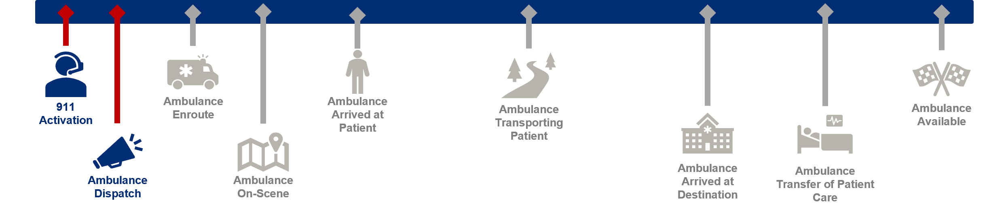
EMS SYSTEM OVERVIEW
911 – Public Safety Answering Points (PSAP)
General Municipal Law Section 209-b, related to emergency rescue and first aid squads, states, in part:
The person designated to receive calls for such emergency services, for the purpose of dispatching such squads or firefighters, shall determine in the first instance from the information furnished to him or her whether an emergency exists and his or her decision, if in good faith, as to whether or not there is an emergency shall be final in relation to dispatching such squads or firefighters.

Slide 13
EMS SYSTEM OVERVIEW
First Response Service and Vehicle Licenses
REDC | FIRST RESPONSE SERVICES | FIRST RESPONSE VEHICLES
CAPITAL | 99 | 361
CENTRAL NEW YORK | 102 | 328
FINGER LAKES | 101 | 456
LONG ISLAND | 17 | 63
MID-HUDSON | 73 | 399
MOHAWK VALLEY | 82 | 166
NEW YORK CITY | 4 | 318
NORTH COUNTRY | 46 | 78
SOUTHERN TIER | 93 | 252
WESTERN NEW YORK | 65 | 270
SUB-TOTALS | 682 | 2,691
TOTAL SERVICES | 682
TOTAL VEHICLES | 2,691

Slide 14
EMS SYSTEM OVERVIEW
Ambulance Service and Vehicle Licenses
REDC | AMBULANCE SERVICES | LICENSED AMBULANCES | LICENSED EASV*
CAPITAL | 90 | 333 | 120
CENTRAL NEW YORK | 51 | 214 | 59
FINGER LAKES | 74 | 322 | 91
LONG ISLAND | 169 | 886 | 396
MID-HUDSON | 145 | 819 | 485
MOHAWK VALLEY | 54 | 116 | 31
NEW YORK CITY | 67 | 2148 | 1709
NORTH COUNTRY | 95 | 205 | 37
SOUTHERN TIER | 84 | 207 | 58
WESTERN NEW YORK | 148 | 399 | 122
SUB-TOTALS | 977 | 5,649 | 3,108
TOTAL SERVICES | 977
TOTAL VEHICLES | 8,757
*Emergency Ambulance Service Vehicle (EASV)

Slide 15

EMS SYSTEM OVERVIEW
Ambulance Service Staffing
Region | Total | Career | Hybrid | Volunteer
Capital Region | 91 | 38 | 39 | 14
Central New York | 50 | 11 | 29 | 10
Finger Lakes | 75 | 14 | 26 | 35
Long Island | 171 | 15 | 94 | 62
Mid-Hudson | 145 | 20 | 46 | 79
Mohawk Valley | 54 | 16 | 10 | 28
New York City | 66 | 34 | 3 | 29
North Country | 95 | 12 | 35 | 48
Southern Tier | 81 | 14 | 23 | 44
Western New York | 148 | 14 | 9 | 125
Out of State | 6 | 5 | 1 | 0
Statewide | 982 | 193 | 315 | 474
982
AMBULANCE SERVICES
20%
CAREER
32%
HYBRID
48%
VOLUNTEER
DATA ON 01/01/22
78.5% of all 911 ambulance patient transports were completed by career ambulance services (20%) 2022

Slide 16
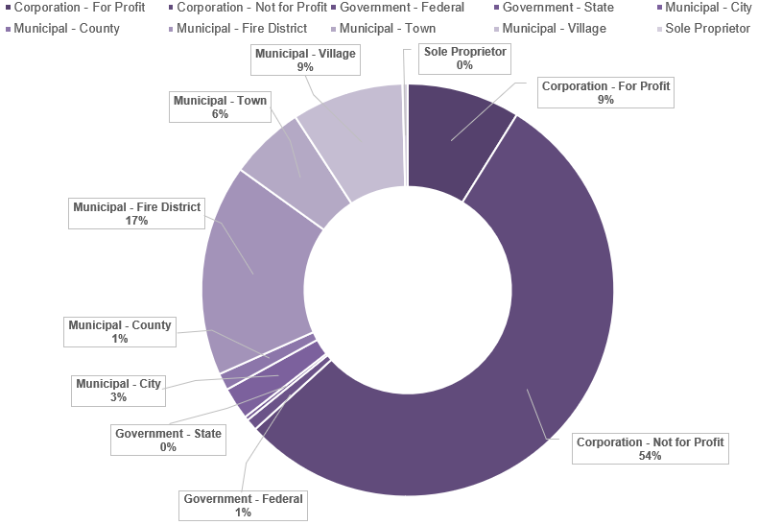
EMS SYSTEM OVERVIEW
Ambulance Service Ownership
Ownership | Total
Corporation – For Profit | 87
Corporation – Not for Profit | 534
Government - Federal | 9
Government – State | 3
Municipal – City | 25
Municipal – County | 13
Municipal – Fire District | 163
Municipal – Town | 58
Municipal - Village | 86
Sole Proprietor | 4
 | 982
54%
NOT-FOR-PROFIT
37%
GOVERNMENT
9%
FOR-PROFIT

Slide 17

EMS SYSTEM OVERVIEW
Ambulance Service Operating Certificates
2019 - 2022
43
(4%)
FEWER AMBULANCE SERVICES
 | 2012 | 2013 | 2014 | 2015 | 2016 | 2017 | 2018 | 2019 | 2020 | 2021 | 2022
Ambulance Services | 1,078 | 1,087 | 1,074 | 1,063 | 1,050 | 1,032 | 1,023 | 1,013 | 995 | 994 | 982
New | 12 | 6 | 8 | 14 | 18 | 14 | 6 | 7 | 8 | 5 | 12
Closed | -3 | -19 | -19 | -27 | -36 | -23 | -16 | -25 | -9 | -17 | -24
Net +/- | 9 | -13 | -11 | -13 | -18 | -9 | -10 | -18 | -1 | -12 | -12
110
NEW
218
CLOSED
The total number of ambulance services in New York State has decreased by 9% over the past 10 years

Slide 18

EMS SYSTEM OVERVIEW
EMS Practitioners
The number of active New York State EMS practitioners has decreased by 17.5% (-7,024) since 2019
42% of the total number of licensed EMS practitioners were active in 2022
 | 2019 | 2020 | 2021 | 2022
Emergency Medical Technician | 27,063 | 20,563 | 24,939 | 23,412
Advanced Emergency Medical Technician | 1,325 | 1,276 | 1,549 | 1,462
Emergency Medical Technician – Critical Care | 1,074 | 914 | 723 | 610
Paramedic | 10,584 | 7,257 | 7,495 | 7,538
Grand Total | 40,046 | 30,010 | 34,706 | 33,022
2022
78,173
TOTAL LICENSED
EMS PRACTITIONERS
33,022
ACTIVE
EMS PRACTITIONERS
71% EMT | 4% AEMT | 2% EMT-CC | 23% PARAMEDIC
Based on the sum of unique license numbers appearing on patient care records

Slide 19

EMS FISCAL OPERATIONS
EMS Primary Funding Mechanisms
Fee for Service
46% of Ambulance Services in New York State Bill Insurance.
Transportation must originate and terminate at a covered location.
Medical necessity justifying the use of an ambulance must be established.
Medicare and most commercial insurance companies reimburse ambulance service providers based on an allowable fee schedule for patient transports. This is usually negotiated to a discounted amount rather than the actual cost of the provided service. The consumer must pay a portion of most bills (co-insurance, co-pay, etc.), and ambulance service billing departments handle collection of that portion of the bill from the consumer.
MEDICAL NECESSITY
Patient transported in emergency situation. Patient needs to be restrained to prevent injury to self or others. Patient unconscious or in shock. Patient required oxygen or other emergency treatment during transport. Patient exhibits signs and symptoms of acute respiratory or cardiac distress. | Patient exhibits signs and symptoms of possible stroke. Patient has to remain immobile because of fracture or possibility of fracture. Patient experiencing severe hemorrhage. Patient can only be moved by stretcher. Patient was bed confined before and after.
COVERED LOCATIONS | SERVICE LEVELS | SERVICE LEVELS
Medicare regulations only allow payment for emergency ground ambulance services when individuals are transported to hospitals, critical access hospitals, skilled nursing facilities, and dialysis centers. | EMERGENCY | NON-EMERGENCY | GENERAL
Scene of accident or acute event | BLS-E Transport ALS-E Transport Level 1 ALS-E Transport Level 2 Specialty Care Transport Paramedic Intercept | ALS-NE Transport Level 1 BLS-NE Transport Level 1 Specialty Care Transport | Ground Mileage Fixed Wing Air Mileage Rotary Wing Air Mileage

Slide 20

EMS FISCAL OPERATIONS
EMS Primary Funding Mechanisms
Municipal Contracts
14% of ambulance services in New York State receive funding through a taxing district.
General Municipal Law (GML) Article 6, Section 122b allows municipalities to provide emergency medical service, general ambulance service or some combination of these either directly with a municipally operated service or by contracting with one or more individuals, municipal corporations, associations, or other organizations to provide such service.
  Subsection (2) of Section 122b allows municipalities to set a schedule of user fees to offset the costs of these services for taxpayers.
  If user fees are assessed, the collection and administration of such fees is the responsibility of the municipality.
Ambulance districts can also be formed as special taxing districts using New York State Town Law Articles 12 and 12-A, and those districts can contract to provide ambulance service to the properties within the district funded by taxes assessed on the property owners of the district in the manner as other town charges (based on assessed value).
Towns are also empowered to contract with any city, village, fire district or incorporated fire company to provide emergency ambulance service within any fire protection district under a fire protection contract. Town Law Section 184 allows for this service subject to the provisions of GML 209(b).
Options for villages to provide emergency or general ambulance service under GML 122-b are generally the same as those for towns. In addition, Village Law Section 10-1000(2) allows the governing board of the village (or fire district) that has its own fire department with an emergency rescue or first aid squad comprised mostly of volunteers to authorize said squad to furnish general ambulance services.

Slide 21

Questions

