Slide 1

New York State Master Plan for Aging
Adam Herbst Deputy Commissioner New York State Department of Health

Slide 2
Opening remarks
What is the Master Plan for Aging
Why Does New York Need a Master Plan for Aging
Master Plan for Aging Organizational Structure
List of Subcommittees
Cross-cutting Themes
Ongoing Engagement
Welcome

Slide 3
Governor Hochul signed an Executive Order on November 4, 2022 calling for the creation of a State Master Plan for Aging to…
Create a blueprint of strategies for government, the private sector, and non-profit sector to support older New Yorkers
Address challenges related to communication, coordination, caregiving, long-term financing, and innovative care
Coordinate all State policy and programs
With the goal of having all older New Yorkers "live fulfilling lives, in good health, with freedom, dignity and independence to age in place for as long as possible"

Slide 4
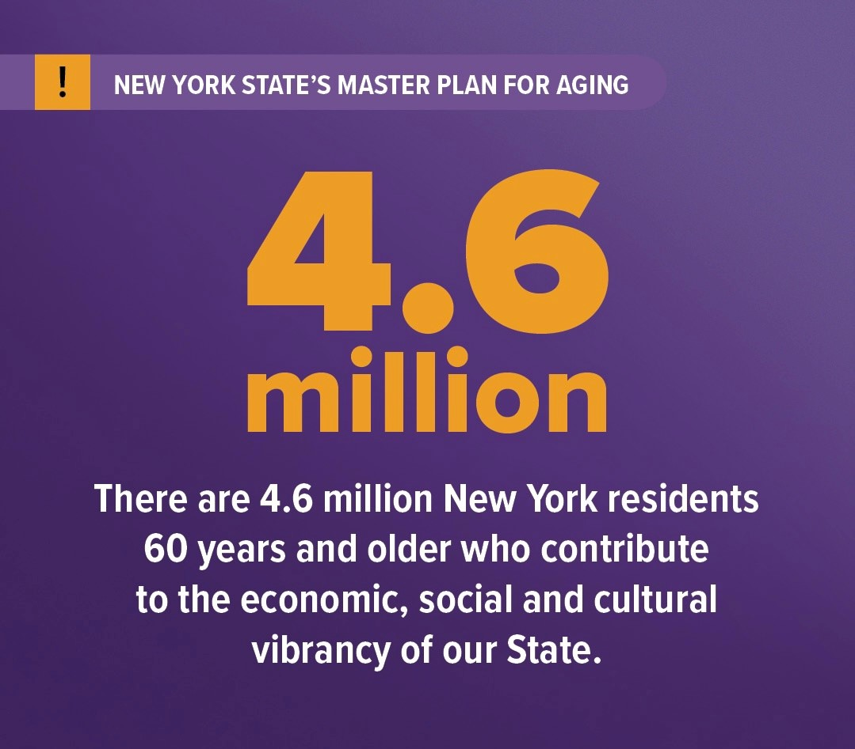
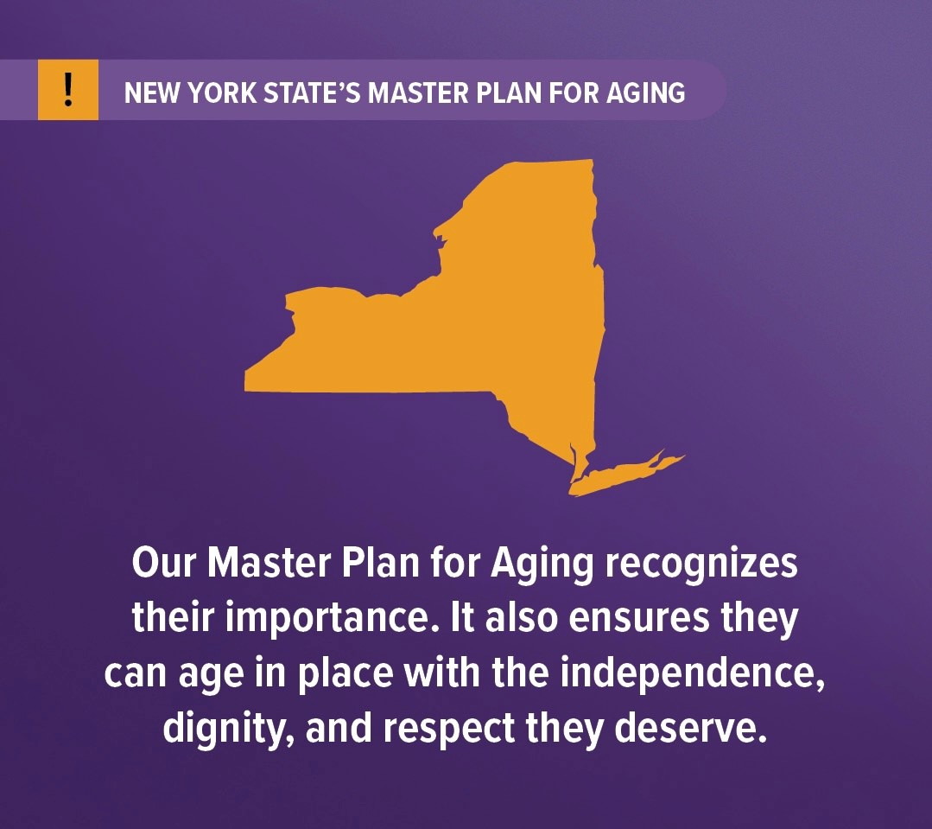
Why does New York need a Master Plan for Aging?
By 2030, 1 in 4 people in New York will be aged 60 years or over.
The Master Plan for Aging builds off our State’s successes in healthy aging, emphasizing aging in place and improving the lived experience for all ages.

Slide 5
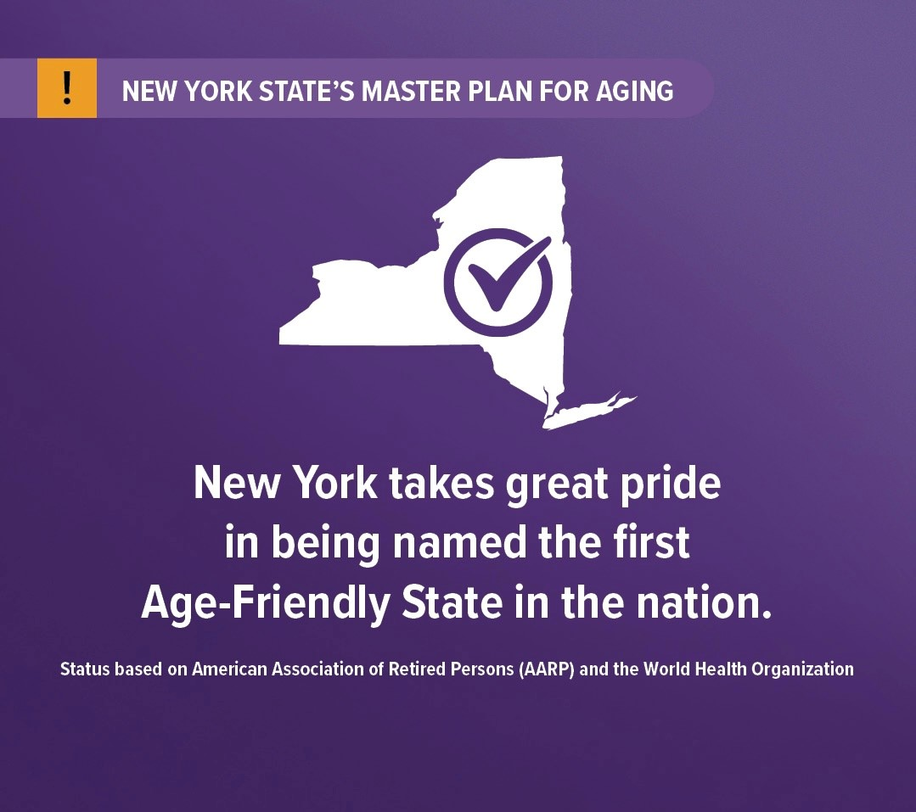
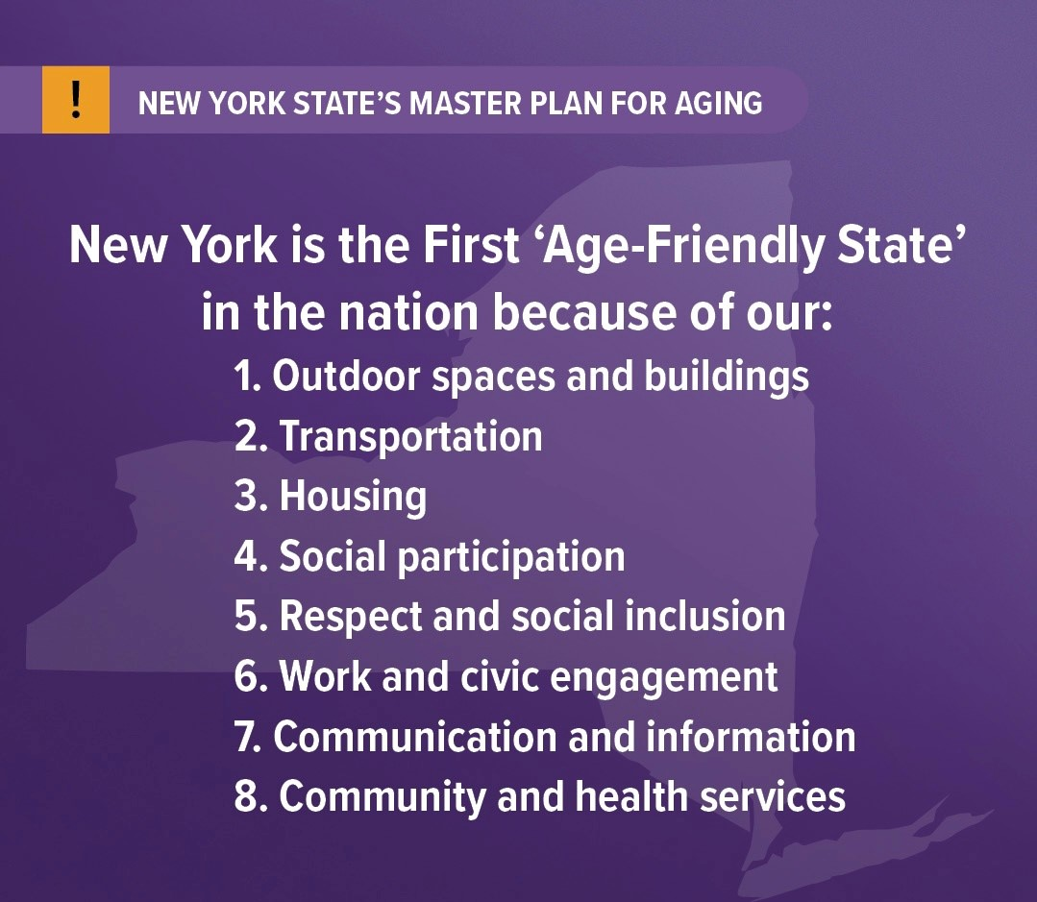
All New Yorkers deserve a fair chance to live not only a long life, but also a healthy and vibrant one
New York is the first Age Friendly State in the Nation. The Department of Health and the State Office for Aging have together supported complementary missions of fostering policy, programs, and services that meet the needs of aging and disabled New Yorkers.

Slide 6
Master Plan’s Bold Agenda
Factors that impact health including transportation and housing
Rising use of healthcare services as people age
Medicaid and Medicare funding
Healthcare workforce challenges
Meaningful choice and remaining in community
Family caregivers

Slide 7
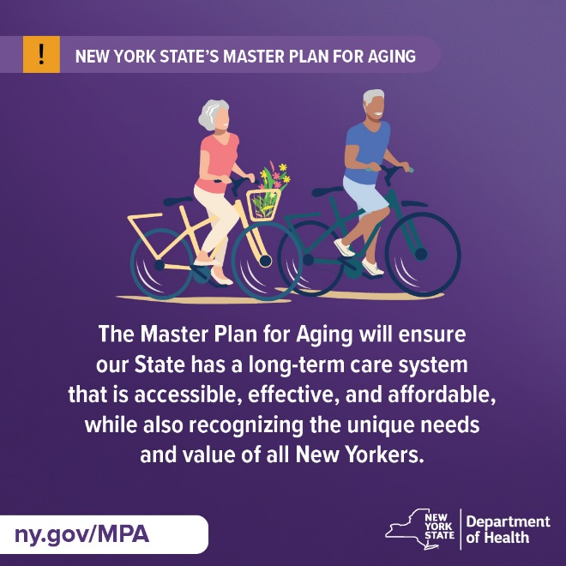
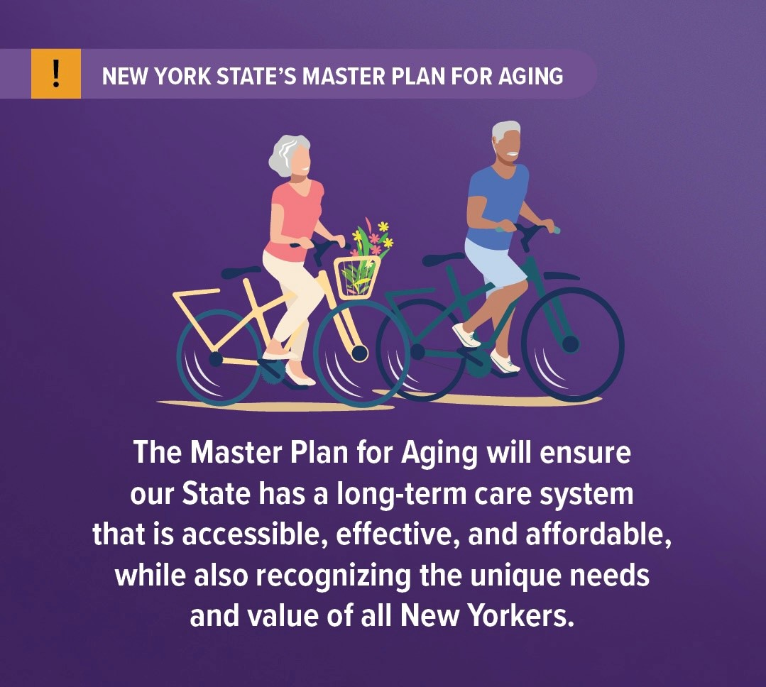
Lay the foundation for change to the aging landscape for the long haul
Integrated and age friendly community health systems
Seamless system of care across settings
Public-private partnerships to support aging in place
Person-centered planning
Fair pay and appropriate working conditions
Increased access to information about services and supports
Expanded availability of services

Slide 8
Master Plan for Aging Structure
NYS Governor
Kathy Hochul
Department of Health
State Office for Aging
Stakeholder Advisory Committee
State Agency Council
Long Term Service and Supports
Home and Community Based Services
Formal Caregivers
Informal Caregivers
Health and Wellness
Housing, Community Development &
Transportation
Economic Security
Safety, Security, Technology
Work Groups
Work Groups
Work Groups
Work Groups
Work Groups
Work Groups
Work Groups
Work Groups
Town Hall Listening Sessions
Public Outreach Surveys
Public Website and Newsletter

Slide 9
Subcommittees
The following subcommittees have been created:
Long Term Services and Supports
Home and Community-Based Services
Formal Caregivers
Informal Caregivers
Safety, Security and Technology
Health and Wellness
Economic Security
Housing, Community Development and Transportation

Slide 10
Housing access and community planning
Informal caregiver and workforce support
Affordability of basic necessities for older adults
Access to services in and engagement with historically marginalized communities
Modernization and financial sustainability of healthcare, residential facilities, and community-based aging network service providers
Social engagement of older adults
Promoting health and access to services and supports in rural communities
Combating elder abuse, ageism, and ableism
Technology access and development
Prevention and wellness promotion and access
The MPA Subcommittees will develop recommendations that are linked to each of these pillars.
Foundational
Pillars to Support
the
MPA

Slide 11

Late 2022/ Early 2023
Establish State Agency Council and Stakeholder Advisory Committee, Subcommittees
Spring/Summer 2023
Expected Timeline for Development of Master Plan for Aging
Preliminary Advisory Report
Throughout 2023
Continued Public Engagement
Early 2024
Draft Final Advisory Report
Early 2025
Adopt Final Master Plan

Slide 12
How can you help to develop the Master Plan?
Communities will have an opportunity to share input through:
A Public Survey
Go to: https://forms.ny.gov/s3/mpasurvey
Town Hall Meetings and Listening Sessions
Emails to MPA@health.ny.gov

Slide 13
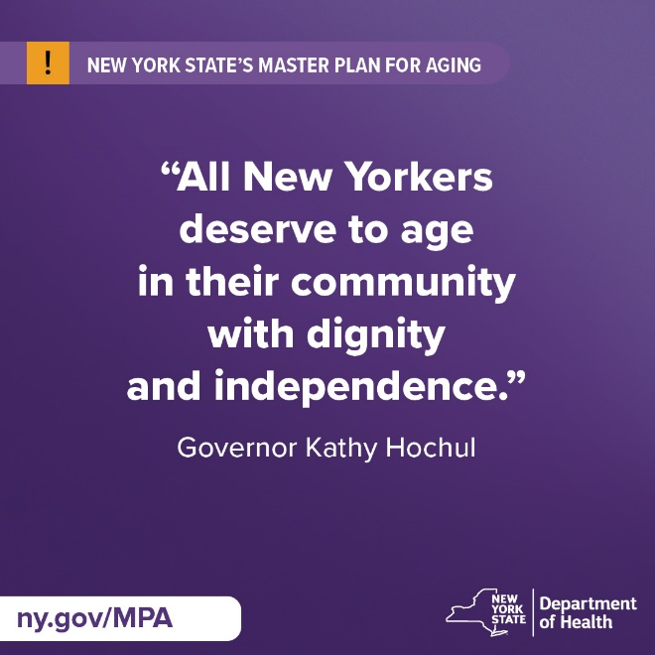
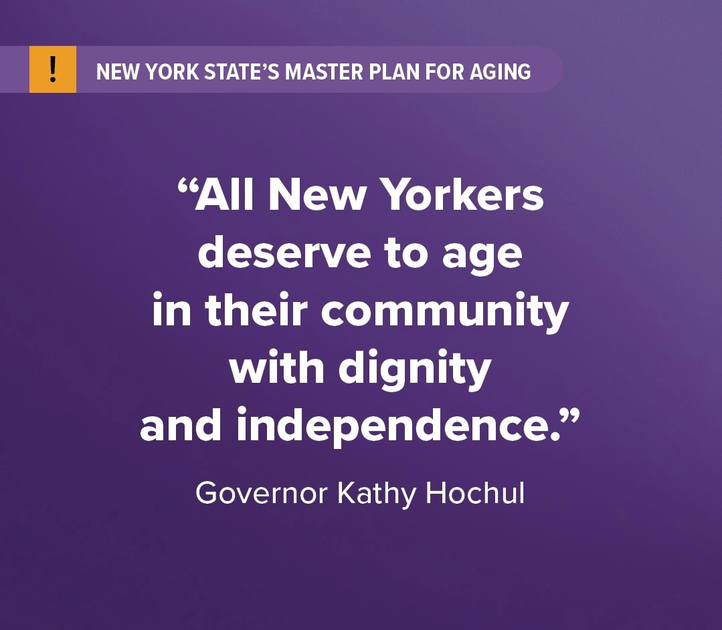
Questions?
Additional questions, ideas and feedback can be sent to MPA@health.ny.gov
Please be sure to visit the Master Plan for Aging website at www.ny.gov/mpa

