Slide 1
Proposed Priority Topic
8/24/2023 Public Health Committee
Shane Roberts, DrPH, MPH
Assistant Director, Office of Public Health Practice
August 24, 2023

Slide 2
Proposed Priority Topic
The Office of Public Health was asked to consider priority topics that the committee might take up, with a focus on identifying critical ‘pop-health’ problems in the State that require intra- agency work within DOH, and/or work with related outside partners (other state agencies, CBOs, professional associations, business, etc.).
Discussion identified four potential topics to be presented as topics for the committee’s consideration:
Public Health Workforce
Climate Change
Public Trust in Health Institutions and Science
Tobacco Use Prevention

Slide 3
Proposed Priority Topic
Further discussions within the Office built a consensus around Public health Workforce as one of the most critical issues faced by public health institutions across New York State, and a topic where the Committee’s ability to elevate and bring attention to issues could provide the greatest benefit.
Several factors make the Department well-positioned to support work in this focus area:
Public Health Infrastructure Grant (2022)
Standing up of Workforce Division
Success of Public Health Corps Program
Workforce Investment in Local Health Departments (43,115,337)

Slide 4
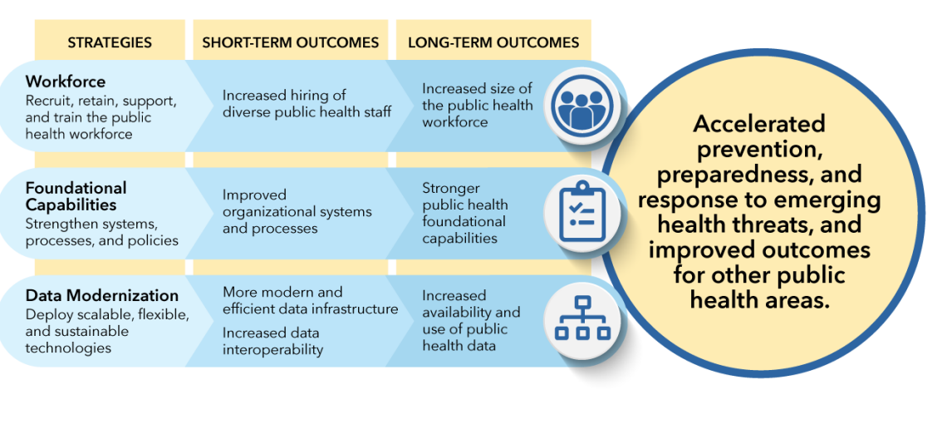
Public Health Infrastructure Grant
Public Health Infrastructure Grant
Department received $133 million (5-year grant) from CDC
Three components
Workforce
Recruit, retain, support, and train the public health workforce.
Foundational Capabilities
Strengthen systems and processes
Data Modernization
Deploy scalable , flexible, and sustainable technologies

Slide 5
Proposal
The Public Health Workforce is both a timely and critical issue both nationally and here in New York. The continued gradual reduction in fulltime staff employed and increase in vacancies across New York’s Local Health Departments[1], are topics worthy of the Committee’s consideration and would benefit from its ability to bring attention and focus to the issue.
Implementation of the Public Health Infrastructure Grant through the work of the nascent Workforce Division and our local partners, will also benefit from the committee’s focus and guidance on the topic.
[1] Michaels I, Pirani S, Fleming M, Arana MM, D'Angelo E, Dyer-Drobnack C, DiManno M, Ravenhall S, Gloria CT. Enumeration of the Public Health Workforce in New York State: Workforce Changes in the Wake of COVID-19. Int J Environ Res Public Health. 2022 Oct 20;19(20):13592. doi: 10.3390/ijerph192013592. PMID: 36294169; PMCID: PMC9602598.

Slide 6
Prevention Agenda Planning Update
8/24/2023 Public Health Committee
Shane Roberts, DrPH, MPH
Assistant Director, Office of Public Health Practice
Zahra Alaali, MPH
Coordinator, NYS Prevention Agenda
August 24, 2023

Slide 7
Progress Update
Internal workgroups reviewed stakeholder input from the 7/13/2023 ad hoc committee meeting, and developed a roadmap for having framework proposals ready for the committee’s review at the October meeting
PA team met with OHIP physicians to discuss alignment between Prevention Agenda and the Quality Strategy
Attended Healthy People 2030 Region 2 meeting to discuss SHIP planning with colleagues from New Jersey and U.S. territories
Met with North Carolina DOH staff to discuss SHIP planning, community engagement, plan implementation, and utilizing Results Based Accountability

Slide 8
Progress Update
Holistic Framework
Integrated Framework
Broad reorganization of priorities, focus areas and goals in alignment with Healthy People 2030 and SDoH
Attempts to reflect changing lens of how public health is viewed/approached post-COVID, with understanding of the importance of racial justice, and social and economic factors on health
Proposes to streamline existing focus areas, goals, and indicators
Maintains existing priority structure, with integration of SDoH and health factors under current five headings
Attempts to retain common-language of past iterations of the Prevention Agenda while aligning focus areas and goals with social and economic factors impacting health
Proposes to streamline existing focus areas, goals, and indicators

