Slide 1
Investing in Community Health: Hospital Community Benefit Spending Across New York State
Isaac Michaels, MPH
DrPH Student (Epidemiology)
University at Albany School of Public Health
imichaels@albany.edu
September 21, 2023

Slide 2
Hospital Community Benefit
Background

Slide 3
What is Community Benefit?
501(c)3 non-profit organizations, including non-profit hospitals, are expected to perform community benefits in lieu of paying taxes.
Notes:
Private non-profit hospitals are granted tax-exempt status in exchange for services they provide to the public. These services are collectively referred to as ‘community benefit.’
There are eight types of community benefit, including ‘charity care’ and ‘community health improvement.’
Under the Affordable Care Act, non-profit hospitals are required to report their community benefit spending to the IRS on Schedule H of IRS Form 990, however a minimum value for community benefit spending is not required under these rules.

Slide 4
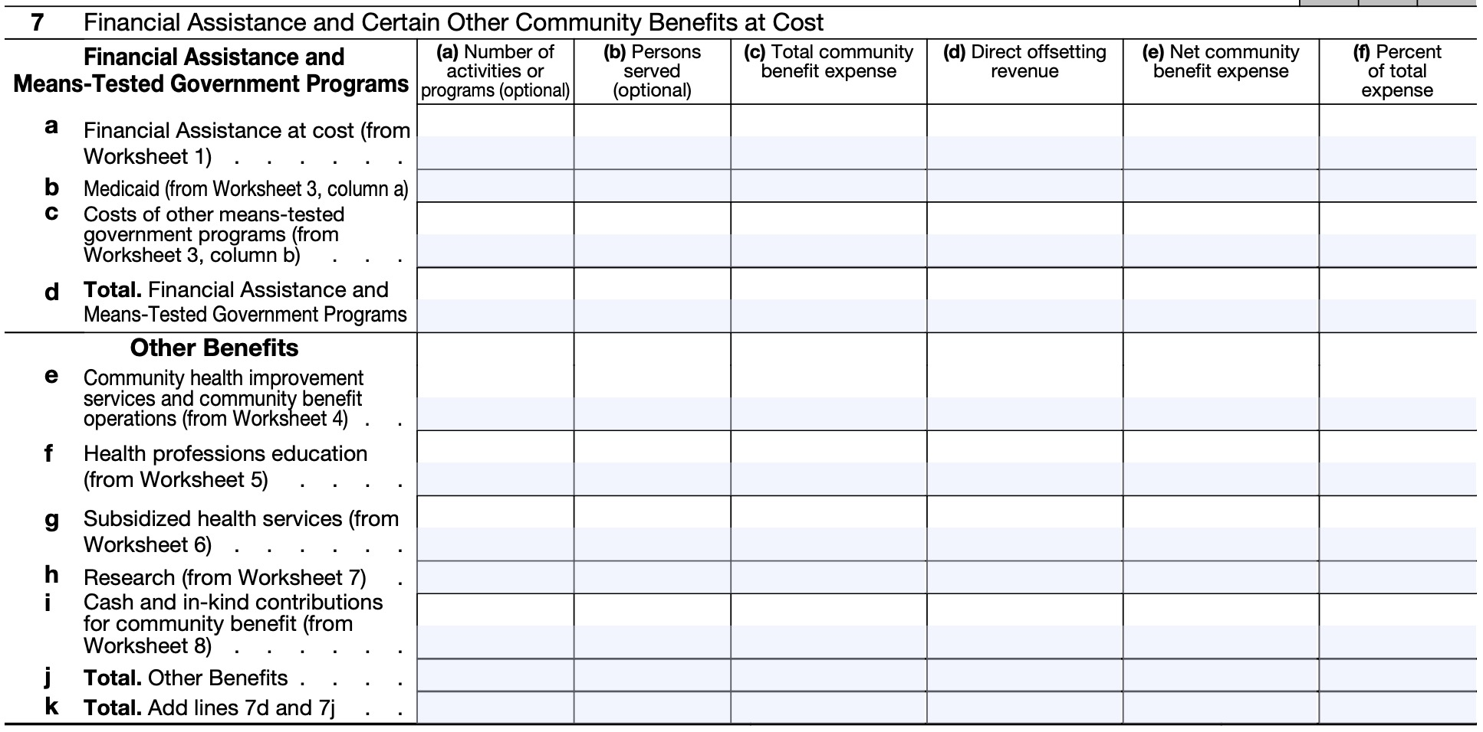
Hospital Community Benefit
IRS defines eight categories of community benefits for hospitals.
Non-profit hospitals are required to report community benefit expenses to IRS on Form 990 Schedule H.
https://www.irs.gov/pub/irs-pdf/f990sh.pdf

Slide 5
Hospital Community Benefit Categories
Financial Assistance at Cost | AKA “charity care.” Free or discounted services for those who cannot afford to pay and meet the hospital’s financial assistance criteria.
Medicaid | Unreimbursed costs from Medicaid.
Cost of Other Means-Tested Government Programs | Unreimbursed costs from CHIP and other federal, state, and local programs.
Community Health Improvement and Community Benefit Operations | Costs associated with planning or operating community benefit Programs (e.g., assigned staff, community health assessments).
Health Professions Education | Programs that result in a degree or certificate or training necessary to be certified; costs for residents or interns.
Subsidized Health Services | Negative margin service; meets an identifiable community need; if no longer offered would be unavailable or fall to the responsibility of another nonprofit or government agency (e.g., emergency room and trauma centers, burn units).
Research | Produces “generalizable knowledge” and funded by tax-exempt sources (e.g., clinical and community health research).
Cash and In-Kind Contributions for Community Benefit | Receiving group must be engaged in a community benefit activity; in-kind donations may include the indirect cost of space donated to community groups and direct cost of donated food or supplies.
https://www.irs.gov/pub/irs-pdf/f990sh.pdf
https://www.ncbi.nlm.nih.gov/pmc/articles/PMC3483984/pdf/AJPH.2011.300339.pdf
Notes:
These are the eight categories of community benefit:
Financial assistance at cost (aka “charity care”)
Unreimbursed costs from Medicaid
Unreimbursed costs from other means-tested government programs (such as CHIP)
Community health improvement and community benefit operations
Health professions Education
Subsidized health services
Research
Cash and in-king contributions for community benefit
The community health improvement category aligns closely with the New York State Prevention Agenda.

Slide 6
Community Health Improvement Services and Community Benefit Operations
Community health improvement services
“[A]ctivities or programs, subsidized by the health care organization, carried out or supported for the express purpose of improving community health.”²
Community benefit operations
“Activities associated with conducting community health needs assessments” ²
“Community benefit program administration” ²
“The organization's activities associated with fundraising or grant writing for community benefit programs.” ²
“Activities or programs cannot be reported if they are provided primarily for marketing purposes or if they are more beneficial to the organization than to the community.” ²
Internal Revenue Service. (2023). Instructions for Form 990-SH, Short Form Return of Organization Exempt From Income Tax. Washington, DC. https://www.irs.gov/pub/irs-pdf/i990sh.pdf

Slide 7
Community Benefit Spending Requirements
Some states have instituted policies that require non-profit hospitals to spend on community benefit. E.g., Illinois, Nevada, Oregon, Pennsylvania, Utah.¹
Neither New York State nor the federal government have minimum-spending requirements for hospital community benefit.
1. Higgins E, Atkeson A. How States Can Hold Hospitals Accountable for Their Community Benefit Expenditures. National Academy for State Health Policy. March 15, 2021. Accessed September 20, 2023. https://nashp.org/how-states-can-hold-hospitals-accountable-for-their-community-benefit-expenditures/.

Slide 8
Community Health Partnerships with Hospitals
Because hospitals have unique resources, infrastructure, and expertise, they can play important roles in improving community health by performing and funding community benefit activities.
Hospitals can use community benefit activities to:
Improve health outcomes overall
Improve access to health care or other services
Reduce health disparities
Prevent disease
Promote wellness
Public health officials and hospitals should work together closely to align community benefit programs with local public health priorities.

Slide 9
Hospital Community Benefit Spending in New York State
Data

Slide 10
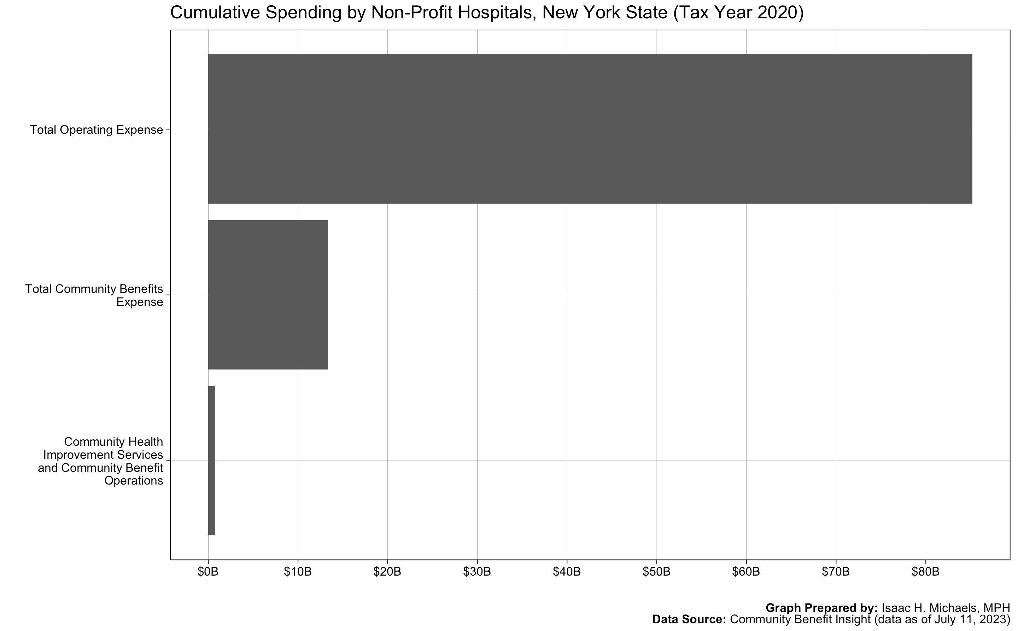

Slide 11
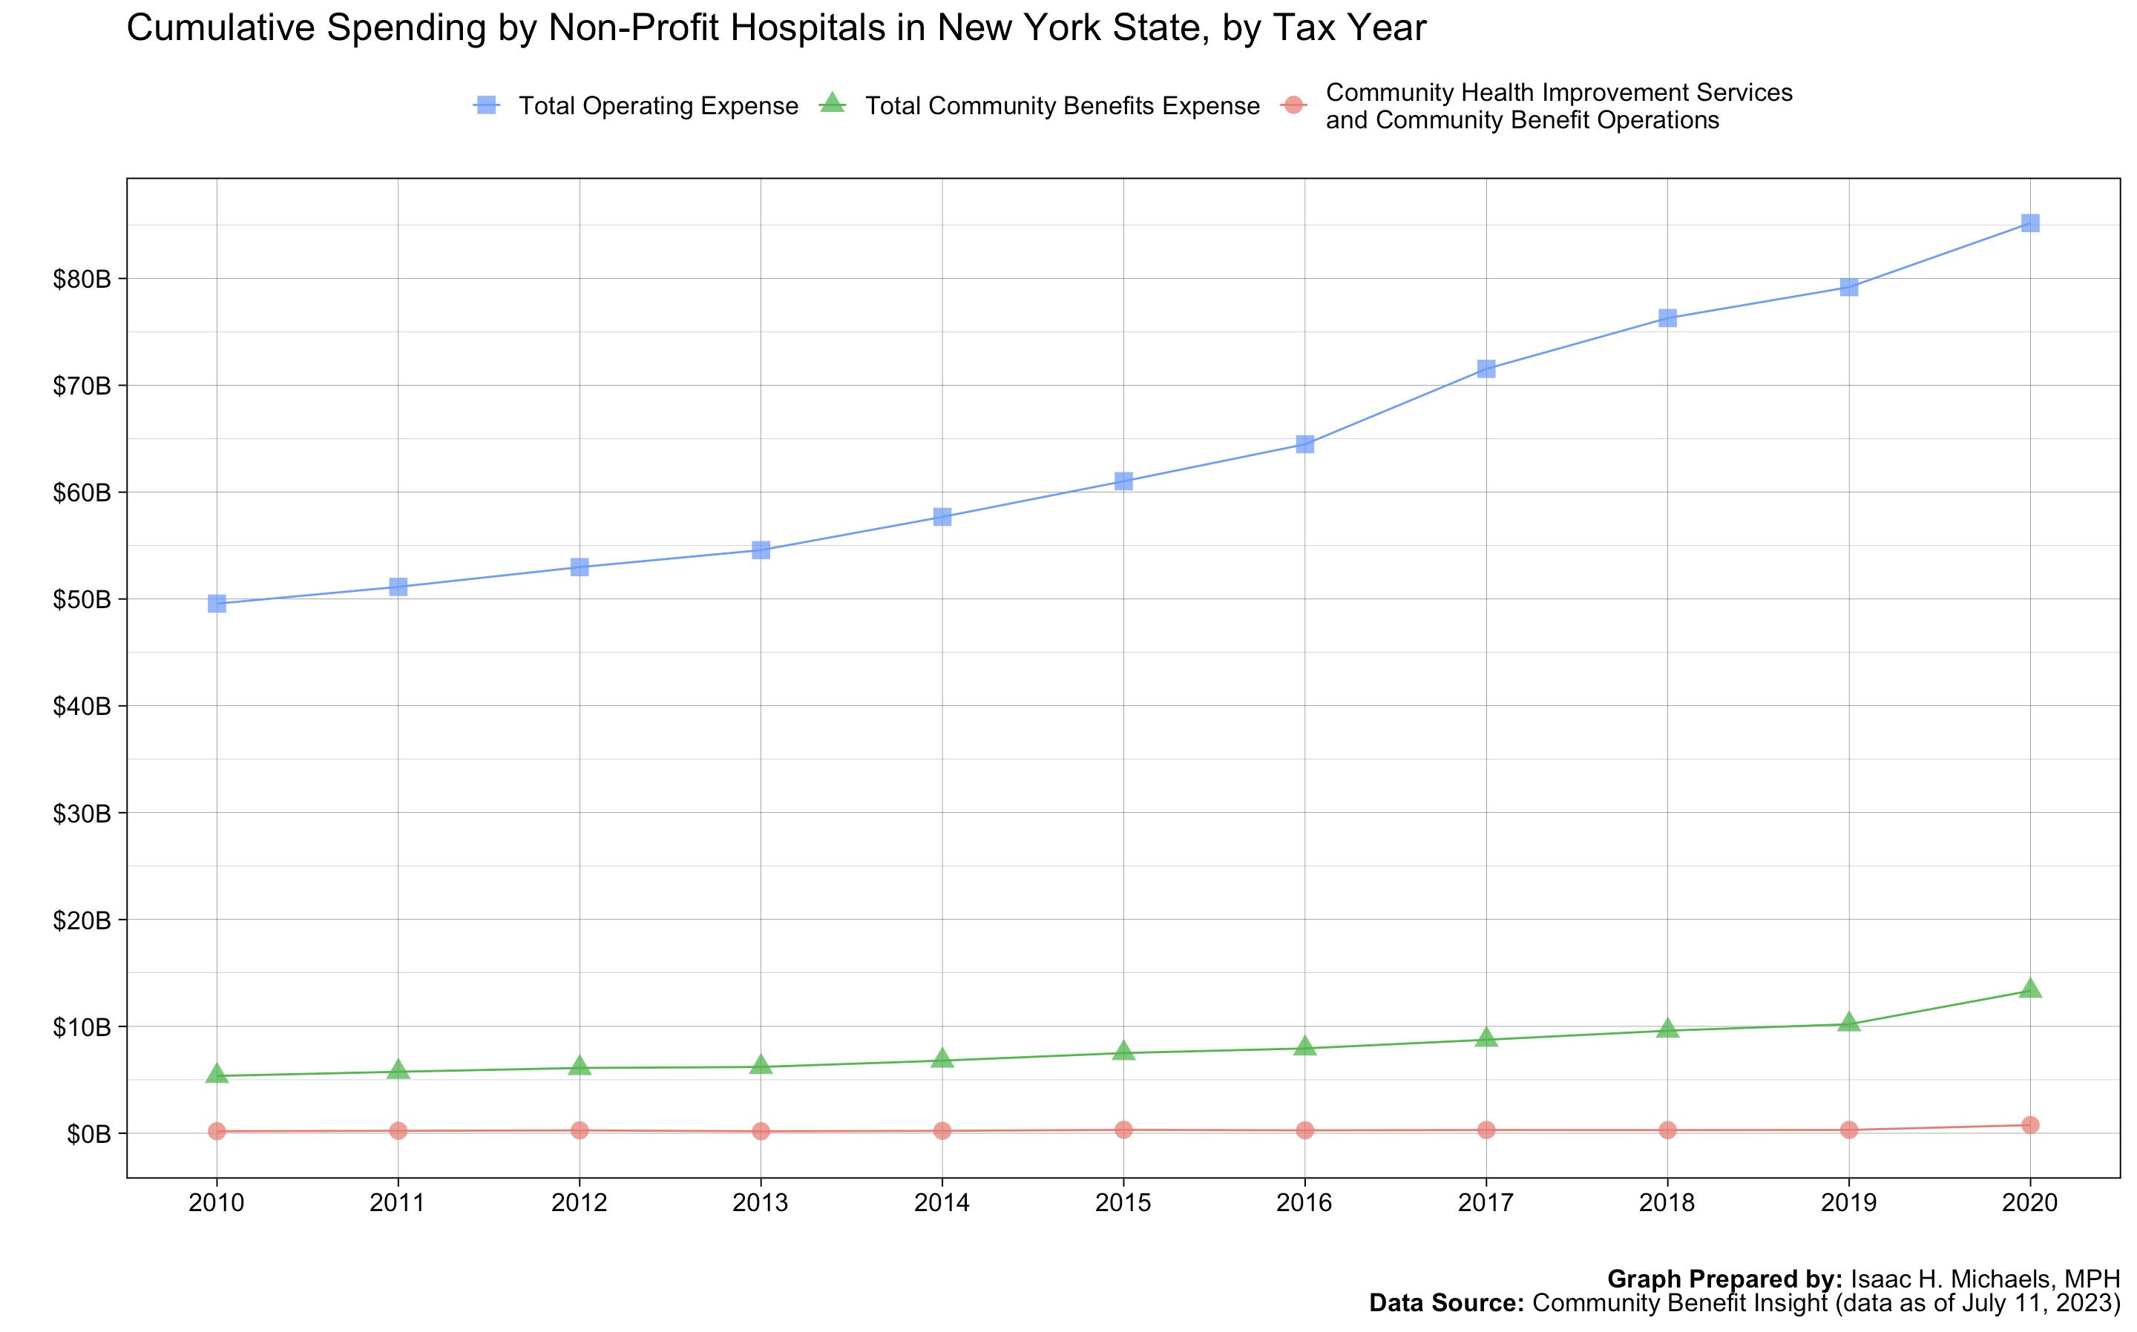

Slide 12
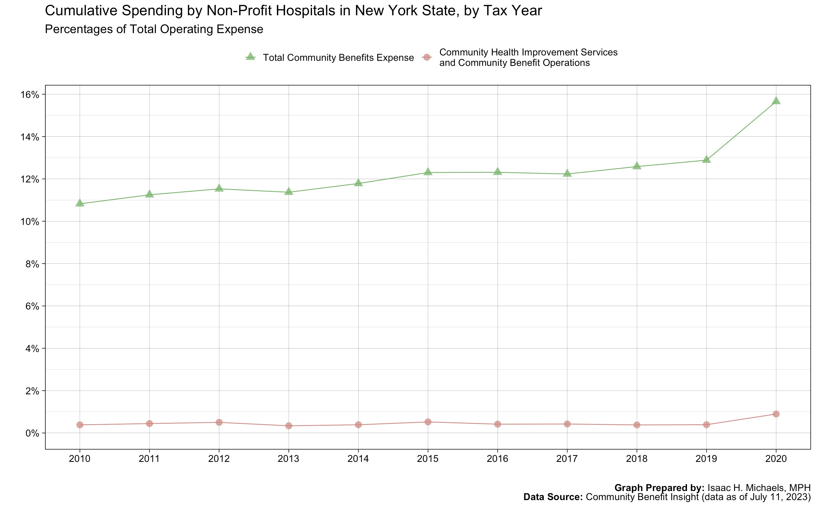

Slide 13
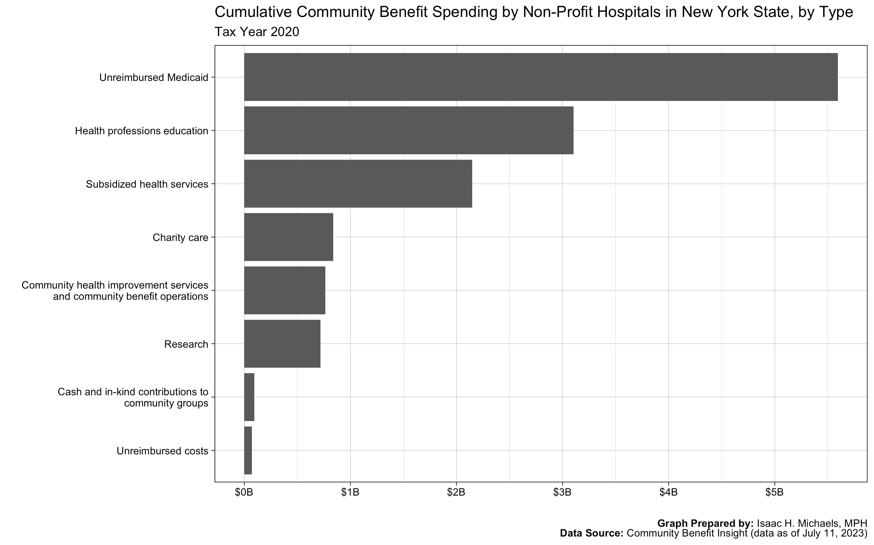

Slide 14
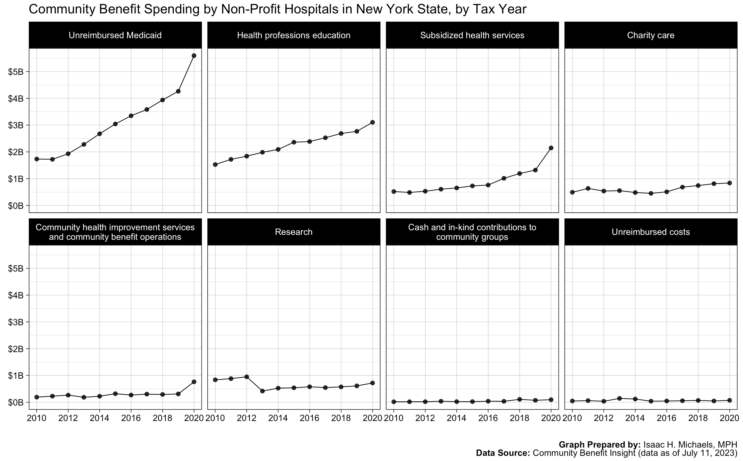

Slide 15
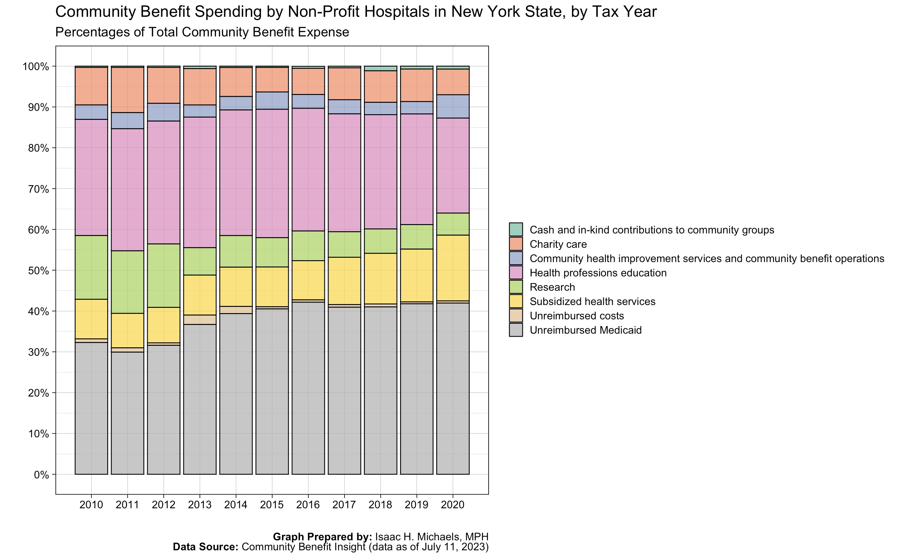

Slide 16
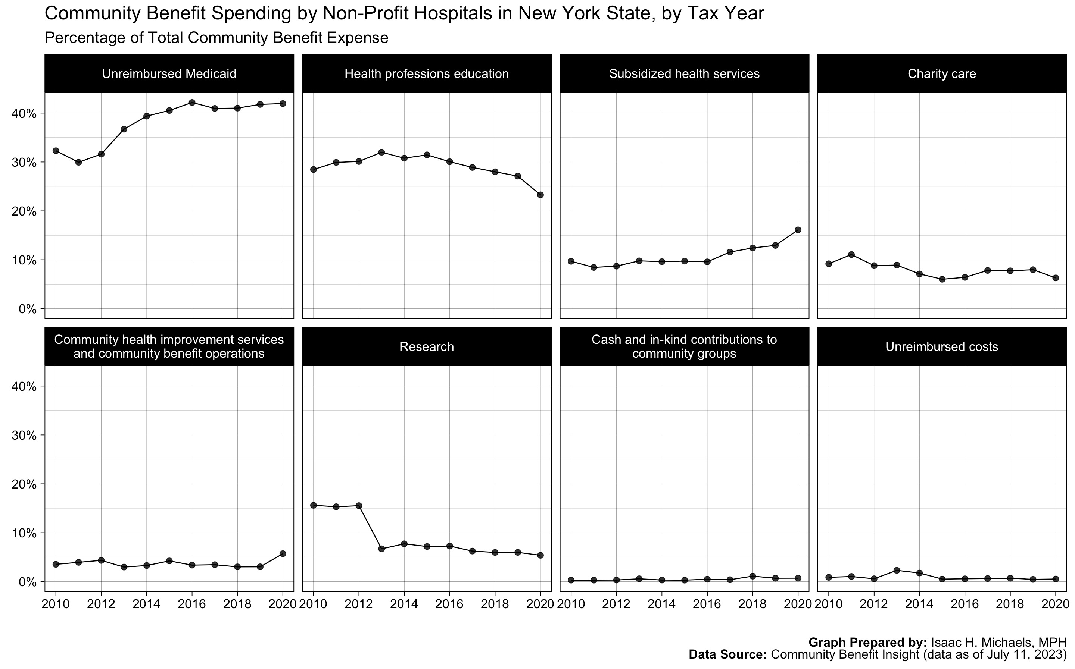

Slide 17
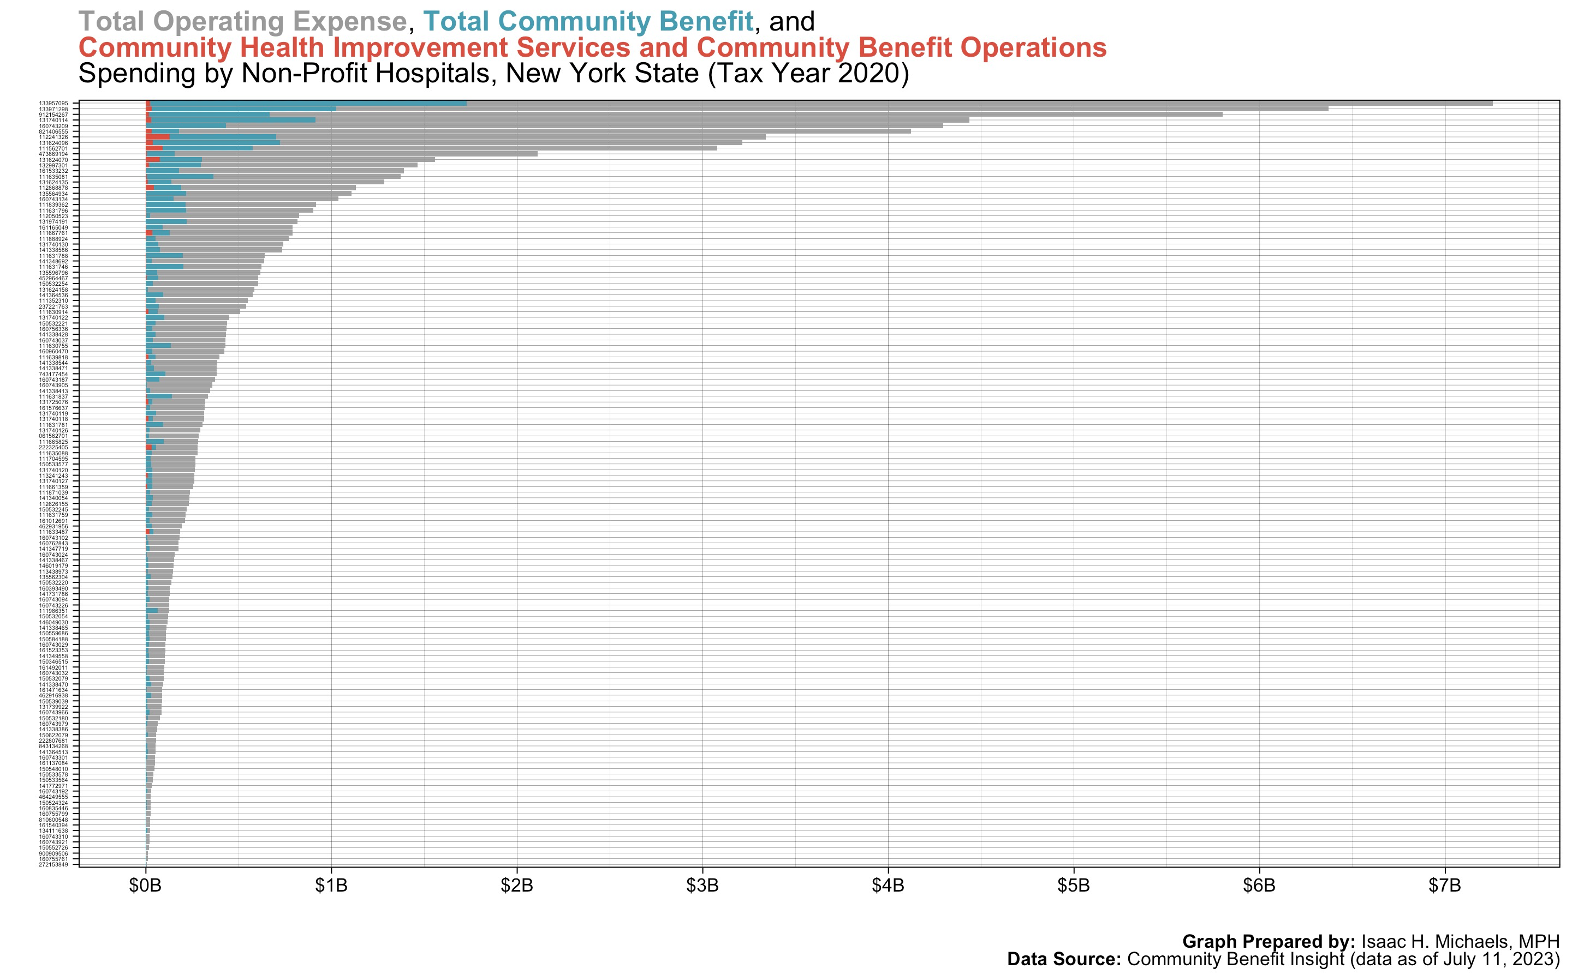

Slide 18
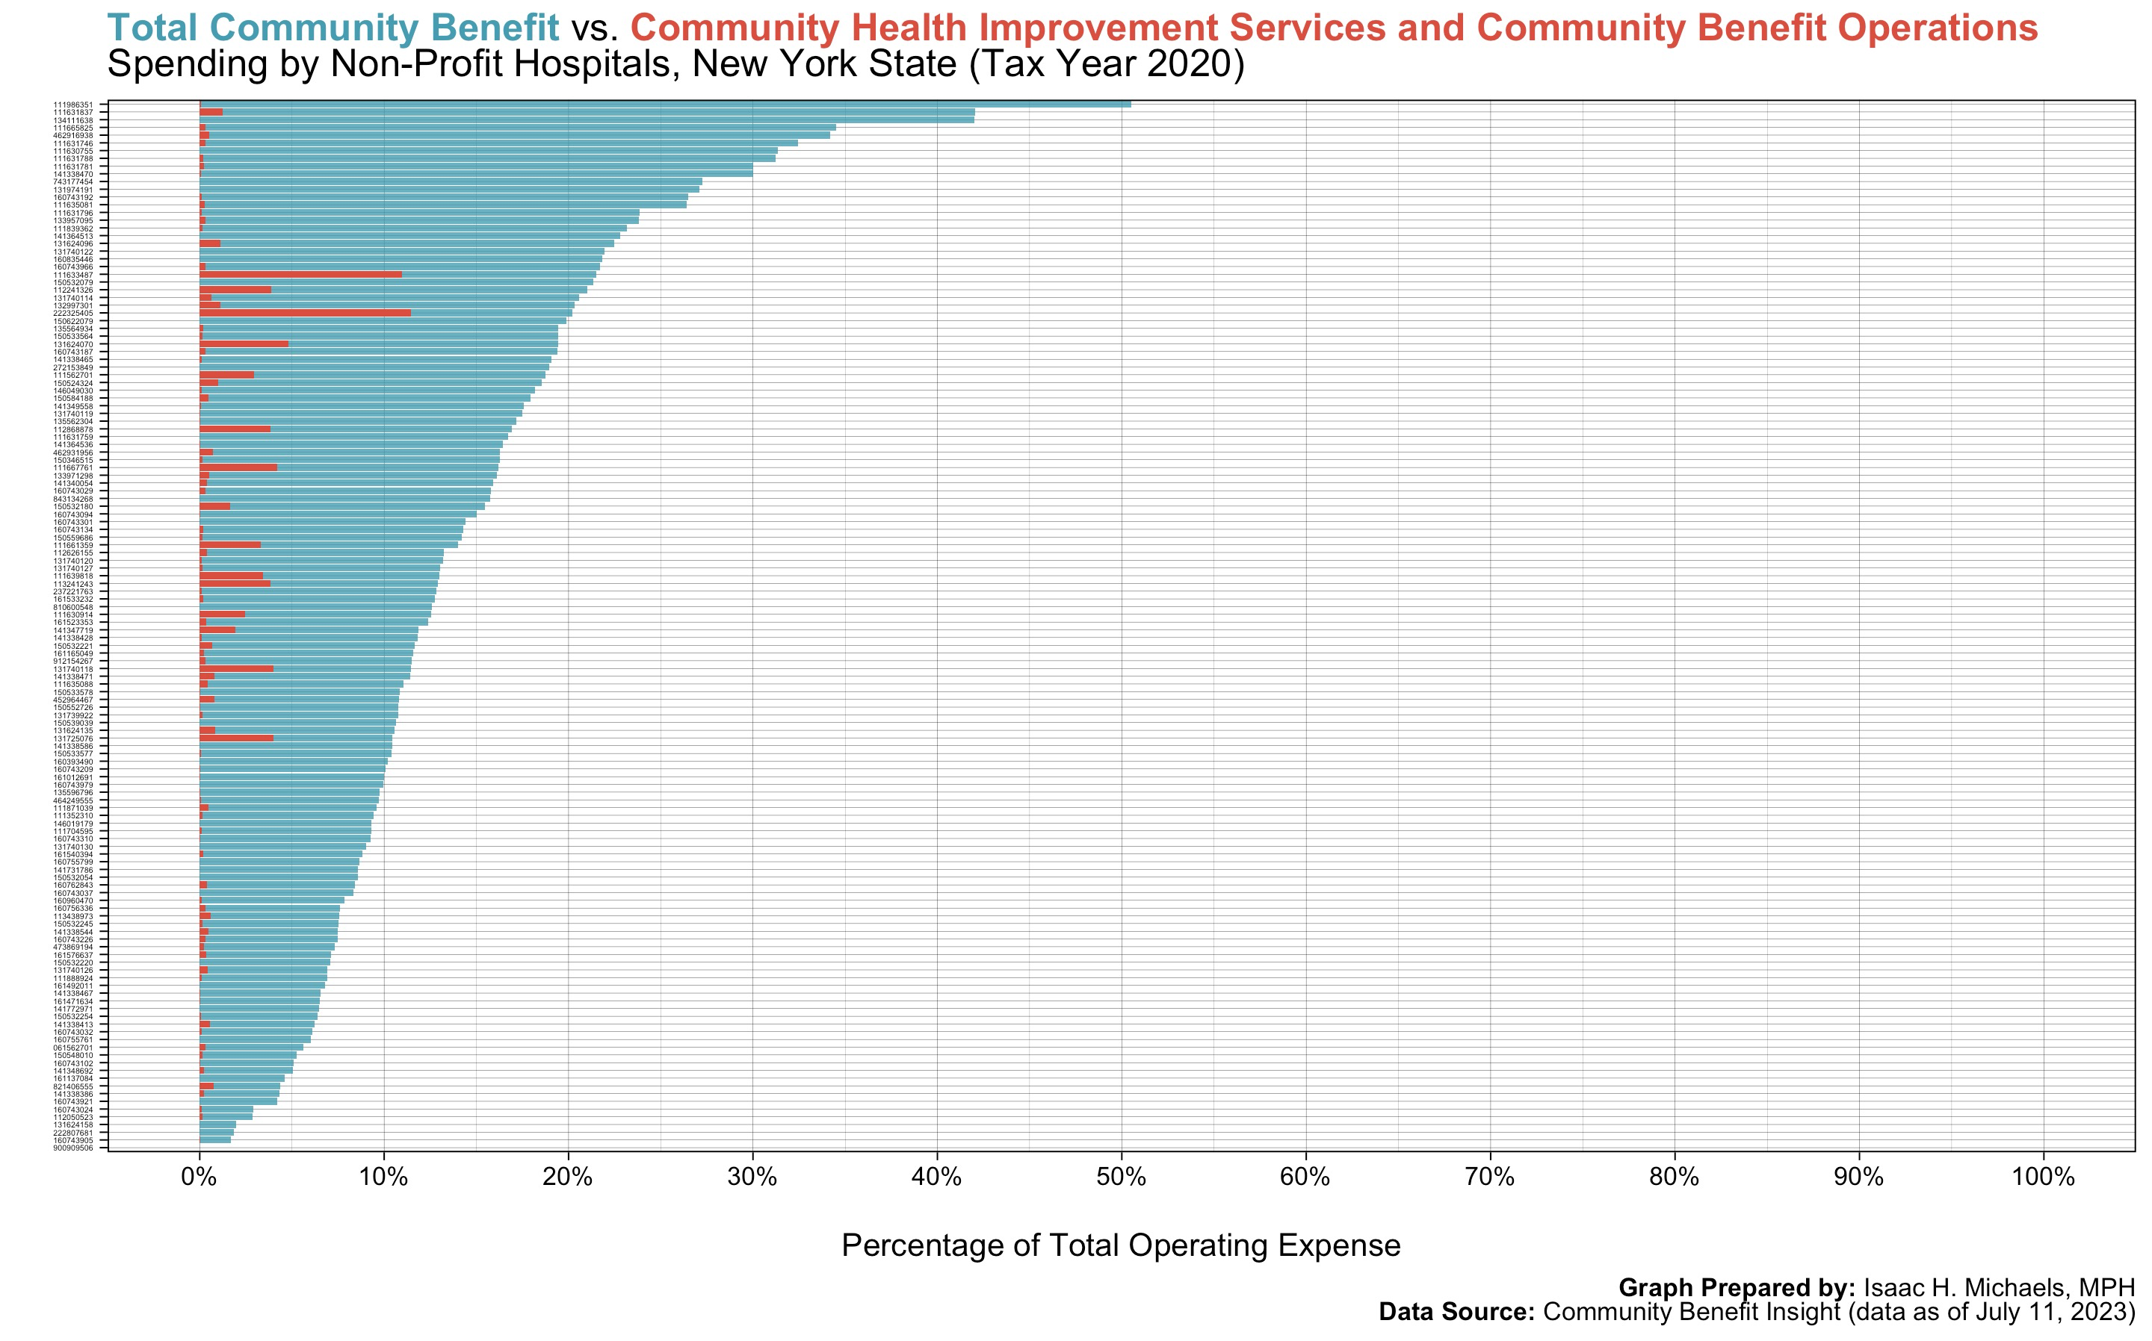

Slide 19
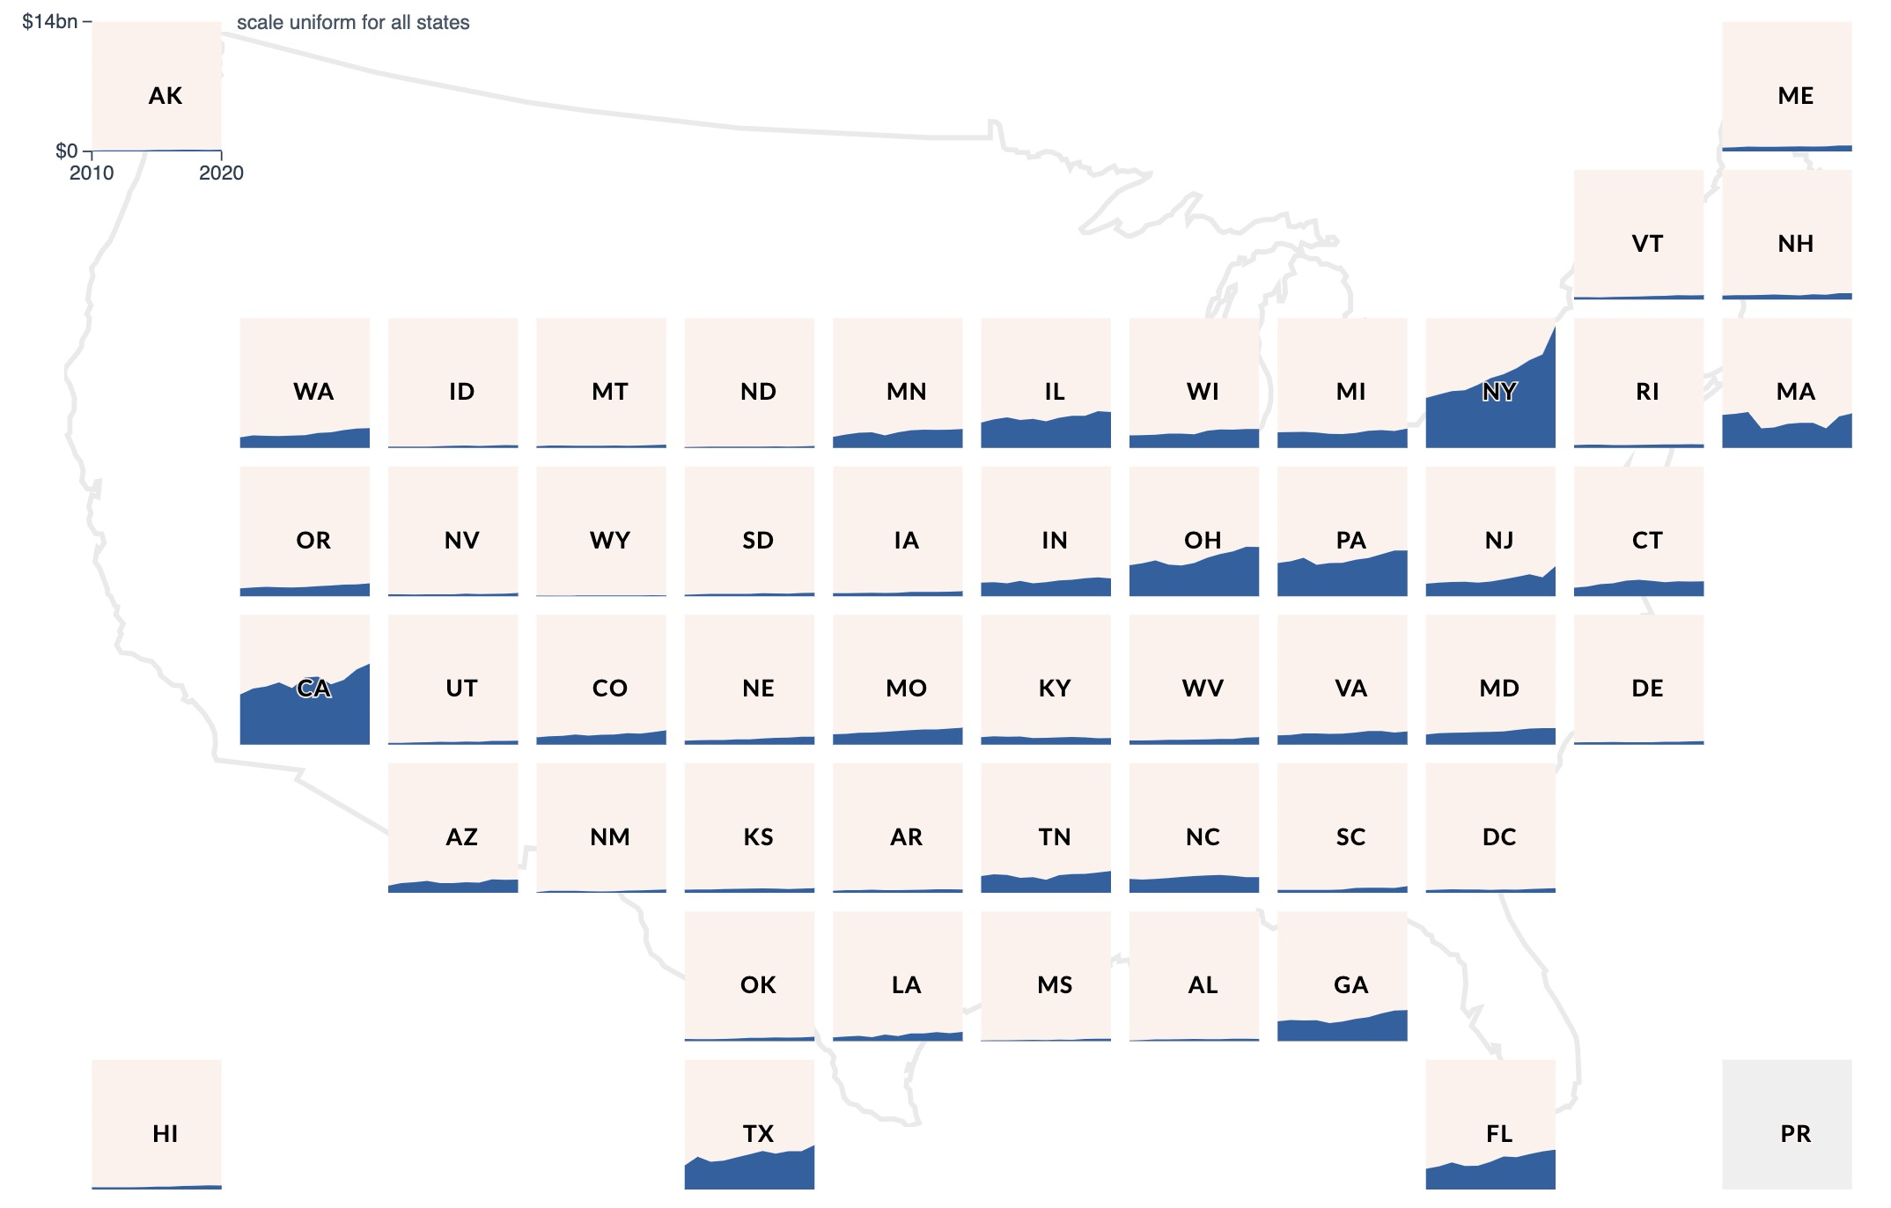
Total Community Benefit State Spending Trends
RTI International. (2023). Community Benefit Insight [Data Retrieval Tool]. Funded by the Robert Wood Johnson Foundation. http://communitybenefitinsight.org/
https://www.communitybenefitinsight.org/?page=national_analysis.home

Slide 20
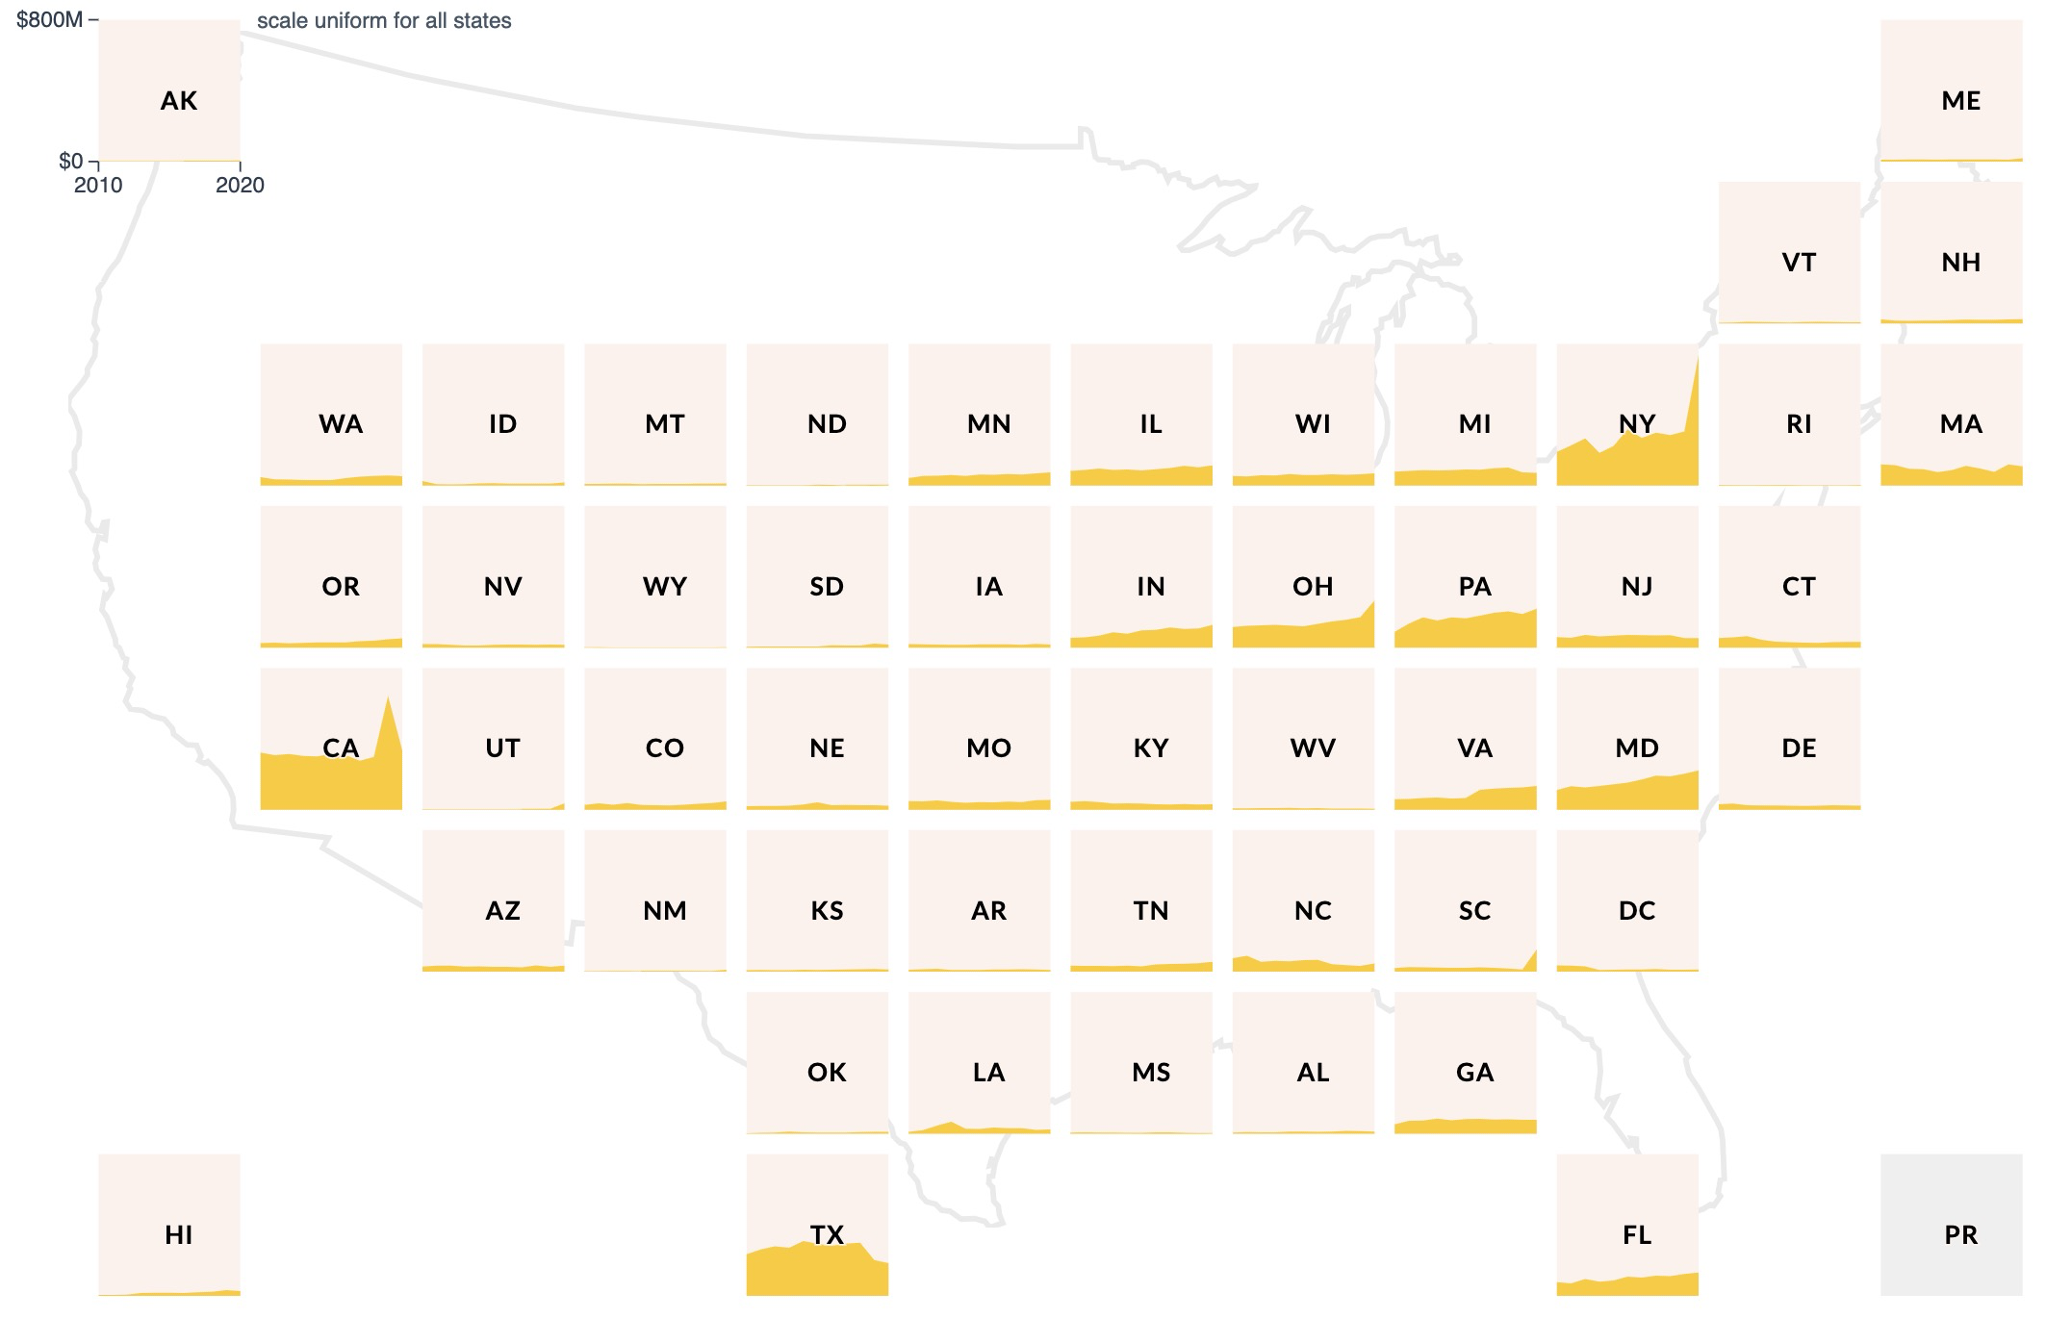
Community Health Improvement Services and Community Benefit Operations, State Spending Trends
RTI International. (2023). Community Benefit Insight [Data Retrieval Tool]. Funded by the Robert Wood Johnson Foundation. http://communitybenefitinsight.org/
https://www.communitybenefitinsight.org/?page=national_analysis.home

Slide 21
Thank You
Isaac Michaels, MPH
imichaels@albany.edu

