Slide 1
Percutaneous Coronary Intervention in Ambulatory Surgery Centers
New York State Cardiac Advisory Committee
October 22, 2025 | PHHPC Health Planning Committee

Slide 2
Introduction
Alda Osinaga, MD, MPH
Chief Medical Officer and Director of the Clinical Center
Office of Health Services Quality and Analytics
New York State Department of Health

Slide 3
AGENDA
Introduction
Evidence: Percutaneous Coronary Intervention (PCI) in Ambulatory Surgery Centers – What Has Been Learned from Prior Studies?
Guidance from the Society for Cardiovascular Angiography and Interventions (SCAI)
New York State (NYS) Data Review

Slide 4
NYS Cardiac Advisory Committee (CAC)
“There shall be a State cardiac advisory committee consisting of physicians and other professionals with expertise in cardiac care appointed by the Commissioner of Health. The State cardiac advisory committee shall, at the request of the commissioner, consider any matter relating to cardiac services including, but not limited to review of existing and prospective services, and shall advise the commissioner thereon.” [10 NYCRR §405.29(b)]
Formally established as a statewide Commissioner’s advisory body in 1974
Membership includes both in- and out-of-state cardiac surgeons, cardiologists and specialists from other pertinent disciplines
Advisory role
Notes:
Additional Notes for presentation
The combination of in-state and out-of-state members means that in addition to representatives with knowledge and experience in NYS, the CAC also has experts practicing in other states and with prominent roles on the national stage.

Slide 5
CAC Membership and Structure Guidelines
All members shall comply with section 74 (Code of Ethics) of the Public Officers Law.
Members should exercise their duties and responsibilities as Committee members in the public interest of the inhabitants of the state, regardless of their affiliation with, or relationship to, any facility, agency or program, category of provider, or interest group.
A Committee member should endeavor to pursue a course of conduct which will not raise suspicion among the public that they are likely to be engaged in acts that are in violation of his or her trust as a Committee member.
No Committee member should permit their employment to impair their independence of judgment in the exercise of their duties as a Committee member.

Slide 6
NYS Cardiac Advisory Committee (CAC) role
1. The CAC has been asked to present to the PHHPC Health Planning Committee at an education session (today’s presentation)
2. The CAC has been asked to make recommendations to the State related to:
Case (patient) selection
Program requirements
Monitoring – including quality and safety considerations
(more to come – see next slide)

Slide 7
CAC Workgroup Process and Timeline
A workgroup of CAC members has been formed to start the discussion on recommendations for the State
Timeline:
Workgroup has met twice thus far to discuss
Workgroup will be presenting proposed recommendations to the full CAC on November 3, 2025
Final recommendations deadline – end of 2025

Slide 8
CAC Workgroup members
Alice Jacobs, MD, Boston University (Chair)
Craig Smith, MD, Columbia University Medical Center-NY Presbyterian Hospital
Peter Berger, MD, Cardiology Consultant
Joseph Dearani, MD, Mayo Clinic
Jeffrey Gold, MD, University of Nebraska System
Stephen Lahey, MD, University of Connecticut Health Center
Frederick Ling, MD, University of Rochester Medical Center
Srihari Naidu, MD, Westchester Medical Center
Jacqeline Tamis-Holland, MD, Cleveland Clinic
Ferdinand Venditti, Jr., MD, Albany Medical College
Kimberly Cozzens, MA, Cardiac Services Program-University at Albany
Alda Osinaga, MD, MPH, NYS Department of Health
Linda Efferen, MD, MBA, MACP, NYS Department of Health

Slide 9
PCI in ASC: What Has Been Learned From Prior Studies?
Alice K. Jacobs, MD
Chair, NYS Cardiac Advisory Committee
Emeritus Professor of Medicine, Boston University

Slide 10
Existing Evidence Base
Emergency and Elective PCI No Surgery-on-Site
Same Day Discharge PCI
Elective PCI in Ambulatory Surgery Centers

Slide 11

The Cardiovascular Patient Outcomes Research Team Non-Primary PCI (CPORT-E) Trial
Cardiovascular Patient Outcomes Research Team [C-PORT] N Engl J Med 2012;366:1792-802

Slide 12
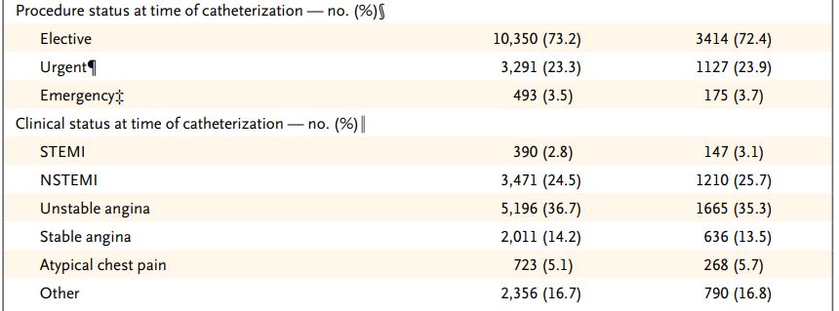
On-Site Cardiac Surgery
(N = 4718)
No On-Site Cardiac Surgery
(N = 14,149)
Clinical Status
Cardiovascular Patient Outcomes Research Team [C-PORT] N Engl J Med 2012;366:1792-802.

Slide 13
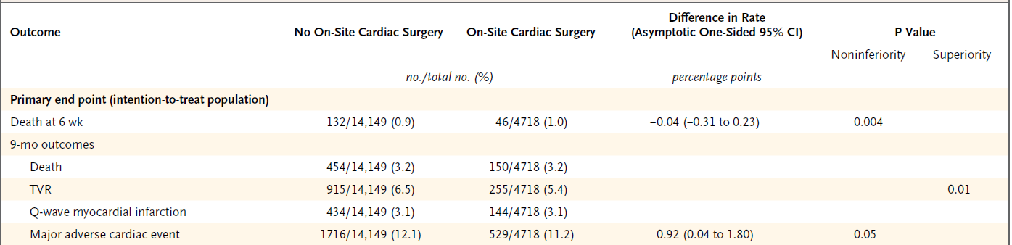
Outcomes at 6 weeks and
9 months
Cardiovascular Patient Outcomes Research Team [C-PORT] N Engl J Med 2012;366:1792-802.

Slide 14
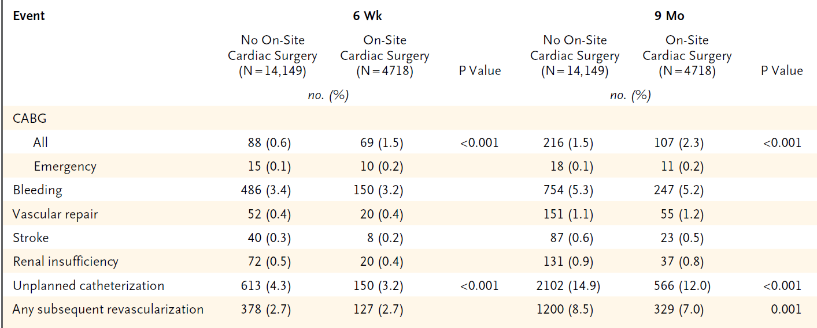
Events at
6 weeks and 9 months
Cardiovascular Patient Outcomes Research Team [C-PORT] N Engl J Med 2012;366:1792-802.

Slide 15
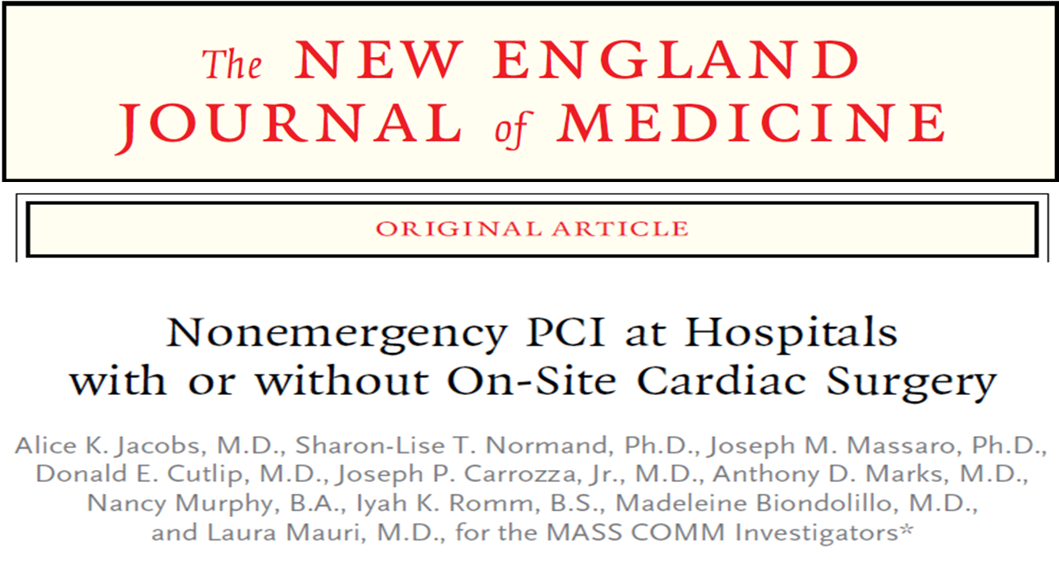
The Randomized Trial to Compare Percutaneous Coronary Intervention between Massachusetts Hospitals with Cardiac Surgery On-Site and Community Hospitals without Cardiac Surgery On-Site (MASS COMM)
Jacobs. N Engl J Med 2013;368:1498-508.

Slide 16
MASS COMM Design
Patients undergoing coronary angiography at hospital without on-site cardiac surgery
Exclusion Criteria
left ventricular ejection fraction < 20%
target lesions with: - unprotected left main stenosis >50%
- device other than balloon angioplasty prior to stent
- saphenous vein graft location
- vessel serving only viable myocardium
Randomized 3:1
Stratified by Diabetes
PCI at hospital without on-site surgery (n=10 sites)
PCI at hospital with on-site surgery
(n=7 sites)
N Engl J Med 2013;368:1498-508.

Slide 17
MASS COMM Trial - MACE at 30-Days (Safety)
 | No On-Site Surgery (n=2774) | On-Site Surgery (n=917) | Relative Risk 95% CI | P Value
Major Adverse Cardiovascular Event (MACE) (%) | 9.5 | 9.4 | 1.00 (1.22) | <0.001
Components of 30-day end point (%)
Death | 0.7 | 0.3 | 1.96 (0.58-6.64) | 0.44
Myocardial Infarction | 6.5 | 6.5 | 1.01 (0.76-1.35) | 1.00
Repeat Revascularization | 2.7 | 3.5 | 0.77 (0.51-1.17) | 0.25
Stroke | 0.4 | 0.1 | 3.93 (0.51-30.21) | 0.21
N Engl J Med 2013;368:1498-508.

Slide 18
MASS COMM Trial – MACE at 12 Months (Effectiveness)
 | No On-Site Surgery (n=2774) | On-Site Surgery (n=917) | Relative Risk 95% CI | P Value
MACE (%) | 17.3 | 17.8 | 0.98 (1.13) | <0.001
Components of 12-month end point (%)
Death | 2.3 | 2.4 | 0.95 (0.57-1.60) | 0.89
Myocardial Infarction | 8.6 | 7.8 | 1.10 (0.84-1.45) | 0.55
Repeat Revascularization | 8.5 | 9.9 | 0.86 (0.67-1.11) | 0.24
Stroke | 1.0 | 0.8 | 1.24 (0.51-3.04) | 0.83
N Engl J Med 2013;368:1498-508.

Slide 19
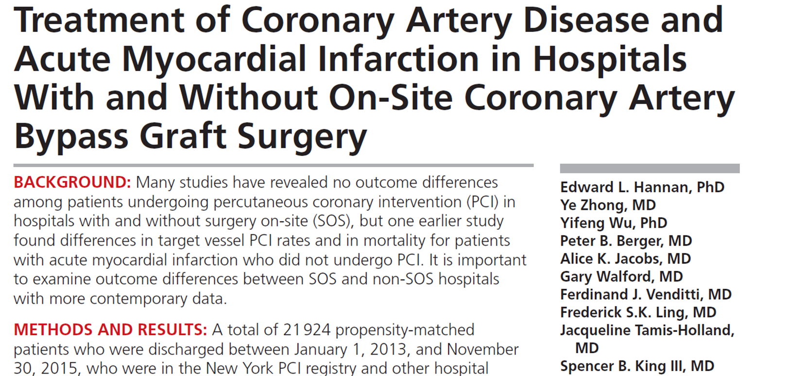
NYS PCI Registry
Hannan. Circ Cardiovasc Interv. 2019;12:e007097.

Slide 20
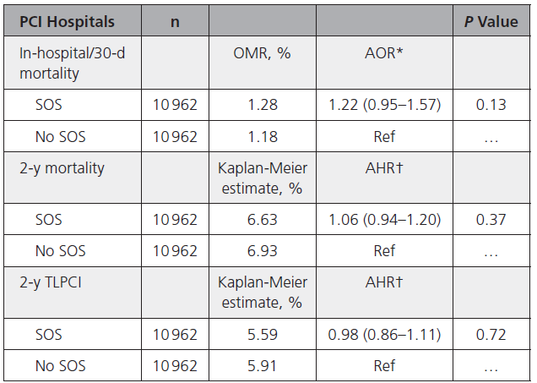
Risk-Adjusted Outcomes for Propensity-Matched Patients With PCI in New York Hospitals With and Without Cardiac Surgery On Site (SOS)
Hannan. Circ Cardiovasc Interv. 2019;12:e007097.

Slide 21
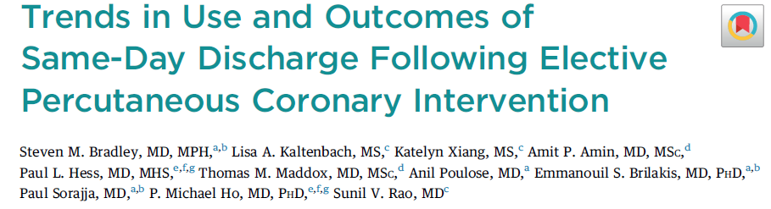
Bradley. J Am Coll Cardiol Intv 2021;14:1655–66.

Slide 22
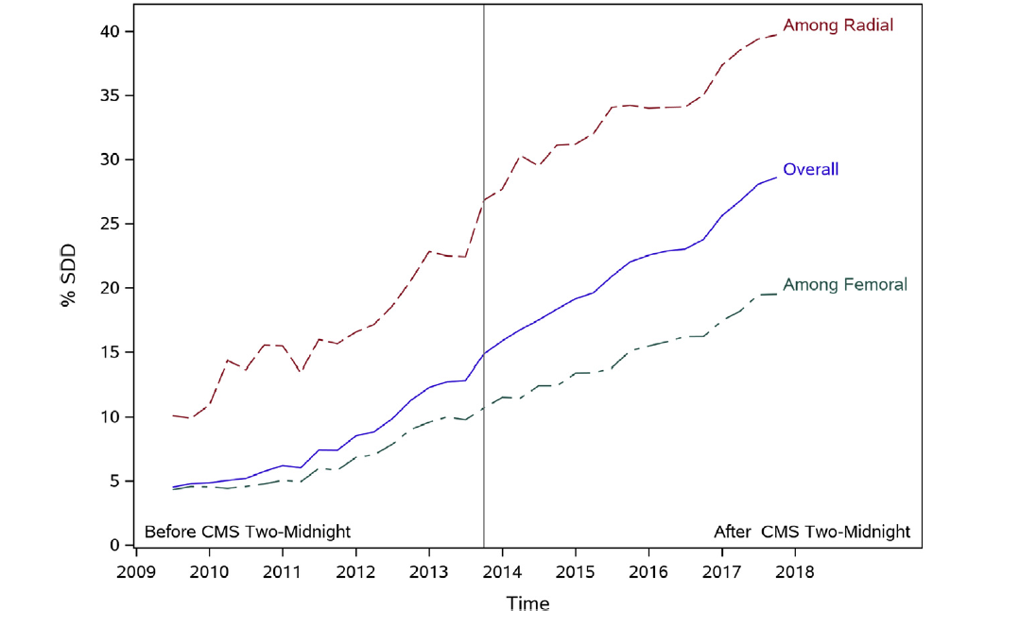
Temporal Trends in Rates of Same-Day Discharge Following Elective Percutaneous Coronary Intervention
Bradley. J Am Coll Cardiol Intv 2021;14:1655–66.

Slide 23
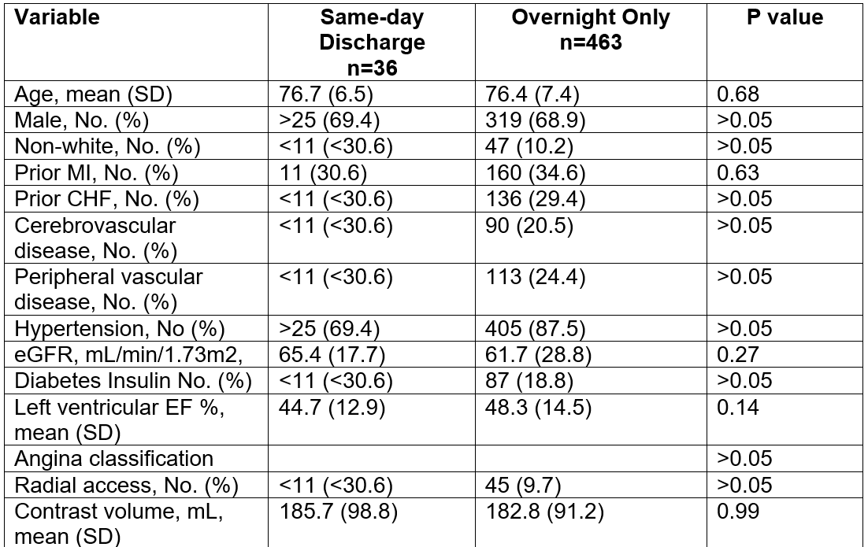
Patient Characteristics by Discharge Status among Patients with 30-day Mortality
Bradley. J Am Coll Cardiol Intv 2021;14:1655–66.

Slide 24
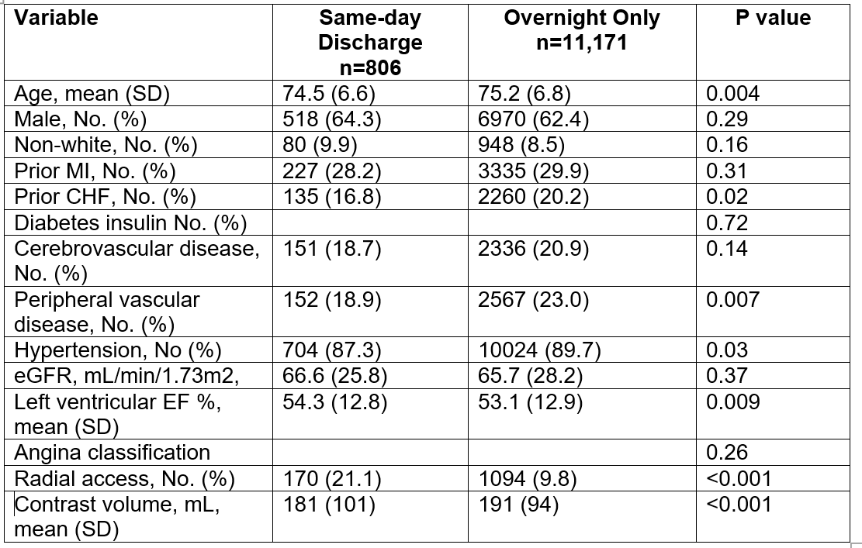
Patient Characteristics by Discharge Status among Patients with 30-day Rehospitalization
Bradley. J Am Coll Cardiol Intv 2021;14:1655–66.

Slide 25

PCI in Ambulatory Surgery Centers
SCAI Scientific
Sessions
May 2025
Health Planning
Committee (HPC)
Presentation
July 2025

Slide 26
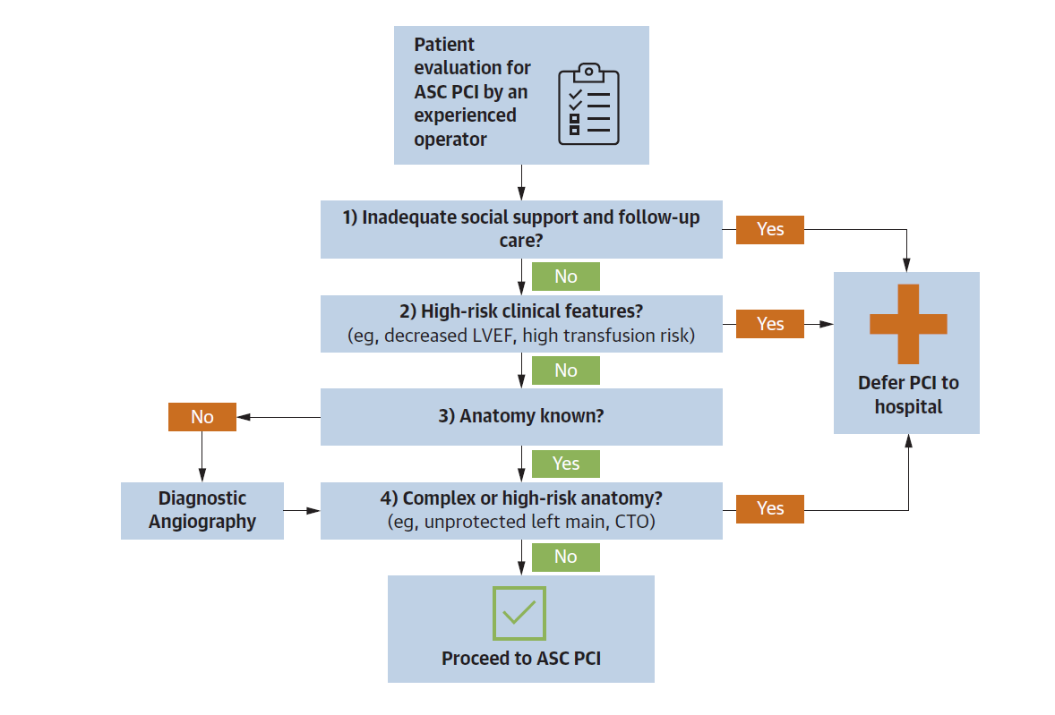
Patient Selection
Box. Catheter Cardiovasc Interv. 2020;96:862–870.
Dangas K, JACC. 2025;86(2):133–143.

Slide 27
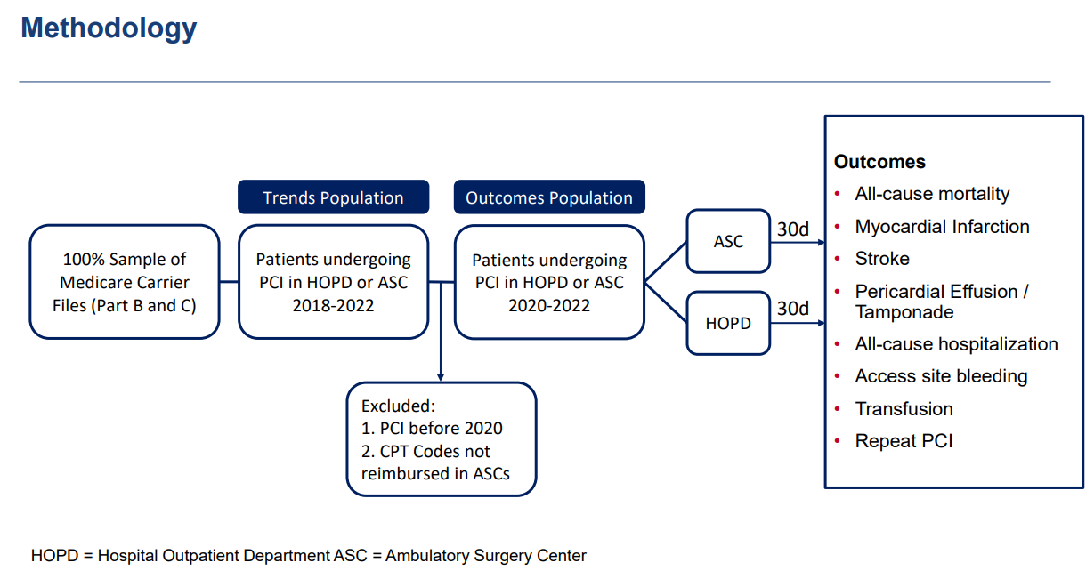
Dangas, July 2025 HPC Presentation

Slide 28
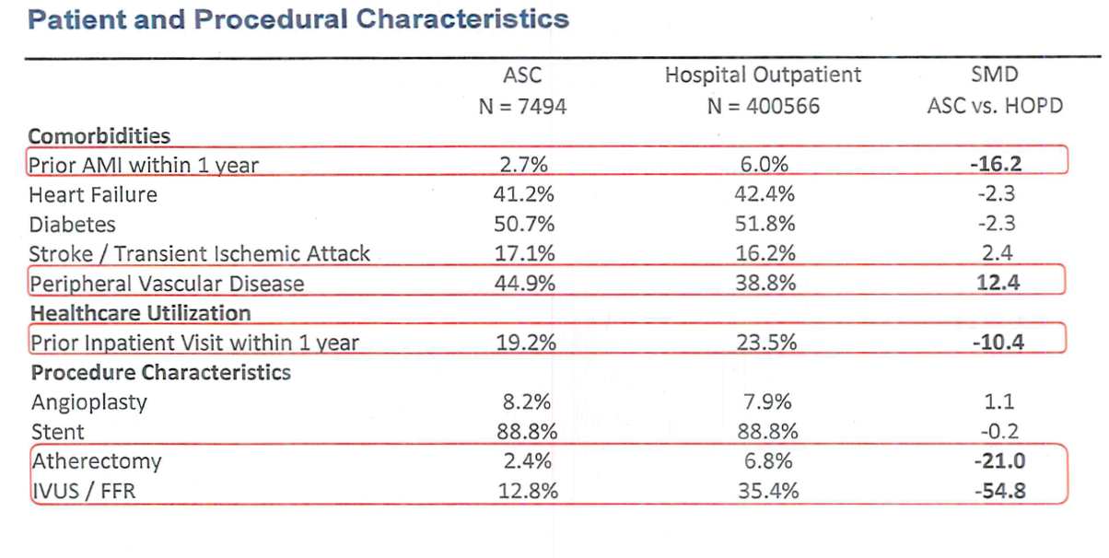
Dangas, July 2025 HPC Presentation

Slide 29
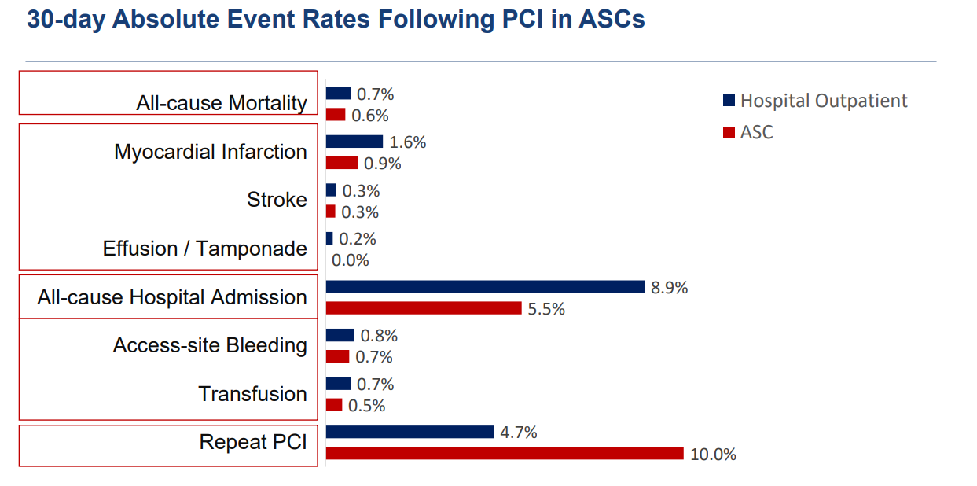
Dangas, July 2025 HPC Presentation

Slide 30
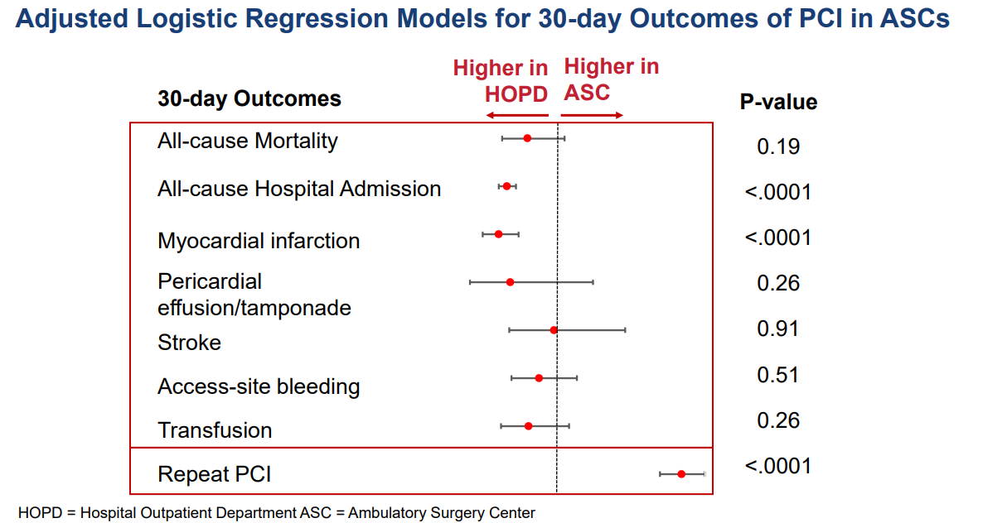
Dangas, July 2025 HPC Presentation

Slide 31
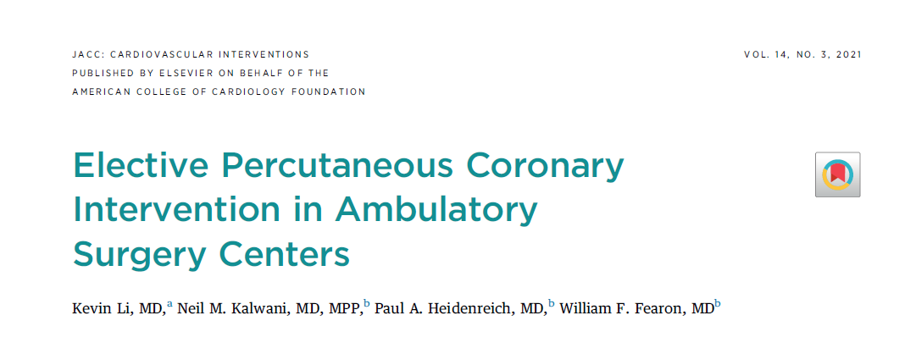
Elective Pci in Ambulatory Surgery Centers
J Am Coll Cardiol Intv. 2021;14(3):292–300.

Slide 32
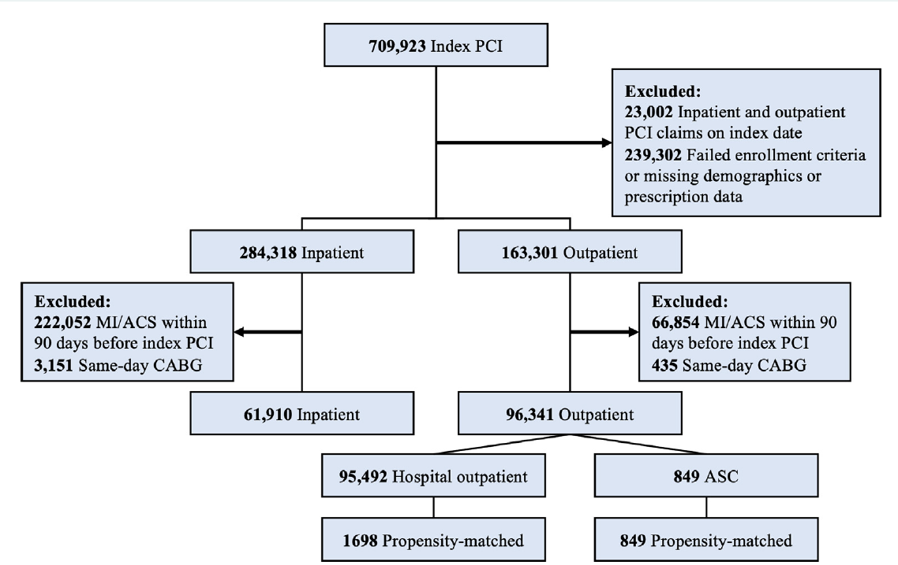
Cohort Flow Diagram
Li. J Am Coll Cardiol Intv. 2021;14(3):292–300.

Slide 33
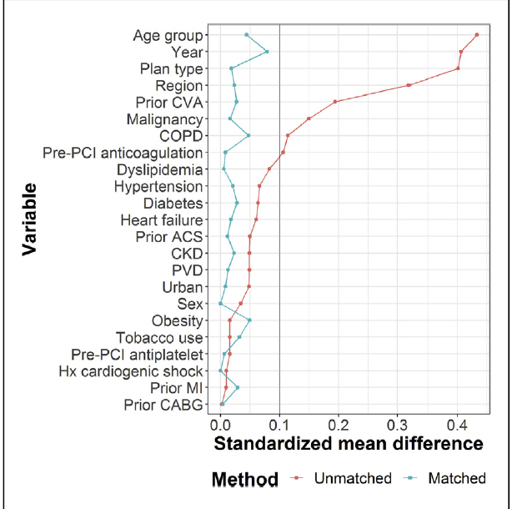
Balance of Hospital Outpatient and Ambulatory
Surgery Center Cohorts Before and After Propensity Score Matching
Li. J Am Coll Cardiol Intv. 2021;14(3):292–300.

Slide 34
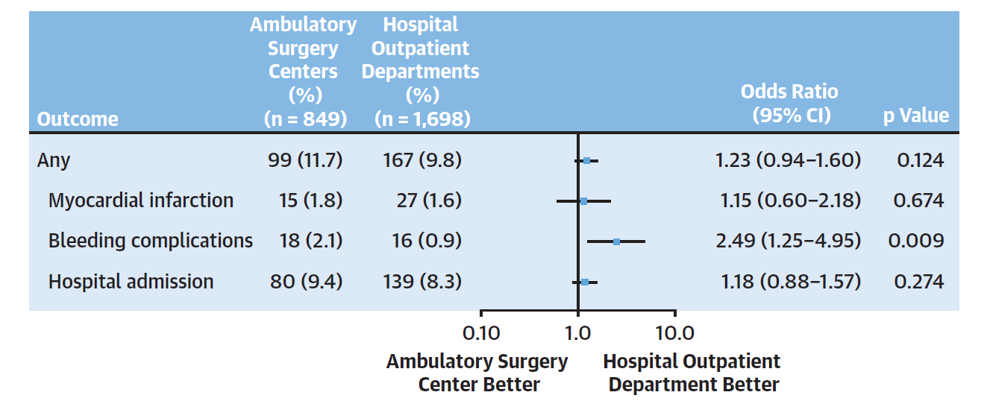
Outcomes of Elective PCI in Ambulatory Surgery Centers and Hospital Outpatient Settings
Li. J Am Coll Cardiol Intv. 2021;14(3):292–300.

Slide 35
PCI in ASC: Evidence Gaps
Prospective randomized trials
Long-term outcomes beyond 30 days
Patient‐reported outcomes in Medicare / vulnerable populations with all payers

Slide 36
PCI in ASC: What else do we need to know?
Patient selection criteria
Program requirements
Optimal treatment strategy informed by guideline recommendations and a “Heart Team” approach

Slide 37
Guidance from the Society for Cardiovascular Angiography and Interventions (SCAI)
Srihari S. Naidu, MD, FACC, FAHA, FSCAI
Cardiac Advisory Committee Member
President of SCAI
System Director, Cardiac Catheterization Laboratory & Director, Hypertrophic Cardiomyopathy Center
Westchester Medical Center and WMCHealth Network / Professor of Medicine, New York Medical College

Slide 38
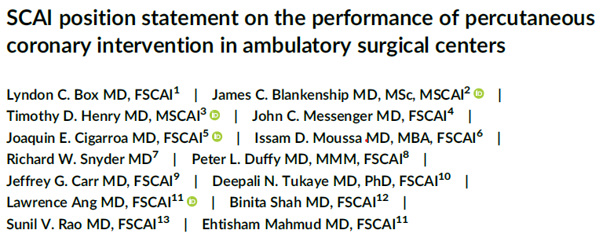
Box LC, Blankenship JC, Henry TD, Messenger JC, Cigarroa JE, Moussa ID, Snyder RW, Duffy PL, Carr JG, Tukaye DN, Ang L, Shah B, Rao SV, Mahmud E. SCAI position statement on the performance of percutaneous coronary intervention in ambulatory surgical centers. Catheter Cardiovasc Interv. 2020 Oct 1;96(4):862-870. doi: 10.1002/ccd.28991. Epub 2020 Jul 2. PMID: 32406995.

Slide 39
SCAI Expert Consensus Opinion 2020
Performance of PCI in an ASC was acceptable
The complication rate for elective PCI is extremely low, and therefore, the performance of PCI in ASCs is reasonable
Acknowledged potential benefits of cost reduction and increased patient satisfaction but also potential unanticipated cost increases
Emphasized that standards for care, including available emergency equipment and QA, should mirror the hospital setting
Recommended restricting procedures to relatively healthy patients and avoiding complex lesions
Journal of the Society for Cardiovascular Angiography & Interventions DOI: 0.1016/j.jscai.2022.100560

Slide 40

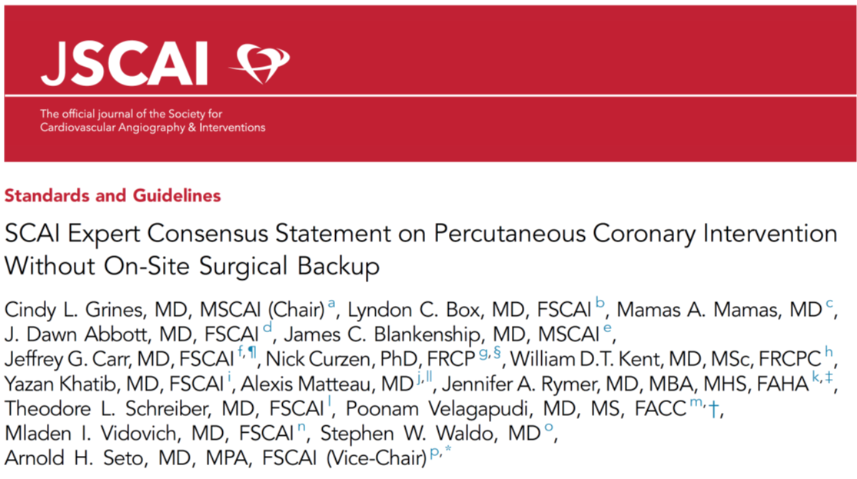
Update January 2023
Continued to emphasize the same standards for quality as the hospital setting
Greater emphasis on physician judgment in case selection
https://www.jscai.org/article/S2772-9303(22)00600-7/fulltext

Slide 41
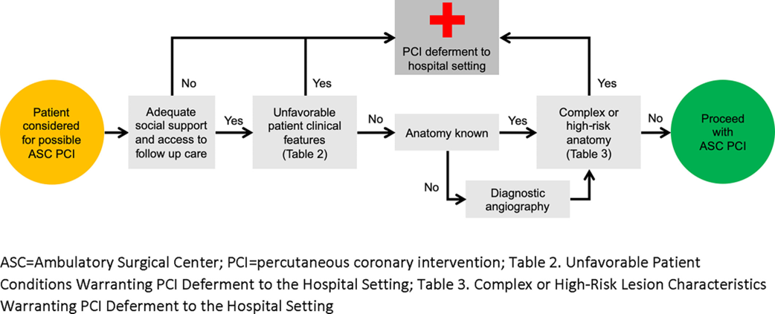
Patient Pathway for Elective ASC PCI
Figure 1. SCAI position statement on the performance of percutaneous coronary intervention in ambulatory surgery centers
Cathet Cardio Intervent, Volume: 96, Issue: 4, Pages: 862-870, First published: 14 May 2020, DOI: (10.1002/ccd.28991)

Slide 42
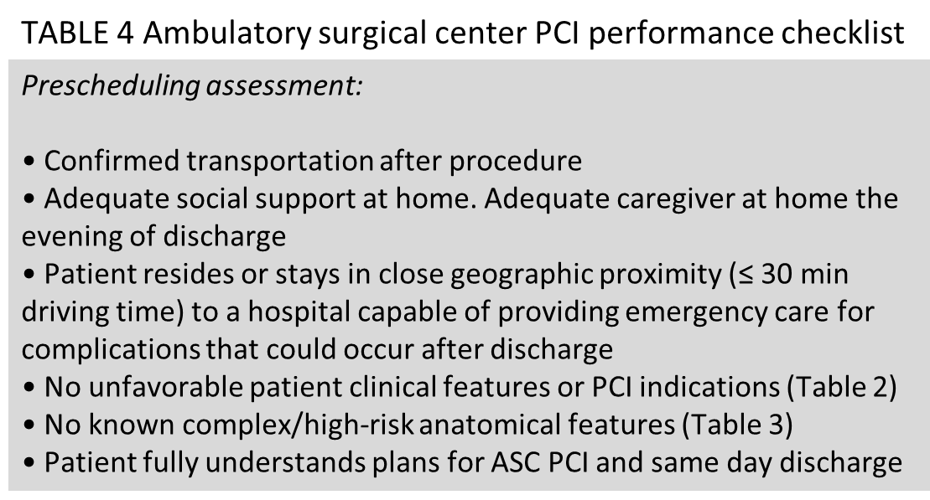
Social Support, Access to Follow-up Care, and Case Selection
Cathet Cardio Intervent, Volume: 96, Issue: 4, Pages: 862-870, First published: 14 May 2020, DOI: (10.1002/ccd.28991)

Slide 43
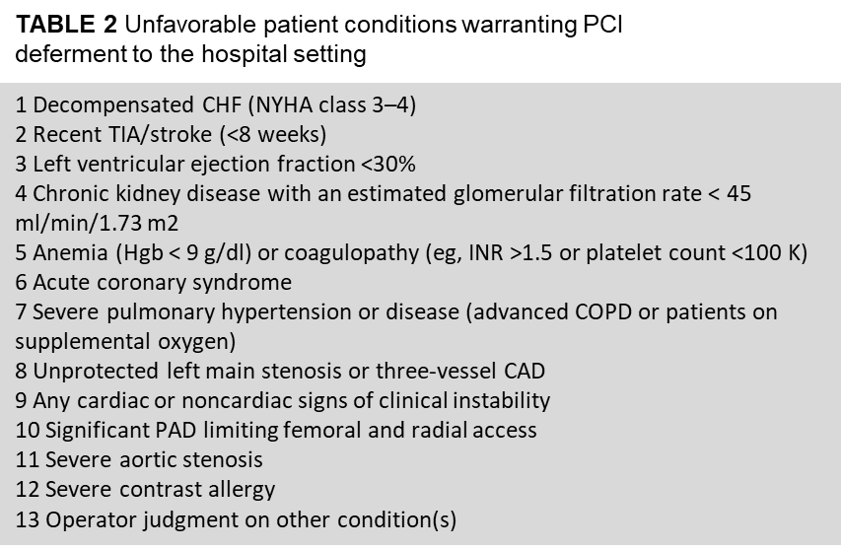
Unfavorable Patient Clinical Features
Cathet Cardio Intervent, Volume: 96, Issue: 4, Pages: 862-870, First published: 14 May 2020, DOI: (10.1002/ccd.28991)

Slide 44
Unfavorable Lesion Characteristics
TABLE 3 Complex or high-risk lesion characteristics warranting PCI deferment to the hospital setting
1 Bifurcation lesions with significant side branch involvement
2 Severe lesion calcification
3 Extremely angulated segment or excessive proximal tortuosity
4 Bypass graft lesions
5 Chronic total occlusions
6 Other vessel characteristics that the operator judges would
impede stent deployment
7 Thrombus in target vessel or lesion
8 Unprotected left main lesions
9 Last remaining conduit
10 Possible need for upfront mechanical circulatory support
Cathet Cardio Intervent, Volume: 96, Issue: 4, Pages: 862-870, First published: 14 May 2020, DOI: (10.1002/ccd.28991)

Slide 45
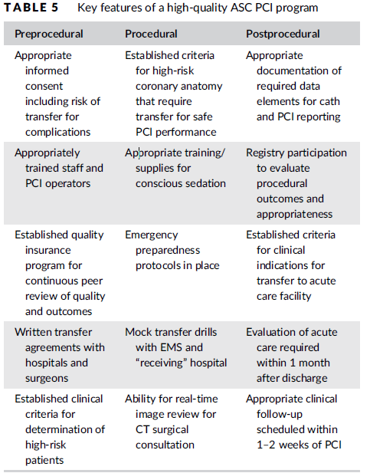
Facility Standards
Cath labs designed in accordance with industry standards and properly equipped for PCI including ability to address potentially catastrophic complications
Staff with appropriate training and credentialing
Transfer protocols for transport to a full-service cardiac hospital within 60-minute ground transport time

Slide 46
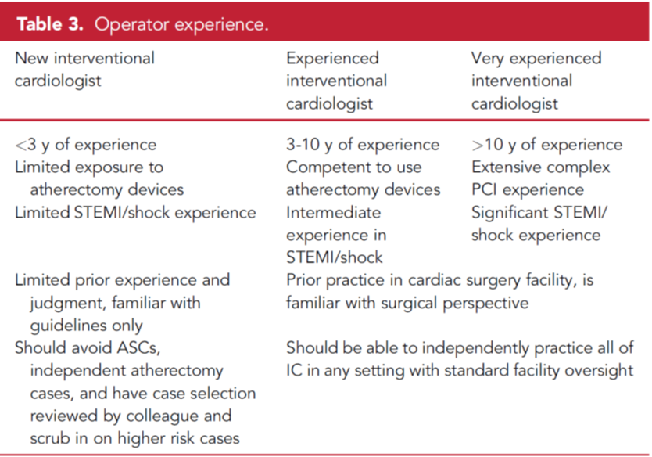
Operator Standards and Experience
Interventional cardiologist with substantial experience
Minimum annual volume of 50 PCI procedures per operator is strongly encouraged
https://www.jscai.org/article/S2772-9303(22)00600-7/fulltext

Slide 47
Quality Assurance Standards
“PCI in ASC site of service should be performed with the same expectations for quality as in the hospital. A quality program must be in place to evaluate procedure appropriateness, technical performance, and assurance of quality of care.”
Cathet Cardio Intervent, Volume: 96, Issue: 4, Pages: 862-870, First published: 14 May 2020, DOI: (10.1002/ccd.28991)

Slide 48
PCI Registry
“Participation in a PCI registry that is specifically designed or modified for the ASC setting will be necessary for ongoing quality assurance. …. Registry data should be used to monitor PCI operator and institutional volumes, outcomes and procedural appropriateness”
Cathet Cardio Intervent, Volume: 96, Issue: 4, Pages: 862-870, First published: 14 May 2020, DOI: (10.1002/ccd.28991)

Slide 49
Ethical Considerations
1. Remuneration should not be based on utilization and/or referrals. Neither the ASC, nor other investors, should provide loans to potential new physician investors.
2. Fee splitting is illegal. Payment by a physician to another physician/clinician for referrals should not occur.
3. A robust quality assurance and utilization review program should be implemented to monitor physician self-referral.
4. Referral to the ASC versus hospital should be determined by medical policy developed on evidence- or consensus-based principles.
5. Administrators/management should not pressure physician investors who select alternative sites for patients to receive care.
6. Policies should be developed that support the ability of physicians to care for patients more likely to experience disparities in care based on social demographics and/or insurance status.
Cathet Cardio Intervent, Volume: 96, Issue: 4, Pages: 862-870, First published: 14 May 2020, DOI: (10.1002/ccd.28991)

Slide 50
Current SCAI Position
Supportive of laws that allow the performance of PCI in ASC
Expectations for quality are the same as hospital setting
Safety equipment
Utilization of adjunctive technologies such as intracoronary imaging and physiology
Quality assurance program
Patient selection is important
Encourage the avoidance of high-risk patients/procedures in the ASC setting, emphasizing physician judgment
Journal of the Society for Cardiovascular Angiography & Interventions DOI: 0.1016/j.jscai.2022.100560

Slide 51
NYS Data Review
Kimberly S. Cozzens, MA
Director, Cardiac Services Program
Research Assistant Professor, Health Policy Management & Behavior
College of Integrated Health Sciences
University at Albany

Slide 52
Identifying Potential ASC PCI COHORT
NYS Percutaneous Coronary Interventions Reporting System (PCIRS) – clinical registry for PCIs performed in NYS
Audited for risk factor accuracy and completeness
Matched to NYS Vital Statistics for out-of-hospital mortality
Applied SCAI guidance to PCIRS data to estimate the cohort of patients that may be eligible for PCI in Ambulatory Surgery Centers
2020 SCAI Position Statement on the Performance of PCI in ASC
2023 SCAI Expert Consensus Statement on PCI without On-Site Surgical Back-up

Slide 53
Identifying Potential ASC PCI COHORT
The data that follows are based on draft recommendations being developed by the CAC Workgroup
Limitations
There are some SCAI criteria for which PCIRS data is not available
E.g. Severe Contrast Allergy
There are some SCAI criteria for which PCIRS data is an approximation
E.g. Stroke or Transient Ischemic Attack in the past 8 weeks
As recommendations are finalized, the numbers may change

Slide 54
Estimating PCI in ASC Cohort, DRAFT
Candidates: Patient for planned Cath/PCI |  |  | 2022 PCIRS Records
Exclusions per SCAI Guidance |  | PCIRS Data Element | # of patients (Start: 48,647) | # left
PCI w/out On-Site Surgery (2023) | PCI in ASC (2020)
Complex Comorbidity / Patient Condition
Not suitable for planned PCI | Any cardiac or noncardiac signs of clinical instability | Anoxic Brain Injury | 129 | 48,518
 |  | Refractory Shock | 381 | 48,137
 |  | Non-refractory Shock | 307 | 47,830
 |  | Cardiac Arrest | 442 | 47,388
 |  | Malignant Ventricular Arrhythmia | 200 | 47,188
Acute Coronary Syndrome | Acute Coronary Syndrome | Previous MI within 7 days* | 14,859 | 32,329
 |  | Unstable Angina | 17,403 | 14,926
*CAC is considering if this should be Myocardial Infarction (MI) within 30 days rather than 7.
Source: NYS Percutaneous Coronary Interventions Reporting System (PCIRS), 2022 Discharges, Draft

Slide 55
Estimating PCI in ASC Cohort, DRAFT
Candidates: Patient for planned Cath/PCI | 2022 PCIRS Records
Exclusions per SCAI Guidance (2020 and 2023) | # of patients start: 14,926 | # left
Complex Comorbidity or Patient Condition: Remaining Criteria E.g., Heart Failure, Valvular Heart Disease, High Risk of Blood Transfusion, History of Stroke, Contrast Allergy | 7,758 | 7,168
Complex or High-Risk Lesion Characteristics E.g., Chronic Total Occlusion, Degenerated Grafts, Thrombus, Calcification | 2,135 | 5,033
Source: NYS Percutaneous Coronary Interventions Reporting System (PCIRS), 2022 Discharges, Draft

Slide 56
Outcomes - Estimated ASC Cohort, DRAFT
Outcome | 2022 PCIRS
 | Number of patients | %
In-hospital Mortality | 0 | 0.00%
In-hospital/30-day Mortality | 5 | 0.10%
30-day Readmissions (N=4,348*) | 115 | 2.64%
-- Readmission for CABG | 2 | 0.04%
-- Readmission for PCI | 28 | 0.64%
Transfer
Discharged to Acute Care Facility | 3 | 0.06%
-- Hospital with SOS (N= 4303) | 3 | 0.06%
-- Hospital without SOS (N= 959) | 0 | 0.00%
Abbreviations: CABG: Coronary Artery Bypass Graft surgery, PCI: Percutaneous Coronary Intervention, SOS: Surgery on Site
Source: NYS Percutaneous Coronary Interventions Reporting System (PCIRS), 2022 Discharges, Draft

Slide 57
Outcomes - Estimated ASC Cohort, DRAFT
Outcome | 2022 PCIRS
 | Number of patients | %
Complications
Any Major Event* | 27 | 0.54%
---Bleeding at PCI Access Site | 8 | 0.16%
---Other Event at PCI Access Site | 5 | 0.10%
---Emergency Cardiac Surgery or PCI | 2 | 0.04%
*Major Events in PCIRS occur during or after PCI but before hospital discharge and include
the following: Stroke, Post-PCI MI, Acute Occlusion in Target Lesion or Significant Side Branch,
Renal Failure, Emergency Cardiac Surgery, Stent Thrombosis, Emergency PCI, Coronary Perforation,
Bleeding or Other Complication at the PCI Access Site .
Source: NYS Percutaneous Coronary Interventions Reporting System (PCIRS), 2022 Discharges, Draft

Slide 58
Outcomes at Hospitals With and Without On-Site Cardiac Surgery
Risk-adjustment models for PCI and Acute MI (heart attack) from the 2022 reporting cycles were used to test if being treated at a hospital with PCI without On-Site Cardiac Surgery was a significant predictor of mortality or readmission
Treatment at a hospital with PCI without On-Site Cardiac Surgery was not significant in any of the tested mortality models
Patients who received PCI at a hospital without on-site cardiac surgery were statistically more likely to be readmitted within 30-days than patients with all other significant risk factors the same who received PCI at a hospital with on-site cardiac surgery (p = 0.02; risk-adjusted odds ratio 1.11, 95% Confidence interval 1.02-1.21)

Slide 59
Outcomes at Hospitals With and Without On-Site Cardiac Surgery, Cont.
 | Hospital without SOS | Hospital with SOS | Total
N (%) | 9472 (22.2) | 33259 (77.8) | 42731
Observed Readmission (%) | 748 (7.90%) | 2442 (7.34%) | 3190 (7.47%)
-- Readmission for CABG | 7 (0.07%) | 54 (0.16%) | 61 (0.14%)
-- Readmission for PCI | 174 (1.84%) | 450 (1.35%) | 624 (1.46%)
Target Lesion PCI ⱡ | 59 (0.62%) | 154 (0.46%) | 213 (0.50%)
Readmission With AMI ⱡ | 29 (0.31%) | 66 (0.20%) | 95 (0.22)
No indication of staging ⱡ | 161 (1.70%) | 431 (1.30%) | 592 (1.39%)
-- Readmission other than PCI/CABG | 567 (5.99%) | 1938 (5.83%) | 2505 (5.86%)
Expected Readmission Rate | 7.36% | 7.49% | --
Risk-adjusted Readmission Rate (95% CI) | 8.01 (7.44-8.60) | 7.31 (7.03-7.61) | --

Slide 60
Outcomes at Hospitals With and Without On-Site Cardiac Surgery, Cont.
Caveats
This is not a full-scale study of outcomes at hospitals without On-Site Cardiac Surgery.
Other important markers of quality such as in-hospital complications, procedural success, and need for repeat procedures were not assessed.

