Slide 1

Experience with diagnostic cath and pci in an ambulatory site
Presentation to the NYS Department of Health
Health Planning Committee
Varinder Singh, MD
SVP, Cardiology, Western Region;
Chair, Cardiovascular Services, Lenox Hill Hospital
October 22, 2025

Slide 2
agenda
History of NGVH
Rationale for PCI Center at NGVH
Key factors in development
Results: Volume, quality
Lessons learned

Slide 3
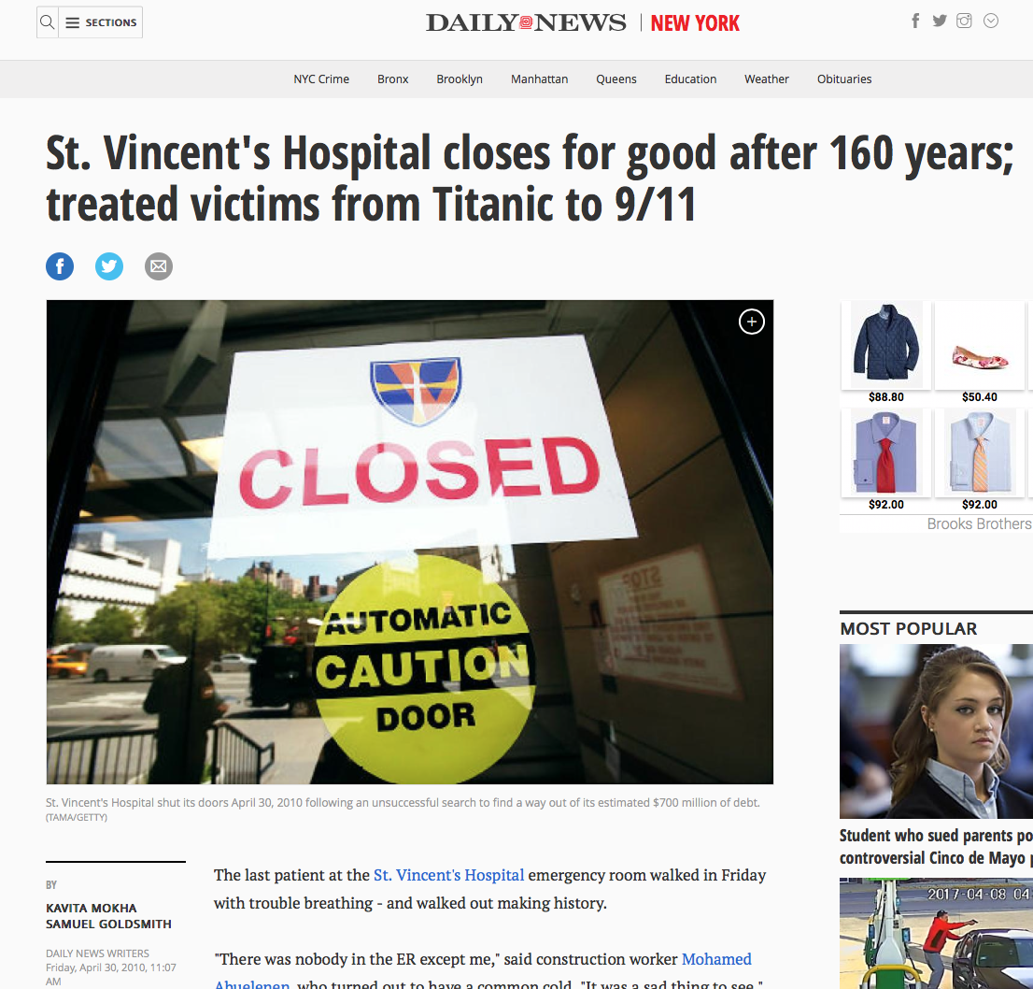
History of northwell Greenwich village hospital
2010 - St. Vincent’s Hospital closed
2014 - LHGV ED opened
2017 – Ambulatory Surgery ORs opened
2019 - Changes in PCI regulations provided opportunity to bring essential program back to the area
July 2025 – Cath lab opened (elective only)
Also in 2025 – Renamed NGVH
Nov 2025 – Go live for full STEMI coverage
Notes:
ED opened July 14, 2014. Projected 20,000 annual visits, now seeing over 40,000 visits annually.

Slide 4
Rationale for pci center at ngvh
Return advanced cardiac care to the community.
Allow all emergency PCI patients to receive treatment within 90 minutes.
When the cath lab opened Mount Sinai Beth Israel had closed, increasing the need for this service in the community.

Slide 5
Key factors in development
NHGV is an EXTENSION of the Lenox Hill program, not a stand-alone lab
Benefits from the quality oversight of a health system (PCI task force)
Cath lab functions as a fully self-sufficient lab
System-wide approach to training
Start with elective cases only
Patient selection criteria
Transfer process for patients requiring higher level of care - benefits from the quality initiative and oversight of a system (our PCI task force )
Target: 100% of patients reach door-to-balloon (DTB) time within 90 minutes

Slide 6
FOCUS ON PATIENT SAFETY
What we have
Existing Northwell protocols and procedures (available upon request)
Full service emergency department on site
General cardiology consults
8 bed inpatient unit
Cardiac CT
Patient selection for elective cases (next page)
What we don’t have
ICU – But we have a “ICU on Wheels” See transfer protocol (page 8)
Anesthesia daytime coverage

Slide 7
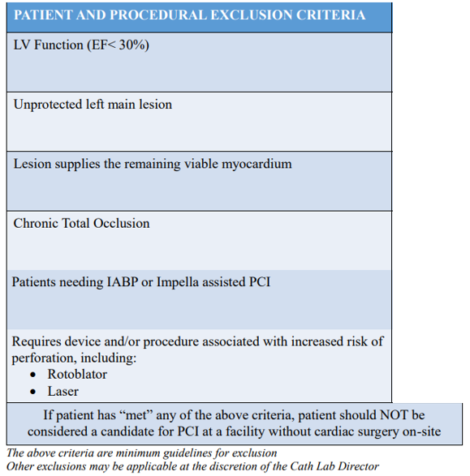
patient selection
Exclusions for ELECTIVE cases only.
We treat all-comers for acutes.

Slide 8
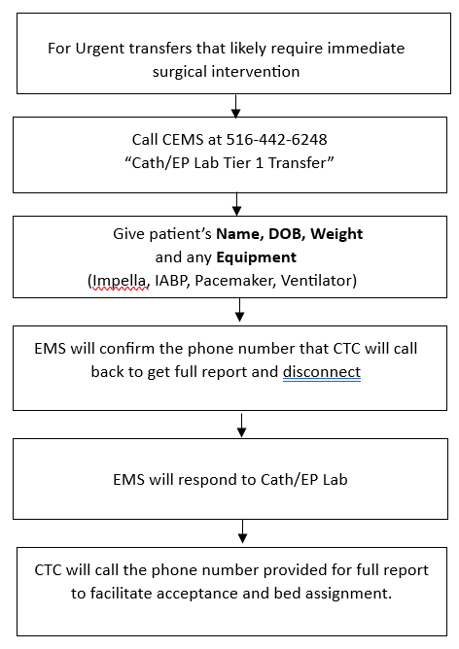
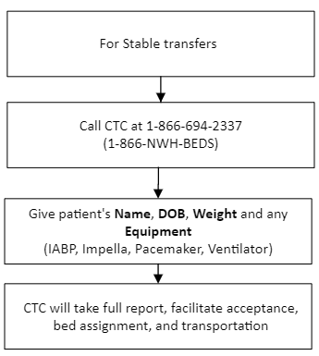
TRANSFER PROTOCOL
Every morning notify CEMS for Standby for cases at:
1-516-719-5040 Prompt # 3
Created unique transfer protocol for NHGV
Separate protocol from community hospital
No ICU to watch patient while ambulance arrives
Every transfer has EMS arrive before the case is finished

Slide 9
NHGV Cath Lab Data (August-October 2025)

Slide 10
Patient Demographics | Overall (n=163)
Age (Years) | 69 + 10
Gender: Male | 67% (109)
Presenting Disposition Outpatient Emergency Room | 96% (157) 4% (6)
Preprocedural Imaging Positive CCTA ---CT-FFR Positive Stress Test | 25% (41) ---27% (11) 58% (94)
NHGV Cath Lab Data
(August-October 2025)
Procedural Outcomes | Overall (n=163)
Post Procedure Disposition Discharge home Transfer to Lenox Hill Hospital CABG Eval Complex PCI | 96% (157) 4% (6) 33% (2/6) 67% (4/6)
Complications Dissection Thrombus Perforation Tamponade BARC Bleeding (3-5) | 0% (0) 0% (0) 1% (1/93) 0% (0) 0% (0)
30 Day Outcomes MACE Revascularization Death Stroke | 0% (0)
CABG Referral | 4% (6/163)
Total Staged PCI | 49% (46/93)
Staged at Main Hospital | 20% (9/46)
Procedural Characteristics | Overall (n=163)
Access Site Right Radial Left Radial Left Ulnar Right Ulnar Conversion to Femoral | 89% (145) 5% (8) 0.6% (1) 5% (8) 1.2% (2)
Procedure Diagnostic Cath Perc Coronary Intervention Right Heart Catheterization Diagnostic Peripheral Intervention Peripheral | 41% (67) 58% (93) 2% (3) 1% (2) 0.6% (1)
Intravascular Imaging IVUS OCT | 100% (93) 17% (16) 83% (77)
Procedure Time (mins) Average | 51 minutes

Slide 11
Lessons learned
Diagnostic caths and interventions can safely be done in a non-hospital site
Integration with a health system is essential
      Quality oversight
      Training
      Backup

