Slide 1
THE OFFICE OF LOCAL HEALTH SERVICES – Reorganization
Mark Waldenmaier
(He/him/his)
Director
Office of Local Health Services (OLHS)
Public Health and Health Planning Council – Public Health Committee – February 18th, 2026

Slide 2
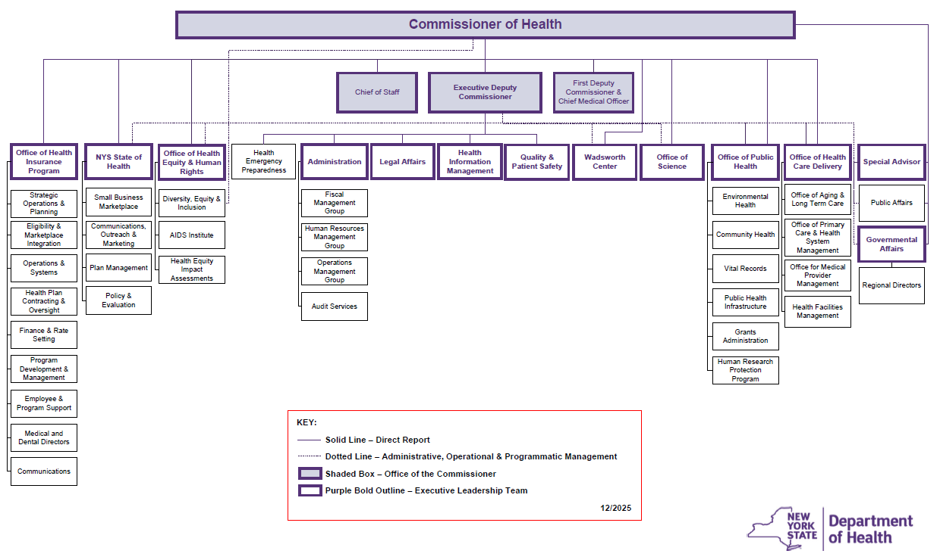
New York State Department of Health
Office of Public Health as one of key major units within the New York State Department of Health
https://www.health.ny.gov/about/docs/org_chart.pdf

Slide 3
New York State Department of Health
Movement of other major offices/centers, but maintained collaboration

Slide 4
New York State Department of Health
Transformation of Public Health Practice to Public Health Infrastructure

Slide 5
New Division of Public Health Infrastructure
Public Health Corps Fellowship Program
Public Health Continuing Education Unit
Public Health Infrastructure Grant Management
Division of Public Health Infrastructure
Office of Public Health Practice
Community Engagement & Outreach Unit
Health, Wealth, & Well-being Unit
Office of Local Health Services

Slide 6
Office of Local Health Services
Article 6 – State Aid
Annual State Aid Survey
Article 6 Reimbursement
Article 6 Performance Incentives
Prevention Agenda
State level planning and implementation
Local Level planning guidance and assistance
Other Prevention Agenda Activities (Dashboard, Communications, etc.)
Other Local or State Health Activities
Public Health & Health Planning Council (PHHPC)
New York State Association of County Health Officials (NYSACHO)
Public Health Accreditation Board (PHAB)

Slide 7
Prevention Agenda Across the Department
Office of Public Health
Elizabeth Whalen, MD, MPH, DipABLM, Medical Director
Division of Public Health Infrastructure
Keshana Owens-Cody, HRM, HPE, Director
Office of Local Health Services
Mark Waldenmaier, Director
Prevention Agenda Team
Zahra Alaali, Prevention Agenda Coordinator

Slide 8
Questions?
Mark.Waldenmaier@health.ny.gov

Slide 10
2025 END OF YEAR SUMMARY NEW YORK STATE PREVENTION AGENDA​
Elizabeth Whalen MD,MPH,DipABLM
(she/her/hers)
Medical Director
Office of Public Health
Mark Waldenmaier
(he/him/his)
Director
Office of Local Health Services
Public Health and Health Planning Council – Public Health Committee – February 18th, 2026

Slide 11



Prevention Agenda Status
State Health Assessment (SHA)
Local & Regional Level Implementation Activities
State Level Implementation Activities

Slide 12
Prevention Agenda Timeline 2025-2026
State Health Improvement Plan (SHIP) Approved
State Health Assessment (SHA) Approved
Office of Health Equity& Human Rights (OHEHR) Interagency Task Force
Refresh of the Ad Hoc Committee Membership
July
September
October
November
December
June 2026
December 2026
2025
2026
Technical Assistance Webinar for Local Health Departments & Hospitals (n=375/201)
Community Health Assessment (CHA) due for Local Health Departments
Community Health Needs Assessment (CHNA) & Community Service Plan (CSP) for Hospitals
Community Health Improvement Plan (CHIP) due for Local Health Departments
Annual Progress Report

Slide 13
State Health Assessment
(SHA)

Slide 14
OVERVIEW OF THE STATE HEALTH ASSESSMENT
Followed national Association of State and Territorial Health Officials (ASTHO) Model
Ensured meeting of Public Health Accreditation Board (PHAB) requirements
The State Health Assessment process identifies & describes:
• The health of the population and areas for health improvement
• Contributing factors that affect health outcomes
• Existing state assets and resources that can be used to address health needs

Slide 15
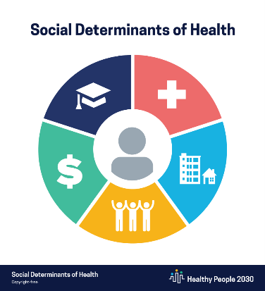
DESCRIPTION OF POPULATIONS
Demographic intersectionality on Social Determinants of Health
Also includes Key Risk Factors and Outcome Measures
Progress from prior Prevention Cycle 2019-2024
Healthcare Access & Quality
Education Access & Quality
Economic Stability
Neighborhood
& Built Environment
Social & Community Context

Slide 16


FINDINGS OF THE STATE HEALTH ASSESSMENT
Aging and Diverse Population.
Life expectancy has declined due to serious health threats, such as COVID-19 and the opioid crisis.
Chronic diseases, including cancers and asthma, continue to be a major burden.
Access to health care in New York State has improved, many individuals still face barriers.
Significant disparities in health outcomes and social determinants of health across racial and ethnic categories, education levels, and income levels.

Slide 17


FINDINGS OF THE STATE HEALTH ASSESSMENT
Lack of social associations, disconnected youth, and single-parent households may contribute to poor mental and physical health.
Obesity, smoking, and lack of physical activity negatively impact people’s health.
Teen pregnancy has declined and breastfeeding rates have improved, but infant and maternal health disparities remain.
Progress in ending acquired immunodeficiency syndrome (AIDS) but still have relatively high rates of sexually transmitted infections (STIs).

Slide 18
PROCESS OF THE STATE HEALTH ASSESSMENT
Collecting and analyzing data
Identifying and describing key issues
Setting priorities and collecting partner feedback
Selecting core indicators that represent the selected priorities
Documenting findings in collaboration with contributors
Sharing the State Health Assessment report with the public
State-level Implementation Plans for 2026
Posted on Health Department website October 22nd, 2025

Slide 19
Questions/Comments?
State Health Assessment (SHA)

Slide 20
Implementation Activities – Local/Regional

Slide 21
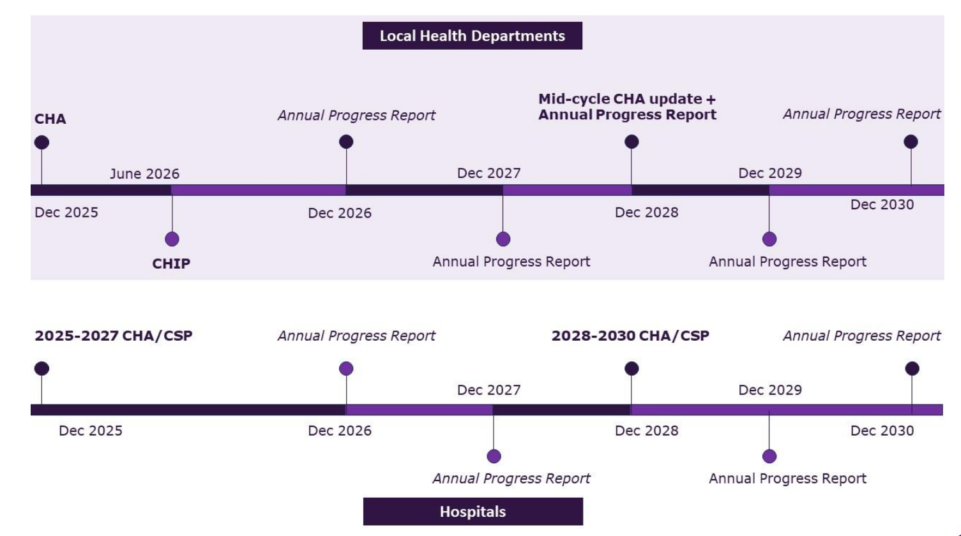
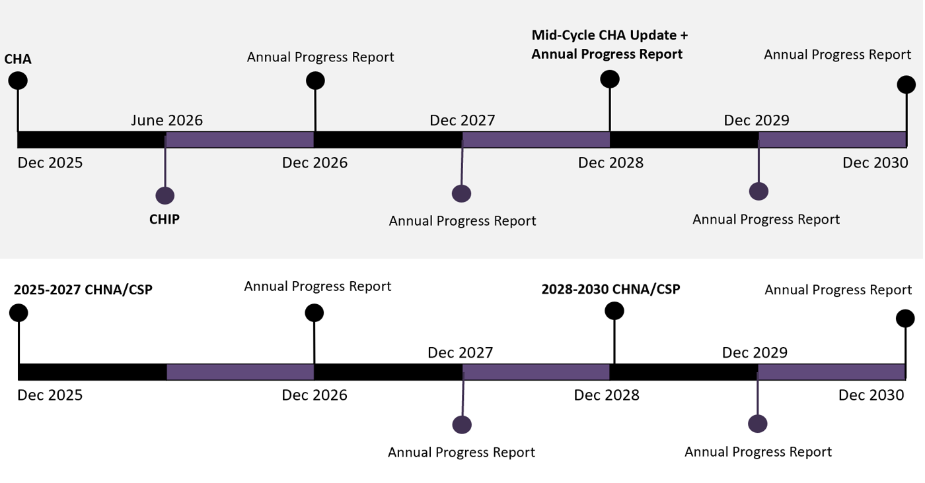
COMMUNITY PLANNING SUBMISSION TIMELINE
Local Health Departments
Hospitals

Slide 22
2022-2024 Local Planning Summary
112 Plans
111 Hospitals/ Systems
58
Local Health Departments
15 Local Health Department Only Community Health Improvement Plans (CHIPS)
38 Joint Plans
59 Hospital Only Community Service Plans (CSPs)
Notes:
43 LHD
& 74 Hospitals
list of counties (n=5) without a hospital
Greene County
Hamilton County
Seneca County
Tioga County
Washington County

Slide 23
2026 to date Local Planning Summary
28 Joint Plans
34 Local Health Departments
70 Hospitals
Single Plans:
23 LHDs & 120 Hospitals
Further Analysis will be completed in Summer/Fall 2026
Notes:
As of February 1st, 2026
NOTE WE ARE NOT CONSOLIDATING INTO SYSTEMS AS WE DID IN PRIOR SLIDE FOR THIS SUMMARY
3 LHDs were allowed extensions
62% of LHDs already submitted both CHA and CHIP!!!!
Decrease of 10 joint plans from prior cycle – LHD to Hospital cycle alignment issue

Slide 24


2025 RESOURCES
Technical Assistance Webinar
https://www.health.ny.gov/prevention/prevention_agenda/2025-2030/health_planning.htm
Local Health Department (LHD) Health Equity Contract
Focus: Supporting implementation of the 2025–2030 Prevention Agenda
~375⁺ Live attendees
~200⁺ Views of recorded session (as of November 18th, 2025)
Focus: Technical assistance and capacity building
State-wide effort to support partnerships, health equity incorporation, and implementation
Contract for June–November 2026

Slide 25
Questions/Comments?
Local Implementation

Slide 26
Implementation Activities – State

Slide 27




Implementation​
Community Health Improvement
Certificate of Need (CON) ​Applications
Hospitals’ Community Benefit Spending
Interagency Collaboration
Align Local Health Department & Hospital planning efforts with Prevention Agenda priorities
Not-for-profit hospitals information on how projects address Prevention Agenda priorities and objectives
Non-profit hospitals receive tax exemptions in exchange for reinvesting those funds into community
Cross-sector collaboration to identify actions and investments by other state and community partners

Slide 28
Leadership
Commissioner & Office of Public Health
Public Health Committee
Hospitals
CSP Liaison Listserv (~120)
https://www.health.ny.gov/prevention/prevention_agenda/hosp.htm
Local Health Departments
CHIP Liaison Listserv (~97)
https://www.health.ny.gov/prevention/prevention_agenda/contact_list.htm
Partners of the Prevention Agenda
State / Regional Collaborators
https://www.health.ny.gov/prevention/prevention_agenda/2025-2030/partnerships.htm
Public Health Contractors
~8,100+ Programs https://dashboard.health.ny.gov/t/PHIG_Public/views/Contractordashboard
Community Based Organizations (CBOs)
Notes:
Public Health Contractors – Contracts & Services specific to topic and county, “List of Resources” as required in SHA/PHAB, etc.
Office of Science typically updates every 2-3 years working across DOH Programs to identify

Slide 29
Prevention Agenda for General Audiences
Implementation Activities - State

Slide 30
PREVENTION AGENDA 101
Development of “101” Modular Training for Website
General Public Understanding of Prevention Agenda
“Entry Point” for New Partners
Development of Prevention Agenda Fact Sheet
General Public Understanding of Prevention Agenda
Translation into 12 top languages of New York
Spanish | Chinese | Russian | Yiddish
Bangla | Korean | Haitian Creole | Italian
Arabic | Polish | French | Urdu
Notes:
Languages for NYS based on OGS web page, and US Census 2020 American Community Survey 5 year estimate

Slide 31
Local/ Community Partners Connections
Partner Identification Method
Connected with Local Health Department/Hospital in their community
https://www.health.ny.gov/prevention/prevention_agenda/2025-2030/partnerships.htm
Self-sign up for Prevention Agenda Listserv (Prevention-L)
https://www.health.ny.gov/prevention/prevention_agenda/2025-2030/contact.htm
Prevention Agenda Frequently Asked Questions
https://www.health.ny.gov/prevention/prevention_agenda/2025-2030/faqs.htm
Prevention Agenda “101” Overviews and Fact Sheet
TBD
Partner Recommendation
Local Health Department/Hospital
Current Prevention Agenda Collaborator
Associations
Ad Hoc Committee
Interagency Groups
Prevention
@health.ny.gov
NYSDOH Website
Notes:
What’s the point of these general information/educational tools – to connect more partners to the planning and implementation effort

Slide 32
Interagency Collaboration
Implementation Activities - State

Slide 33
INTERAGENCY TASKFORCE
Briefing of Prevention Agenda on November 4th, 2025 to the Office of Health Equity and Human Rights (OHEHR) Interagency Taskforce
Taskforce composed of 20+ Diversity, Equity, and Inclusion Officers of State Agencies
Health Equity one of foundations of the Prevention Agenda
Review of Plans, Dashboard, and Next Steps
Meeting also indicated dissolve of Task Force → Participation and Activities will transfer to the New York State Workforce Diversity and Inclusion Advisory Council/Committee.
Notes:
So sorry – last week turned into one of those weeks.
In response to your questions:
At the last meeting we had roughly 12 agencies represented. I believe we were missing our colleagues from NYSOFA unless I missed a name.
The group that we are shifting focus to is the: Workforce Diversity and Inclusion Advisory Council comprised of Diversity and Inclusion Liaisons in the different State Agencies.
Let me know if there is anything else I can assist with! Best, Kacey

Slide 34
2026 WORKGROUP DEVELOPMENT
Updating of Ad Hoc Membership list – new & re-invites
Focus on state-wide non-profits, professional associations, and advocacy groups whose goals are align with the Prevention Agenda
Analysis of state agency partners existing activities and groups which support Prevention Agenda
Identified State Agencies for Workgroup
NYS Office for the Aging (NYSOFA)
NYS Office of Addiction Services and Supports (OASAS)
Department of Financial Services (DFS)
NYS Office of Children & Family Services (OCFS)
NYS Department of Education (SED)
NYS Department of Labor (DOL)
NYS Office for People with Developmental Disabilities (OPWDD)
NYS Office of Mental Health (OMH)
NYS Department of Veterans' Services
Office of Temporary & Disability Assistance (OTDA)
Department of State (DOS)
Department of Agriculture & Markets
State/City University of New York (SUNY/CUNY)
Department of Parks & Recreation

Slide 35
Questions/Comments?
State Implementation

Slide 36
Questions?
Elizabeth.Whalen@health.ny.gov Mark.Waldenmaier@health.ny.gov prevention@health.ny.gov

Slide 37
Public Health Committee Meetings in 2026
Mark Waldenmaier
(He/him/his)
Director
Office of Local Health Services
Public Health and Health Planning Council – Public Health Committee – February 18th, 2026

Slide 38
2026 Meeting Schedule
Each meeting will be day prior to the Full Council Meeting
For questions about the meetings, please reach out to Colleen Leonard, Colleen.Leonard@health.ny.gov
Public Health Committee Meeting Date | Time | Location
February 18th, 2026 | 1:00-3:00 pm | Albany
March TBD --- Ad Hoc Committee | TBD (afternoon) | Albany
May 6th, 2026 | 1:00-3:00 pm | Albany
June 23rd, 2026 | 1:00-3:00 pm | NYC
September 16th, 2026 | 1:00-3:00 pm | Albany
December 16th, 2026 | 1:00-3:00 pm | NYC

