Slide 1
Person-Centered Service Planning
Home and Community-Based Services
Final Rule Implementation
Presented by: Center For Long Term Care Finance and Supports Policy Bureau
Karen Meier, Angela Davis, and Jennifer Alhart
July 2023

Slide 2
Agenda
Person-Centered Service Planning (PCSP) in Context – Goal of HCBS Final Rule, Applicability
What’s new with PCSP?
Summary of PCSP Requirements
Overview of Roles and Responsibilities in PCSP Process and new Template
PCSP & Settings
Role of PCSP in Ongoing Monitoring and Quality Assurance
Notes:
Person Centered Service Planning isn’t new. Everyone listening to this webinar has an idea of what person centered planning is and believes that they or their organization is doing it and has been doing it for years. The Home and Community Based Services Final Rule published by CMS in 2014 and many other regulations and guidance documents published since lean heavily on the importance of robust person centered service planning to ensure that services are delivered in a manner that gives the recipients the power to direct those services to advance their strengths, preferences and goals in meeting their needs to be as independent as possible and as integrated into the greater community as they desire. We’ve come a long way in offering home and community based services. This focus is to make sure that we don’t just provide services in recipients’ homes rather than in an institution, but that they can realize the full benefit of being in the community.
Now that the rule has been out there for over eight years, CMS is very serious about monitoring how states are complying with the requirements. Remember the rule went into effect immediately for all but two aspects: settings and modifications in provider owned and controlled settings. So, while we’ve updated our contracts and sent out guidance and messaged to plans, districts and providers that there are more robust person-centered service plan requirements, we’re here today to make sure those guidance materials are clear, that the revised template is required at least in content, and that it is a key tool the state will be using in many contexts to monitor ongoing compliance and Quality Assurance.

Slide 3
 | Institutional Care | Managed Care | Integrative Supports | Community Supports
Organizing Principle | System Centered Based on Targeted Population | Coordinated Services and Outcome Centered based on targeted population | Person-Centered – Based on unique qualities of each Individual | Citizen/community centered Based on the individual rights and for the betterment of community
Individual-Professional Relationship | Expert-Patient. Professional directed & power over | Provider-Consumer Professional responds to consumer need & power- over | Facilitator/Broker-self-directed individual (individual designs with others & power shared. | Resource-Autonomous Citizen. Community supporting with professional auxiliary & power collective.
Individual-Service Experience | Functionally specific and pre-set services & programs based assessed deficiencies. Push-Model Driven | Habilitation pathways or treatment protocols determined by clinical assessments. Coordinated care – pull driven. | Individualized supports, circles of support, peer-supported, wrap-around services. Person driven- supports negotiated. | Self or co-directed. Home & community located Community-driven (allocation).
Organizational Culture, Coordination Mechanism – How Power Shows Up | .Bureaucratic or paternalistic culture Hierarchy, command & control | Rules-based, clinically dominated culture. Managed care entities & care management | Affiliation, appreciation -based culture. Network, facilitated dialog & mutual adaptation (person-centered planning) | Inclusive, diverse culture. Seeing from the whole – through a process of collective sense making & innovation cycles
Outcomes for Individuals | Placement. Personal Care, face to face service Activity & supervised housing | Appropriate service levels. Reduced service costs Consumer satisfaction | Individualized supports leading to own home, relationships & meaningful activity | Citizenship, full inclusion & participation in the community in typical settings Life of distinction (assumption of valued roles

Slide 4
Goal of HCBS Final Rule: What matters to me; not what matters for me
The HCBS Settings Rule was created to ensure that every person receiving Medicaid-funded HCBS has full access to the benefits of community living.
Provides freedom to make choices and to control the decisions that impact their lives, including controlling personal resources; being treated with privacy, dignity, respect, and freedom from coercion and restraint.
Includes, even when living and/or receiving services in provider owned or controlled settings, deciding what and when to eat; having visitors; being able to lock doors; and having the protections of a lease or other legally enforceable agreement.
The rule requires a person-centered process for receipt of HCBS, which means that the individuals receiving services direct the planning process and the plan reflects their own preferences and goals they have set for themselves.
July 2023

Slide 5
HCBS Final Rule and Managed Care
Requirement to conduct Person-Centered Planning are included throughout the relevant sections of the Medicaid Managed Care Model Contracts, including but not limited to:
Medicaid Managed Care/HIV Special Needs Plan/ Health And Recovery Plan Model Contract: Section 10.35; Appendix S
Managed Long Term Care Partial Capitation Contract: Article V, Section J
Medicaid Advantage Plus (MAP): Section 10.13
Covered Services which are classified as HCBS include:
LTSS – personal care, consumer directed personal assistance services, ADHC, Long-term Home health care, private duty nursing
MLTC benefits: SADC, Home delivered meals, environmental modification
Children’s HCBS – community habilitation, day habilitation, prevocational services, supported employment, planned and crisis respite, adaptive and assistive equipment, environmental modifications, vehicle modifications, caregiver/family supports, community self advocacy training and supports, non-medical transportation, palliative care (express therapy, pain and symptom management, bereavement service, massage therapy).
BH HCBS (HARP) – habilitation, educational support services, pre-vocational services, transitional employment, intensive supported employment support, ongoing supported employment support, non-medical transportation
Notes:
https://www.health.ny.gov/health_care/medicaid/program/medicaid_health_homes/hh_children/overview_services_available_hcbs_and_ei.htm
chrome-extension://efaidnbmnnnibpcajpcglclefindmkaj/https://www.health.ny.gov/health_care/medicaid/program/medicaid_health_homes/special_populations/docs/adult_bh_hcbs_workflow_2022.pdf

Slide 6
The Person Comes First in Person Centered Planning
Person-Centered Thinking is a way of thinking that helps create the means and resources for a person to live a life that they value.
Person-Centered Planning is a way to assist people needing HCBS services and supports to construct and describe what they want and need to bring purpose and meaning to their life.
Person-Centered Practice is the alignment of service resources that give people access to the full benefits of community living and ensure they receive services in a way that may help them achieve individual goals.

Slide 7
PCSP Process
Authorizers of HCBS (Medicaid Managed Care (MMC) and MLTC Plans and Local Districts of Social Services (LDSS), Regional Resource Development Centers (RRDCs), or Health Homes (HH)) must:
Provide all information and support to make sure the person directs the process whenever possible
Include people chosen by the person receiving services and their representative in the planning process
Make sure the person can make informed decisions about their life and goals
Ensure a timely and convenient process, including a convenient location for the person
Reflect cultural considerations and be in a language suitable to the person, and
Offer the person choices about their services and from whom they receive them

Slide 8
PCSP Process, Continued
Authorizers must also:
Ensure the person-centered service plan (PCSP) is written and updated as needed (whenever there is a significant change in condition, upon reassessment interval, or upon request by individual)
Include a method for the person to request changes to the PCSP
Ensure the process includes strategies for resolving conflict
Record the alternative HCBS settings that were considered by the person
Ensure the PCSP is finalized and signed upon agreement
Ensure the finalized PCSP is distributed to any persons involved, including the individual served and service providers, and redistributed whenever changes are made
Notes:
We suggested the MLTC plan complete the HIPAA form so they can share it with the SADC.

Slide 9
PCSPs Must Identify:
Strengths
Preferences
Needs (Clinical and Supportive)
Desired Outcomes/Goals

Slide 10
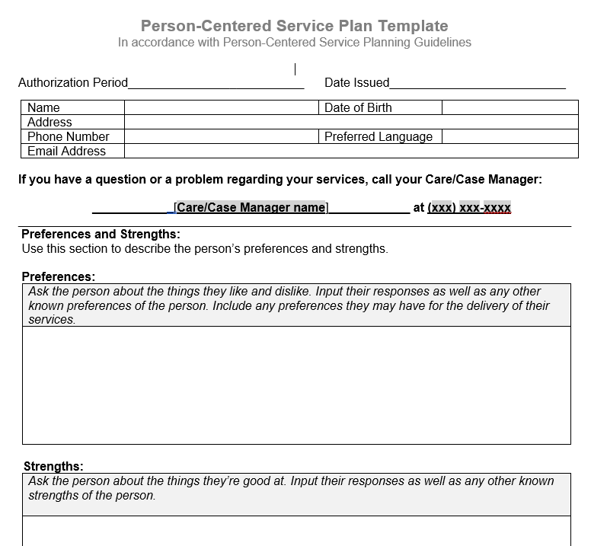
Differences In Plan Templates

Slide 11
Roles & Responsibilities
MMCO (“plans”) and LDSS (“districts”) are responsible for ensuring that the primary PCSP is developed and maintained, and services are authorized accordingly.
There is also an expectation that plans and districts coordinate with service providers to ensure that the PCSP remains up-to-date and comprehensively documents the individual’s experience.
It is expected that the MMCO Care Manager will coordinate with the HH Care Manager to ensure that one comprehensive PCSP is completed, and authorization of services is not delayed due to administrative barriers.
The respective roles of the MMCO and the HH must also be formalized by entering into a Statewide Administrative Health Home Services Agreement (ASA) using the template that has been developed by the Department.

Slide 12
PCSP and Settings
Notes:
One of the reasons we released revised guidance and the template is because the State’s transition period under the HCBS rule to ensue that settings in which people in receipt of HCBS live and/or receive services comply with the standards outlined in the rule is over. As of March 17, 2023 all such settings must be compliant unless they are covered by a Statewide Corrective Action Plan approved by CMS. The CAP applies to very few settings, specifically Adult Day Health Care, Social Adult Day Care, Adult Care Facilities and certain programs authorized by the Office for People with Development Disabilities (OPWDD). In New York, we use the PCSP to make sure that all the standards are met and that any modification to the additional standards which we will talk about, that may be appropriate for specific individuals in specific situations are documented. This is also a primary tool in monitoring ongoing compliance and quality assurance.

Slide 13
Settings are:
Where someone in receipt of Medicaid-funded HCBS lives, even if the services received only occur outside of the home
Where someone receives HCBS in the community, such as an Adult Day Health Care Program or Social Adult Day Care (for MLTC enrollees)
Community locations such as a park, library or commercial for-profit or not-for-profit space where HCBS may be provided
Sometimes owned or controlled by a provider, which may be obvious, such as a certified setting operated by an OPWDD provider or less obvious where the landlord of the supported housing unit the HCBS recipient lives in controls who provides HCBS in the building
Provider owned or controlled settings have additional standards that must be met to comply with the HCBS Final Rule
July 2023

Slide 14
Five Inalienable Standards For All Settings
HCBS recipients must both live and receive services in settings that:
Are integrated in and support full access to the greater community; and selected by the individual from among options
Ensure an individual’s rights of privacy, dignity and respect
Assure freedom from coercion and restraint
Optimize autonomy and independence in making life choices
Facilitate choice about services and who provides them

Slide 15
Additional standards for residential settings that are provider owned or controlled
Individuals in residential units have legally enforceable agreements giving them the same protections and responsibilities as any tenant living in that jurisdiction
Privacy in sleeping or living unit
Units have lockable entrance doors
The individual and appropriate staff have keys/codes to doors
Choice of roommates in shared units
Freedom to furnish and decorate sleeping or living units

Slide 16
Additional Standards For Residential And Non-Residential Settings (Provider-Owned or Controlled)
Freedom and support to control one’s own schedule and activities
Community Integration and Corrective Action Plan (CAP)
Access to food and visitors at any time
The setting is physically accessible to the individual (*not modifiable)
July 2023
Notes:
Exactly a provider owned setting means that the provider can select who can live there based on admission/retention standards, like an ACF or a certified setting owned by an OPWDD provider. A provider controlled setting may not be as obvious but the landlord controls who can provide services in the setting (contractually or otherwise).

Slide 17
Person Centered Service Plan and Settings
Notes:
Speak to ensuring that people appreciate the rights they have. . .
Applies to private homes, as well
As with assessments, the expectation is that a conversation is held between the care manager and the participant and details about their living arrangement are shared. This may take place in an interview like context in which the care manager asks where the person lives, if they are happy with this option, if they feel they can do what they like to do in their home, come and go as they please, see who they want when they want to, etc. . .

Slide 18
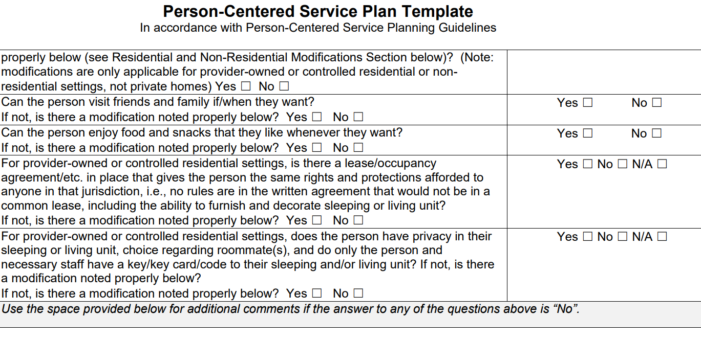
Person Centered Service Plan and Settings, continued
Notes:
Speak to ensuring that people appreciate the rights they have. . .

Slide 19
Modifications to Person-Centered Plans
Any modification to the standards on slides 15 and 16 must be:
Supported by a specific assessed need
Justified in the PCSP and must:
Follow positive interventions and supports used prior to any modifications
Use less intrusive methods of meeting the need that were tried and did not work
Come with a clear description of the condition that is directly proportionate to the specified need

Slide 20
Modifying A PCSP On A Case-by-Case Basis
Modifications to the additional standards must be:
Directed by and with the informed consent of the individual being supported
Subject to regular collection and review of data measuring the ongoing effectiveness of the intervention(s) used
Reviewed periodically within defined time limits to determine if the modification is still necessary
Developed to assure that interventions and supports will cause no harm

Slide 21
Modification Example
Jaime requires assistance with managing access to snack foods due to their tendency to eat frequently, which raises Jaime's blood sugar levels. ADHC or SADC staff tried counseling Jaime but were not successful. With Jaime’s informed consent (or that of Jamie’s representative) staff will support Jaime with accessing the snack cabinet for at least the next 6 months and will document this information in Jaime’s PCSP to make sure that it is working well. The modification will be reviewed periodically to determine if it is still needed.
Notes:
Supported by a specific assessed need: Jaime has trouble keeping her blood sugar under control which leads to difficulties managing her diabetes.
Justified in the PCSP and must:
Follow positive interventions and supports used prior to any modifications Staff tried counseling Jaime about smarter snack choices
Use less intrusive methods of meeting the need that were tried and did not work Staff helped Jaime find appropriate snacks
Come with a clear description of the condition that is directly proportionate to the specified need Rather than prohibiting snacks, Jaime was able to make smarter choices with staff assistance

Slide 22
Modifications Can Be Used When An HCBS Recipient:
Lives in a provider-owned or controlled setting, e.g., group homes and select supportive housing units that have house rules and are not run like private homes
Receives services in a setting that is provider-owned or controlled, where their ability to control their own schedule, activities, or access to food or visitors may need to be modified to better support them, e.g., Adult Day Health Care Program, Social Adult Day Care, Structured Day
When a member lives 24 hours a day with an unrelated paid caregiver receiving HCBS funding (these are provider-owned or controlled settings under the Rule)

Slide 23
Modifications Cannot Be Used In Private Homes
People living in private homes are presumed to have more control over their food, visitors, activities and when they come and go. Modifications should not be necessary in these environments.
However, when PCSP are developed, maintained and monitored; and when reviewing PCSP during routine or focused surveillance activities, plan, district or state staff should ensure that HCBS recipients living in private homes realize the inalienable rights required in all appropriate settings, as well as this kind of control of their environment.

Slide 24
Person-Centered Service Plan and Modifications
Person-Centered Service Plan Template
In accordance with Person-Centered Service Planning Guidelines
Residential and Non-Residential Modifications (applies when a HCBS provider owns or controls the Residential or Non-Residential setting):
Fill out these boxes for special populations receiving HCB services under 42 CFR 441 Subparts G, K, or self-directed 1905(a) State plan services, including the Consumer Directed Personal Assistance Program (CDPAP). Such residential modifications described here may relate to a change in status of written, legal agreements to live in the current setting; privacy; sleeping/living unit having lockable entrance doors with only the person and appropriate staff keeping keys; choice of roommate(s); freedom to furnish/decorate within legal agreements; and for both residential and non-residential settings, control of schedules, activities, and access to food at all times; or the ability to receive visitors of the person’s choosing at any time. [Duplicate modifications box if needed for multiple modifications]. ☐ I, ______________________, understand the information below and agree to the use of the modification(s) required to address my assessed risks and needs. I know that I can change my mind and will tell my Care/Case Manager if I do.
Modification:
Specific Individualized Assessed Need (Note: a diagnosed disability is not a specific assessed need):
Positive Interventions and Supports used Before this Modification:
Diagnosis/Condition Related to the Modification:
Method for Collection and Review of Data for Effectiveness:
Timeframes/Limits for Review and Determination of Need for Modification:
Assurance that the Modification Will Cause No Harm:
Notes:
Note page number and included features

Slide 25
PCSP Follows The Person
The revised template focuses more specifically on the person and includes all the required standards/modifications. Strengths and Preferences are addressed first, allowing the person to talk about themselves, and build a trusting, meaningful relationship with the Care Manager.
The template must be written, and easily accessible and understandable to all of those involved in the PCSP.
The person and representative must receive a copy of the signed PCSP.
Ideally, the document will be updated with notes from the all service providers involved in carrying it out. This will ensure that all parties are aware of modifications to the additional standards and that documentation is maintained for ongoing monitoring and quality assurance.

Slide 26
PCSP and Private Settings
In May 2019, CMS made it clear that states’ responsibility to oversee compliant settings extends beyond provider-owned or controlled settings to private homes and permitted states to presume that recipients’ homes and those of relatives, friends or neighbors were compliant.
Now CMS is expecting states to commit to ongoing monitoring of private homes in a more direct manner. NYS is working with agencies/programs overseeing HCBS and with CMS to better understand the purpose of the Rule and then develop a plan to comply within NYS resources.
In the meantime, NYS is revising the NYS STP as requested by CMS to provide additional detail about our member and/or provider settings and their compliance status.
Notes:
Our understanding of the State’s responsibility to monitor private settings on an ongoing basis is evolving.

Slide 27
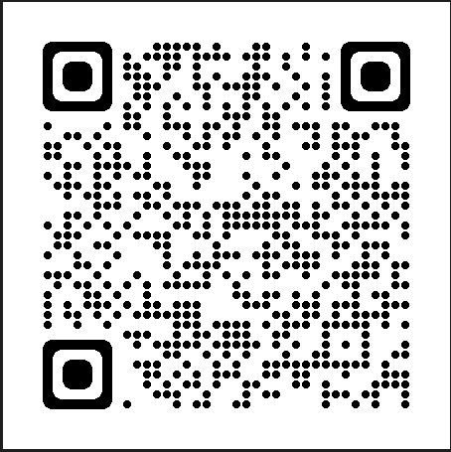
HCBS Final Rule Guidance and PCSP Template
PCSP Template
Applicable Waivers
1915(c) NHTD, Children’s Waiver, TBI, OPWDD Comprehensive Waiver
1915(k) Community First Choice Option
1115
PCSP Guidance
The Person-Centered Plan requirements are included in Section 2402(a) of the Affordable Care Act

Slide 28
Questions?
HCBSrule@health.ny.gov

