Slide 1
Provider Enrollment for Health Home Care Management Agencies (CMAs)
Category of Services (COS) 0265
September 21, 2017

Slide 2
Steps for Enrolling CMAs in COS 0265
Determine whether the CMA currently has a National Provider Identifier or NPI number. If not,
Complete the application for an NPI number found on the National Plan and Provider Enumeration (NPPES) website:
https://nppes.cms.hhs.gov/#/
NPI number is a unique 10 digit identification number issued to health care providers in the U.S. by the Centers for Medicare and Medicaid Services (CMS).
The NPI number is generally issued in 10 days or less.
NPI number is required to complete eMedNY application for new MMIS #.

Slide 3
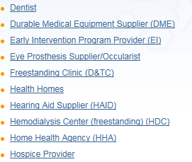

Enrolling in eMedNY
Once an email from CMS is received with the NPI number, visit the eMedNY website at the following link: https://www.emedny.org/info/providerenrollment/

Slide 4
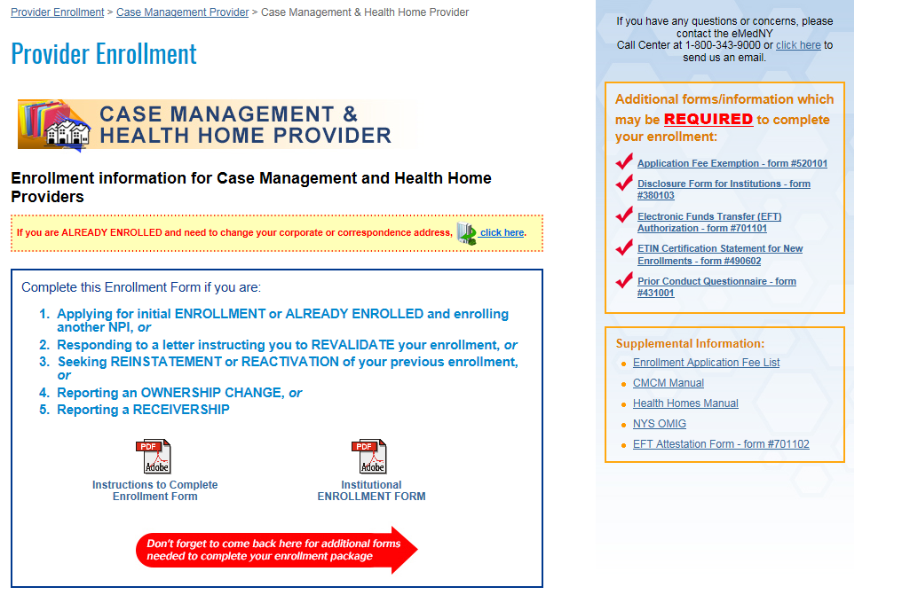
eMedNY Application

Slide 5

eMedNY Application: Additional Requirements
Provider Enrollment Application Fee
Authorization Issued by the Appropriate NYS Agency (Part 3 of Instructions)
  Authorization is issued by the DOH Medicaid Health Home Program for CMAs obtaining a COS 0265.
  Verification is conducted to assure a contractual relationship exists between the CMA and the lead Medicaid Health Home.
  An Authorization letter will be issued to the CMA with cc to DOH Medicaid Provider Enrollment and the lead Health Home.
  Documentation such as a BAA or letter from the Health Home could be included with the eMedNY application to facilitate verification.
  eMedNY application process and approval may take up to 90 days.

Slide 6
Next Steps: Updating the Health Commerce System
Adding the COS 0265 will likely change your organizations MMIS ID. If so, this update must be carried over to The Health Commerce System (HCS).
Once you have your new MMIS ID approved through eMedNY, you must contact the Health Home team to let us know.
For Health Commerce System (HCS) MMIS ID updates, contact the Health Home Team email webform at the following link: https://apps.health.ny.gov/pubdoh/health_care/medicaid/program/medicaid_health_homes/emailHealthHome.action
Select “Health Commerce Accounts for Health Homes” from the drop down box.
Please allow 5 business days for this change to reflect in the HCS system.

Slide 7
Next Steps: Updating MAPP HHTS
  Your organizations new MMIS ID will need to be added to MAPP HHTS and connected in the system to the Health Home(s) that you are working with. All MAPP user roles will be added under the new MMIS ID.
  In order to add your new ID and create new provider relationships, your organization will need to submit a request to MAPP CCC mapp-customercarecenter@cma.com and include the new MMIS ID (include the old MMIS ID also for reference) and the HHs MMIS ID you need to be connected with.
  If you have already completed your MAPP user training under the old MMIS ID, your user training status will carry over for that role.
  If there is a change in your MAPP Gatekeeper, you may complete a new MAPP Gatekeeper form found here: https://www.health.ny.gov/health_care/medicaid/program/medicaid_health_homes/mapp/index.htm
  The segments in the MAPP HHTS associated to the old MMIS ID will need to be ended and new segments created under the new ID once it has been added to the system.
  A one-on-one call can be requested with DOH to walk through your organization’s specific questions and assist your organization in understanding how to make these changes in MAPP HHTS. You can request this call and submit your questions in advance to MAPP CCC mapp-customercarecenter@cma.com

Slide 8
Contact Information
Questions regarding the application process
Contact the eMedNY Call Center: 1-800-343-9000
All other Health Home enrollment questions
Contact Health Home Program Provider Line: 518-473-5569

