Slide 1

In 2011, Governor Andrew M. Cuomo established a Medicaid Redesign Team (MRT), which initiated significant reforms to the state’s Medicaid program.
This included a critical initiative to provide “Care Management for All” by transitioning New York State’s long-term care recipients into managed care.
A key component of Care Management for All is the Fully Integrated Duals Advantage (FIDA) demonstration project, a partnership between the Centers for Medicare and Medicaid Services (CMS) and the New York State Department of Health (NYSDOH).
Through FIDA, certain dual-eligible individuals (Medicaid and Medicare) will be enrolled into fully-integrated managed care plans.
Care Management
for ALL
FIDA

Slide 2
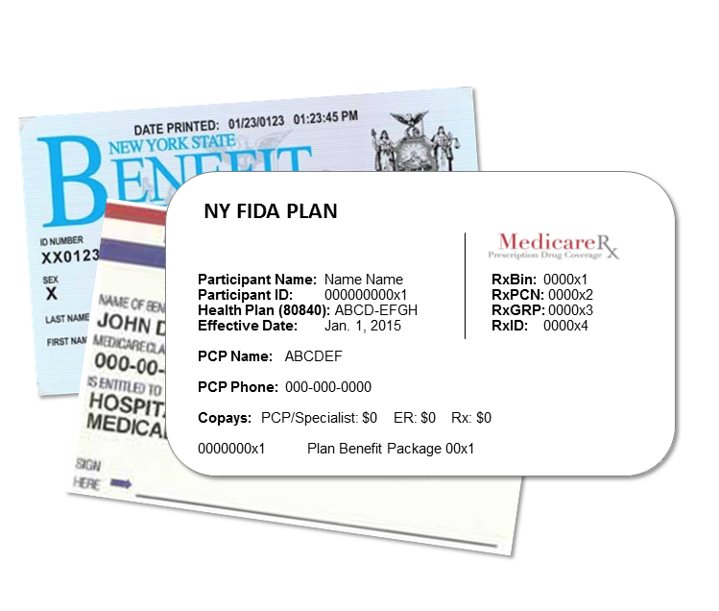
Fully Integrated Duals Advantage Program
The FIDA demonstration project began in January 2015 and runs through December 2017.
To be a FIDA plan, a plan must be approved as a Managed Long-Term Care (MLTC) plan, be approved as a Medicare Advantage (with prescription drug) plan, and meet all the FIDA requirements.
Currently, 21 plans have executed a three-way contract with CMS and NYSDOH and have completed the readiness-review process.
This is based on many elements such as systems, staffing, network adequacy, marketing, and training.

Slide 3


Who’s eligible for FIDA?
Westchester
  Participants must be:
  21 or older;
  Entitled to benefits under Medicare Part A and enrolled under both Medicare Parts B and D and receiving full Medicaid benefits; and
  Be a resident of a demonstration county: Bronx, Kings, New York, Queens, Richmond, and Nassau; starting January 1, 2015.
  The program will expand into Westchester and Suffolk counties later this year.
Bronx
New York
Suffolk
Queens
Nassau
Kings
Richmond
And meet one of the following three criteria:
Require community-based long-term services and supports (LTSS) for more than 120 days,
Are eligible for the Nursing Home Transition and Diversion Waiver program, or
Are nursing facility clinically eligible and receiving facility-based LTSS.

Slide 4
And who’s not eligible?
Exclusions to FIDA eligibility
  Under the age of 21.
  Residents in an Assisted Living Program.
  In the Foster Family Care Demonstration.
  Residents of a New York State Office of Mental Health (OMH) facility or of a psychiatric facility.
  Receiving services from the New York State Office for People With Developmental Disabilities (OPWDD) system.
  Expected to be Medicaid eligible for less than six months.
  Eligible for Medicaid benefits only for tuberculosis-related services.
  With a "county of fiscal responsibility” code 97, 98, or 99.
  Residents of Intermediate Care Facilities for Individuals with Intellectual Disabilities (ICF/IIDD).
  Eligible to live in an ICF/IIDD, but choose not to.
  Residents of alcohol/substance abuse long-term residential treatment programs.
  Eligible for Emergency Medicaid.
  In the OPWDD Home and Community Based Waiver Services (HCBS) waiver program.
  In the Traumatic Brain Injury (TBI) waiver program.
  Receiving hospice services (at time of enrollment).
  Eligible for the family planning expansion program.
  Under 65 (screened and require treatment), in the Centers for Disease Control and Prevention Breast or Cervical Cancer Early Detection program, need treatment for breast or cervical cancer, and are not otherwise covered under creditable health coverage.

Slide 5
Abdominal Aortic Aneurism Screening
Adult Day Health Care
AIDS Adult Day Health Care
Ambulance
Ambulatory Surgical Centers
Assertive Community Treatment
Assisted Living Program
Assistive Technology (State Plan and Supplemental to State Plan)
Bone Mass Measurement
Breast Cancer Screening (Mammograms)
Cardiac Rehabilitation Services
Cardiovascular Disease Risk Reduction Visit (therapy for heart disease)
Cardiovascular Disease Screening and Testing
Care Management (Service Coordination)
Cervical and Vaginal Cancer Screening
Chemotherapy
Chiropractic
Colorectal Screening
Community Integration Counseling
Community Transitional Services
Consumer Directed Personal Assistance Services
Continuing Day Treatment
Day Treatment
Defibrillator (implantable automatic)
Dental
Depression Screening
Diabetes Monitoring (Self-Management Training)
Diabetes Screening
Diabetes Supplies
Diabetic Therapeutic Shoes or Inserts
Diagnostic Testing
Durable Medical Equipment
Emergency Care
Environmental Modifications
Family Planning Services
Freestanding Birth Center Services
Home and Community Support Services (HCSS)
Health/Wellness Education
Hearing Services
HIV Screening
Home Delivery and Congregate Meals
Home Health
Home Infusion Bundled Services
Home Infusion Supplies and Administration and Medicare Part D Home Infusion Drugs
Home Maintenance Services
Home Visits by Medical Personnel
Immunizations
Independent Living Skills and Training
Inpatient Hospital Care (including Substance Abuse and Rehabilitation Services)
Inpatient Mental Health Care
Inpatient Mental Health over 190-day Lifetime Limit
Intensive Psychiatric Rehabilitation Treatment Programs
Inpatient Services during a Non-covered Inpatient Stay
Kidney Disease Services (including End Stage Renal Disease services)
Mammograms
Medicaid Pharmacy Benefits as Allowed by State Law
Medical Nutrition Therapy
Medicare Part B Prescription Drugs
Medicare Part D Prescription Drug Benefit as Approved by CMS
Medication Therapy Management
Mobile Mental Health Treatment
Moving Assistance
Non-Emergency Transportation
Nursing Facility (Medicaid)
Nutrition (includes Nutritional Counseling and Educational Services)
NYS Office of Mental Health Licensed Community Residences
Obesity Screening and Therapy to keep weight down
Opioid Treatment Services – Substance Abuse
Other Health Care Professional Services
Other Supportive Services the Interdisciplinary Team Determines Necessary
Outpatient Blood Services
Outpatient – Medically Supervised Withdrawal- Substance Abuse
Outpatient Mental Health
Outpatient Rehabilitation (OT, PT, Speech)
Outpatient Substance Abuse
Outpatient Surgery
Palliative Care
Pap Smear and Pelvic Exams
Partial Hospitalization (Medicaid)
Partial Hospitalization (Medicare)
PCP Office Visits
Peer-Delivered Services
Peer Mentoring
Personal Care Services
Personal Emergency Response Services
Personalized Recovery Oriented Services
Podiatry
Positive Behavioral Interventions and Support
Preventive Services
Private Duty Nursing
Prostate Cancer Screening
Prosthetics
Pulmonary Rehabilitation Services
Respiratory Care Services
Respite
Routine Physical Exam (1/year)
Sexually Transmitted Infections (STIs) Screening and Counseling
Skilled Nursing Facility
Smoking and Tobacco Cessation
Social and Environmental Supports
Social Day Care
Social Day Care Transportation
Specialist Office Visits
Structured Day Program
Substance Abuse Program
Telehealth
Transportation
Urgent Care
Vision Care Services
“Welcome to Medicare” Preventive Visit
Wellness Counseling
FIDA coverage in New York State includes
…items and services currently covered by:
Medicare
Medicaid
Long-term care
Behavioral health
Wellness programs
Prescription drugs
HCBS waiver services
There are no FIDA specific costs* to participants, including no co-payments,
no premiums, and no deductibles for any covered items
or services.
*Medicaid spend-down requirements still apply.

Slide 6

Enrolling in FIDA
There are two types of enrollment:
  Opt-in, which is initiated by an individual.
  Passive, which is enrollment by the state that the individual can decline by opting out.
All enrollments (opt-in and passive) will be through the enrollment broker, NY Medicaid Choice.
Participants may disenroll at any time during the demonstration.

Slide 7
Exclusions from passive enrollment
Native Americans, but they may opt-in to the demonstration at any time;
Those eligible for the Medicaid buy-in for the working disabled and are nursing-home certifiable;
Aliessa court ordered individuals;
Those assigned to a CMS Accountable Care Organization (ACO) at the time they would otherwise be included in passive enrollment;
Those participating in the CMS Independence at Home (IAH) demonstration; and
Those enrolled in:
  Program of All Inclusive Care for the Elderly (PACE);
  A Medicare Advantage Special Needs Plan for institutionalized individuals;
  Health Homes; and
  Employer or union-sponsored coverage for employees or retirees.
Eligible for FIDA,
but excluded from passive enrollment:

Slide 8

Enrollment timeline
January 1, 2015, effective date for individuals to opt-in to the demonstration.
April 1, 2015, first effective date for certain individuals who will be passively enrolled. Passive enrollment will be phased-in over time.
Nursing Home Transition
        Individuals residing in nursing homes prior to February 1, 2015, will not be passively enrolled into FIDA.
        Individuals new to custodial status in nursing homes as of January 1, 2015, will be passively enrolled into FIDA on or after August 1, 2015.

Slide 9
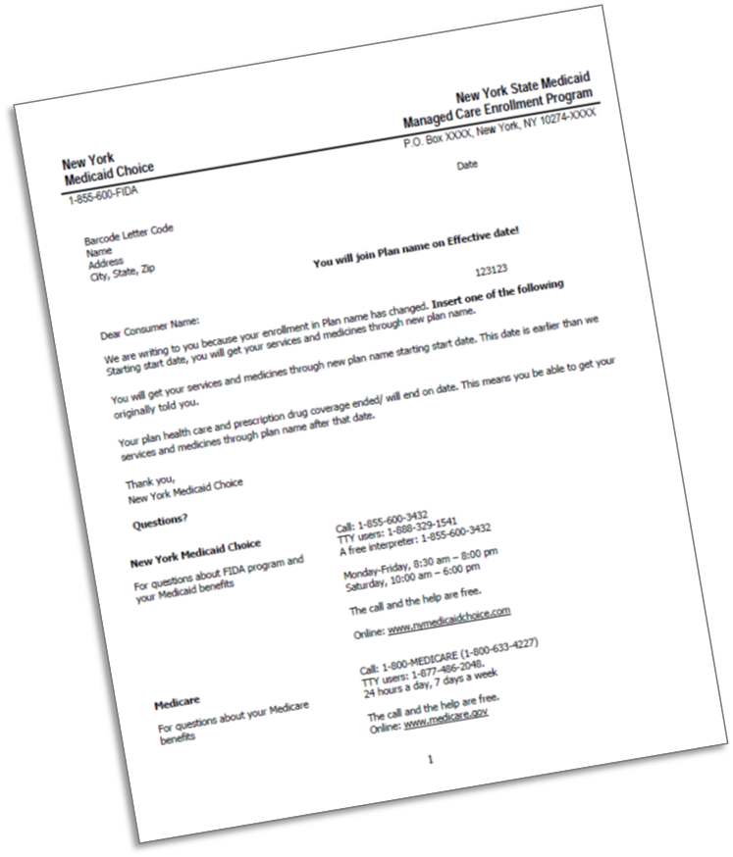

Enrollment notices
All FIDA-eligible duals received the FIDA program announcement letter in December 2014.
The program announcement letter is the first notification a participant receives and marks the start of potential opt-in enrollment.
NY Medicaid Choice will send participants passive enrollment reminder notices before their scheduled date for passive enrollment.

Slide 10

Enrollment process
NY Medicaid Choice will enroll individuals and provide education and assistance.
Individuals who are eligible for FIDA and enrolled in a MLTC plan will “transition in place” to the FIDA plan offered by the parent organization of their MLTC plan.
Individuals will be informed about FIDA and offered an opportunity to select a FIDA plan or to opt-out of the program.

Slide 11

  Transition
  of care
  To ensure a smooth transition of care for participants, a FIDA plan must:
  Make arrangements to help ensure that all community-based supports, including non-covered services, are in place prior to a participant’s move.
  Make sure participating providers are fully knowledgeable and prepared to support the participant.

Slide 12

Continuity of care
Each FIDA plan must ensure that:
Participants have access to all of their providers and authorized services, including prescription drugs, for at least 90 days or until their person-centered service plan is finalized and implemented – whichever is later.
  Participants can stay in their current nursing homes. FIDA plans must have contracts or payment arrangements with all nursing homes, so that FIDA enrollees who are already in a nursing home can stay at that same nursing home for the duration of the demonstration.

Slide 13

The Interdisciplinary Team
Each participant must have an individualized comprehensive care plan. FIDA plans are required to use an Interdisciplinary Team (IDT) approach.
Led by an accountable care manager, the team will ensure integration of the participant’s medical, behavioral health, community-based or facility-based LTSS, and social needs.
The IDT will be based on a participant’s specific needs, and deliver services with respect to linguistic and cultural competence, and dignity.

Slide 14

  IDT composition
  A participant’s IDT must be made up of:
  The participant or, in the case of incapacity, an authorized representative;
  The participant’s designee(s), if desired by the participant;
  A primary care provider (PCP) or a designee with clinical experience from the PCP’s practice who has knowledge of the participant’s needs;
  Behavioral health professional, if there is one, or a designee with clinical experience from the professional’s behavioral health practice who has knowledge of a participant’s needs;
  The FIDA plan care manager;
  The participant’s home care aide(s), or a designee with clinical experience from the home care agency who has knowledge of the participant’s needs;
  The participant’s nursing facility representative, who is a clinical professional, if receiving nursing facility care; and
  Other providers either as requested by the participant or designee; or as recommended by the IDT.
  The RN who completed the participant’s assessment, if approved by the participant or designee.

Slide 15

Independent Consumer Advocacy Network
This network will act as a resource and advocate for participants and families as they navigate the MLTC and FIDA program systems. It will also serve beneficiaries of LTSS in Mainstream Managed Care plans.
The contract for this statewide ombudsman program was awarded to a network of not-for-profit organizations, with Community Service Society of New York (CSS) serving as the entity responsible for coordinating services.
The CSS network will provide consumers with direct assistance in navigating their coverage and in understanding and exercising their rights and responsibilities.
CSS will be known as the Independent Consumer Advocacy Network (ICAN) and can be reached by calling 1 (844) 614-8800 or online at: www.icannys.org.

Slide 16

Integrated grievances and appeals process
The grievances and appeals process incorporates the most consumer-favorable elements of the Medicare and Medicaid grievance and appeals systems into a consolidated, integrated system for participants.
All notices are consolidated and being jointly developed by CMS and NYSDOH. Notices must communicate the steps in the integrated appeals process, as well as the availability of the participant ombudsman to assist with appeals.
Providers can file an appeal on behalf of a participant but do not have a FIDA-specific right to appeal plan payment decisions.

Slide 17

FIDA
Find out more:
Call NY Medicaid Choice at: 1 (855) 600-3432
For TTY service, call: 1 (888) 329-1541
For an interpreter, call:
1 (855) 600-3432, and press Option 1
Visit the NY Medicaid Choice website:
http://www.nymedicaidchoice.com
Or visit the FIDA website:
http://www.health.ny.gov/health_care/medicaid/redesign/fida/
All phone services are free.

Slide 18


If you have questions related to FIDA, email us: FIDA@health.ny.gov
New York State’s Medicaid Reform Team (MRT) website: http://www.health.ny.gov/health_care/medicaid/redesign/mrt_101.htm
Subscribe to our listserv:
http://www.health.ny.gov/health_care/medicaid/redesign/listserv.htm
“Like” MRT on Facebook:
http://www.facebook.com/NewYorkMRT
Follow MRT on Twitter: @NewYorkMRT

