Slide 1

A personal health care plan that’s centered on you.
One plan that brings together the resources of Medicare and Medicaid.
A plan that gives you all the care you need, in one place.
Introducing …
New York State’s
FIDA
program.

Slide 2
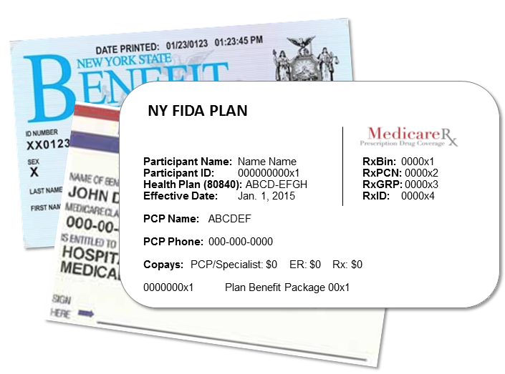
How is FIDA different?
FIDA is short for
“Fully Integrated
Duals Advantage.”
It’s a managed care plan specifically for people who receive services through both Medicare and Medicaid.
FIDA puts you at the center of all important care decisions.

Slide 3

Take control of
your health care
with a FIDA plan
In the FIDA program, your health and well-being are central to the care-planning process.
You will be a part of your Interdisciplinary Team (IDT),
which is essentially your care team.
Your team will also include your care manager, doctors, and other people that you trust. You will all work together to make decisions about your plan of care.

Slide 4

What can your FIDA care team
do for you?
Making decisions about long-term care can be confusing and frustrating.
If you join a FIDA plan, your care team will work with you to make sure you know which Medicare and Medicaid services you can get.
Your team will connect you to a network of health care and supportive services that can offer you a variety of options and additional services.
They will help you get your services and get you to your appointments.

Slide 5




Which services can you get with a FIDA plan?
The FIDA benefit package includes more services than any other managed care plan in New York.
It includes all Medicaid and Medicare services, as well as other services that you may one day need - such as behavioral health, substance abuse, and other services.

Slide 6
Abdominal Aortic Aneurism Screening
Adult Day Health Care
AIDS Adult Day Health Care
Ambulance
Ambulatory Surgical Centers
Assertive Community Treatment
Assisted Living Program
Assistive Technology (State Plan and Supplemental to State Plan)
Bone Mass Measurement
Breast Cancer Screening (Mammograms)
Cardiac Rehabilitation Services
Cardiovascular Disease Risk Reduction Visit (therapy for heart disease)
Cardiovascular Disease Screening and Testing
Care Management (Service Coordination)
Cervical and Vaginal Cancer Screening
Chemotherapy
Chiropractic
Colorectal Screening
Community Integration Counseling
Community Transitional Services
Consumer Directed Personal Assistance Services
Continuing Day Treatment
Day Treatment
Defibrillator (implantable automatic)
Dental
Depression Screening
Diabetes Monitoring (Self-Management Training)
Diabetes Screening
Diabetes Supplies
Diabetic Therapeutic Shoes or Inserts
Diagnostic Testing
Durable Medical Equipment
Emergency Care
Environmental Modifications
Family Planning Services
Freestanding Birth Center Services
Home and Community Support Services (HCSS)
Health/Wellness Education
Hearing Services
HIV Screening
Home Delivery and Congregate Meals
Home Health
Home Infusion Bundled Services
Home Infusion Supplies and Administration and Medicare Part D Home Infusion Drugs
Home Maintenance Services
Home Visits by Medical Personnel
Immunizations
Independent Living Skills and Training
Inpatient Hospital Care (including Substance Abuse and Rehabilitation Services)
Inpatient Mental Health Care
Inpatient Mental Health over 190-day Lifetime Limit
Intensive Psychiatric Rehabilitation Treatment Programs
Inpatient Services during a Non-covered Inpatient Stay
Kidney Disease Services (including End Stage Renal Disease services)
Mammograms
Medicaid Pharmacy Benefits as Allowed by State Law
Medical Nutrition Therapy
Medicare Part B Prescription Drugs
Medicare Part D Prescription Drug Benefit as Approved by CMS
Medication Therapy Management
Mobile Mental Health Treatment
Moving Assistance
Non-Emergency Transportation
Nursing Facility (Medicaid)
Nutrition (includes Nutritional Counseling and Educational Services)
NYS Office of Mental Health Licensed Community Residences
Obesity Screening and Therapy to keep weight down
Opioid Treatment Services – Substance Abuse
Other Health Care Professional Services
Other Supportive Services the Interdisciplinary Team Determines Necessary
Outpatient Blood Services
Outpatient – Medically Supervised Withdrawal- Substance Abuse
Outpatient Mental Health
Outpatient Rehabilitation (OT, PT, Speech)
Outpatient Substance Abuse
Outpatient Surgery
Palliative Care
Pap Smear and Pelvic Exams
Partial Hospitalization (Medicaid)
Partial Hospitalization (Medicare)
PCP Office Visits
Peer-Delivered Services
Peer Mentoring
Personal Care Services
Personal Emergency Response Services
Personalized Recovery Oriented Services
Podiatry
Positive Behavioral Interventions and Support
Preventive Services
Private Duty Nursing
Prostate Cancer Screening
Prosthetics
Pulmonary Rehabilitation Services
Respiratory Care Services
Respite
Routine Physical Exam (1/year)
Sexually Transmitted Infections (STIs) Screening and Counseling
Skilled Nursing Facility
Smoking and Tobacco Cessation
Social and Environmental Supports
Social Day Care
Social Day Care Transportation
Specialist Office Visits
Structured Day Program
Substance Abuse Program
Telehealth
Transportation
Urgent Care
Vision Care Services
“Welcome to Medicare” Preventive Visit
Wellness Counseling
FIDA coverage in New York State includes
…items and services currently covered by:
Medicare
Medicaid
Long-term care
Behavioral health
Wellness programs
Prescription drugs
Home and Community Based Services waiver services
There are no FIDA specific costs* to participants, including no co-payments,
no premiums, and no deductibles for any covered items
or services.
*Medicaid spend-down requirements still apply.

Slide 7

  Transition
  of care
  To ensure you have a smooth transition of care, your FIDA plan must:
  Make arrangements to help ensure that all community-based supports, including non-covered services, are in place prior to your move.
  Make sure participating providers are fully knowledgeable and prepared to support you.

Slide 8


Who’s eligible for FIDA?
Westchester
  Participants must be:
  21 or older;
  Entitled to benefits under Medicare Part A and enrolled under both Medicare Parts B and D and receiving full Medicaid benefits; and
  Be a resident of a demonstration county: Bronx, Kings, New York, Queens, Richmond, and Nassau; starting January 1, 2015.
  The program will expand into Westchester and Suffolk counties later this year.
Bronx
New York
Suffolk
Queens
Nassau
Kings
Richmond
And meet one of the following three criteria:
Require community-based long-term services and supports (LTSS) for more than 120 days,
Are eligible for the Nursing Home Transition and Diversion Waiver program, or
Are nursing facility clinically eligible and receiving facility-based LTSS.

Slide 9

Enrollment timeline
January 1, 2015, effective date for individuals to opt-in to the demonstration.
April 1, 2015, first effective date for certain individuals who will be passively enrolled. Passive enrollment will be phased-in over time.
Nursing Home Transition
        Individuals residing in nursing homes prior to February 1, 2015, will not be passively enrolled into FIDA.
        Individuals new to custodial status in nursing homes as of January 1, 2015, will be passively enrolled into FIDA on or after August 1, 2015.

Slide 10

Independent Consumer Advocacy Network
This network will act as a resource and advocate for participants and families as they navigate the MLTC and FIDA program systems. It will also serve beneficiaries of LTSS in Mainstream Managed Care plans.
The contract for this statewide ombudsman program was awarded to a network of not-for-profit organizations, with Community Service Society of New York (CSS) serving as the entity responsible for coordinating services.
The CSS network will provide consumers with direct assistance in navigating their coverage and in understanding and exercising their rights and responsibilities.
CSS will be known as the Independent Consumer Advocacy Network (ICAN) and can be reached by calling 1 (844) 614-8800 or online at: www.icannys.org.

Slide 11

FIDA
Find out more:
Call NY Medicaid Choice: 1 (855) 600-3432
For TTY service, call: 1 (888) 329-1541
For an interpreter, call: 1 (855) 600-3432,
and press Option 1
Visit the NY Medicaid Choice website:
http://www.nymedicaidchoice.com
Or visit the FIDA website:
http://www.health.ny.gov/health_care/medicaid/redesign/fida/
All phone services are free.

Slide 12

NY Medicaid Choice staff will:
Provide you with information and education about FIDA plans in your area.
Let you know if your doctor works with a FIDA plan.
Help you learn about navigating the managed care system.

Slide 13


If you have questions related to FIDA, e-mail us: FIDA@health.ny.gov
New York State’s Medicaid Reform Team (MRT) website: http://www.health.ny.gov/health_care/medicaid/redesign/mrt_101.htm
Subscribe to our listserv:
http://www.health.ny.gov/health_care/medicaid/redesign/listserv.htm
“Like” MRT on Facebook:
http://www.facebook.com/NewYorkMRT
Follow MRT on Twitter: @NewYorkMRT

