Slide 1
Highway Transportation System & Graduated Driver Licensing Law

Slide 2
Session Goals
Classify risk factors present in the Highway Transportation System (HTS) and why attitude is important to driving.
Understand the phases of the New York State Graduated Driver Licensing (GDL) Law, along with associated requirements and restrictions.

Slide 3
Key Vocabulary and Topics
Highway Transportation System (HTS)
Roadway
Vehicles
Road Users
Risks of Driving
Causes of Risk
New York State Graduated Driver’s Licensing Law
MV-285
MV-262
License Revocation
License Suspension

Slide 4
The Highway Transportation System (HTS)
The HTS is designed for the movement of people and freight safely and efficiently.
It is continually updated to make it more efficient and safer by improving the roads, producing vehicles equipped with more safety features, and continually educating its users.

Slide 5
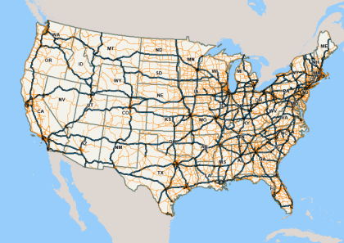
What Makes Up the HTS?
Roadways
Vehicles
Road Users
Federal Highway Administration. HEPGIS Maps-National Highway System

Slide 6
What makes up the HTS? - Learning Activity
Name the different kinds of roadways that we travel on, then list the environments that these roadways are located in.
Name the different vehicles on the HTS
Name the different users of the HTS

Slide 7
Did You Know?
Roadways
The US has 3.9 million miles of roadway, of which 3 million miles are rural roads. The Interstate system accounts for only 1.2% of total mileage but carries 23.8% of total travel.
Vehicles
There are approximately 272 million vehicles using US roads.
Road Users
Roadways are used by approximately 225 million licensed drivers, in addition to those using public transportation, cyclists, and pedestrians.

Slide 8
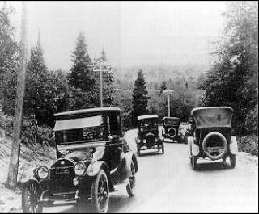
HTS is always evolving – For Example Roadways Improvements
Federal & State Standardization of traffic controls and laws
Construction of limited access roads like highways
New York State Department of Motor Vehicles, Pre Licensing Course Instructor’s Manual, Unit II The Task of Driving Within the Highway Transportation System.

Slide 9
HTS – Vehicle Improvements
Vehicle safety devices and systems are continually improved with the intention of reducing the risk of injury and death.
Can you name some of these safety devices and systems?
Let’s take a look at a few over time

Slide 10
HTS – Improvements for Users
Licensing procedures
Introduction of the Graduated Driver Licensing Law
Special Class Licenses
Development of Driver Safety Programs (1950’s)
Stricter legislation regarding driving behaviors

Slide 11
HTS – Standards and Enforcement
Federal, state, and local government agencies work together to manage the HTS
Example: The National Highway Safety Act sets guidelines about vehicle registration, driver licensing, traffic laws, traffic courts, highway construction and maintenance.
State, County, and City agencies work together to establish laws based on data collected
Laws are enforced by state and local law enforcement agencies

Slide 12
Driving is Based on Trust
You trust that all drivers know the “Rules of the Road”
This knowledge allows you to predict what other drivers will do, as well as allows other drivers to predict what you are going to do.

Slide 13
YOU Are the Most Important Part of the HTS
You CAN'T control the following:
Other drivers behaviors
The weather
The condition of the roads
The position of the sun
Animals crossing the roads
You CAN control:
Your behaviors
Your mental well-being
Your physical well-being
Your reactions to other drivers, road conditions, and types of vehicles on the road

Slide 14
Class Discussion
What does it mean to be physically fit to drive?
What does it mean to be emotionally fit to drive?
Can you be emotional or physically fit to drive sometimes and not other times?

Slide 15
Class Discussion
How does a driver’s attitude affect their driving?
What are some skills a person must have to drive safely?
How do habits affect driving?

Slide 16
The Responsibilities of Driving
Ensure your vehicle is in good mechanical condition
Continually update your knowledge of laws, vehicle features, roadway conditions/changes
Have self-control to make rational decisions
Properly adjust and adapt to different situations (mental flexibility)
Maintain physical and mental well-being
Constantly be aware of your surroundings (place your head on a swivel)

Slide 17
The Risks of Driving
What is risk?
Exposure to dangerous situations
It is ALWAYS present when you drive
How do we access risk?
By acting and reacting to the actions and conditions of other users of the HTS, the environment, and condition/design of the roads
How do we manage risk?
By making adjustments in steering, braking, and speed; avoiding distraction and impairment

Slide 18
Sources of Risk in HTS
Driver
Inexperienced drivers, distraction, fatigue, impairment
Vehicle
Bad tires, headlight out, snow/icy windshield
Roadway
Heavy traffic, pot holes, traffic accident

Slide 19
Determine whether the following are Driver Contributed (D), Vehicle Contributed (V), or Roadway Contributed (R)
___ Angry
___ Talking to Passengers
___ Narrow Bridge
___ School Zone
___ Broken Windshield
___ Speeding
___ Loose Gravel
___ Tire Blowout
___ Swerved Over Center Lane
___ Drinking and Driving
___ No Painted Lane Lines
___ Traffic Jam
___ Using Cellphone
___ Stuck Accelerator
___ T-Intersection
___ Competitive Behavior
D
D
D
D
R
R
R
R
V
D
D
V
R
R
V
D

Slide 20
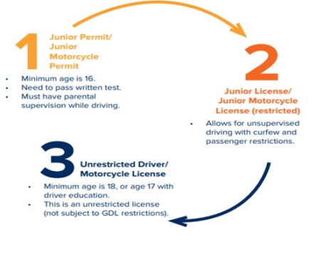
Phases of Licensing for Young Drivers in NYS
New York State uses a graduated licensing process for young drivers

Slide 21
Graduated License Law Restrictions
The restrictions depend on whether you have a junior learner permit or a junior driver license:
Junior Learner Permit
Supervised Daytime driving (5am – 9pm)
Front seat passenger must be a supervising licensed driver that is 21 and over
Supervised Nighttime driving (9pm – 5am)
Junior Driver License
No Supervision during Daytime driving (5am – 9pm)
No more than one passenger under the age of 21 unless family
Unsupervised nighttime driving if you are coming to and from work/school (must have ID)
Supervised nighttime driving (9pm – 5am) otherwise

Slide 22
Where Will You Be Driving?
Restrictions will vary depending on which of the three following geographic regions you drive in:
Upstate New York (defined as any county north of the NYC border)
New York City (defined by the five Boroughs)
Long Island (defined as Nassau and Suffolk Counties)

Slide 23
Learn More
Review the applicable version(s) of the New York State Department of Health’s A Brief Overview of New York State Graduated Licensing Law (GDL) for more information
Upstate New York
New York City
Long Island

Slide 24
Junior Permit to a Junior License
To move from a permit to a junior license you must:
Hold a junior permit for a minimum of 6 months
Take a pre-licensing course driver education course
Complete at least 50 hours of parent supervised driving, with 15 hours after sunset
Complete a MV-262 (Certification of Supervised Driving)
Schedule and pass the road test

Slide 25
Recommended Hours of Driving
It is recommended that at least 10 hours of the supervised practice be in moderate to heavy traffic.
Supervised practice should occur in a variety of driving environments and weather conditions.

Slide 26
Junior License to Unrestricted License
Under 18
If you are 17, you are eligible for an unrestricted license (Class D or M) if you have a junior driver license or limited junior driver license and have completed a state-approved high school or college driver education course
To change your junior license to a senior license, bring your junior license and Student Certificate of Completion (MV-285) that you received from your instructor
You must return your certificate and junior license to receive the senior license

Slide 27
Junior License (Restricted) to Unrestricted License
A full unrestricted license will be sent in the mail to anyone holding a junior license after their 18th birthday.

Slide 28
Did you recall these points?
What is the purpose of the HTS
To move people and freight quickly, economically, and safely
How has New York State managed the risk of young drivers entering the HTS?
The Graduated Drivers Licensing Law is designed to prevent crashes by helping young drivers gradually and safely build their skills behind the wheel by progressing through a series of licensing stages

Slide 29
How did you do?
B
___ Phase 1
___ Phase 2
___ Phase 3
Unrestricted Driver/Motorcycle License. Must be 18 years of age or 17 with a Driver and Traffic Safety Course completion
Junior Permit or Junior Motorcycle permit. Must be 16 years of age, pass a written permit test and drive under parental supervision.
Junior License or Junior Motorcycle License with restrictions. Allows for unsupervised driving with curfews and limits on numbers of passengers.
C
A

Slide 30
Review
What are the three types of risk factors present in the HTS?
Driver, Vehicle, Roadway
How can your attitude effect driving?
Your attitude can affect your driving by changing the way you assess risk and make driving decisions. For example, strong emotions such as anger, can affect your ability to make good decisions, increasing the chances that you may make a mistake.

Slide 31
References
Federal Highway Administration Research and Technology. Public Roads., Vol 60 No 1. From 1916 to 1939: The Federal-State Partnership at Work.
Federal Highway Administration. Highway Statistics 2017. Chart DV-IC: Licensed Drivers, Vehicle Registrations, and Resident Population (In Millions).

