Slide 1
Physical and Emotional Preparedness

Slide 2
Session Goals
Describe and understand physical and mental health; explain how physical and mental health impacts driving behaviors.
Identify how to reduce risks associated with physical and mental health.
Identify strategies that can be used to help prevent or reduce impact of physical and mental impairments on a driver and explain why these are effective or ineffective.
Explore how attitudes, values and beliefs relate to the maintenance of a driver’s license in New York State.

Slide 3
Key Vocabulary and Topics
Self-Talk
Optimal Health
Aggressive Driving
Depression
Stress
Anger
Self-Control
Road Rage
Risk Taking
High Risk
Calculated Risk
Impulsive Risk
DMV Point System
Insurance Point System
Suspension - Definite and Indefinite
Suspension
Revocation
Zero Tolerance Violations
Implied Consent Violation
Driving Record
Driver Responsibility Assessment Fee
Driver Transcript/Abstract
Point Insurance Reduction Program
Administrative vs Traffic Laws

Slide 4
Choices and Consequences
How do attitudes, emotions and values interfere with safe driving?
What health attitudes and behaviors support a safe driving environment?
How do unhealthy attitudes and behaviors result in physical and mental impairment?
What physical and mental conditions interfere with safe driving?
What are the differences between impulsive and calculated risks?
What are the differences between aggressive driving vs. road rage?

Slide 5
“Optimum Health” Learning Activity
Directions: Explore the following questions with your group and once you’ve come to a consensus have the recorder take notes for a class discussion.
What does the term “optimum health” mean to you?
Can you describe what you think good physical and mental health might look like in yourself or others?
Describe what poor physical and mental health might look like?
How can you work towards “optimum health”?

Slide 6
Discussion
Why do you think the minimum age of 16 years old has been designated as the age when a person in New York State is allowed to get a permit?
Why not 13 or 14 years old?
Does maturity have anything to do with this?

Slide 7
Discussion
Is there a difference between how you feel before school in the morning and how you feel after school in the late afternoon?
How many different emotions or feelings have you had so far today?
Which ones felt pleasant or good?
Which ones were difficult or uncomfortable to deal with?

Slide 8


Which ones could affect your driving in a negative way? How? Why?
Could any affect our driving in a positive way?

Slide 9
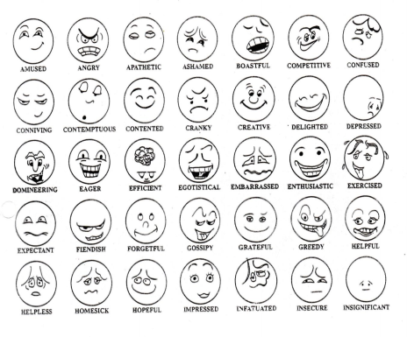
Emotions Learning Activity
Pick 2 or 3 positive emotions – Write down situations where you might feel this way.
THEN
Pick 2 or 3 negative emotions – Write down situations where you might feel this way.
New York State Pre-Licensing Course Instructor’s Manual. Expressions of Various Feelings Image.

Slide 10
Can Emotions Affect Your Health?
Physical Health
What are some physical health issues that can affect driving?
Potential physical effects of emotions: heartbeat increases, breathing quickens, digestion slows, palms sweat, exhaustion, physical stress
Mental Health
What are some mental health issues that can affect driving?
Potential mental effects of emotions: depression, anxiety, sadness, feeling overwhelmed, migraines

Slide 11
Class Discussion
Are there ways of knowing when our feelings might become a problem with our driving?
Do we have a plan on how we can avoid being influenced by our emotions and feelings?

Slide 12
Situations in a Hat Learning Activity
Direction:
Choose a card from “a hat” and explain –
How would you respond?
How would it affect your behavior?
Your emotions?
Your attitude?
Your driving behavior?
As a class, discuss the responses and whether you would handle the situation differently.

Slide 13
Situations
Construction has started on the bridge along the route home. You dread the drive home.
Traffic is heavy and the car ahead stops suddenly causing you to stop abruptly. You get quite a scare.
You have left late and know that you will be late again for work.
You know that you are going to start a new job next week, but you are going away for the 4th of July weekend.
You are traveling to a family wedding. It’s about 120 miles to your destination. A snowstorm has been forecasted for your area.

Slide 14
Situations
Your girlfriend wants to break up and has decided to do it by text message. She has asked that you not contact her.
You want to go bowling with your friends but before you go your dad wants you to trim the bushes first.
Mom says that the only way you can take the car is if you fill up the tank as it is on empty.
Your sister needs a ride to her friend's house, and you are supposed to meet up with your own friends at the movie theater.
The car ahead of you keeps riding the brake. As the car approaches a traffic light it slows down and then speeds up to make the light. You get stuck with the red light.

Slide 15
Attitudes & Emotions Can Contribute to Crashes Through…..
Aggressive Driving
Road Rage
Distractions
Taking Risks
Remember
“You are Essential to Safe Driving!”

Slide 16
Class Discussion
Do you think that “peers” can be a factor in how one drives?
Can one’s personality affect their driving?
Identify some personality traits that could impact driving.

Slide 17
Self-Control and Self Talk
Self-Control – learn to filter; don’t take everything that is said/done personally
Self-Talk – It’s what you say to yourself that can make the difference between a good or poor decision.
What are some ways to control your emotions before and while driving?

Slide 18
Ways to Control Your Emotions While Driving
Maintain a positive attitude
Plan ahead
Train yourself to always use correct procedures
Don’t drive when upset and/or depressed
Expect mistakes from others
Don’t give in to negative peer pressure
Identify troublesome situations
Avoid triggering aggressive driving

Slide 19
Taking Risks Chances and Choices

Slide 20
Calculated Versus Impulsive Risks
Calculated risks are those taken after the driver sizes up the situation
Impulsive risks are hasty actions without much thought about the consequences

Slide 21
Risk – Reduce the Factors
Keep your vehicle in top condition all of the time, not just at inspection time
Anticipate the actions of others
Protect yourself and others by buckling up
Drive only when you're in sound physical and mental condition
Make a conscious effort to develop your driving skills
CONTROL YOUR RISK!

Slide 22
Why Do Drivers Speed? Research Says…

Slide 23
Why Do Drivers Speed?
They are in a hurry because of the length of the trip and the driving environment
Peer and social pressure
They are inattentive to their driving
They don’t expect to get caught and it just feels good

Slide 24
What Influences YOU?

Slide 25
National Road Safety Foundation: One Second in Time
View the video “One Second in Time” by National Road Safety Foundation.
https://www.youtube.com/watch?v=sGaa-bhQji0

Slide 26
“One Second in Time” Discussion
The charge in this tragic collision was criminally negligent homicide. The sentence was 5 years.
Neither of the young men meant it, but now both must live with it.
Is serving jail time worth it?
Discuss how these men will have to live with their choices for the rest of their lives.

Slide 27
Aggressive Driving vs Road Rage Know the difference!

Slide 28
What Does Aggressive Driving Look Like?
Do you make frequent lane changes?
Express frustration?

Slide 29
Are You an Aggressive Driver?
What behaviors might you have that others might see as aggressive?
Do you run red & yellow lights?
Do you speed?
Tailgate?
Do you get upset when others aren’t driving the way you think they should be driving?

Slide 30
Actions Speak Louder than Words
"Your beliefs become your thoughts.
Your thoughts become your words.
Your words become your actions.
Your actions become your habits.
Your habits become your values.
Your values become your destiny."
~Mahatma Gandhi

Slide 31
Aggressive driving is NOT road rage, though it might trigger it!
Aggressive driving generally involves traffic infractions while road rage generally includes “crimes”.
How can aggressive driving escalate into road rage?

Slide 32
Actions That Can Help Drivers Avoid Road Rage
Make every attempt to get out of the way, first and foremost
Don’t block the passing lane or the right hand turning lane
Don’t retaliate by tailgating once they pass you
Use signals when switching lanes - be a courteous driver
Put your pride aside - Smile and avoid conflict at all costs
Don’t take the other driver’s mistakes personally
Don’t challenge another driver by speeding up or attempting to hold-your-own
Don’t abuse the horn!

Slide 33
Important Reminders: Encountering Someone with Road Rage
Don’t drive home with the driver following you
Drive to the nearest police station if you can
Avoid eye contact with any driver trying to engage you - eye contact can sometimes enrage an aggressive driver
Avoid gestures - ignore gestures and refuse to return them. NEVER exit the vehicle to argue or otherwise engage another motorist or pedestrian
Report serious aggressive driving - you or a passenger may call the police. But, if the driver must use a cell phone, put the phone on speaker and as soon as you can pull over to a populated area. Don’t pull off to a place where you may get trapped

Slide 34
How Driving Laws Can Affect Behavior A Review of NYS Laws, Violations, and The Point System

Slide 35
Administrative Laws vs. Traffic Laws
Are the following examples of administrative laws or traffic laws?
Graduated Licensing
Right-of-Way
Vehicle Registration
Vehicle Insurance
Drinking and Driving
A
Text Messaging
Seat Belt Use
Right on Red
Passing
Financial Responsibility
T
T
T
A
T
A
T
T
A
Laws and rules are guides for law enforcement and the courts
Know and obey the laws so that you are predictable to others
Remember: Driving is a privilege

Slide 36
NYS Point System Discussion
What is the point system and why do we have one?

Slide 37
The Point System Explanation
Definition: The Point System
The NYS DMV point system identifies “persistent violators;” that is, drivers who commit a series of violations in a short time period (18 months in general).
While each violation listed alone is not serious enough to require license suspension or revocation, the accumulation of several violations on your driving record can indicate that action must be taken.

Slide 38
Violations & The Point System
The point values charged against your record are from the date you commit the violation, not the date you are convicted.
If you get 11 or more points within 18 months, you will be notified by mail that your driver license will be suspended.
You can request a DMV hearing only to show that the convictions in question were not yours.
You cannot re-argue the convictions or request the suspension be waived based on special circumstances.

Slide 39
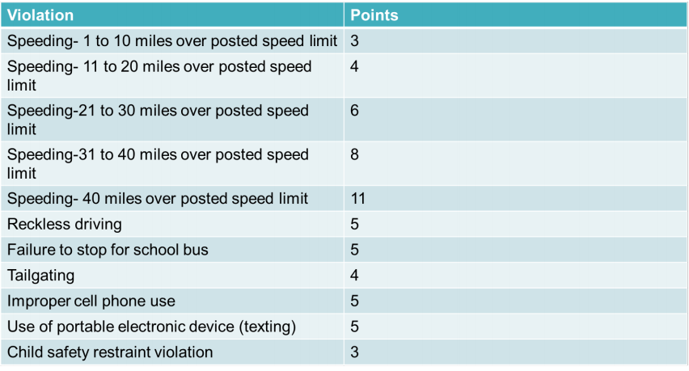
Points Assigned for Common Traffic Violations
New York State Department of Motor Vehicles. About the New York State Driver Point System. https://dmv.ny.gov/tickets/about-nys-driver-point-system

Slide 40
New York State Driving Laws Learning Activity
Directions: Using Chapter 9 of the New York State Driver’s Manual as a reference, answer the questions below and be prepared to participate in the class discussion.
What is the NYS point system for driving?
What information is entered on the driving record/driver abstract?
Who is held accountable for an offense on the driving record?
How many points can you get on your license in NY before it can be suspended?
How long will your license be suspended?
1 of 3

Slide 41
New York State Driving Laws Learning Activity
How long do points stay on your driving record?
What is Implied Consent Law and what are the penalties for non-compliance?
What is Zero Tolerance? What is the penalty for this?
How long will your license be suspended/revoked for a DWAI? DWI?
What is aggravated DWI and what are the penalties?
Is it illegal to drive when the driver has taken drugs or a controlled substance?
2 of 3

Slide 42
New York State Driving Laws Learning Activity
What is the open container law and what are the penalties imposed for this violation?
What is Leandra’s Law and what are the penalties for this violation?
What is a “speed contest” and what are the penalties for this type of violation?
What is the penalty for passing a school bus when red flashing lights are activated?
What are the penalties for not wearing a seat belt?
What are the penalties for cell phone or texting violations?
What is Graduated Licensing Law and who does it affect?
3 of 3

Slide 43
Do You Know About the Driver Responsibility Assessment Fee?

Slide 44
Point and Insurance Reduction
You can reduce your point total by up to four points and save up to 10 percent on your auto liability and collision insurance premiums by taking a DMV-approved “Motor Vehicle Accident Prevention Course.”
Completion of a point reduction course cannot prevent a mandatory suspension or revocation or be applied as a “credit” against future points, or prevent revocations.
It also cannot reduce a Driver Responsibility Assessment by the DMV.
See Driver’s Manual for more information.

Slide 45
Suspensions & Revocations Discussion
What do you think?
What does it mean if your license is suspended?
What happens if your license is revoked?
Should it be a criminal offense to drive with a suspended license?
When should a driver permanently lose their driving license privileges?

Slide 46
Definition of Suspension
A suspension means your license or driving privilege is taken away for a period of time. You may need to pay a suspension termination fee. Your suspension period can be definite (which has a beginning and end date) or indefinite, which does not end until you take a required action.
If you receive a definite suspension order, it will tell you how long the suspension period will last. You cannot drive until the period ends, you pay a termination fee, and have a valid driver’s license again. You can use DMV’s My License, Permit or ID service to check if your license is valid.
If you receive an indefinite suspension order, this order will tell you what you must do to remove the suspension.
It is a criminal offense to drive with a suspended license. This happens when drivers accumulate too many points, have multiple violations, speeding tickets, or DUI/DWI.

Slide 47
Definite Suspensions
Common reasons for definite suspensions
You did not have automobile liability insurance.
You were convicted of an alcohol or drugged driving charge.
You received too many traffic tickets in a certain amount of time.
You did not follow the rules for junior license holders.

Slide 48
Indefinite Suspensions
Common reasons for indefinite suspensions
Failure to answer a traffic ticket
Failure to pay for a traffic ticket fine
Failure to file a motor vehicle accident report
Failure to pay child support
Unpaid NYS tax debts
Lack of automobile liability insurance

Slide 49
Revocation of Driver’s License
If you receive an order from DMV saying your license or driving privilege is revoked, this means your license has been cancelled. You must surrender your license to DMV, and you must start over with the licensing procedure to get a new one when the revocation period ends.
You may be required to retake the 5-hour pre licensing course, retake the written and driving tests and pay a license reapplication fee.

Slide 50
Reasons for Revocations
Common reasons for revocations:
Operated or permitted operation of a vehicle without insurance
Involved in an uninsured motor vehicle crash
Convicted of an alcohol or drugged driving charge
Convicted of a serious traffic offense or multiple offenses
Failed a DMV road retesting for reported health problems
Making false statements on application for license or registration
Driver in a motor vehicle crash that involved a fatality
Excessive parking tickets

Slide 51
Violation, Suspension or Revocation Learning Activity
Review the following charges and determine the severity of the charge. Identify how many points the court might charge the driver.
Reckless driving
Inadequate brakes
Driving 40 miles or more over the speed limit of 55 MPH
Cellphone/texting violation
Speed contest
Failing to stop for a school bus
Following too closely
DWI license suspended
Zero Tolerance violation
Passing a School Bus
Driving Unlicensed
Lapsed Inspection Violation

Slide 52
Physical and Mental Readiness Quiz
True or False
Peer pressure is not influential in your decision-making process
Responsible decisions can help you be in control of your life
Anger can’t impair your ability to drive safely
Depression, sorrow, and anxiety can adversely affect driving
Friends can influence how you drive
Maturity and independent thinking can help you resist peer pressure
Wearing a seat belt shows an attitude towards safe driving
Turning off your cell phone while driving demonstrates a belief and commitment to safety on our roads.
F
T
F
T
T
T
T
T

Slide 53
References
NHTSA. Traffic Tech Technology Transfer Series: Motivations for Speeding – Additional Data Analysis.
National Road Safety Foundation. One Second in Time Video.

