Slide 1
Impaired Driving

Slide 2
Session Goals:
Define alcohol
Determine factors that influence BAC
Identify how alcohol and other drugs affect driving ability
Identify indicators of impaired driving
Determine NYS Laws as they relate to impaired driving
Identify strategies to prevent impaired driving
Discuss how drowsiness can cause crashes
Determine methods to reduce the risks of drowsy driving

Slide 3
Key Vocabulary and Topics
Blood alcohol concentration (BAC)
Designated driver
Implied consent law
Intoxication
Over-the-counter medications (OTC)
Prescription medications
Chemical tests
Inhibitions
Zero Tolerance Law
Alcohol
DWI - Driving While Intoxicated
DWAI - Driving with Abilities Impaired
Aggravated DWI
Drowsy Driving

Slide 4

Alcohol
Alcohol is an odorless, colorless, depressant drug in beer, wine, and distilled spirits.

Slide 5
Amount of Alcohol in Standard Drinks
Drink Volume | Amount of Ethyl Alcohol
12 ounces of beer | 5-6% Alcohol
5 ounces of wine | 12-13% Alcohol
1.5 ounces of liquor | 40% Alcohol
These drinks contain about the same amount of alcohol!

Slide 6
Your Blood Alcohol Concentration (BAC)
Your BAC is dependent on:
How much alcohol you drink
How much time passes between drinks
Your weight

Slide 7
Not All Drinks are the Same
Craft beers often have more alcohol content and are served in larger (16 oz) glasses. This equates to 3 standard drinks!!
Wine alcohol content varies widely from 5.5% to as much as 25%. What kind of wine in what kind of wine glass could determine whether you get an Impaired Driving Offense or not.
Don’t assume the bartender will always give you a 1.5 oz shot of 40% alcohol. Sometimes bartenders put more than 1 shot in a drink.

Slide 8
What Do You Think
How many alcoholic drinks does it take to affect driving?
1 to 2 drinks
3 to 4 drinks
5 to 6 drinks
7 to 8 drinks

Slide 9
Alcohol and Its Effects on Driving Ability
Increases reaction time
Reduces ability to see clearly
Changes judgement of speed and distances
Often decreases inhibition
Increases risk taking

Slide 10
How Can You Tell if a Driver is Impaired?
Traveling at erratic speeds – either too fast or too slow
Running over curbs or turning into wrong lanes
Weaving from side to side
Ignoring or overshooting traffic signs

Slide 11
Chemical Test Refusal
If you refuse to take the test after being arrested, your driver’s license will be suspended when you are arraigned in court on the alcohol or other drug-related charge.
Your refusal can be brought up in court when you are tried on alcohol or drug-related charges.
If a DMV hearing later confirms you refused the test, your driver’s license will be revoked even if you are found not guilty of the alcohol or other drug-related violation.
For information about driver’s license revocation and civil penalties for chemical test refusals, see NYS Department of Motor Vehicles, Alcohol and Drug Driving Violations.

Slide 12
Penalties for Alcohol/Drug-Related Violations
Aggravated Driving While Intoxicated
AGG-DWI (.18 and higher Blood Alcohol Content (BAC))
CONVICTION | FINE ONLY* | JAIL SENTENCE | REQUIRED LICENSE ACTION
1st Offense (Misdemeanor) | Minimum $1000 Maximum $2,500 | Up to 1 Year | Minimum 1-Year Revocation
2nd Offense (Class E Felony) Within 10 Years | Minimum $1,000 Maximum $5,000 | Up to 4 years | Minimum 18-Month Revocation

Slide 13
Penalties for Alcohol/Drug-Related Violations
Driving While Intoxicated
DWI (.08 and higher Blood Alcohol Content (BAC) or DWAI-Drug)
CONVICTION | FINE ONLY* | JAIL SENTENCE | REQUIRED LICENSE ACTION
1st Offense (Misdemeanor) | Minimum $500 Maximum $1,000 | Up to 1 Year | Minimum 6-Month Revocation (DWI); Minimum 6-Month Suspension (DWAI-D)
2nd Offense (Class E Felony) Within 10 Years | Minimum $1,000 Maximum $5,000 | Up to 4 years (DWI & DWAI-D); minimum 5 days jail or 30 days of community service (for DWI within prior 5 years) | Minimum 1-Year Revocation

Slide 14
Penalties for Alcohol/Drug-Related Violations
Driving While Impaired by Combined Alcohol & Drugs
DWAI-Combination
CONVICTION | * | JAIL SENTENCE | REQUIRED LICENSE ACTION
1st Offense (Misdemeanor) | Minimum $500 Maximum $1,000 | Up to 1 Year | Minimum 6-Month Revocation
2nd Offense (Class E Felony) Within 10 Years | Minimum $1,000 Maximum $5,000 | Up to 4 years | Minimum 1-Year Revocation

Slide 15
Penalties for Alcohol/Drug-Related Violations
Driving While Ability Impaired
DWAI (more than .05 up to .07 Blood Alcohol Content (BAC))
CONVICTION | FINE ONLY* | JAIL SENTENCE | REQUIRED LICENSE ACTION**
1st Offense (Traffic Infraction) | Minimum $300 Maximum $500 | Up to 15 days | 90-day Suspension
2nd Offense (Traffic Infraction) Within 5 Years | Minimum $500 Maximum $750 | Up to 30 days | Minimum 6-Month Revocation

Slide 16
Zero Tolerance for Drivers Under Age 21
Under the NYS “Zero Tolerance Law”, a driver under the age of 21 cannot legally drive with a blood alcohol content of 0.2 or above (a level that may occur from using mouthwash or cough syrup)
License suspended for 6 months; Driver must also pay $100 suspension termination fee and $125 civil penalty to be relicensed
For a second offense, license will be revoked for at least one year or until the driver is 21, whichever is longer

Slide 17
Ignition Interlock Program and Leandra’s Law
An ignition interlock device, purchased and installed at the expense of the motorist, is connected to a motor vehicle ignition system and measures the alcohol content of the breath of the driver.
The vehicle cannot be started until the driver provides an acceptable sample breath
Receive automatically if charged with DWI and Aggravated DWI
Receive if convicted of Leandra’s Law.
Impaired driving with children 15 years old or younger in the car

Slide 18
Additional Reminders
If you kill or cause an injury to another person because of an alcohol or other drug-related violation, you can be convicted of criminally negligent homicide, vehicular manslaughter or assault. These carry a fine of thousands of dollars and a maximum jail term of 15 years.
If you drive while your license is suspended or revoked, you face a mandatory fine between $200 and $1000, and a mandatory jail term or probation. If impaired or intoxicated when you are arrested, the maximum mandatory fine is $5,000 and the vehicle can be seized.

Slide 19
Additional Reminders
Liability insurance may not cover the cost of injuries and damage from a traffic crash. You could be sued for thousands of dollars, making it difficult and expensive to buy liability insurance for several years.
You could also face costly legal fees in addition to fines and surcharges.
You could have a criminal record, making it harder to get a job or move forward in your job.

Slide 20
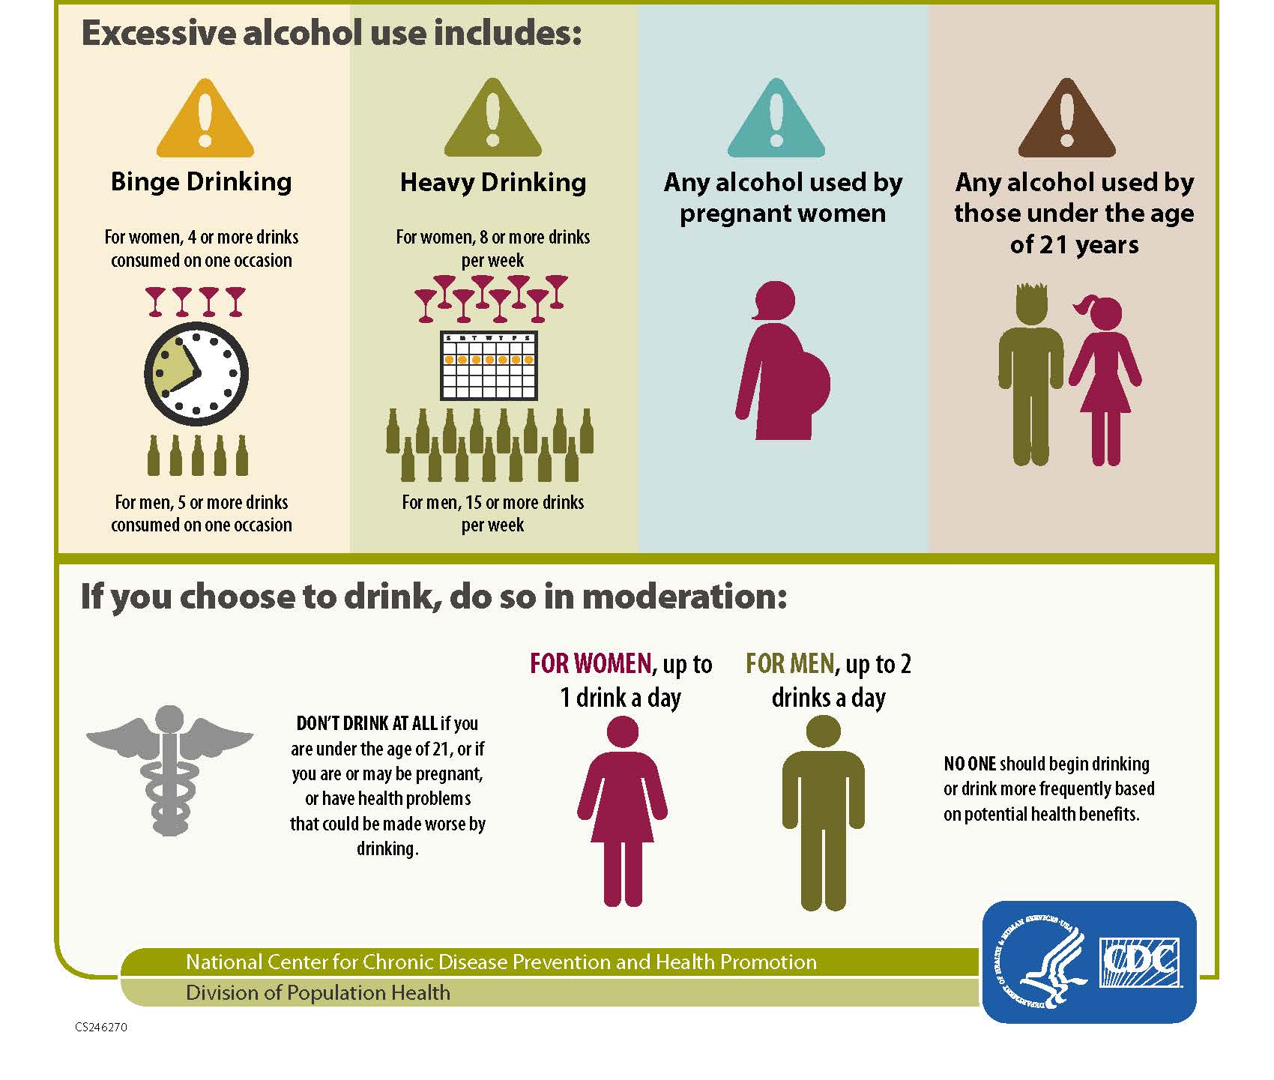
Centers for Disease Control and Prevention. Alcohol Use and Your Health InfoGraphic. https://www.cdc.gov/alcohol/fact-sheets/alcohol-use.htm

Slide 21
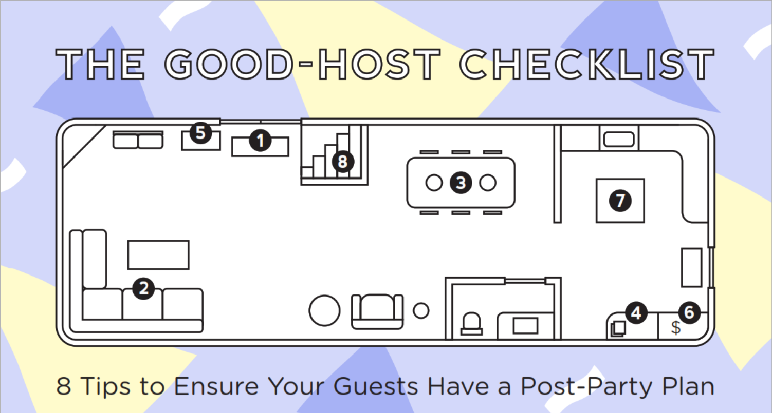
Good Host Check List
Stop DWI New York and the Governor’s Traffic Safety Committee. Good-Host Checklist Infographic. http://stopdwi.org/content/good-host-checklist

Slide 22
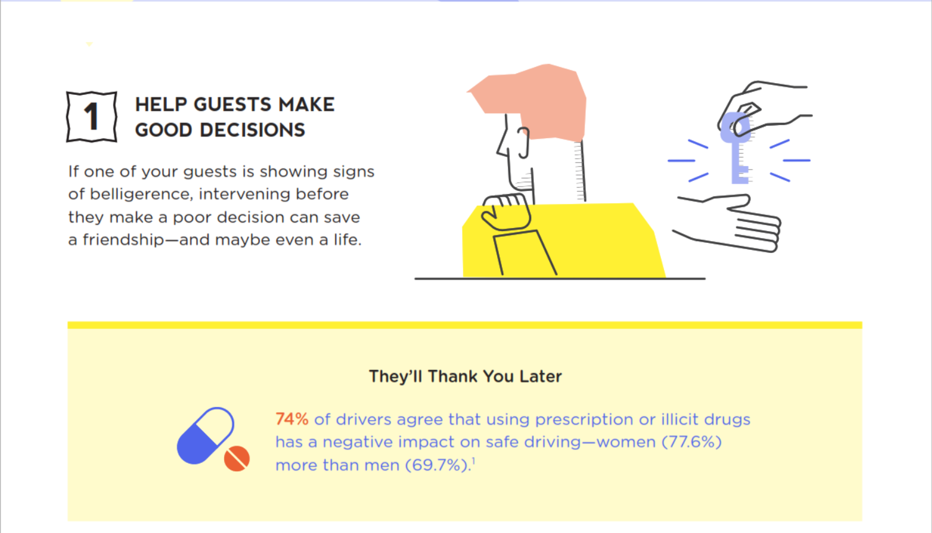
Good Host Check List
Stop DWI New York and the Governor’s Traffic Safety Committee. Good-Host Checklist Infographic. http://stopdwi.org/content/good-host-checklist

Slide 23
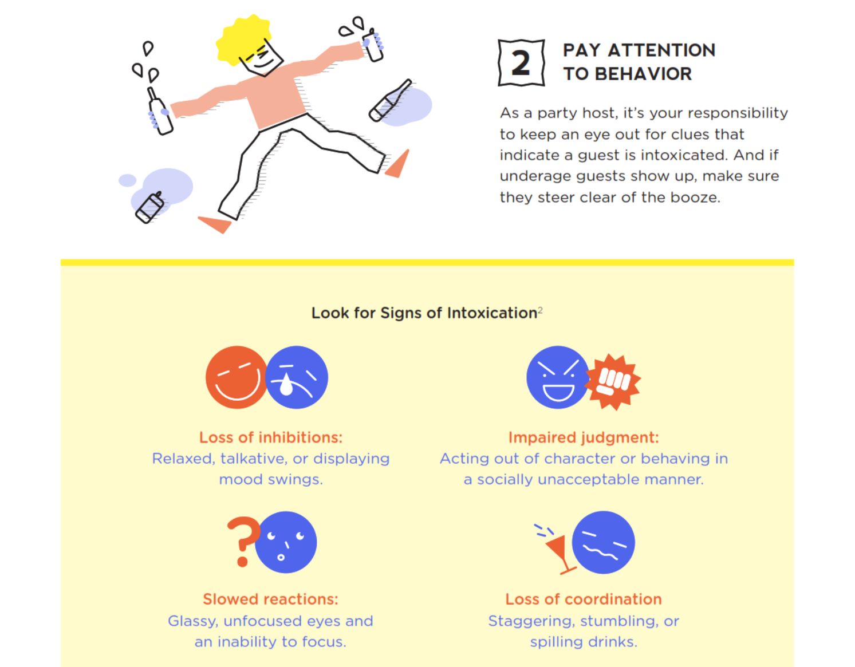
Good Host Check List
Stop DWI New York and the Governor’s Traffic Safety Committee. Good-Host Checklist Infographic. http://stopdwi.org/content/good-host-checklist

Slide 24
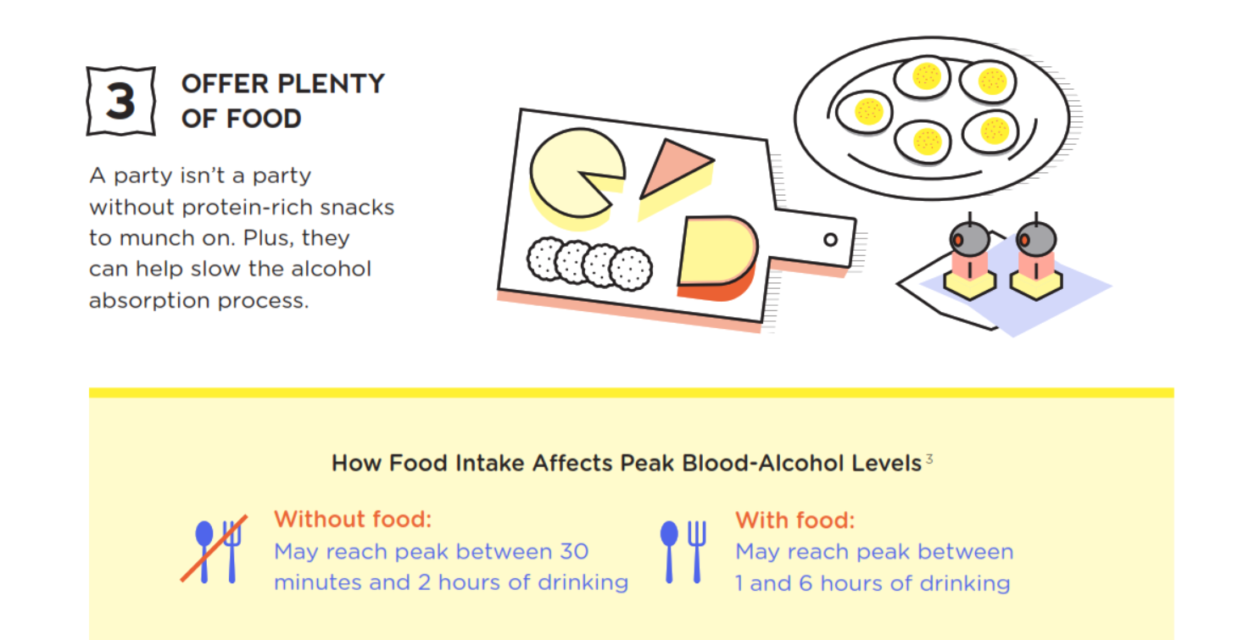
Good Host Check List
Stop DWI New York and the Governor’s Traffic Safety Committee. Good-Host Checklist Infographic. http://stopdwi.org/content/good-host-checklist

Slide 25
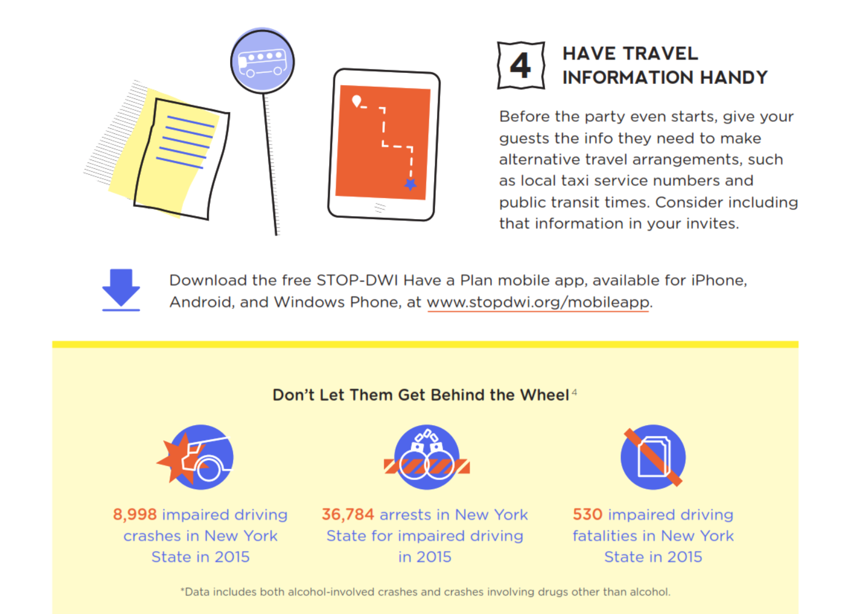
Good Host Check List
Stop DWI New York and the Governor’s Traffic Safety Committee. Good-Host Checklist Infographic. http://stopdwi.org/content/good-host-checklist

Slide 26
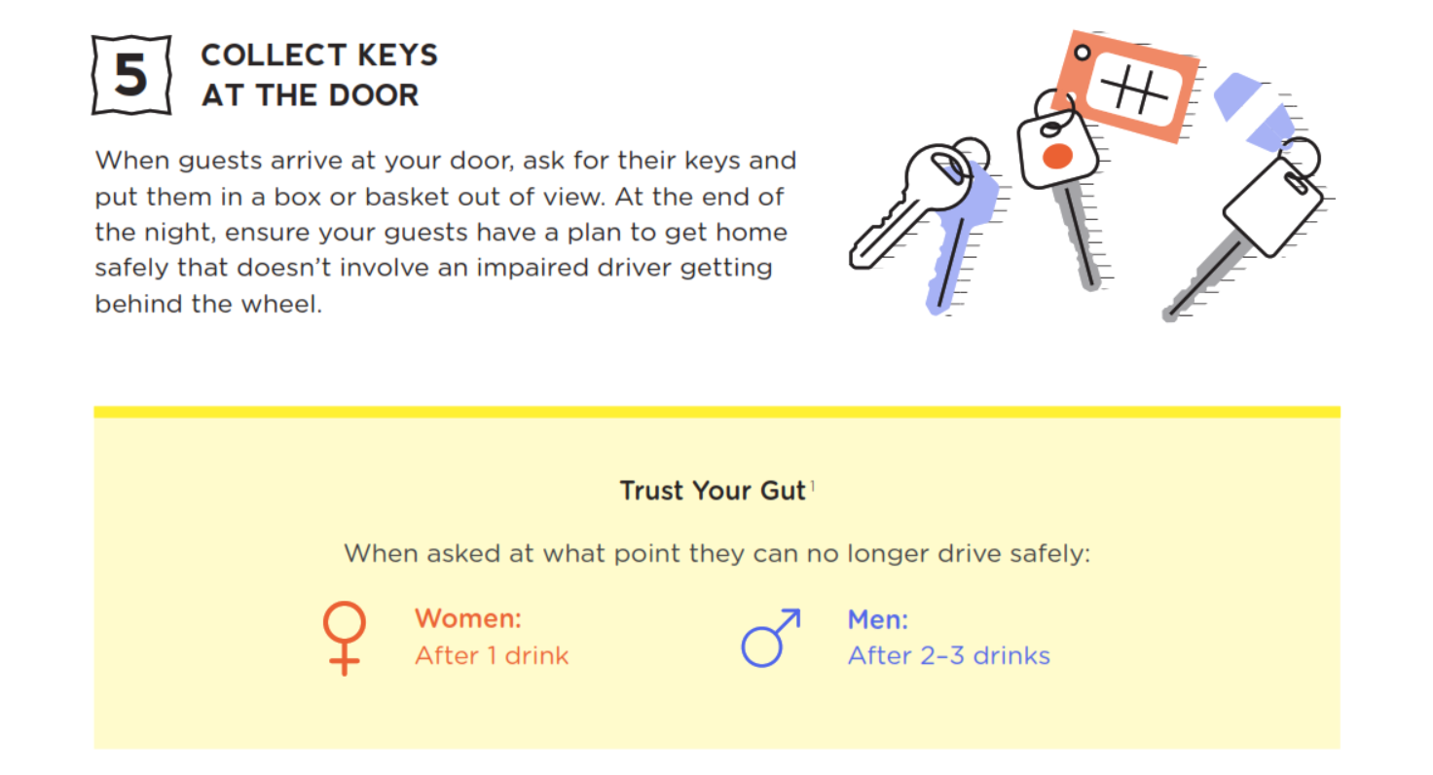
Good Host Check List
Stop DWI New York and the Governor’s Traffic Safety Committee. Good-Host Checklist Infographic. http://stopdwi.org/content/good-host-checklist

Slide 27
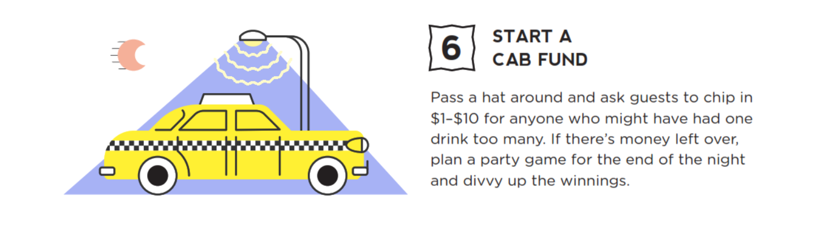
Good Host Check List
Stop DWI New York and the Governor’s Traffic Safety Committee. Good-Host Checklist Infographic. http://stopdwi.org/content/good-host-checklist

Slide 28
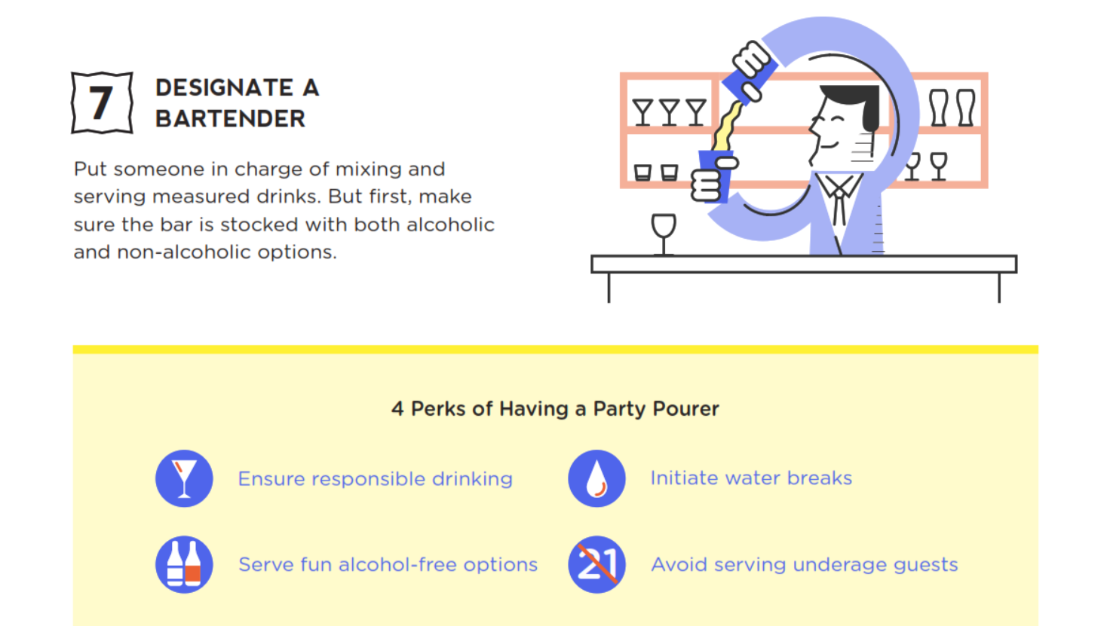
Good Host Check List
Stop DWI New York and the Governor’s Traffic Safety Committee. Good-Host Checklist Infographic. http://stopdwi.org/content/good-host-checklist

Slide 29
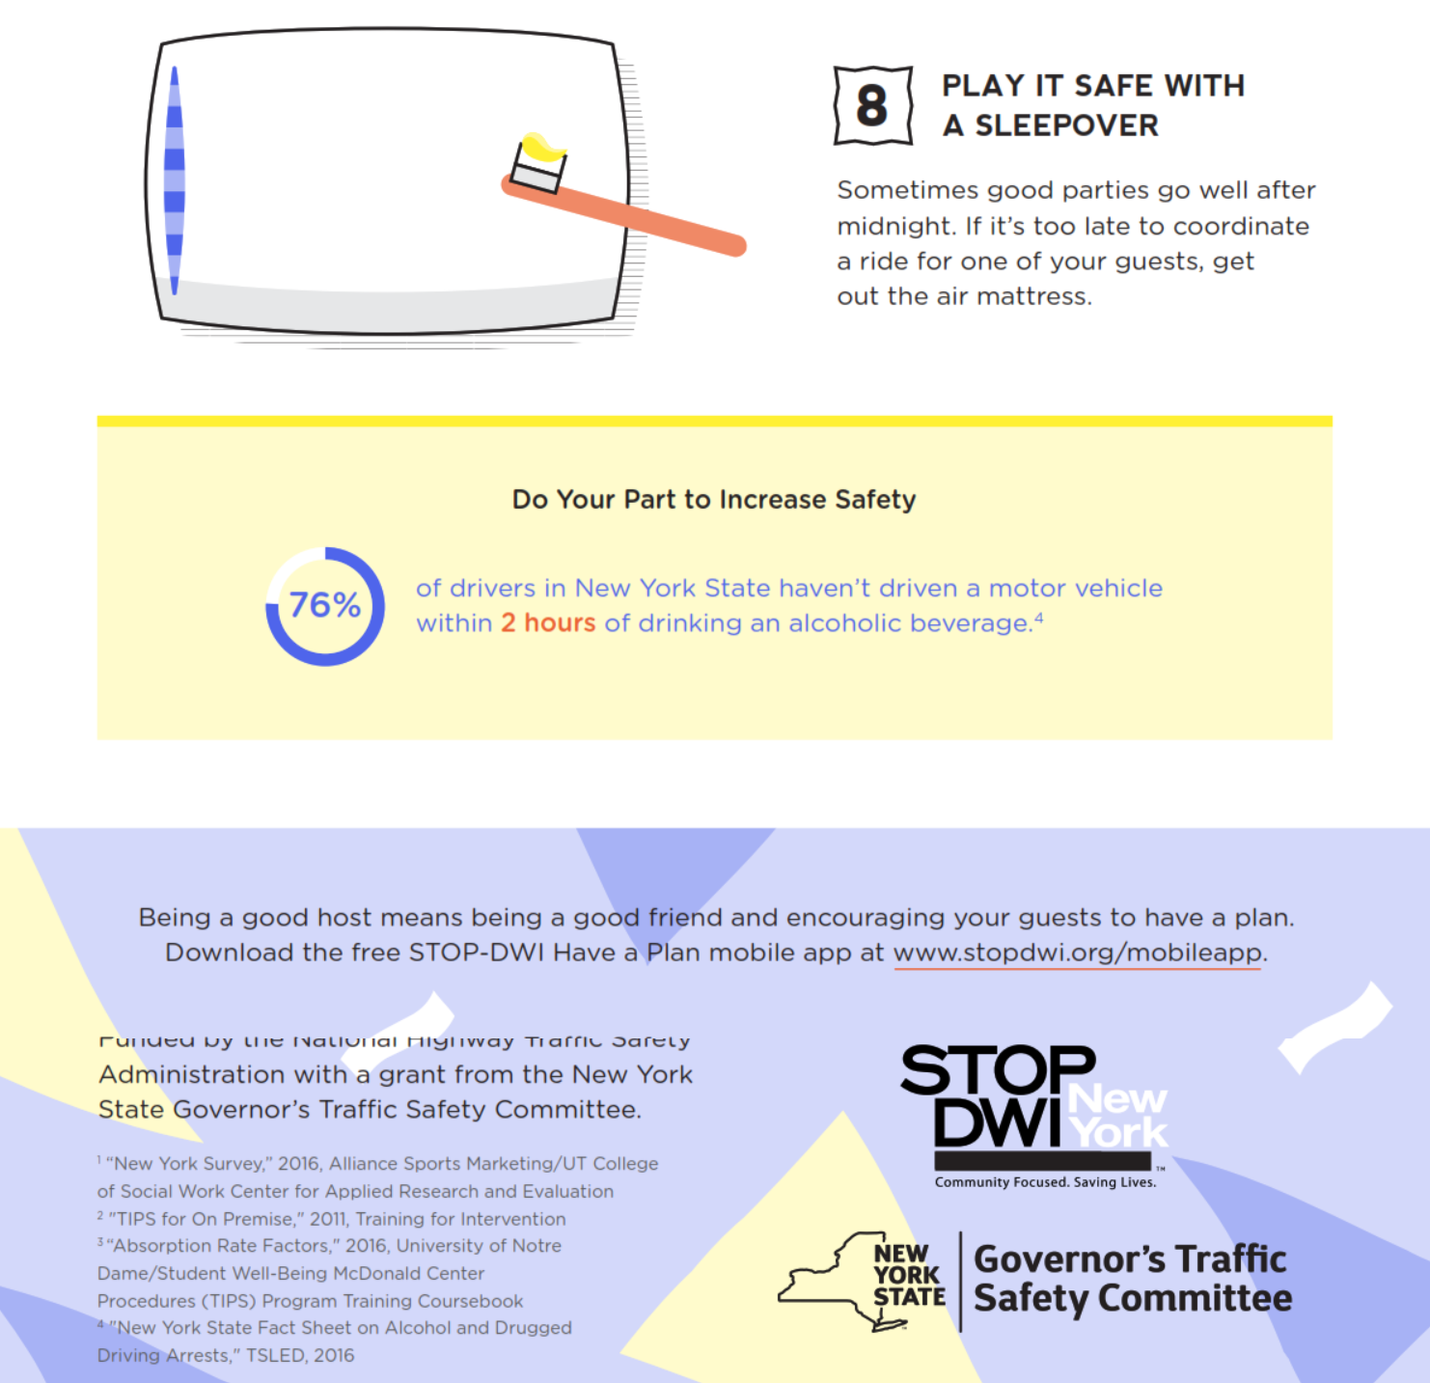
Good Host Check List
Stop DWI New York and the Governor’s Traffic Safety Committee. Good-Host Checklist Infographic. http://stopdwi.org/content/good-host-checklist

Slide 30
Other Drugs
Drugs, including many prescription and over-the-counter medications, can affect your ability to drive while taking.
Make sure to check warning labels for drug effects. Check with your doctor or pharmacist about driving on the medication.
Never drink alcohol while you are taking other drugs. It could be dangerous, often enhancing the effects of the alcohol and the other drug.

Slide 31
Other Drugs
It may be a criminal offense to drive while impaired by the effect of alcohol and drugs including marijuana, cocaine, LSD, heroin and opium and some prescription drugs like tranquilizers.
Drugs can affect your reflexes, judgment, vision, and alertness in ways similar to alcohol, and may have other dangerous effects as well.
A combination of alcohol and other drugs severely reduces your ability to drive and can cause serious health problems, which can include death.

Slide 32
Consequences Learning Activity
Personal – Consequences that affect the driver. For example loss of freedom or personal injury.
Legal – Legal consequences that affect the driver. For example, loss of license or fines.
Passenger – Consequences that affect the passenger(s) in the vehicle.
Bystander – Consequences that affect the people not in the vehicle.
Financial – Consequences that have a monetary consequence.

Slide 33
Strategies for Impaired Driving Prevention
If you go to events with the same group of friends, rotate drivers. Each friend takes a turn being the “designated driver” who does not drink or use drugs.
Arrange to remain overnight.
Before you drink, give your keys to a friend who isn’t drinking or using drugs and who will not let you drive after you do so.
Call a cab or use public transportation.

Slide 34
Signs of Drowsy Driving
Yawning repeatedly
Struggling to keep your eyes open or focused
Forgetting the last few miles driven
Tailgating or missing traffic signals
Swerving or drifting between lanes of traffic

Slide 35
Like Alcohol, Sleepiness….
Slows reaction time
Decreases awareness
Impairs judgment
Increases your risk of crashing

Slide 36
Who’s at Risk?
Anyone who is tired is at risk, but the following groups have a higher risk of driving drowsy:
Commercial drivers, including tractor trailer, tour bus, and public transit drivers
People who work long hours or late night shifts
People with sleep disorders
New parents or caregivers of babies and young children
High school and college students, young or newer drivers

Slide 37
Strategies to Stay Alert Behind the Wheel
Get enough sleep before you drive, especially when going on long trips.
Make regular stops or switch drivers every 100 miles or 2 hours.
Drivers are most likely to feel drowsy between 1pm - 4pm and 2am-6am. If possible, avoid driving during these times.
Don’t count on caffeine. It can provide a short fix or ‘pick me up’, but be aware, it takes 30 minutes before you feel the effect and it can wear off quickly
Avoid prescription and over-the-counter medicines that could make you drowsy
Never drink alcohol when you’re tired. It slows down your reflexes and causes drowsiness.

Slide 38
Getting Better Sleep
Make it a priority to get a least 7 hours of sleep daily. Teens require up to 10 hours.
Keep the sleep area dark.
Avoid caffeine and alcohol before you go to sleep.
Set up a routine for bedtime; listen to relaxing music, read, or take a warm bath or shower before you go to sleep.
Clear your mind. Make a list of your thoughts or concerns before you go to sleep, so you do not forget them.

Slide 39
Getting Better Sleep
Lower the thermostat to 60-65°F before going to sleep.
Use the "Do Not Disturb" sign if you are staying in a hotel or motel.
Turn off or unplug cellphones and electronic devices where you sleep.
Use a fan or wear earplugs to block outside sound.
Pay attention to side effects of medicines and adjust the time you take them, as they might interrupt your sleep.

Slide 40
How Sleepy Are You?
0 Would never doze | 1 Slight chance of dozing | 2 Moderate chance of dozing | 3 High chance of dozing
Warning Signs
Sitting and reading, watching television
Sitting inactive in a public place, for example, a theater or meeting
As a passenger in a car for an hour without a break
Lying down to rest in the afternoon
Sitting and talking to someone
In a car, while stopped in traffic
Sitting quietly after lunch (when you’ve had no alcohol)
If your total is 10 or higher, consider discussing these results with your physical or other healthcare provider. Keeping a sleep diary for two weeks or longer can help you identify behaviors that might contribute to your fatigue.

Slide 41
True or False Learning Activity
F
A person can burn off alcohol by strenuous activity.
A person will be affected by drinking beer.
A person will not drive as well after a few alcoholic drinks.
Alcohol will not affect a person who has built up a tolerance.
A person can sober up by drinking black coffee and taking a cold shower.
T
T
F
F

Slide 42
References
New York State Department of Motor Vehicles. Driver’s Manual.

