Slide 1
Signs, Signals, and Markings

Slide 2
Session Goals
Understand what traffic control devices are and why they are important.
Understand the many factors that influence their ability to observe, recognize, understand and react to traffic control devices.
Understand why correct application of right of way rules is important.
Demonstrate the ability to observe, recognize, understand and react to the three types of traffic control devices: signs, signals, and markings behind the wheel.
Demonstrate the ability to implement proper right of way in different situations behind the wheel.

Slide 3
Key Vocabulary and Topics
Colors for Traffic Signs:
Red
Yellow
White
Black
Green
Brown
Blue
Orange
Fluorescent Yellow
Fluorescent Pink
Shapes for Traffic Signs:
Octagon
Triangle
Diamond
Circular
Pentagon
Rectangle

Slide 4
Key Vocabulary and Topics
Types Traffic Signs:
Regulatory
Warning
Construction
Guide
Incident
Chevron
Traffic Signals:
Steady red/ yellow/green
Flashing red /yellow
Flashing yellow arrow
Red “X” and arrow
Yellow “X” and arrow
Green arrow
Pedestrian signals, countdown timers
Multiple left turn lanes
Multiple right turn lanes

Slide 5
Key Vocabulary and Topics
Pavement Markings:
White lines (solid or broken
Yellow lines
Double solid yellow lines
Solid yellow line with a broken yellow line (on your side of center line)
Solid yellow line with a broken yellow line (on far side of center)
Blue curb or red curb
Lane marker arrows
Bicycle paths
Special Vehicle Lights:
Side markers
Vehicle back- up lights
License plate light
Vehicle turn signals
High mounted brake lights
Parking lights

Slide 6
Traffic Control Device
Traffic control devices provide information about the condition and shape of the road ahead, laws that govern the roads, and hazards ahead.
They include:
Pavement markings
Signal lights
Traffic lights
They help to improve safety on the road by allowing for the organized and foreseeable movement of traffic.

Slide 7
Recognizing Traffic Control Devices
Why are the below characteristics of traffic control devices important….
Color?
Shape?
Words?
Placement?

Slide 8
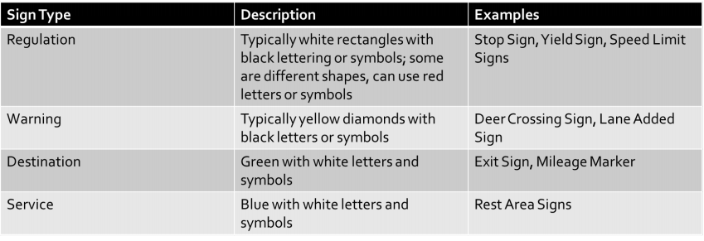
Traffic Signs
The shape and color of traffic signs give indications of the information they can provide including traffic rules, special hazards, your location, how to get where you are going, and where services are available.

Slide 9
Common Traffic Signs and Meanings
Stop Sign (Regulation)
Color: Red with white letters
Meaning:
Come to a full stop. Yield the right-of-way to vehicles and pedestrians in or heading towards the intersection. Go when it is safe.
You must come to a full stop before the stop line if there is one. If not, you must stop before the crosswalk.
If there isn’t a stop line or crosswalk, you must stop before you enter the intersection, at the point nearest the intersection that gives you a view of traffic on the intersecting roadway.

Slide 10
Common Traffic Signs and Meanings
Yield Sign (Regulation)
Color: Red and white with red letters
Meaning:
Decrease speed as you reach the intersection. Prepare to stop and yield the right-of-way to vehicles and pedestrians in or heading toward the intersection
You must come to a full stop at YIELD sign IF traffic conditions require it. When you approach a YIELD sign, check carefully for traffic and be prepared to stop.

Slide 11
Common Traffic Signs and Meanings
Other Regulation Signs
Color: White, with black and/or red letters or symbols
Meaning:
These signs give information about rules for traffic direction, lane use, turns, speed, parking, and other special requirements
Some regulation signs have a red circle with a slash over a symbol. This indicates that an action, like a right turn, is not allowed or that some vehicles are restricted from the road. Rectangular white signs with black or red letters or symbols are indications to be alert for special rules.

Slide 12
Common Traffic Signs and Meanings
Warning Signs
Color: Yellow, with black letters or symbols
Meaning:
You are approaching a hazardous location or a location where there is a special rule
A warning sign can be accompanied by a yellow and black “recommended speed” sign, indicating reduced speed is advise.

Slide 13
Common Traffic Signs and Meanings
Work Area Signs
Color: Orange, with black letters or symbols
Meaning:
People are at work on or near the roadway; traffic can be controlled by a flag person
A work area speed limit as low as 25 can be posted. Even if no speed limit is provided, you must drive at a reduced speed through the work zone and you must always obey the flag persons.

Slide 14
Common Traffic Signs and Meanings
Service Signs
Color: Blue, with white letters or symbols
Meaning:
Show the location of services like rest areas, gas stations, camping and medical facilities.

Slide 15
Common Traffic Signs and Meanings
Destination Signs
Color: Green, with white letters
Meaning:
Show the direction and distance to locations

Slide 16
Traffic Lights
Usually red, yellow, green from top to bottom or left to right
Traffic signals indicate who has the right of way at an intersection
If traffic lights are out of service or not operating correctly when you approach an intersection, you must come to a stop as you would for a stop sign. You must then continue according to the rules of right-of-way, unless you are told to continue by a traffic officer.

Slide 17
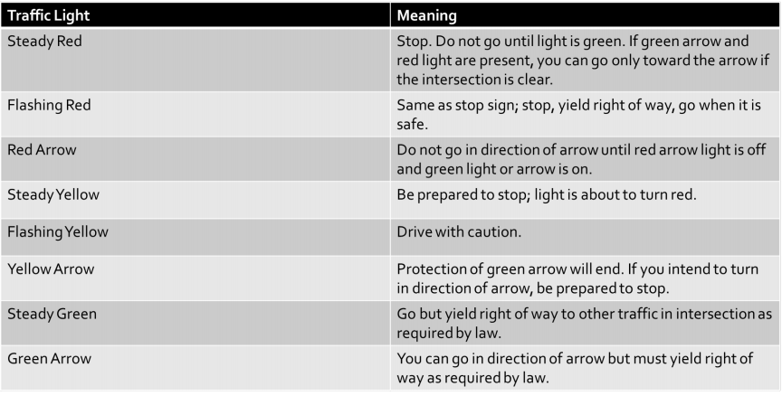
Traffic Lights and What They Indicate

Slide 18
Pedestrian Signals
Designed to allow pedestrians to cross streets safely
Some signals are automatic, some must be activated by pushing a button
Many have audible indications that corresponds with the countdown.

Slide 19

Pavement Markings
What colors are used in pavement markings?
What do pavements markings do?
Indicate when passing or lane changing is allowed
Designate turn lanes
Where to stop for traffic signs and signals
Direction of traffic

Slide 20
Edge and Lane Lines
Solid lines along the edge | Tells you where the edge is, where the travel lane ends and the shoulder begins Illegal to drive across Angled edge lines that move towards the center indicate the road is narrower ahead
White lines | Driver will always drive on the left side of white lines Multiple white lines indicate multiple lanes of traffic going in same direction
Yellow lines | Driver will always drive on the right side Oncoming traffic should be expected left of line
Solid White Lines that Run Across Lanes of Traffic | Pedestrian crosswalks Stopping line

Slide 21
White Pavement Markings
Solid White Line | Tells you where the edge is, where the travel lane ends and the shoulder begins (also called the fog line)
Dashed White Line | You can pass Usually indicates multiple lanes of traffic
White Arrows | Indicates the direction drivers should move
Double White Line | Separate travel lanes Can not change lanes for any reason
White Words | Provides information for the driver

Slide 22
Yellow Pavement Markings
Solid Single Yellow Line | If located on left edge, you are traveling on a divided highway or one-way street Marks the edge of a median or divider
Double Solid Yellow Line | Traffic is traveling in both directions You cannot pass on either side
Single Dashed Yellow Line | Traffic is traveling in both directions Both drivers can pass
Double line where one line is solid and the other is dashed | Traffic is traveling in both directions Vehicles directly to the right of dashed line can pass Vehicles directly to the right of the solid line cannot pass
Double Dashed Yellow Lanes | Reversible traffic lanes

Slide 23
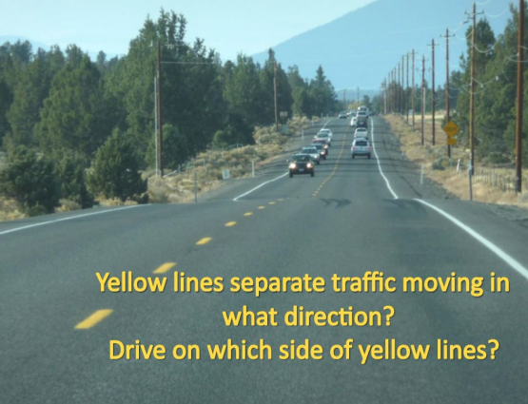
Pavement Markings
Western Oregon University. Oregon Driver Risk Prevention Curriculum Playbook. Oregon Department of Transportation.

Slide 24
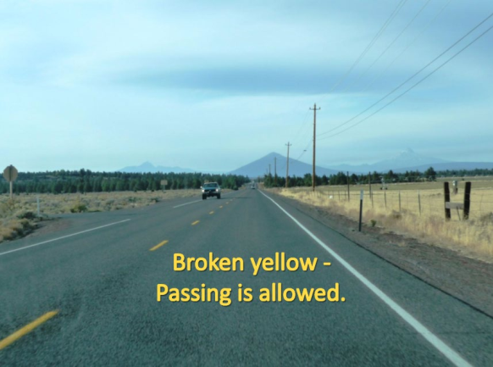
Pavement Markings
Western Oregon University. Oregon Driver Risk Prevention Curriculum Playbook. Oregon Department of Transportation.

Slide 25
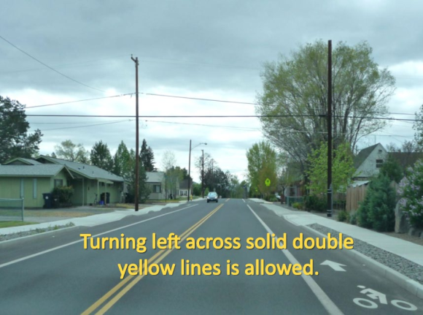
Pavement Markings
Western Oregon University. Oregon Driver Risk Prevention Curriculum Playbook. Oregon Department of Transportation.

Slide 26
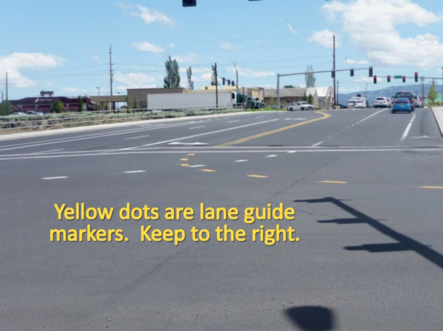
Pavement Markings
Western Oregon University. Oregon Driver Risk Prevention Curriculum Playbook. Oregon Department of Transportation.

Slide 27
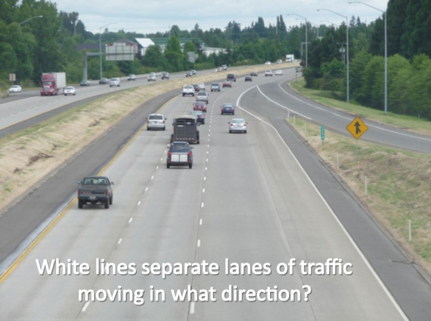
Pavement Markings
Western Oregon University. Oregon Driver Risk Prevention Curriculum Playbook. Oregon Department of Transportation.

Slide 28
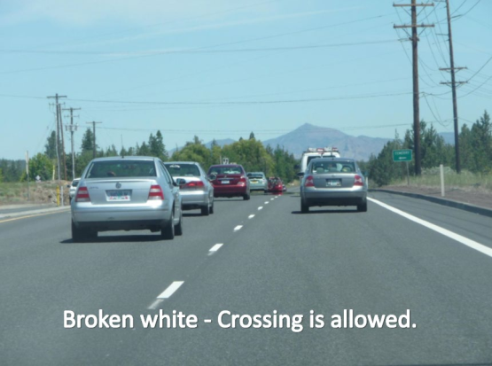
Pavement Markings
Western Oregon University. Oregon Driver Risk Prevention Curriculum Playbook. Oregon Department of Transportation.

Slide 29
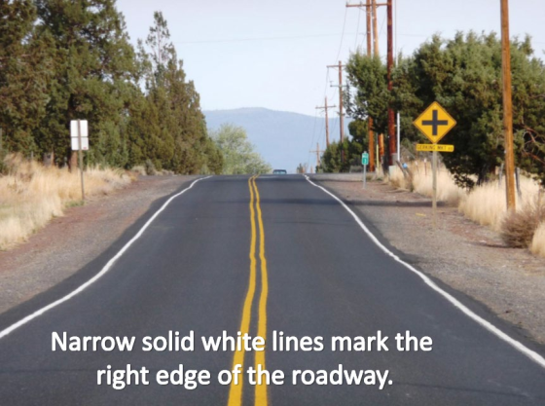
Pavement Markings
Western Oregon University. Oregon Driver Risk Prevention Curriculum Playbook. Oregon Department of Transportation.

Slide 30
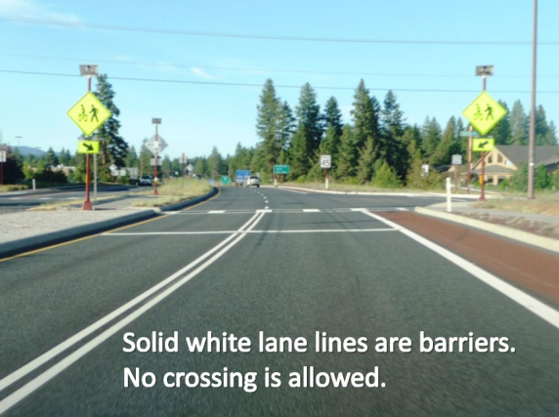
Pavement Markings
Western Oregon University. Oregon Driver Risk Prevention Curriculum Playbook. Oregon Department of Transportation.

Slide 31
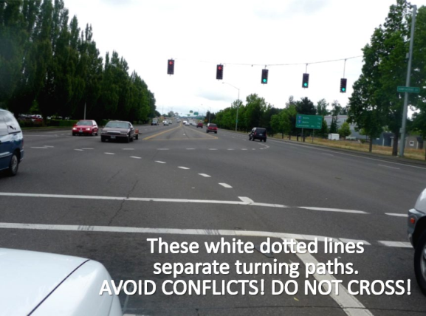
Pavement Markings
Western Oregon University. Oregon Driver Risk Prevention Curriculum Playbook. Oregon Department of Transportation.

Slide 32
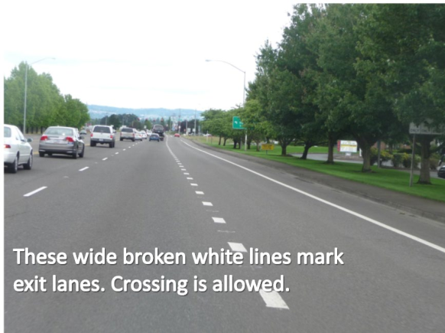
Pavement Markings
Western Oregon University. Oregon Driver Risk Prevention Curriculum Playbook. Oregon Department of Transportation.

Slide 33
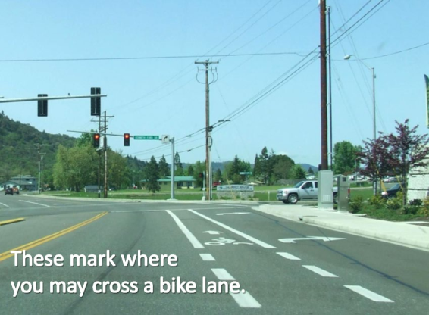
Pavement Markings
Western Oregon University. Oregon Driver Risk Prevention Curriculum Playbook. Oregon Department of Transportation.

Slide 34
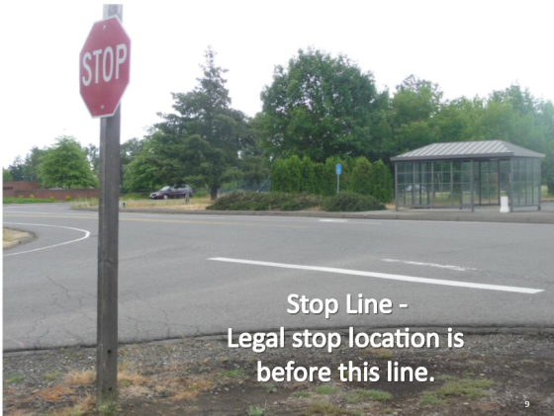
Pavement Markings
Western Oregon University. Oregon Driver Risk Prevention Curriculum Playbook. Oregon Department of Transportation.

Slide 35
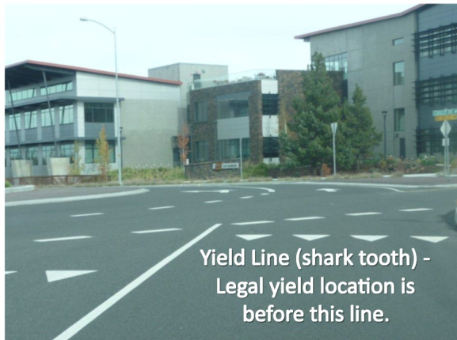
Pavement Markings
Western Oregon University. Oregon Driver Risk Prevention Curriculum Playbook. Oregon Department of Transportation.

Slide 36
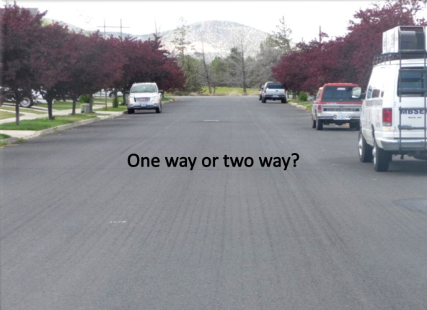
Pavement Markings
Western Oregon University. Oregon Driver Risk Prevention Curriculum Playbook. Oregon Department of Transportation.

Slide 37
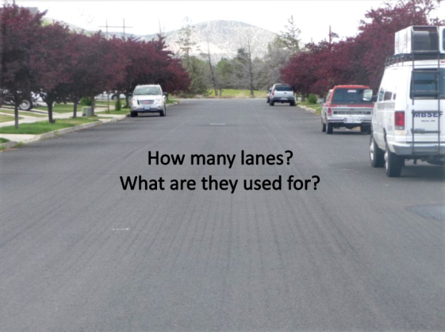
Pavement Markings
Western Oregon University. Oregon Driver Risk Prevention Curriculum Playbook. Oregon Department of Transportation.

Slide 38
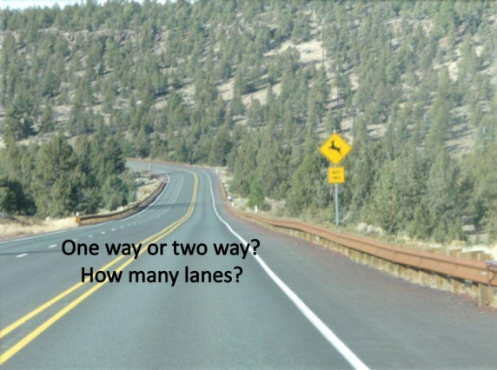
Pavement Markings
Western Oregon University. Oregon Driver Risk Prevention Curriculum Playbook. Oregon Department of Transportation.

Slide 39
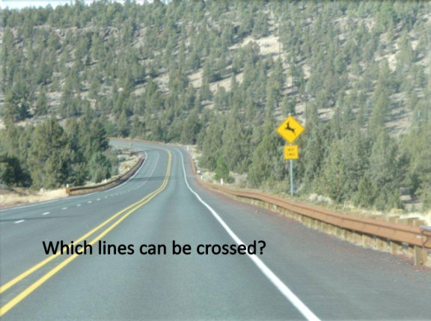
Pavement Markings
Western Oregon University. Oregon Driver Risk Prevention Curriculum Playbook. Oregon Department of Transportation.

Slide 40
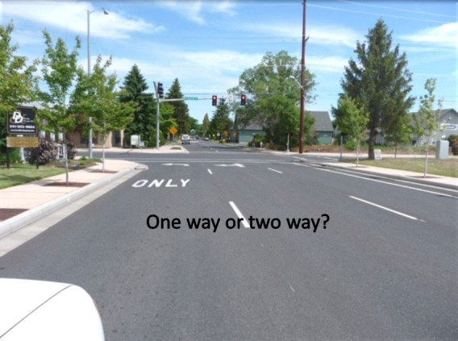
Pavement Markings
Western Oregon University. Oregon Driver Risk Prevention Curriculum Playbook. Oregon Department of Transportation.

Slide 41
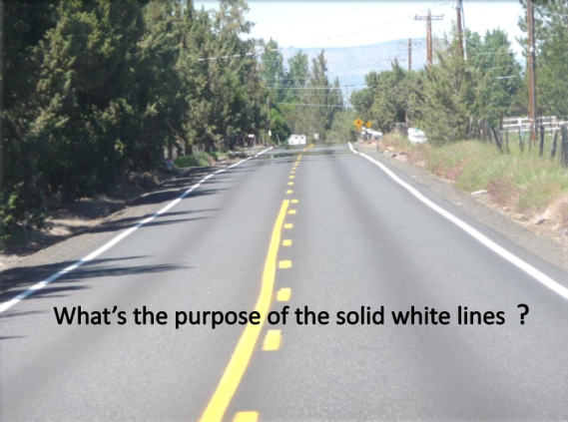
Pavement Markings
Western Oregon University. Oregon Driver Risk Prevention Curriculum Playbook. Oregon Department of Transportation.

Slide 42
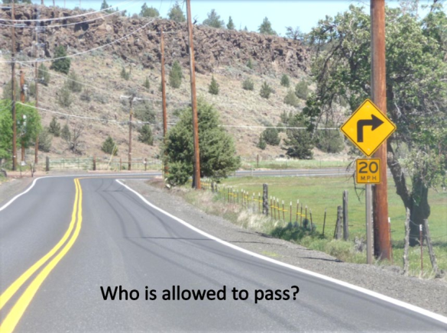
Pavement Markings
Western Oregon University. Oregon Driver Risk Prevention Curriculum Playbook. Oregon Department of Transportation.

Slide 43
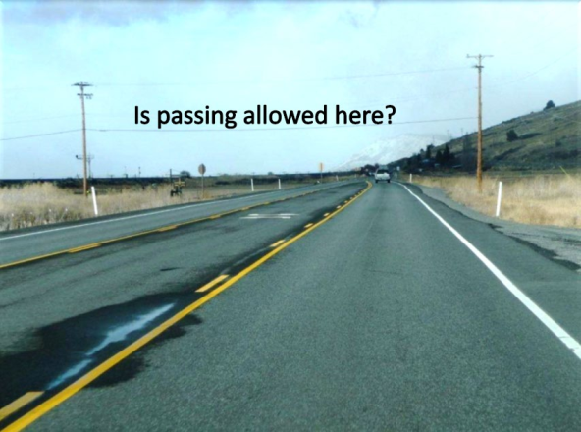
Pavement Markings
Western Oregon University. Oregon Driver Risk Prevention Curriculum Playbook. Oregon Department of Transportation.

Slide 44
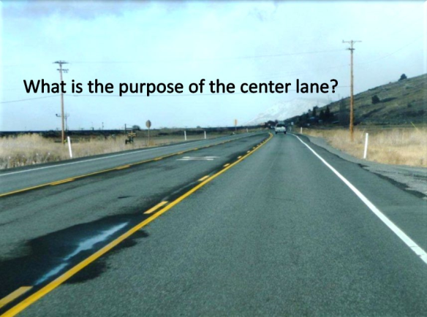
Pavement Markings
Western Oregon University. Oregon Driver Risk Prevention Curriculum Playbook. Oregon Department of Transportation.

Slide 45
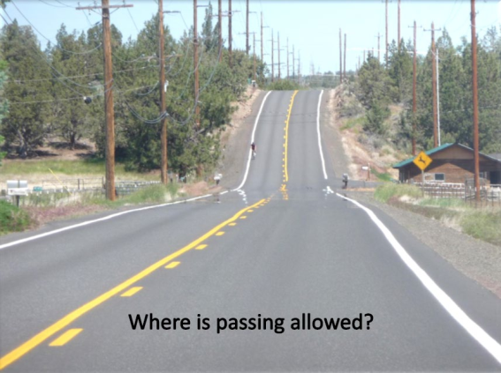
Pavement Markings
Western Oregon University. Oregon Driver Risk Prevention Curriculum Playbook. Oregon Department of Transportation.

Slide 46
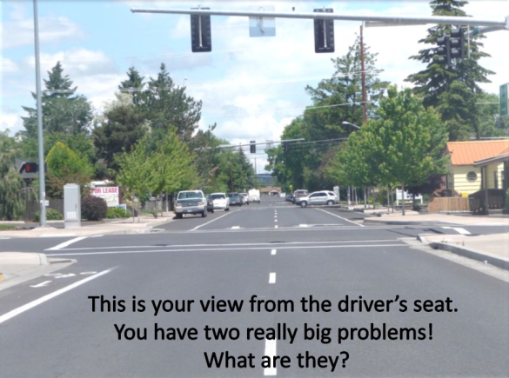
Pavement Markings
Western Oregon University. Oregon Driver Risk Prevention Curriculum Playbook. Oregon Department of Transportation.

Slide 47
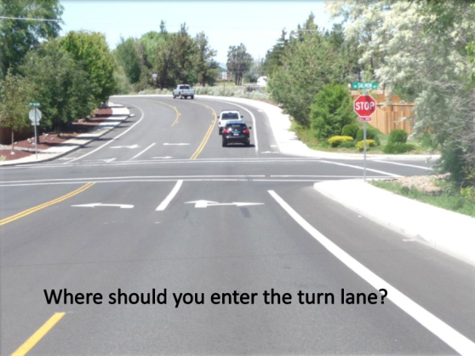
Pavement Markings
Western Oregon University. Oregon Driver Risk Prevention Curriculum Playbook. Oregon Department of Transportation.

Slide 48
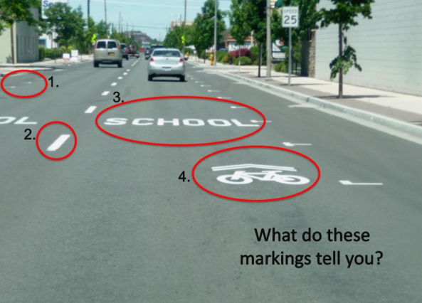
Pavement Markings
Western Oregon University. Oregon Driver Risk Prevention Curriculum Playbook. Oregon Department of Transportation.

Slide 49
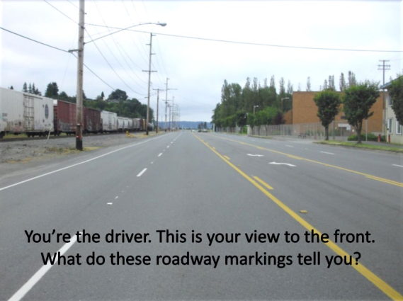
Pavement Markings
Western Oregon University. Oregon Driver Risk Prevention Curriculum Playbook. Oregon Department of Transportation.

Slide 50
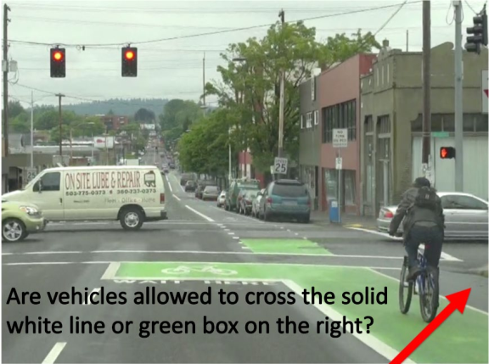
Pavement Markings
Western Oregon University. Oregon Driver Risk Prevention Curriculum Playbook. Oregon Department of Transportation.

Slide 51
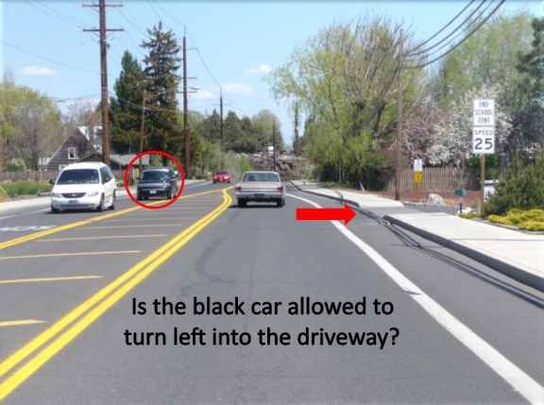
Pavement Markings
Western Oregon University. Oregon Driver Risk Prevention Curriculum Playbook. Oregon Department of Transportation.

Slide 52
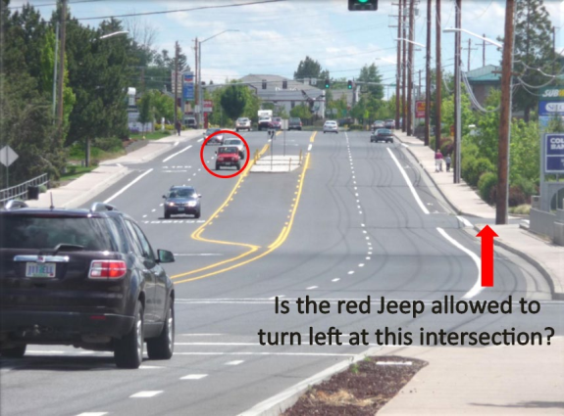
Pavement Markings
Western Oregon University. Oregon Driver Risk Prevention Curriculum Playbook. Oregon Department of Transportation.

Slide 53
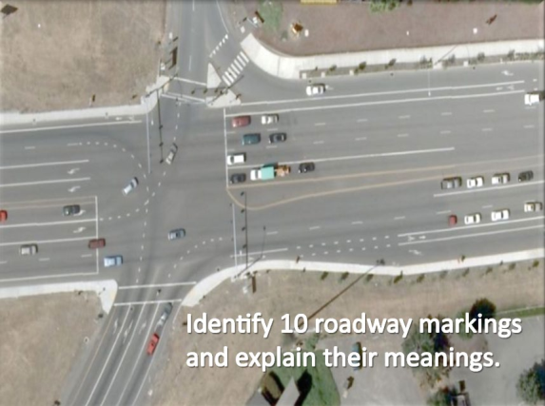
Pavement Markings
Western Oregon University. Oregon Driver Risk Prevention Curriculum Playbook. Oregon Department of Transportation.

Slide 54
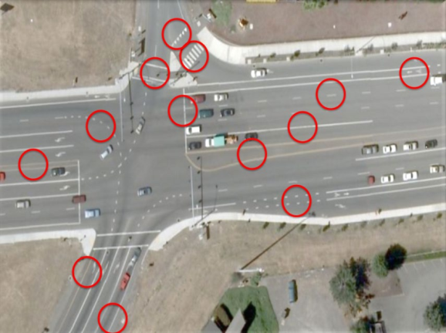
Pavement Markings
Western Oregon University. Oregon Driver Risk Prevention Curriculum Playbook. Oregon Department of Transportation.

Slide 55
Right-of-Way
Traffic signs, signals, and markings don’t always resolve traffic conflicts
Right-of-way rules help to address these conflicts. They tell you how traffic should proceed in different conditions.

Slide 56
General Right-of-Way Rules
A driver who approaches an intersection must yield the right-of-way to traffic that is in the intersection.
If drivers approaching from opposite directions reach an intersection at about the same time, a driver that turns left must yield to traffic that moves straight or turns right.
At intersections not controlled by signs or signals, or where two or more drivers stop at STOP signs at the same time and they are at right angles, the driver on the left must yield the right-of-way to the driver on the right.

Slide 57
General Right-of-Way Rules
A vehicle that enters a roadway from a driveway, alley, private road, or another place that is not a roadway, must stop and yield the right-of-way to traffic on the roadway and to pedestrians.
Drivers must yield to pedestrians who legally use marked or unmarked crosswalks. This means you must slow down or stop if necessary.
You cannot enter an intersection if traffic is backed up on the other side and you cannot get completely through the intersection. Wait until traffic ahead clears, so you do not block the intersection.

Slide 58
General Right-of-Way Rules
Be alert to cross-streets or offset intersections so that you don’t cause gridlock by blocking another street.
A driver who enters a traffic circle or rotary must yield the right-of-way to drivers already in the circle.

Slide 59
Intersections
Watch the video “Intersections: Rules of the Road” by the California DMV
https://www.youtube.com/watch?v=QHFpGAmgct4

Slide 60
Review
What shape does a regulation sign typically have?
Rectangular
What type of pavement marking shows you which lane you must use for a turn?
Arrow
Which of the following must you obey over the other three: Red light, flashing red light, stop sign, or police officer.
Police Officer

Slide 61
Review
What do these lines indicate?
One broken: You can pass other vehicles or change lanes if you can do so safely without interfering with traffic.
One solid: You can pass other vehicles or change lanes, but you can only do so when obstructions in the road or traffic conditions make it necessary.
Double solid: You cannot pass or change lanes. You cannot go across the lines except to turn left to enter or leave the highway (e.g., to or from a driveway or to do a U-turn).
Solid and broken together: If you are on the side with the solid line, you cannot pass other vehicles or go across the line except to make a left turn into a driveway. If you are on the side with the broken line, you can pass if it is safe to and you will not interfere with traffic.

Slide 62
Review
You are at a green light, but traffic on the other side of the intersection does not allow you to pass all the way through the intersection. Can you enter the intersection?
No
Does a vehicle prepared to enter a traffic circle have right-of-way over vehicles in the circle?
No

Slide 63
References
New York State Department of Motor Vehicles. New York State Driver’s Manual.

