Slide 1
Vision and Space

Slide 2
Session Goals
Explain the elements of the Smith System/SIPDE and apply to various driving situations
Determine which lane position is appropriate for driving circumstances

Slide 3
Key Vocabulary and Topics
SIPDE
Smith System
Path of Travel
Field of Vision
Fringe Vision
Central Vision
Peripheral vision
Zone control system/lane positions
Target
Target area
Targeting path
Line of Sight
Closed areas of space
Open areas of space
Blind spots
Driving limitations
Visual lead
Visual Searching
Separate
Compromise
Space Cushion
3-4 Second Rule

Slide 4
Visibility Group Activity
Instructions: Divide class into small groups and assign each group one of the below conditions that could affect visibility when driving.
Develop a list of strategies to minimize risk of your assigned situation. The list should include strategies to incorporate before and during a drive.
Glare from sun
Night driving
Rain
Snow
Fog
Dust

Slide 5
Check Your Responses
Space you will occupy
Section of roadway where target is located
Distance you can see ahead in the direction you are going
A fixed object seen in the center of the path you intend to drive 20-30 seconds in the future
The path the car will travel when focused on the target/target area
C
__Line of sight
__Path of travel
__Target
__Target area
__Targeting path
A
D
B
E

Slide 6
Check Your Responses
A safe distance between the driver’s own vehicle and any other vehicle that may be in front, along either side, or to the rear.
Adjusting speed or position to deal with one risk at a time
A method for judging safe following distance at any speed. This time should elapse between the time a vehicle clears a given point and the following vehicle clears the same point.
Accepting the least of the risks present when multiple risks that are present cannot be separated.
B
__Separate
__Compromise
__Space Cushion
__3-4 Second Rule
D
A
C

Slide 7


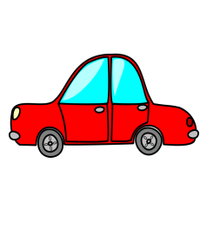
Field of Vision
Central Vision
(Viewing Path of
Travel)
FocalVison (Targeting, Reading Signs)
The task of driving is 90% visual input.
Peripheral
Vision (Motion
and Color
Changes)

Slide 8
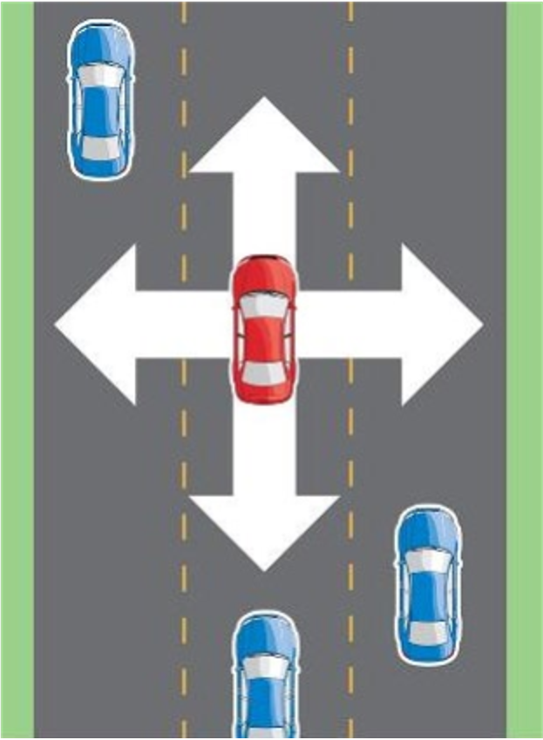
Space Cushion
Think of it as a protective bubble around your car
The extra space will help you move in case of an emergency or hazardous situation.
Always leave yourself an out!
Try to maintain a space cushion in the front and on at least one side of your vehicle
The area hardest to manage a space cushion is the rear of the car
Courtesy of AARP’s Smart Driver Course. (2013, September 3). Speed Management – Safety is in Your Hands

Slide 9
Brainstorm Activity
Working in small groups, discuss how vehicle speed, physical environment, and weather conditions affect visual space and following distance.
Explain how you would determine safe visual space and following distance in rain, snow, or when driving in heavy traffic.

Slide 10
Blind Spots
Blind spots are areas around the vehicle that cannot be directly observed by the driver while at the controls.
They can be caused by the window pillars, head rests, passengers, and other objects.

Slide 11
Compensating for Blind Spots
When changing lanes, remember to execute a signal (to let other know your intention), check your mirrors, and complete a head check in the direction you intend to move.
You also might have to lean forward or to a side to view the space you wish to enter.

Slide 12
Knowing Where and What to Search for
Look for road signs and traffic control devices to provide directional information, road conditions, hazards, and regulatory information
Look for oddities such as slowed traffic in areas where traffic should be moving quickly
Are there obstructions in the way of your sight?
Are there distractions on the side of the road, such as pedestrians?
Is the sun coming up/going down?
Will the weather be changing in your drive?

Slide 13
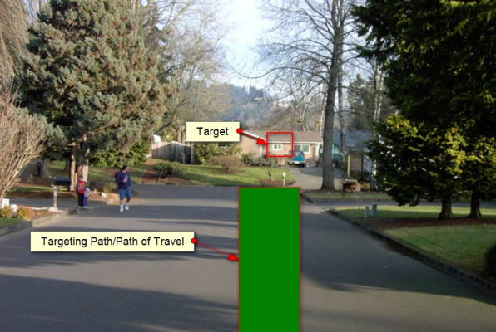
Using Targets and Path of Travel
The target is a fixed object seen in the center of the path you intend to drive (Path of travel).
Johnson, M. Drive Right, 4th Edition, pp. 75-76; Prentice Hall

Slide 14
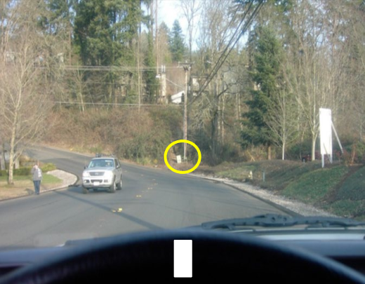
Use Your Steering Wheel
You can use the steering wheel to reference the alignment of the car to the target and to the road.
When the car is on target, you will see the center of the steering wheel aligned to the target.
Johnson, M. Drive Right, 4th Edition, pp. 75-76; Prentice Hall

Slide 15
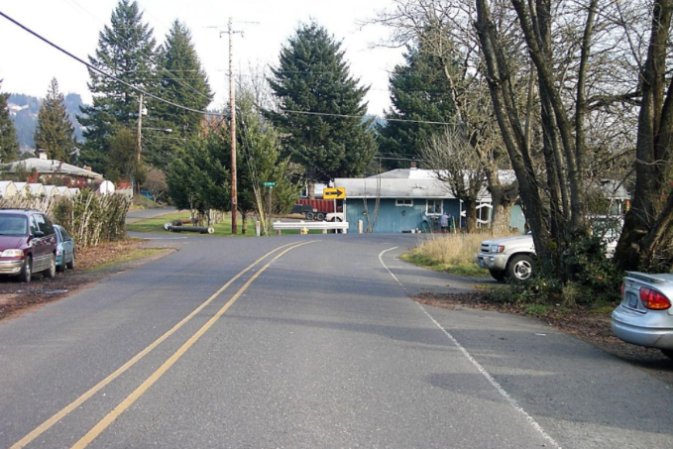
Practice
Where is your target?
Johnson, M. Drive Right, 4th Edition, pp. 75-76; Prentice Hall

Slide 16
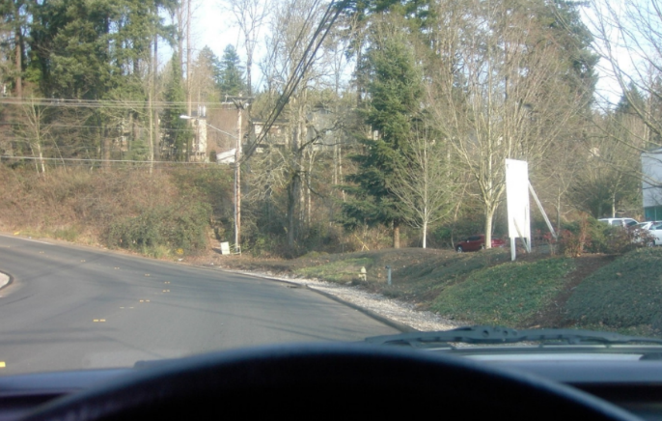
Practice
Is the car on target?
Johnson, M. Drive Right, 4th Edition, pp. 75-76; Prentice Hall

Slide 17
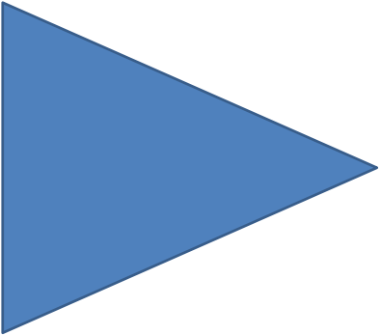
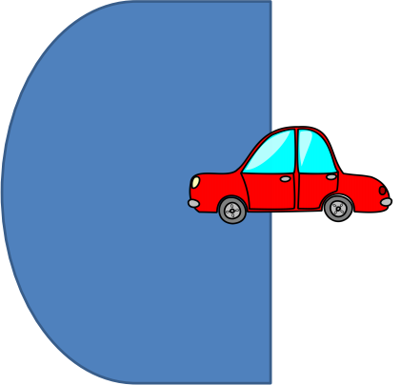
Putting Theory Into Practice
Central Vision
(Viewing Path of
Travel)
Focal Vison (Targeting, Reading Signs)
Peripheral Vision (Motion and color changes)

Slide 18
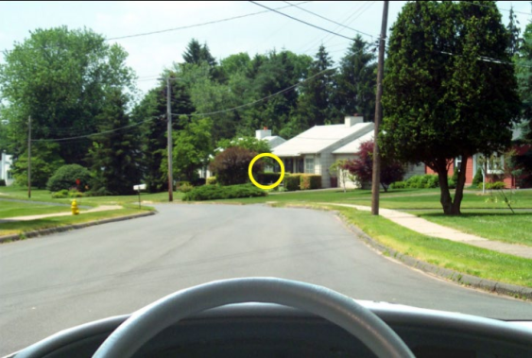
Theory to Real-Life
Focal vision is a narrow, focused vision which is used to identify detail and objects. (5-10 degrees straight in front of you)
We see the target with our Focal Vision.
Johnson, M. Drive Right, 4th Edition, pp. 75-76; Prentice Hall

Slide 19
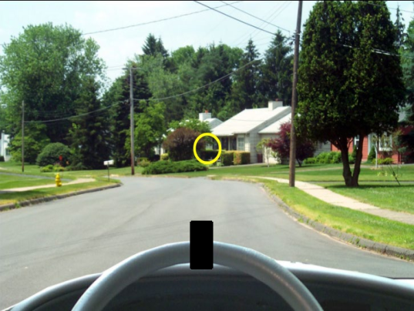
As we look ahead, we can tell how the car is aligned to the target by seeing the target with our Focal Vision and steering wheel with our central vision (30 – 36 degrees)
Vehicle to roadway reference
Viewing path of travel
Viewing line of sight to target area
Central Vision
Focal Vision
Peripheral Vision
Johnson, M. Drive Right, 4th Edition, pp. 75-76; Prentice Hall

Slide 20
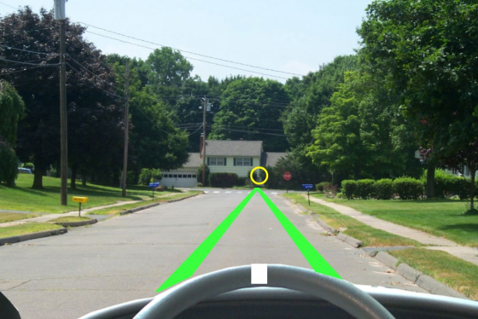
Use your central vision to see the car aligned to the target.
The edges of the steering wheel indicate where the car’s tires will travel on the road.
Johnson, M. Drive Right, 4th Edition, pp. 75-76; Prentice Hall

Slide 21
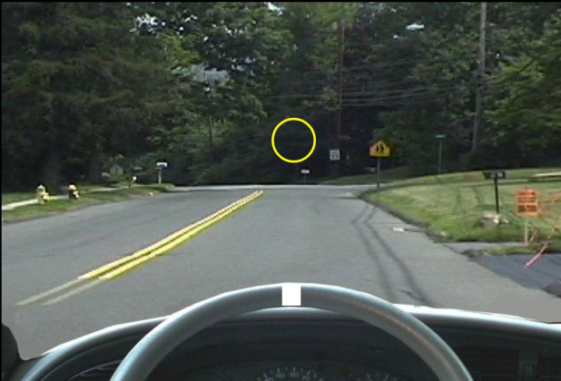
This car is on target. See how the center of the steering wheel aligns with the target.
Johnson, M. Drive Right, 4th Edition, pp. 75-76; Prentice Hall

Slide 22
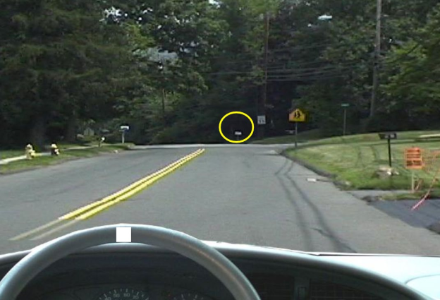
This car is off target
Johnson, M. Drive Right, 4th Edition, pp. 75-76; Prentice Hall

Slide 23
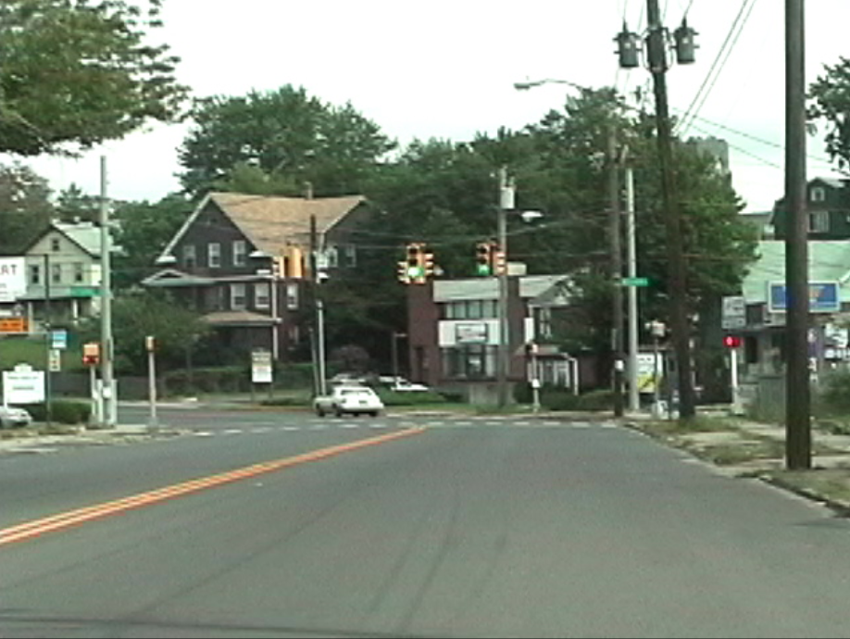
Where is your target if you intend to make a left turn?
Johnson, M. Drive Right, 4th Edition, pp. 75-76; Prentice Hall

Slide 24
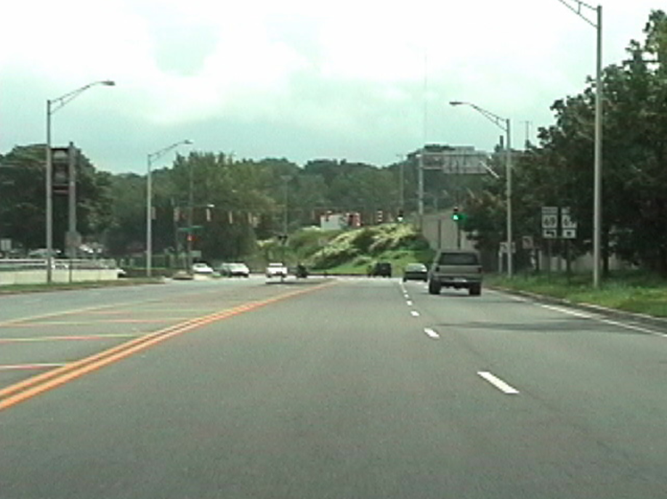
Where is your target if you’re intending to make a right turn?
Johnson, M. Drive Right, 4th Edition, pp. 75-76; Prentice Hall

Slide 25
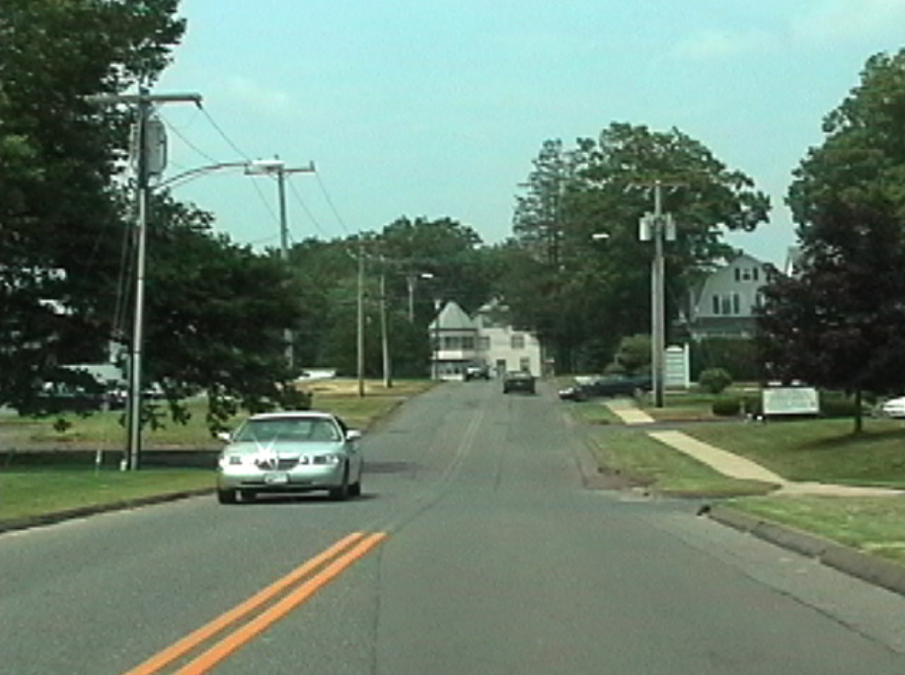
What is your target?
Johnson, M. Drive Right, 4th Edition, pp. 75-76; Prentice Hall

Slide 26
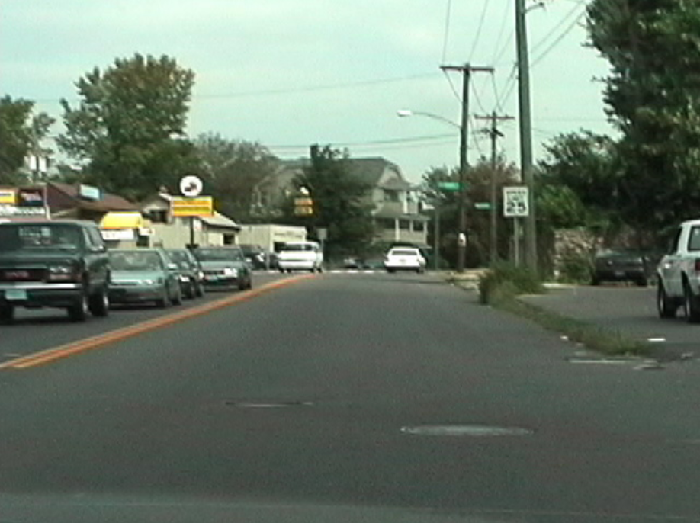
What is your target?
Johnson, M. Drive Right, 4th Edition, pp. 75-76; Prentice Hall

Slide 27
Defensive Drivers Thought Activity
You are not out on the road alone in that you must deal with many different situations, road conditions, and road users.
Let’s take a minute to think about what it takes to be a “safe driver”. Write down 5 things that you think safe, defensive drivers do.

Slide 28
What Does Defensive Driving Mean?
Driving carefully
Making good decisions. The more you learn, the better decisions you’ll make.
Compensating for others

Slide 29
Smith System
Aim high in steering (look far ahead)
Get the big picture (look for hazards)
Keep your eyes moving (don’t stare)
Make sure other highway users see you
Leave yourself an out (space cushion)

Slide 30
SIPDE Process
S – Search the area ahead and around your vehicle (20-30 seconds, 12-15 seconds, 3-4 seconds; front, sides, and rear of your vehicle; central, fringe, and peripheral)
I – Identify hazards and escape routes
P – Predict what other drivers will do
D – Decide on an action to take given any situation
E – Execute that action (continue as is, brake, or engage in evasive steering)

Slide 31
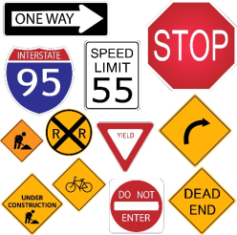
Search
Search for other roadway users
Roadway features & conditions
  Intersections
  Hills
  Blind corners
  Changes in surface or conditions of roads
  Roadside hazards
Signs, signals, and markings

Slide 32
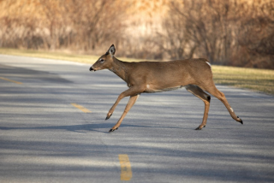
Identify
Identify potential hazards in your immediate path of travel such as animals crossing the road, workers and equipment in work zones, trash in the roads, unsecured loads in the back of pickup trucks, etc.

Slide 33
Predict, Decide and Execute
Rely upon your experience and knowledge of the rules of the road to predict the actions of other drivers, their potential paths of travel, and what conflicts could result.
Decide in advance on what safe action you should take if you come across a hazard (e.g. change your speed, change your direction)
Communicate your intended safe action to other drivers and execute
Western Oregon University. Oregon Driver Risk Prevention Curriculum Playbook. Oregon Department of Transportation.

Slide 34
Zone Control System
A zone refers to one of the six spaces around your vehicle. It is the width of a traffic lane and extends as far as you can see.
Right Front Zone
Right Rear Zone
Front Zone
Space Occupied by Your Vehicle
Rear Zone
Left Front Zone
Left Rear Zone
Direction of Travel

Slide 35
Zone Control System
A zone can be open, closed, or changing
Open Zone: No restrictions on sight or travel path
Closed Zone: The travel path is unavailable because it is blocked by another vehicle or there is an obstruction blocking the driver’s view
Changing Zone: The travel path will shortly be occupied by another driver or the driver’s view will soon be blocked by an obstruction

Slide 36
Driving Limitations
Limited Space – narrow road, heavy traffic, overpass, underpass, large vehicles, placement of other vehicles.
Limited Time – following distance, changing speeds, speed of other vehicles
Limited Visibility – curves, hills, adverse weather, visual noise (buildings, parked cars, trees, snowbanks, fences, etc.)
Limited Traction – adverse weather, gravel, different road types/conditions

Slide 37
Lane Position
The width of the lane allows drivers to make lane position adjustments to minimize the risk and create more space between their car and problem situations.
LP1 – Center of the lane
LP2 – Left edge of the lane (on yellow line)
LP3 – Right edge of lane (one white line)
LP4 – Over yellow line
LP5 – Over white line
LP1
LP2
LP3
LP4
LP5

Slide 38
Which Lane Position Would You Use?
There is a car on the right signaling to leave the curb
Vehicle is approaching you, driving on the center lane
Light traffic, traveling on the highway
Police officer conducting a traffic stop on the shoulder
LP1
LP2
LP3
LP4
LP5

Slide 39
Review
Your field of vision consists of three parts. What are they?
  Central vision, fringe vision, and peripheral vision
Which part of your field of vision helps you determine motion changes and color changes, but is blurry?
  Peripheral vision
This part of your field of vision is clear and sharp, but very small, so you must keep your eyes moving.
  Central vision

Slide 40
Review
What does the acronym SIPDE stand for?
  Search, Identify, Predict, Decide, & Execute
How can you adjust your vehicle to upcoming hazards?
  By changing your lane position to reduce risk

