Slide 1
Driving Maneuvers

Slide 2
Session Goals
Identify all vehicle controls and demonstrate an understanding of their importance as they relate to starting, braking, acceleration, and steering a motor vehicle.
Recognize and demonstrate an understanding of the natural laws and forces encountered when driving, and their apparent risk while operating a motor vehicle.
Describe and execute important driving maneuvers, including parallel parking, three-point turns, lateral maneuvers and perpendicular/angle parking.

Slide 3
Key Vocabulary and Topics
Steering techniques
  Hand over hand
  Push and pull
Changing lanes
SMOG
Pulling away from curb
Lateral moves
Oversteering
Understeering
Right hand turns
Left hand turns
U-turn
Two-point turn
Three-point turn
Parallel parking
Angle parking
Perpendicular parking
Reference parking points
Uphill/downhill parking
Backing left and right

Slide 4
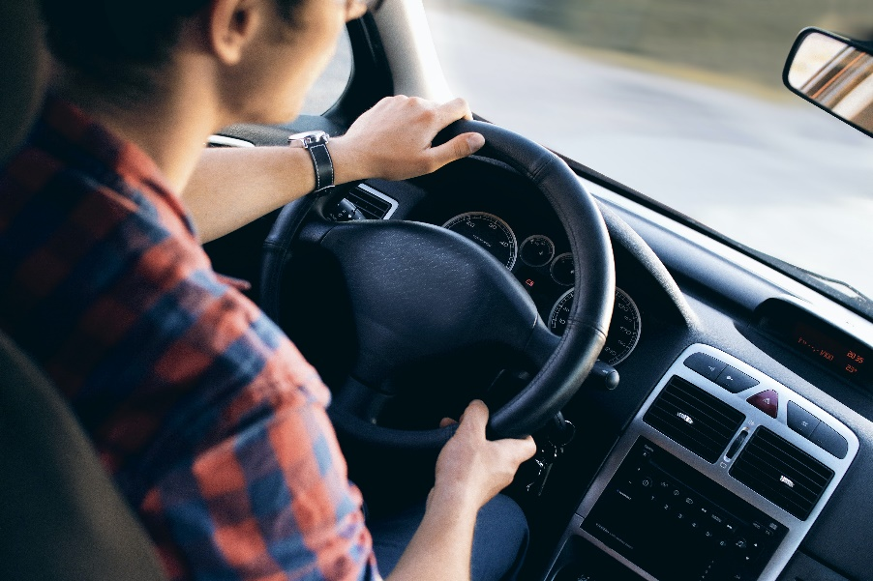
Review of Steering Techniques
Three steering techniques
  Hand-over-hand
  Hand-to-hand
  One-hand steering
Make sure to keep your thumbs poised on the outside of the wheel rather than using a full, tight grip

Slide 5
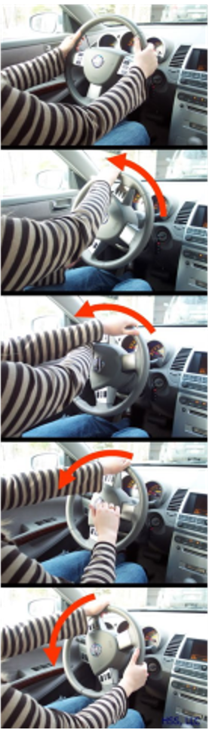
Hand-Over-Hand Steering
Place your hands at the 9 & 3 o’clock positions on the steering wheel
If making a Left turn - Use your right hand to push the wheel up and around until you reach the 12 o’clock position
Your left hand then will cross the right hand to continue pulling in the left turn
For a right turn – Use your left hand to push the wheel up and around until you reach the 12 o’clock position
Your right hand then will cross the left hand to continue pulling in the right turn
Once through your turn, loosen your grip on the steering wheel and let the steering wheel adjust itself so that the vehicle is going straight on the road
National Highway Traffic Safety Association. Using Efficient Steering Techniques

Slide 6
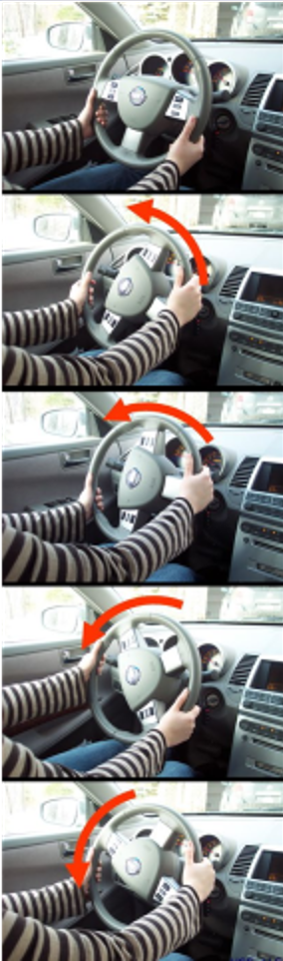
Hand-to-Hand Steering
Beginning at the 9 & 3 o'clock positions on the wheel, one hand pushes up on the steering wheel while the other hand slides to the top and then pulls the wheel down, repeating the action until the turn is complete.
This is sometimes called “feeding” the wheel, “push/pull steering” or “H-T-H” hand to hand steering technique. Both hands are always employed in the steering and wrists never cross.
Which technique works best for you; Hand-to-Hand or Hand-Over-Hand?
National Highway Traffic Safety Association. Using Efficient Steering Techniques

Slide 7
One-Handed Steering
You can not pass your road test if you do one-handed steering. You must have both hands on the wheel.
Why is it not recommended to use one-handed steering?
When is it appropriate to use one handed steering?

Slide 8
Steering Discussion
What is the correct hand position for driving on a straightaway?
What is the correct hand position when backing up a vehicle?
How do you know your wheels are straight?
Why don’t you want to wrap your thumbs around the wheel?

Slide 9
Mirror Review
Reminder: Your mirrors are essential for all driving maneuvers!
When/how often should a driver use their mirrors?
How do you know if your mirrors are adjusted properly?
Should you adjust all the mirrors for night driving?

Slide 10
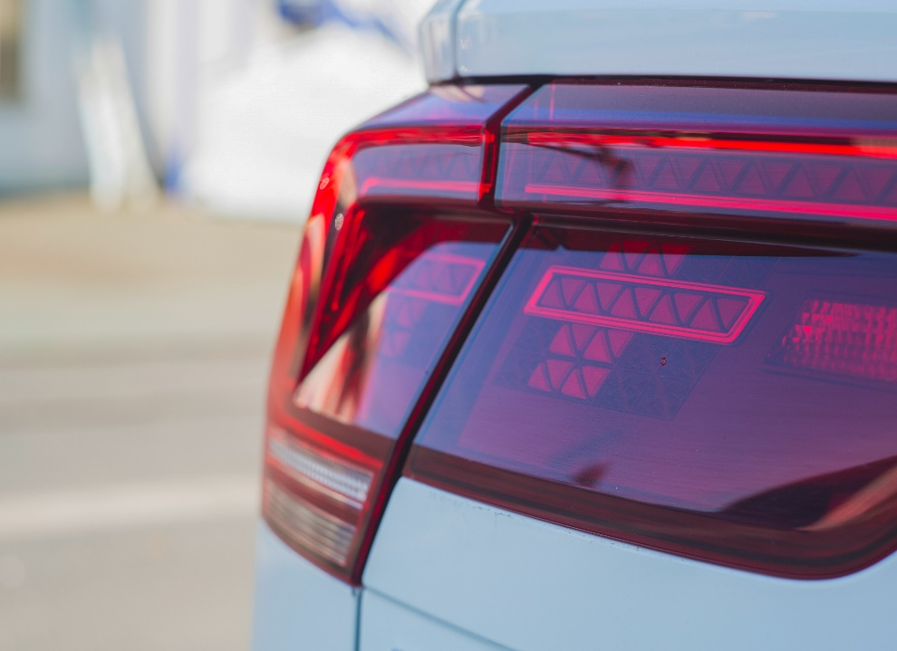
Using Your Turn Signals
Develop the habit of using your turn signals EVERY TIME you plan to turn, change lanes, slow, or stop. This allows you to be seen by other drivers by attracting their attention.
You should signal at least 100-150 feet before you turn in residential areas. You do not want to signal so far ahead of your turn that it causes confusion with other turns ahead.
Signal at least 200 feet before if you are in the country or traveling at higher speeds.
Why do you think people don’t use their turn signals?

Slide 11
Lateral Movement: Pulling Away from a Curb or Lane Changing
Before changing your lane position (e.g. changing lanes or pulling away/to a curb), you must determine if the zone is open or closed or changing.
You must signal your intention to change your position by using your turn signal
Use the acronym SMOG to help you remember the steps
  S – Signal intention
  M – Mirror checks
  O – Observe
  G - Go

Slide 12
Pulling Toward a Curb
Signal, check your mirrors, observe blind spots and the area around your vehicle, then brake.
Why should you signal first then brake?
Note: After parking at the curb, your wheels must not be more than one foot from the curb.
Look before you open the door and get out! Are you going to open it while cars or bicyclists are passing?

Slide 13
Pulling Away from the Curb
Turn your signal on to show you want to move into traffic
Check all your mirrors
  Check your rearview mirror for pedestrians, bicyclists, motorcyclists, and other vehicles
  Are there any other potentials you can spot in your rearview mirror? (close and oncoming)
  Check your side mirrors? Do you see hazards near and approaching?
Move your body and observe to the front of you, to the rear of you, and to the back of you
When path is clear, you can accelerate smoothly into the lane (Go).
Don’t forget to turn off your turn signal!

Slide 14
Check for Understanding – Activity 1
Explain the proper way to hold and adjust your steering wheel to assist in control and safety
How do you know if your wheels are straight?
When should you engage your turn signal?
What does the acronym SMOG stand for?
What is one of the first steps to take when preparing to pull away from the curb?

Slide 15
Turning: Key Concepts
Signal 100-150 feet before the turn. Avoid signaling earlier than this to avoid any confusion about where you are planning to turn.
Slow before you make the turn – Start slowly accelerating mid-way through the turn to complete it.
Going too fast through a turn can cause you to overturn your car! You should not exceed 10-15 MPH on a 90 degree turn.
Turning wide is also a problem for many drivers. It is caused by turning too late or failing to reduce speed in advance of the turn.
Review Chapter 5 of the NYS Driver’s Manual for Additional Information

Slide 16
Additional Considerations When Preparing to Turn
Search for traffic (e.g. vehicle, pedestrian, motorcycle and bicycle) on all sides of your vehicle. Look twice!
Most crashes involving pedestrians, motorcyclists, and bicyclists are because the driver did not see them.
Oversteering occurs when the car turns more than the driver intends when the rear tires lose grip and come around the car causing it to spin if not corrected.
Understeering occurs when your tires lose traction. Although the driver intends to turn, the vehicle continues forward.

Slide 17
Making Right Hand Turns
Signal 100 – 150 feet before the turn without causing confusion of which turn you are going to make
Slow down BEFORE the turn. 10-15 mph should be sufficient for a 90 degree turn
Did you check your mirrors? What are you looking for? (Left, right, rearview)
Enter Lane position 3 (right side of lane)
Right before you approach the turn – Look again for pedestrians, hazards, or stopped traffic

Slide 18
Making Right Hand Turns
Look where you want the vehicle to go
Make sure the front wheel follows the turn of the curb and clears before you steer all the way right
Recovery – Start straightening the wheel about ½ way through the turn
Slowly accelerate midway through the turn to get through it.
Get back up to speed when the vehicle has completed the turn

Slide 19
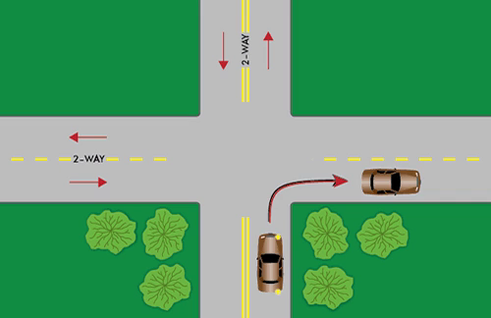
Right Turn Example
This short clip will illustrate how to make a right turn
https://dmv.ny.gov/about-dmv/chapter-5-intersections-and-turns

Slide 20
Making Left Hand Turns
Signal 100 – 150 feet before the turn without causing confusion of which turn you are going to make
Slow down BEFORE the turn. 10-15 mph should be sufficient for a 90-degree turn
Right before you approach the turn – Look again for pedestrians, hazards, or stopped traffic
Did you check your mirrors? What are you looking for? (Left, right, rearview)
Enter Lane position 2

Slide 21
Making Left Hand Turns
Look where you want the vehicle to go
Make sure the front wheel follows the turn
Recovery – Start straightening the wheel about ½ way through the turn
Slowly accelerate midway through the turn to get through it.
Get back up to speed when the vehicle has completed the turn

Slide 22
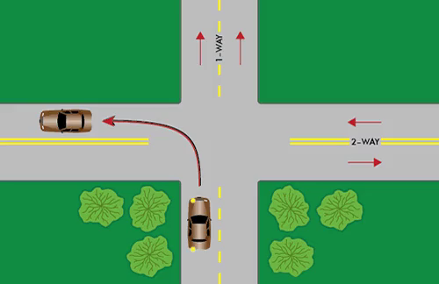
Left Hand Turn Example (One Way to Two Way Road)
https://dmv.ny.gov/about-dmv/chapter-5-intersections-and-turns

Slide 23
Backing Left and Right
Before you back up
  Check for traffic, pedestrians, parked vehicles, telephone poles, or any other object that is in your path of travel
  You need to look all around you, just like an owl!
Keep both hands on the wheel when backing up and turning. Physically turn and look in the direction you want to back the vehicle to.
The vehicle will move in the same direction the top of the wheel is turned.
Back slowly. Make quick glances to the front and sides of the car to be sure your path is clear
Be aware that the front of the vehicle will swing out wide in opposite direction from the rear of the vehicle.

Slide 24
Checking for Understanding Activity
When do you signal for a turn in residential areas? Is it different when driving in country?
What should your speed be for a sharp 90 degree turn?
Explain understeering and oversteering
What is recovery when associated with turning?
What steps would you take in order to back to the left?

Slide 25
Turning Around: General Tips
Be smart – select the SAFEST way to turn around
Usually, the safest method is to drive around the block or pull into parking lot
Backing into a driveway and then driving forward out of the driveway is typically safer than backing out. Why do you think this is?
SMOG and “roll slow, steer fast” as you execute control and visibility when backing is necessary.

Slide 26
Don’t Attempt to Turn Around
Near the crest of a hill, curve, or any location where visibility from oncoming or vehicles behind you is an issue
On an entrance/exit ramp
On a highway or fast-moving road
Near a busy intersection or in busy traffic
In a school zone
Where a sign says that turning around is prohibited (No U Turn)

Slide 27
U-Turns
Signal right in advance of your turn, check your mirrors, begin breaking, pull into lane position 3 and STOP
Engage the left signal. Look in front of you (oncoming traffic), behind you (traffic approaching behind you), to the left of you (Pedestrians other obstructions), to the right of you (Pedestrians)
Look to the Left and front of you one more time
If all clear, turn your wheel all the way to the left as it will go. Gradually move the vehicle towards the other side of the road

Slide 28
U-Turns
Keep vehicle moving smooth and steady – ROLL SLOW, STEER FAST
Accelerate once you have determined that you can clear the opposite curb
Keep moving through the turn
Make sure your turn signal is turned off!

Slide 29
2-Point Turn
Allows you to change direction using a driveway or cross street. Point refers to the place the vehicle stops to turn the wheel for both 2-Point and 3-Point turns.
Put on your turn signal and slow down as you get ready to pull in the driveway or street
Drive past the entrance (e.g. driveway or road) you wish to back into
Ensure there are no pedestrians, bicyclists, vehicles, or other obstacles in your path of travel
Put the vehicle into reverse and turn in the direction you want to back your car into

Slide 30
2-Point Turn
Once in the driveway, turn your wheel straight and stop when your vehicle is completely out the road
Turn your signal on again to the direction you wish to turn.
Look for pedestrians, bicyclists, vehicles, or other obstacles in your path of travel
When clear, make the left or right turn on to the roadway

Slide 31
3-Point Turn (K-Turn, Broken U-Turn)
Signal with your right turn signal, then pull into lane position 3 (right side of road) and STOP.
Signal with your left turn signal
Check for pedestrians, bicyclists, vehicles, or other obstacles in your path of travel
Turn left and go across the road (ROLL SLOW, STEER FAST) and stop when you approach the left curb
Look again for traffic and obstacles in your path of travel. Put your car in reverse and backup to the right to the opposite curb. STOP.
Look one final time for obstacles in your path of travel. Place the car in Drive and pull away from the curb proceeding in your new direction.
Remember: Slow vehicle – fast hands; try to time the speed of the turn so that you aren’t grinding the tires.

Slide 32
Check for Understanding – Activity 3
What is the first step in executing a U-Turn?
What does a “Point” refer to when discussing 2 and 3 point turns?
What are some other names for a 3-Point turn?
What is the steering sequence for a 3-Point turn, starting from after you have pulled over to the side of the road?

Slide 33
Parallel Parking Tips
Signal your intentions first to move to the curb then slow and brake
Select a space that is large enough for your vehicle to back into
Pull up beside the vehicle you wish to park behind to the point where your side mirror is next to the other vehicles’ side mirrors
Look for obstacles in your path. Back the vehicle slowly and begin to turn your steering wheel completely to the right swinging the front of the car out.
When your side mirror approaches the right bumper of the other vehicle, turn your wheel to the left to swing the front of the vehicle in towards the curb.
Continue backing into the space until the car is completely in
Shift car into Drive. Pull ahead to straighten the car.
See https://dmv.ny.gov/about-dmv/chapter-7-parallel-parking for additional instructions

Slide 34
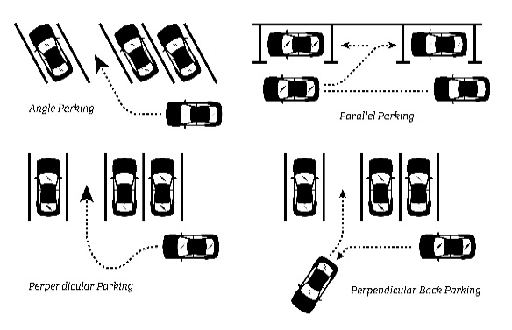
Perpendicular and Angle Parking

Slide 35
Perpendicular Parking - Entering
Pulling in at a right angle to the curb, between two vehicles:
Locate your space
SMOG
Move as far away as possible from the space you are planning to enter
Turn into the space when the passenger mirror is in line with the white line of the parking space
Steer into the space, watching for the turning radius
Straighten wheels when you are about halfway into the space
Make sure you don’t pull too far forward (the curb/perpendicular line will be just below your side mirrors)

Slide 36
Perpendicular Parking - Exiting
Place the vehicle gear into reverse, making sure the wheels are straight
Look 360 before vehicle moves, like an owl
Back slowly as necessary, looking all around the entire time
Keep straight until your front tire is lined up with the back tires of the other vehicle
Steer slowly in the correct direction to finish the back out
Remember to look back in the direction that you want the vehicle to go and steer in that direction
Watch to insure that bumpers don’t “kiss”

Slide 37
Angle Parking
Pulling in at a diagonal angle to the curb, between two vehicles
Locate your space
SMOG
Move as far out away from the selected space as possible
Look to see the very end of the space before turning in
Aim for the center as necessary
Stop without going too far forward as you rewind the wheel (the curb edge will appear just below your side mirror)

Slide 38
Angle Parking - Leaving
Place your vehicle in Reverse and straighten the wheels
Look 360 degrees BEFORE you move your car
Back slowly, continuing to look all around your vehicle
Keep straight until your bumper clears the other parked vehicles
Steer in the correct direction to finish
  Top of wheel steers to the right, vehicle moves to the right
  Top of wheel steers to the left, vehicle moves to the left

Slide 39
Parking on a Hill
Make sure you turn your wheels in the correct direction to ensure that the vehicle will not roll into traffic
With a curb
  Facing downhill, turn front wheels towards the curb, using it as a block
  Facing uphill, turn the front wheels way from the curb, using it as a block should the car go in reverse
With no curb
  Facing uphill or downhill, turn your tires to the right so your vehicle will roll off the road and not into traffic
Always make sure your vehicle is in park if it is an automatic (first gear if a manual transmission). Make sure you engage the parking/emergency brake for extra safety.

Slide 40
Review
When performing a parking maneuver, it is important that the vehicle rolls slowly, but your hands steer ______
  Quickly
What is a checkpoint or reference point? Name one checkpoint regarding parallel parking
  A guide to a successful set up for parking. Line up mirror to mirror to ensure the vehicle starts in a parallel position to the vehicle being parked behind.
When parallel parking, are signals required and if so, what/when would you signal?
  Yes. Signal to slow before stopping. Signal right to indicate turning back with back up lights on. Signal to leave the space and re-enter traffic.
List two checkpoints when executing perpendicular parking?
  Center your vehicle in the parking lot lane; begin turning when you can see the end of the parking space you are turning into, don’t oversteer.

Slide 41
Review
When parking downhill with a curb, which way do you turn your when and what precautions should you take when securing your vehicle?
  Point towards the curb. Set the parking brake.

Slide 42
References
New York State Department of Motor Vehicles. New York State Driver’s Manual.

