Slide 1
Driving in Different Environments

Slide 2
Session Goals
Understand the major types of roadways that make up the Highway Transportation System, the key differences of driving in rural, urban, and multi-lane settings, and how to manage risk and remain safe while driving on these roads.

Slide 3
Key Vocabulary and Topics
Acceleration lane
Entrance/exit ramp
Expressway
Urban roadway
Rural roadway
Overtaking
Cruise control
Merge point area
Rural roadway
Shared left-turn lane
Slow moving vehicle
Techniques: Isolate, Separate, Compromise, Minimize hazards
Characteristics of different driving environments
Limited visibility, space and traction situations
School zone
Advisory speed
Basic speed laws
Point of no return
Yielding right of way
Protected lanes
Collector lanes

Slide 4
Driving Environments Brainstorm
How do driving environments change?
How should we adjust our driving techniques in those different environments?

Slide 5
Different Driving Environments
Residential areas
Urban areas
Rural areas
Highways/Expressways

Slide 6
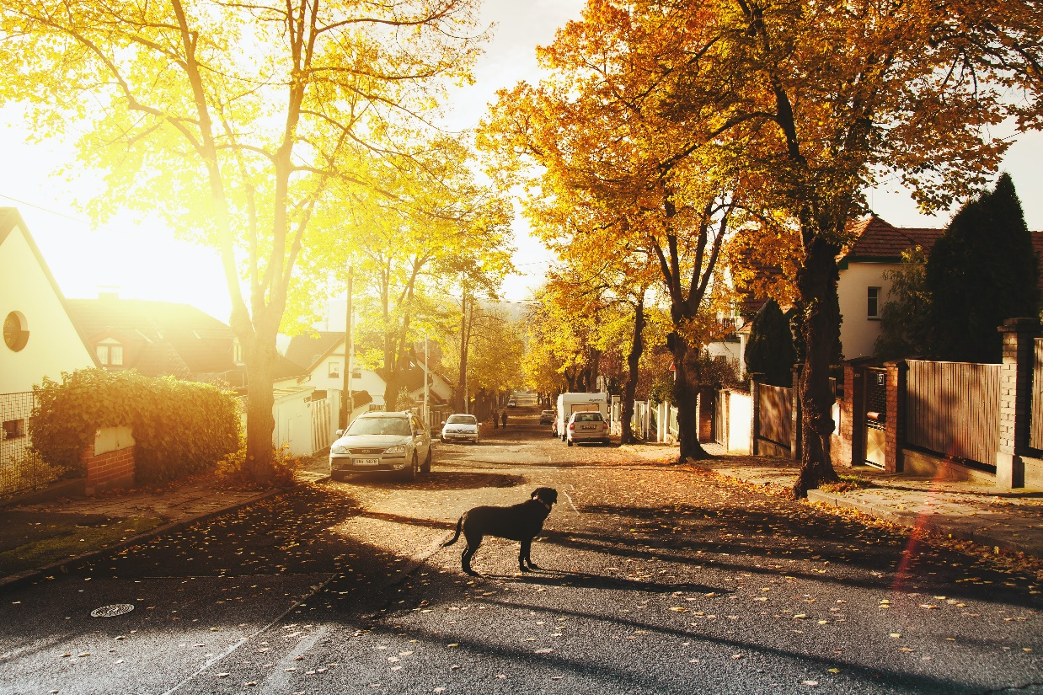
Potential Residential Hazards
Children playing
Driveways (vehicles backing out)
Animals
Pedestrians
Bicyclists
Municipal Vehicles
School buses
Mailman (UPS, Fed Ex, etc.)
Ice cream truck
Emergency vehicles
RV’s

Slide 7
Driving in Residential Areas
Speed limits range from 15 – 45 MPH
Scan the environment (move eyes continuously side to side for hazards)
Minimize time spent near parked vehicles (the door may pop open; the vehicle may pull out quickly)
Cover the brake past parked vehicles – there may be a child or adult stepping out between the cars.

Slide 8
Driving in Residential Areas
Separate multiple hazards 99% of the time by slowing down; speeding creates another problem
Use lane positioning on turns (round off right turns and square off left turns)
Look left first at intersection (you cross their path first)
Show before you go (creep out at stop signs before accelerating on your way)

Slide 9
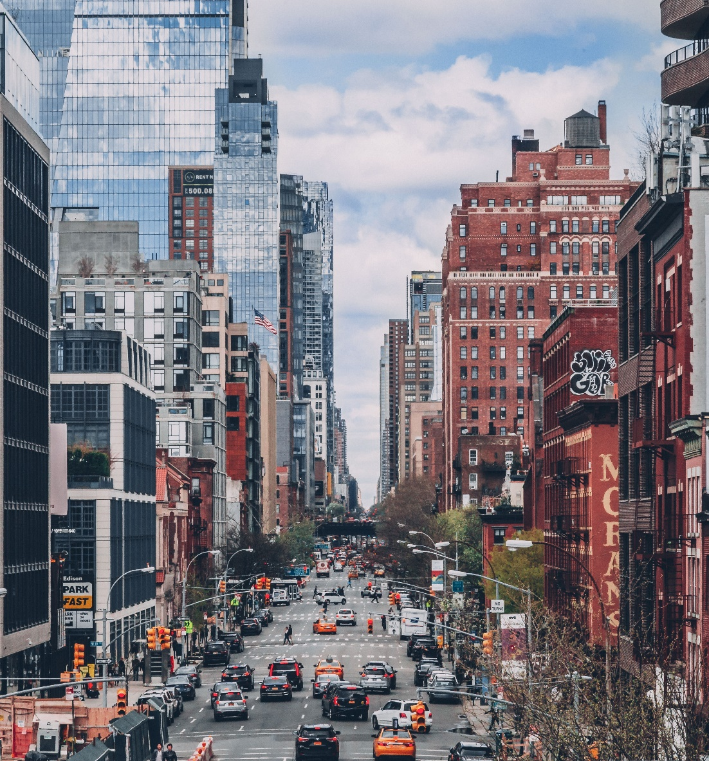
Urban Area Characteristics/Potential Hazards
Vehicles parking/double parked vehicles
Delivery vehicles
Slower traffic/heavy traffic
Bike lanes/bicyclists
Pedestrians (jaywalkers, distracted)
Busy intersections
One way streets
Construction
Protected/unprotected turns
Tailgaters, distracted drivers
Public transport vehicles/school buses

Slide 10
Urban Area Driving
Stay within the speed limit (15-30 MPH)
Be more aggressive with visual skills
Be ready to change lane position at any time
Be ready to stop at any time
Change lanes early for upcoming turns
Expect tailgaters and signal early when you plan to turn or stop
Remember left on red opportunity (turning left from a 1-way onto a 1-way street)
Lots of stopping and going!

Slide 11

Rural Area Characteristics/Potential Hazards
Poor road conditions – rough road, soft surfaces (gravel or dirt)
Obstacles on the road
  Large animals (deer, horses, cows)
  Small animals (raccoons, skunks, etc.)
  Debris
  Slow moving vehicles (tractors, horse and buggies)
Blind curves
No shoulder or guard rails

Slide 12
Highway and Expressway Characteristics/Potential Hazards
Highway hypnosis (Stay awake)
Velocitation (check your speed after you leave the highway)
Possible ramp signal lights (entrance ramps)
Possible “ramp overflow” (exit ramps)
Red/Green signal “X” over lane (toll booths)
Disabled vehicles (look for pedestrians)
Emergency vehicle stopped in right lane
Police officer (lane change if possible)
Construction zone speed limits
Missed exit! What do you do?
The difference between a highway and an expressway is that highways have intersections, while expressways have on ramps and exit ramps. Highways are very dangerous because of the cross traffic.

Slide 13
Advantages of Expressway Driving
No cross traffic (No intersections)
Median or barrier between opposing lanes of traffic
Reduced chance of encountering animals or slow moving vehicles
Reduced risk of hitting stationary objects
Drivers can anticipate conditions ahead through signs

Slide 14
Strategies for Practicing
Prepare yourself and your vehicle. Make sure you are alert and well rested and to check vehicle gas and coolant levels, tires.
Build experience gradually
Concentrate fully on the “driving task”
Cooperate with other drivers

Slide 15
Two “Nevers”
1. Never stop in the acceleration lane!
If you must stop for any reason (mechanical problems, unsure of direction, illness, etc.). Pull off to the right side of the entrance ramp.
2. Never back up to get a missed exit!
If you miss your exit, go to the next one and reverse your direction.

Slide 16
Expressways: Speed Limits
Basic Speed Law – speed that is safe and prudent for the weather and roadway conditions
Maximum Speed Limits – These are the posted speed limits
Minimum Speed Limits – The lowest legal speed you can drive under ideal conditions (example for the I-90, it is 45 MPH)
Common Speed – The speed used by most drivers
Wolf Packs – a group of drivers traveling together at higher speeds; driving in them allows you little or no margin of safety

Slide 17
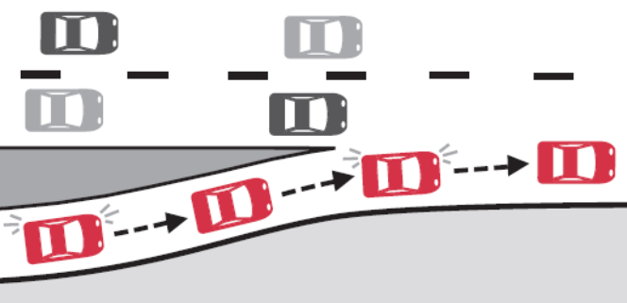
Entering the Expressway
New York State Department of Motor Vehicles. New York State Driver’s Manual.

Slide 18
Entering the Expressway
Choose the proper ramp. Signal. Check for “Do Not Enter” signs or “Wrong Way” signs.
2. Recognize your position on the ramp. Is there a short signal light?
3. Stabilize on the ramp. Obey the advisory speed limit.
4. Signal for the merge.
5. Adjust speed for the ramp.

Slide 19
Entering the Expressway
6. Glance back over your shoulder for the gap in traffic that you will need. Which vehicle will you “lead” or “follow”?
7. Use the entire acceleration lane to merge if possible.
8. Match speed of traffic (50-65 mph).
9. Use side view mirror to confirm your decision to lead or follow.
10. Merge smoothly. ISOLATE your vehicle in traffic. Stay between the wolf packs.

Slide 20
When You Should Increase Your Following Distance:
Entering & exiting
• Following a truck
• Bad weather
• Being tailgated
• Heavy traffic
• Following a motorcycle
Operating a motorcycle
Driving a truck
Pulling a trailer

Slide 21


Traffic Merging with You
Warning signs for merging traffic
(merging traffic)
(merging traffic with new lane creation)
To separate hazards you can change lanes or adjust your speed (slow down or speed up as needed)

Slide 22
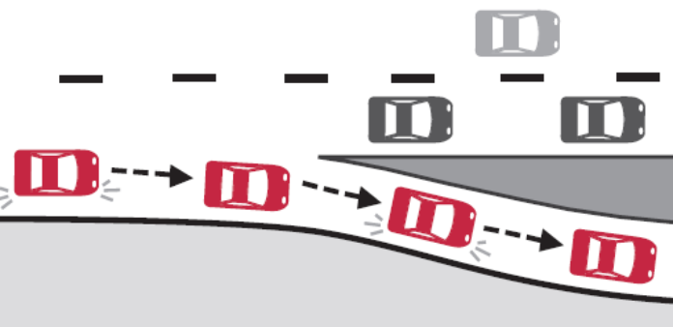
Exiting the Expressway
New York State Department of Motor Vehicles. New York State Driver’s Manual.

Slide 23
Exiting the Expressway
1. Signal early, when you can see the arrow pointing to the ramp.
2. Let off of the accelerator only if no other vehicles behind you.
3. Do not brake on the expressway unless the exit ramp is short.
4. Blind spot check.
5. Lane change into the deceleration lane. All four vehicle wheels should be in lane before you begin braking.
6. Slow down in the deceleration lane.
7. Recognize upcoming control.
8. Watch velocitation.

Slide 24
Decision Making While Driving
We as drivers can make (3) THREE decisions while driving:
  Change our speed
  Change our direction
  Communicate
Changing speed can be referred to as “separating”
Changing direction can be referred to as “minimizing”
Communicating refers to signaling to another roadway user

Slide 25
Forms of Communication
Horn
Sends a message 360 degrees around your vehicle
Must be aware of where it is located on the steering wheel
Should be aware of difference between using the “friendly toot” (for humans) or the “sharp blast” for animals

Slide 26
Forms of Communication
Lights
Headlights on at all times so others can see you sooner
Flash bright lights once to communicate
Tap brake pedal to flash brake lights before turning or stopping
Use turn signals for turns and lane changes
Use 4-Way Flashers for hazardous conditions, vehicle problems and emergencies

Slide 27
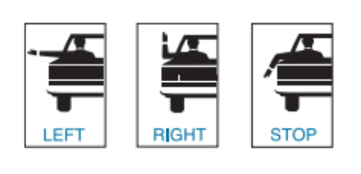
Hand Signals
Use hand signals when turn signal is not working and/or to reinforce turn signals and brake lights
New York State Department of Motor Vehicles. New York State Driver’s Manual.

Slide 28
Lane Position
The width of the lane allows drivers to make lane position adjustments to minimize the risk and create more space between their car and problem situations.
LP1 – Center of the lane
LP2 – Left edge of the lane (on yellow line)
LP3 – Right edge of lane (one white line)
LP4 – Over yellow line
LP5 – Over white line
LP1
LP2
LP3
LP4
LP5

Slide 29
Eye Contact
Use eye contact with other roadway users to confirm that they see you.
If you can not make eye contact, you must assume they do not see you.

Slide 30
Minimize – Separate - Compromise
Minimize – Steer away to increase the distance between your vehicle and a (single) hazard
Separate – Change speed to take 2 or more hazards one at a time
Compromise – Give up your speed (Time) and/or lane position (Space) to avoid a collision when you are not able to minimize or separate.

Slide 31
Minimize
Steer away to place more distance between your vehicle and a hazard.
Parked vehicle
Increase Space
(LP 2/4)
YOU

Slide 32
Minimize
Do not get trapped by lines.

Slide 33
Approaching vehicle in poor lane position
Increase Space
(LP 3/5)
Minimize
Steer away to place more distance between you and the hazard

Slide 34
Approaching vehicle on or over the center line.
Minimize
Do not get trapped by lines.

Slide 35
Minimize
The large approaching vehicle.

Slide 36
MINIMIZE means to MOVE your lane position.
Minimize
all single hazards
(steer away)

Slide 37
Parked vehicle on the left
Anticipate that others will do the same and help when possible.

Slide 38
STOP
????
Minimize roadway feature, hidden side road
Vision blocked by tree

Slide 39

Minimize
Roadway Features
Going uphill with the threat of a vehicle in poor lane position
Poor Vision oncoming traffic, move to LP3

Slide 40
Minimize on the expressway if possible to allow others to merge
Y
O
U

Slide 41
Drivers
Good Drivers: minimize a single hazard by moving away from it
Fair Drivers: do nothing and hope everything will work out
Poor Drivers: allow themselves to drift closer to the hazard

Slide 42
Separate = Changing Speed
Separate two or more hazards by changing speed to take them one at a time
It could mean slowing down or speeding up
95% of the time in residential areas it means slowing down. Why?
Accelerating may cause another problem!

Slide 43
Separate Multiple Hazards
When there are two or more hazards minimizing is out! WHY?
2
Parked vehicle
1
YOU

Slide 44
2
To do nothing would mean that the oncoming vehicle and our vehicle and the parked vehicle will all be in the same location at the same time.
This is a
COLLISION TRAP!
No escape if something goes wrong
1

Slide 45
1
SEPARATE
By slowing down we are able to change the order of the hazards and take them both one at a time.
Change your speed handle the approaching vehicle first, then MINIMIZE the parked vehicle.
more
space
2
Critical decision: to slow down

Slide 46

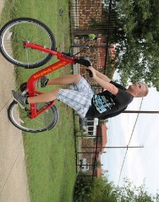
SEPARATE
Slow Down! We cannot steer out of this.

Slide 47
Substitute any two roadway users at same time.
SEPARATE!

Slide 48
SEPARATE
Roadway feature
The approaching vehicle and the potential side road hazard.
STOP
?

Slide 49
Flashing Yellow light at an intersection
SEPARATE
Traffic control and multiple hazards.
STOP
Slow down and cover the brake to prepare for dangerous intersection.
STOP

Slide 50
?
SEPARATE
The upcoming curve and the potential side road hazard.
STOP
1

Slide 51
SEPARATE
Slow before minimizing
?
STOP
1
The upcoming curve and the potential side road hazard.

Slide 52
SEPARATE
Going uphill with the threat of a vehicle in poor lane position and the pedestrian.
Minimize the potential oncoming threat, then separate (slow down) before reaching the top of hill.
Poor Vision for oncoming traffic.
Poor Space
with pedestrian on shoulder

Slide 53
Speeding up a bit may solve this multiple hazard situation
Why can’t we change lanes or slow down?

Slide 54
Compromise
Compromise by giving up what is necessary to avoid a collision
We have two possessions on the road. Our “time” and our “space”.
Time = our speed
Space = our lane position
  Both are ours to give to the other driver
Compromise by giving more space to the greater hazard
Compromise by choosing the lesser of two alternatives
Compromise when you can not minimize or separate
Compromise can happen in both non-emergency and emergency situations
Compromise can save a life!

Slide 55
Non-Emergency Situation
Compromise
At a stop sign
STOP

Slide 56
Non-Emergency Situation
Compromise
YIELD
Do the same at a yield sign.

Slide 57
CONSTRUCTION
Non-Emergency
STOP
Stop – Give up your time for as long as needed.
Roadwork
Ahead
Flagman
Ahead

Slide 58
Non- Emergency
COMPROMISE
Child follows the ball out into the street and you see it and predict it.
Come to a complete stop and let him pick up the ball.

Slide 59
SEPARATE
Multiple hazards
Flashing yellow light at an intersection
STOP
Slow down, proceed with caution, and be prepared to stop, swerve or stop and swerve to avoid a collision.
STOP
Be prepared for the emergency.
COMPROMISE

Slide 60
Pedestrian suddenly appears!
EMERGENCY!
COMPROMISE Reduce speed drastically!
Broken down vehicle on roadside with approaching vehicle. (plenty of space)

Slide 61
EMERGENCY - COMPROMISE
Child suddenly runs out in front.
Slam on Brakes!

Slide 62

Give up your lane position to avoid the crash.
EMERGENCY!
Vehicle crossed into your lane.
COMPROMISE SPACE!
Take the shoulder – Take the ditch if needed.

Slide 63
Quiz
Stopped UPS truck on a curve
Is this a Minimize, Separate, or Compromise situation for the driver?
UPS
40
Notes:
Answer-compromise

