Slide 1
Sharing the Road

Slide 2
Session Goals
Identify all road users and types of transportation that they use.
Understand their characteristics, limitations, and special considerations.
Explain the importance of communication as a means of preventing crashes.
Predict and anticipate the errors of other road users to avoid crashes

Slide 3
Key Vocabulary & Topics
Sharing the road with other users:
  Pedestrians
    Mid-block crosswalks
  Construction workers
  Bicycles and mopeds
  Large Trucks & RV’s “No-zones”
    Off-tracking - rear wheels
    Roll Over hazards
  Emergency vehicles
    Move-over laws
    Emergency vehicle procedures
  Farm vehicles
  Horse and buggies

Slide 4
Key Vocabulary & Topics
Braking Time/Distance
  Total stopping distance
Truck escape ramp (TER)
Turbulence
Underride collision
Work zone
Stop line vs crosswalk
Crossing, Joining, Leaving Traffic
Five Traffic Conflict Situations
  Intersection vehicles and pedestrians
  Oncoming vehicles
  Entering and existing vehicles
  Vehicles ahead of you
  Vehicles behind you

Slide 5
Importance of Communication
Good communication involves a sender of information and a receiver of information. Without these two components, communication did not happen.
Good communication on the sender’s part is timely and specific to the receiver.

Slide 6
Methods of Communicating
Signaling devices (traffic lights, pedestrian signals)
Vehicle Lights used to signal other drivers signals (e.g. turn signals, brake lights)
The horn sounds warnings (e.g. quick taps, lasting blast)
Headlights (e.g. flashing on and off, low beam to high beam)
Body actions (e.g. hand signals, nodding)
Vehicle position (e.g. lane choice, position in the lane, direction of front tires)

Slide 7
Common Messages
Show what you intend to do/where you intend to go
Reveal hazards to oncoming drivers/pedestrians, etc.
Acknowledgement of other road user’s messages
Use messages that allow you to see and be seen

Slide 8
Anticipating Errors
Let's brainstorm anticipation errors that could put us at risk...
Failure to “See and Be Seen”
Improper signaling
Improper following distance
Sudden braking
Failure to yield to other roadway users

Slide 9
Sharing the Road
Can you name some common traffic situations where a driver might encounter risk? Such as…
Anticipating the behaviors of other roadway users:
  Approaching a 4-way intersection
  Merging onto a Highway
  Entering a traffic circles

Slide 10
Sharing the Road with Pedestrians: Key Points
Drivers
Expect pedestrians
Pay attention! Don’t text while driving!
Obey the speed limit
Pedestrians
Use crosswalks
Obey signals
Look left, look right, look left again!
Pay attention! Don’t text while walking!

Slide 11
Pedestrians: Special Considerations
Children are less visible to drivers
Older people may not hear or see well and may be unaware of possible conflicts
Pedestrians may be distracted (texting, listening to music) which means they may not be paying attention to where they are going
Always be cautious and expect the unexpected when coming out of alleys, driveways, driving in school zones, driving on busy city cross streets, near parks, or within residential neighborhoods
Parking lots present high-risk areas to hitting a pedestrian or even a shopping cart, which will damage your vehicle

Slide 12
Intersections Video
View Video “Intersection Perfection” by NYSDOT
Intersection Perfection - YouTube

Slide 13
Distractions Video
View video “See! Be Seen! Distractions and Pedestrian Safety” By NYSDOH
https://www.youtube.com/watch?v=B1x1EXOAAxw

Slide 14
Visibility Video
View Video “Pedestrian Safety – See and Be seen Visibility” by NYSDOH
https://www.youtube.com/watch?v=flMytAcid1o

Slide 15
See! Be Seen! Video Discussion
What take away messages did you get from these videos?
Will your driving behavior change as a result?

Slide 16
Sharing the Road with Bicyclists: Key Points
Drivers:
Give bicyclists extra space whenever possible
Reduce speed when passing
Always expect the bicyclist to pull out in front of you. They may encounter vehicle doors opening, railroad tracks, storm drains, potholes, puddles, and other roadway hazards that cause them to swerve.
When passing a bicyclist, pass on the left, providing them at least one-half lane between your vehicle and them.

Slide 17
Sharing the Road with Bicyclists: Key Points
Bicyclists
Share the responsibility for avoiding conflicts with other roadway users. Bicyclists should:
Wear a helmet for head protection. Know and follow the laws regarding roadway riding, lane position, and sidewalk riding
Obey all signs, signals, and laws
Wear light-colored clothing and have lights and reflectors on bicycles when riding at night
Do not wear earphones while riding
Keep bicycles in safe operating condition

Slide 18
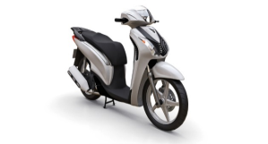
Sharing the Road with Mopeds/Motor Scooters: Special Considerations
Limitations in acceleration
May not be able to keep up with traffic
When approaching, take same precautions as you would when approaching a bicyclist

Slide 19
Motorcycles: Key Points and Special Considerations
NYS requires all motorcyclists wear a DOT approved helmet
A motorcyclist should wear eye protection, heavy shoes/boots, full length pants, leather jacket/heavy long sleeved shirt, and full fingered gloves.
Special Considerations
Weather and roadway conditions present greater problems for motorcyclists:
Rain or hot weather can cause the pavement to be slippery
Road conditions like potholes can throw a motorcycle out of control

Slide 20
Motorcycles: Special Considerations
Special Considerations:
Motorcycle tires can get caught in railroad tracks
Motorcyclists carrying passengers need great attention as the extra passenger affects acceleration, braking, and turning
They often travel in groups
Turn signals are often small and hard to see
Motorcyclists may use hand signals
The motorcyclist may drive right or left of center of the lane because of oil slickness on the road

Slide 21
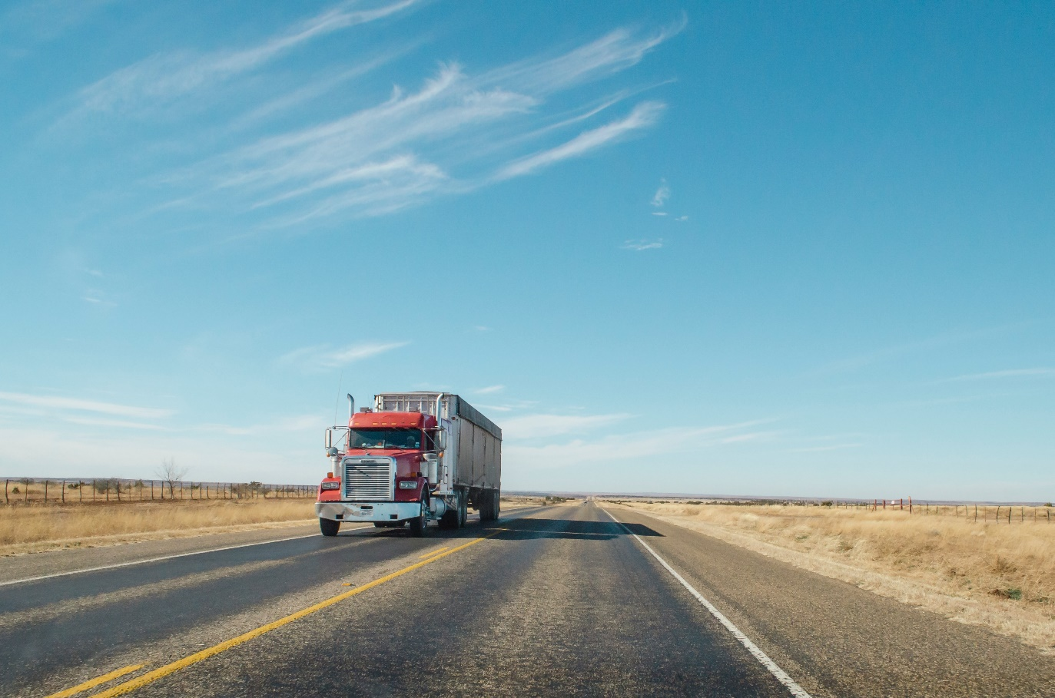
Discussion
What special considerations should you keep in mind when driving around large trucks?

Slide 22
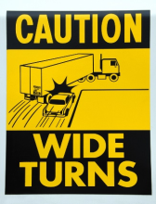
Large Trucks: Special Considerations
Trucks make wide-right turns
Distance to stop is significantly increased because of weight
Large trucks cause visibility problems for other drivers
There are large blind spots (No Zones) in front, to the sides, and to the rear of every large truck
Staying behind or to the left of truck that is making a right turn is advisable

Slide 23
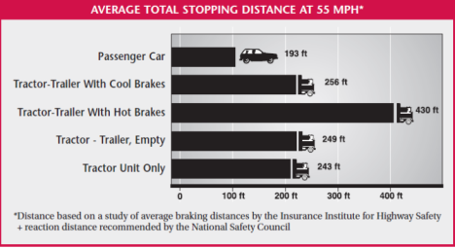
Distance to Stop
Large vehicles take much longer to stop than smaller vehicles moving at the same speed
Leave space between your vehicle and trucks
If you are in front of a truck, indicate your intention to turn or change lanes early; don’t make sudden moves.
New York State Department of Motor Vehicles. New York State Driver’s Manual.

Slide 24
Approaching Large Trucks
Don’t underestimate the size and speed of approaching large vehicles
  Larger size can cause vehicles to appear to be moving slower than they really are
  Vehicles also may not appear as large as they really are from a distance
When driving on a two-way highway, move as far to the right as possible to ensure your vehicle will not be hit by an approaching large truck.

Slide 25
Passing Large Trucks
Check front and rear zones, signal a lane change, and change lanes smoothly.
Stay in lane position 2 during the passing maneuver, and complete your pass as quickly as possible.
After you see both headlights in your rearview mirror, signal, check over your right shoulder, and return to the right lane.
Do not slow down during or after completing the pass. Maintain your highway speed.
Never pass close behind a large truck that is backing up. If you try to pass in this situation, you will likely enter one of the blind spots

Slide 26
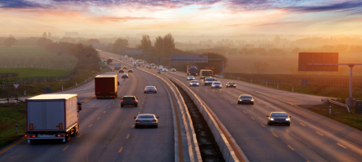
Stopping Behind Large Trucks
Always leave space when you stop behind a truck or other large vehicle, especially when facing up hill; these vehicles could move backward slightly when starting

Slide 27
Special Purpose Vehicles
School Buses
  Required to stop both ways if lights are on
Metro Buses
  Stop frequently to pick up and drop off riders
Snowplows
  Will go slower than other traffic. If you are going to pass them, give them plenty of room
Farm machinery/Horse and buggies
  Very slow moving, be patient!

Slide 28
Other Special Purpose Vehicles
Wide-Loads (e.g. transportation of mobile homes)
  These vehicles deserve plenty of room, may be slow moving, often times will take curves and corners wide. May have a trail vehicle to protect the vehicle in traffic areas.
Recreational vehicles
  Can range in size from being small (e.g. 4-wheeler) which is difficult to see – to large (e.g. RV Camper) causing visibility problems.
  Are increasingly becoming problems in places you wouldn’t expect them such as within city limits.

Slide 29
Emergency Vehicles
New York State Move Over Law
As soon as you see lights, vests, or reflectors, check traffic around you. SLOW DOWN and safely MOVE OVER
Drivers MUST use due care when approaching an emergency vehicle or hazard vehicle including police vehicles, fire trucks, ambulances, construction and maintenance vehicles and tow trucks
The Move Over Law applies to both sides of the roadway, not just the shoulder on the right

Slide 30
Emergency Vehicles
View Video “Slow Down, Move Over PSA” by NYS DMV
https://www.youtube.com/watch?v=74SgAZv89wE&t=7s

Slide 31
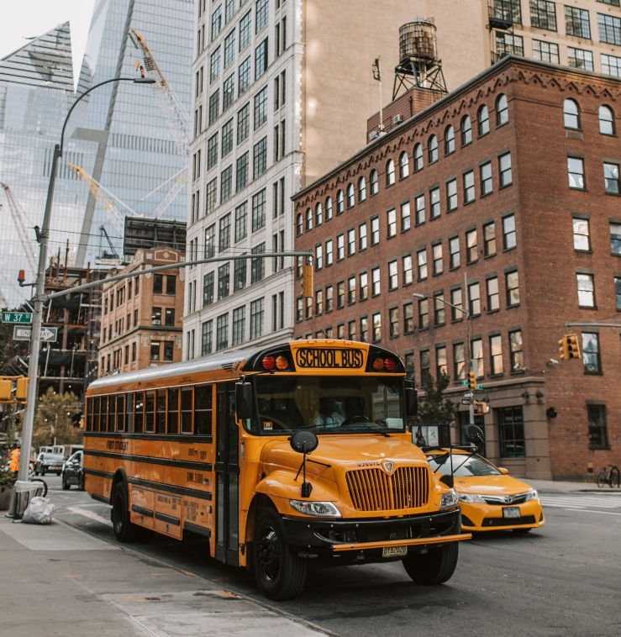
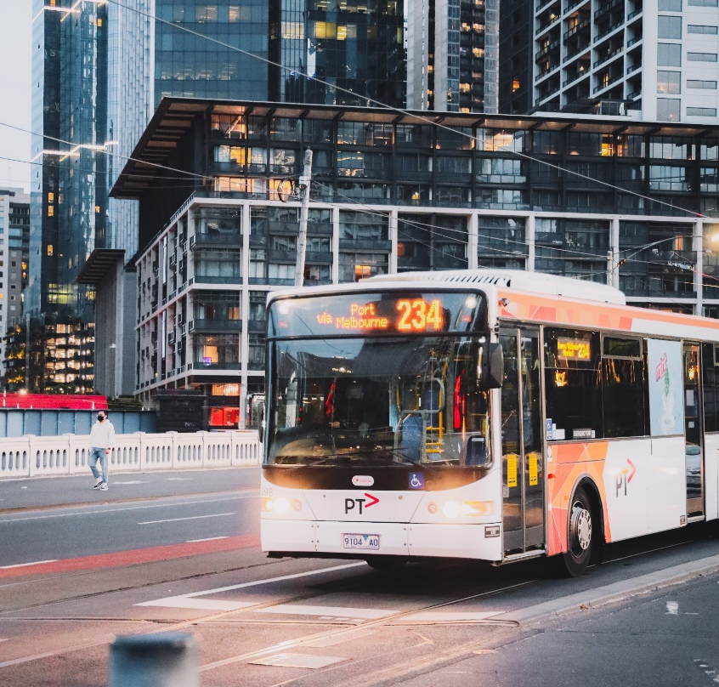
Buses
Two most common types of buses
Local mass transit buses
School buses
Laws Governing School Buses
Traffic going in both direction on a two-way street needs to stop when a school bus stops to load or unload passengers
Follow the school zone speed limit posted around schools

Slide 32
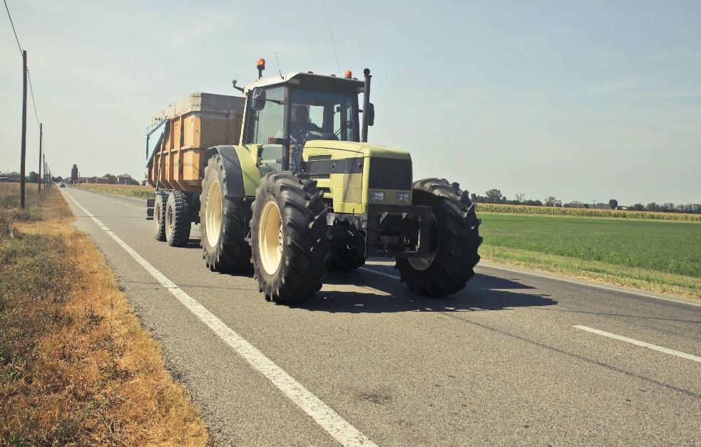
Farm Vehicles
Are often going well below the speed limit
Expect to see them a lot during the Spring (for planting) and the Fall (for harvesting) when driving on country roads
When passing, make sure you have a clear line of sight—give them plenty of room!!

Slide 33
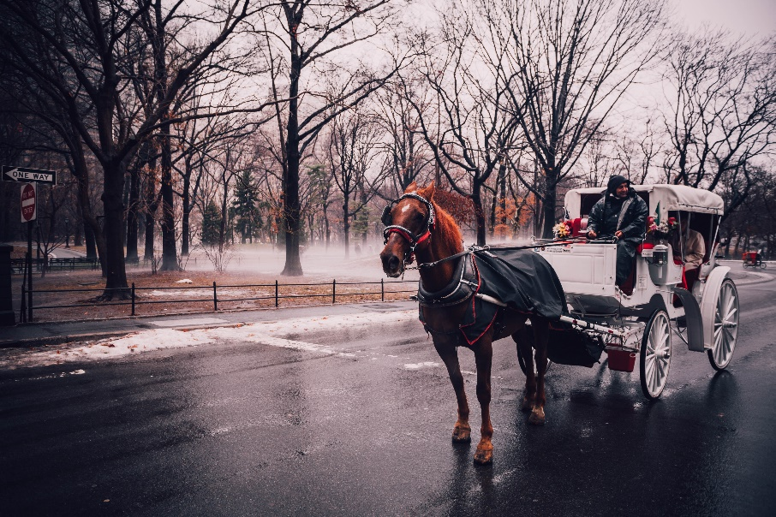
Animals – Horse Drawn Carriages
Limitations:
Sight
Speed
Erratic behavior when frightened
Special Considerations
Horses and horse-drawn carriages
  Visibility issues
  Easily scared
  Don’t beep at them
  Slow down
  Give extra room when passing

Slide 34
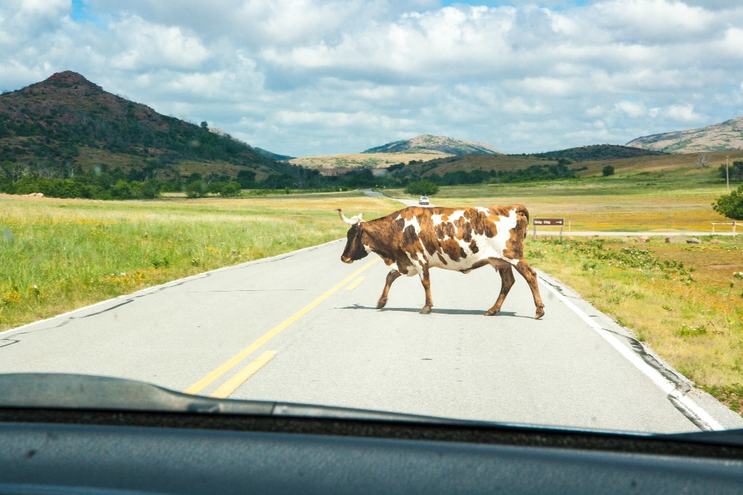
Animals – Wild and Domestic
Characteristics:
  Vary in size
    Small = squirrel, cat, dog, raccoon, etc.
    Large = Moose, horse, cow, etc.
  May be pets (duty to inform)
  Drivers swerve to miss

Slide 35
Avoiding Collisions with Animals
Vary in size
Large animals are more active first thing in the morning, in the evening and at night
Large animals are particularly active during rut – hunting season
Do not swerve to avoid hitting a large animal and risk losing control of your vehicle
If you hit a dog, cat, horse, or an animal such as cattle – you must inform the owner of the animal or a police officer. Give your name, address, proof of insurance, and license number.

Slide 36
Railroad Crossings
Trains can’t change lanes and it takes them 3/4 of a mile to stop with an average load. Hence, on the road drivers must be vigilant and adhere to safety rules.
Train intersection collisions occur each year because of drivers who are impatient and who try to beat the safety precautions set up to protect drivers.
What controls can be found at a train intersection?

Slide 37
Rail Signs and Signals
Active Signs: electronic devices that warn of the approach, or presence, of rail traffic at grade crossings
Passive Signs: signs that alert motorists that they are approaching a highway-rail grade crossing

Slide 38

Signs: Before the Crossing
Watch for these signs:
New York Operation Lifesaver Inc.

Slide 39

On the Road: Pavement Markings
Be alert for these pavement markings:
New York Operation Lifesaver Inc.

Slide 40
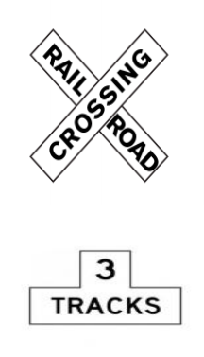
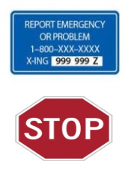
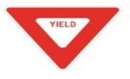
Signs: At the Crossing
Watch for these signs:
New York Operation Lifesaver Inc.

Slide 41
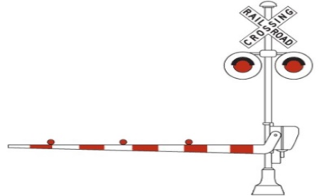
Devices: At the Crossing
Some crossings have active warning devices
New York Operation Lifesaver Inc.

Slide 42
References
Governor’s Traffic Safety Committee. Slow Down, Move Over Public Service Announcement.

