Slide 1
Physics of Driving and Occupant Restraints

Slide 2
Session Goals
Understand the natural laws and forces that affect their driving daily.
Demonstrate and understanding of how traction, tire pressure, tire tread, and braking may impact a driver’s ability to respond to the natural forces and driving conditions encountered.
Demonstrate knowledge of why occupant protection is important.
Demonstrate knowledge of laws related to occupant restraint.
Understand that as the driver, they are responsible for ensuring correct occupant protection use within their vehicle.

Slide 3
Key Vocabulary and Topics
Gravity
Center of gravity
Inertia
Centrifugal force
Kinetic energy
Vehicle suspension balance
Friction
Traction
First collision
Second collision
Third collision
Passive restraint
Active restraint
Seatbelt
Booster seat
Child car seat / booster seat
Air bag
NYS Seatbelt Law

Slide 4
Gravity
You can feel the pull of gravity as you drive up and down hills
Driving uphill, you will lose speed unless you use extra power
Driving downhill, you will increase in speed
Do not ride your brakes downhill, instead use engine compression by shifting into a lower gear BEFORE you go down the hill

Slide 5
Center of Gravity
The point around which an object’s weight is evenly distributed
A vehicle’s stability decreases as its center of gravity rises

Slide 6
Natural Laws - Inertia
What is inertia?
An object in motion stays in motion until acted upon by some outside force.
Can you name some situations where the road or the conditions of the road, will affect speeding up or slowing down of a vehicle?

Slide 7
Kinetic Energy
Kinetic energy is the amount of energy an object has because of its motion. If we want to accelerate it, we must apply a force (pushing the gas peddle). Energy then transfers to the vehicle (moving it) to a constant speed. The energy transferred is Kinetic energy.
What happens when vehicle doubles in speed going from 20 MPH to 40 MPH?
You will need four times the distance to stop the vehicle as the speed increases.
If a vehicle’s speed doubles, the forces involved in a collision will be quadrupled.
Knowing this information, helps traffic engineers study traffic patterns and identify where driving errors might occur and determine safe speed limits for these areas.

Slide 8
Empty truck going 25 MPH will only travel 15 feet
Double truck weight going 25 MPH will travel 30 feet
Empty truck going 50 MPH will travel 60 feet
A vehicles’ kinetic energy increases dramatically with increases in weight and speed.

Slide 9
Balance
Balance of the vehicle is so important not only for vehicle control but also for the maintenance of the vehicle
How can you tell your vehicle is accelerating? You should feel a backward motion as the weight of the vehicle is shifted to the rear.
How about when your vehicle is decelerating? The weight of the vehicle is shifted forward so you should feel forward motion in your seat.
What happens if you take turn too fast? The weight of the vehicle shifts in the opposite direction of the turn.

Slide 10
What Factors Contribute to Single-Vehicle Crashes?
Statistics show that more than 50 percent of occupant fatalities occur as a result of single-vehicle crashes. Why do you think this is?
Single-vehicle crashes involve too fast for conditions, improper steering or braking or a combination of all three.
These factors can upset a vehicle’s balance and can lead to a loss of traction and loss of control in maintaining the intended path of travel.

Slide 11
Road Surface and Traction
Traction is simply the grip that a tire has to the road
Without traction, a driver can not control their vehicle (e.g. steering, accelerating, or stopping)
Drivers must learn to recognize conditions that may indicate a change in traction, which in turn will require a change in speed or direction.
What are road conditions that negatively affect a vehicle’s traction?

Slide 12

Road Surfaces
What are the different kinds of road surfaces you will encounter when driving?
What are traction concerns for each type of road surface?
What are some road elements that drivers should be cautious of because they may be slippery?
What’s the best way to stay in control of the vehicle’s
traction for each road surface?

Slide 13
Conditions that Affect Traction: Temperature Changes
As the temperature changes on road surfaces, what are some concerns which may arise?
- Warm to Cold?
- Cold to Hot?

Slide 14
What other Road Factors Impact Traction & Control?
Elevated and shaded areas of a roadway may freeze before other areas.
Areas where water or wet material has gathered may be slippery.
Exposure to strong winds when on wet or icy roads may impact control.

Slide 15
Road Design Can Impact Traction
The surface of the road shoulder may provide less traction & control.
Roadways that are not flat and straight may impact traction and control. Some examples might include tight curves, pitched or banked roadways, as well as roads which are crowned (higher in the center). Have you encountered any of these?

Slide 16
Tires and Traction
Tread – the grooved surface of a tire that grips the road
When the road is wet, the tread allows water to flow through the grooves and away from the tire, allowing the tire to grip the road.
A worn, bald tire is dangerous!
Will not grip a wet or icy road
The tire may puncture causing a blowout

Slide 17
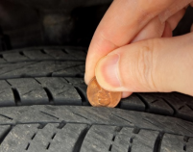
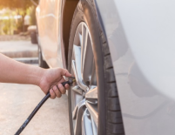
Tire Inflation
How do you check for proper tread depth?
How do you know how much air to put in your tire?

Slide 18
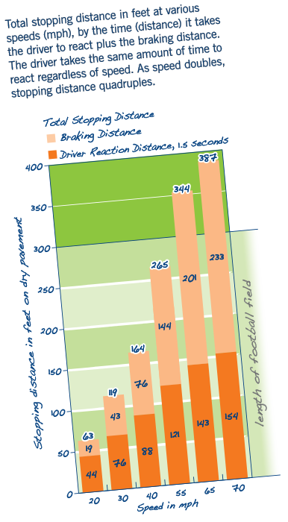
Factors That Affect Braking Distance
Speed
Vehicle Condition
Roadway Surface/Conditions
Driver Ability
Hills
Loads
Weight of the vehicle
Tire grip
Note: Braking stops the wheels, not the vehicle
National Highway Traffic Safety Administration. Safety in Numbers Newsletter.

Slide 19
Force of Impact
Force of Impact – the force with which a moving object hits another object
Three factors determining how hard something will hit another object:
Speed
Weight
Distance between impact and stopping

Slide 20
Three Collisions When a Crash Occurs
First – the vehicle hits an object
Second – the occupant hits the interior parts of the vehicle, such as the steering wheel or dashboard
Third – the occupants’ internal organs slam up against their skeletal structure, resulting in the most injuries in a crash

Slide 21
Three Collisions in a Crash Video
View “Three Stages of a Collision, DDC4 6th Edition – National Safety Council driver course excerpt”
https://www.youtube.com/watch?v=zSiDRaV7O24

Slide 22
Seat Belt Video
View “Get it Together – Buckle Up” by NYS DMV
https://www.youtube.com/watch?v=RuZoGfq27Xs&t=19s

Slide 23
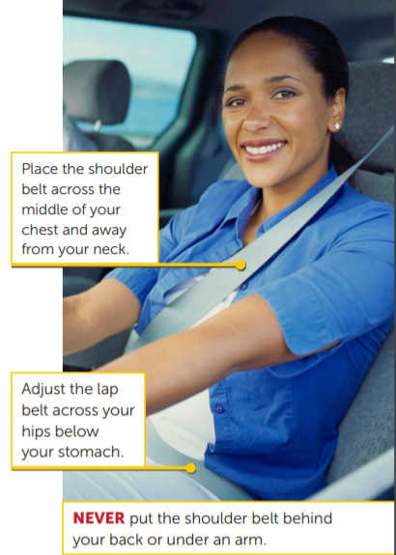
Occupant Protection – Seat Belts
Wearing your seat belt is the single most effective thing you can do to protect yourself in a crash.
Air bags are designed to work with seat belts, not replace them.
Seat belt fit matters – the shoulder belt should lay across the middle of the chest and way from neck; the lap belt should ay across your hips not your stomach
Everyone in the car should be properly restrained (in a car seat, booster or seat belt, depending on their age and size)
National Highway Traffic Safety Administration. Top 5 Things You should Know About Buckling Up.

Slide 24
Adjusting Your Head Restraints
The bottom of the head restraint should align with the bottom of your ears.
Proper adjustment can protect your head and neck in case of a crash.

Slide 25
Don’t Forget to Buckle Up in the Back (NY State law passed in November 2020)

Slide 26
Key Points from NYS Vehicle and Traffic Law
Seat Belt Use for Drivers and Passengers
All drivers, front seat, and rear passengers must wear seat belts regardless of age (NYS Law passed in November 2020)
Children under 100 lbs have further requirements

Slide 27
Key Points from NYS Vehicle and Traffic Law
Child Passenger Safety (Car Seats and Booster Seats)
Children under the age of four must be in a federally approved child restraint system attached to the vehicle by a safety belt or LATCH system.
A child under age 4 who weighs more than 40 pounds can be restrained in a booster seat with a lap and shoulder belt.

Slide 28
Key Points from NYS Vehicle and Traffic Law
A child of age 4, 5, 6 or 7 must use a booster seat with lap and shoulder belt or a child safety seat (The child safety restraint system must meet the height and weight recommendations of the restraint manufacturer.)
A child more than 4 feet 9 inches in height or weighing more than 100 pounds is allowed to use a seat belt that has both a lap belt and a shoulder harness. If the seat belt does not fit correctly, the child must use a booster seat with a lap and shoulder belt.

Slide 29
Can you Name Other Protective Devices in your Car?
Front and rear crash area zones
Energy absorbing bumpers
Side door beams
Reinforced windshields
Energy absorbing steering wheel and column
Padded dash
Seat belts
Head restraints

Slide 30
Match These Key Terms
F
The adhesion, friction or grip between the tires and the road surface
The amount of energy needed to propel a vehicle
The point around which an object’s weight is evenly distributed
The distribution of the weight of the vehicle on the chassis
An object in motion continues to move straight ahead until acted upon by some outside force
The force that pulls all things to Earth
__Gravity
__Center of Gravity
__Inertia
__Traction
__Kinetic Energy
__Vehicle Suspension Balance
C
E
A
B
D

Slide 31
References
“Three Stages of a Collision, DDC4 6th Edition – National Safety Council driver course excerpt”
“Get it Together – Buckle Up” by NYS DMV
New York State DMV. Chapter 8 Defensive Driving

