Slide 1
Adverse Driving Conditions

Slide 2
Session Goals
Identify techniques to see and be seen by other drivers in adverse driving situations.
Determine different driving environments factors that reduce traction.
Identify evasive steering and braking actions that a driver can take under conditions of limited traction.
Identify vehicle maintenance issues that correspond to different seasons.
Identify vehicle technology that will assist in traction and steering control.
Identify seasonal equipment to keep in vehicle throughout the year.

Slide 3
Key Vocabulary and Topics
ABS
Accelerator failure
All wheel drive
Brake failure
Collision reporting
Cornering
Counter steer
Dash dimmer control
Engine failure
ESC (Electronic Stability Control)
ESP (Electronic Stability Protector)
Evasive action (steering and braking)
Fishtailing
Front-wheel skid
Glare recovery
Hydroplaning
High beam/low beam

Slide 4
Key Vocabulary and Topics
Map light
Moth syndrome
Off road recovery
Overdriving headlights
Power steering failure
Rear mirror/night adjustment
Rear-wheel skid
Reduced visibility risks
Rocking the vehicle
Rumble strips
Sight distance rule
Skidding
Tire blowout
Tire footprint
Traction

Slide 5
Choices and Consequences
How do attitudes, emotions, beliefs and values interfere with safe driving?
What healthy attitudes and behaviors support a safe driving environment?
How do unhealthy attitudes and behaviors result in physical and mental impairment?
What physical and mental conditions interfere with safe driving?
What are the differences between impulsive and calculated risks?
What are the differences between aggressive driving and road rage?

Slide 6
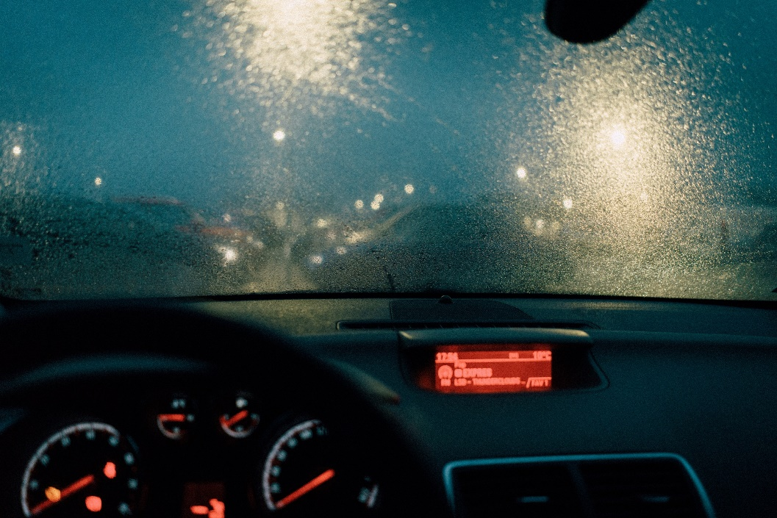
Brainstorm
As we drive, there are a number of environmental conditions that we will encounter where we will not only need to see other drivers, but also be seen by other drivers.
Let’s brainstorm different environmental conditions you might encounter and how they could affect your ability to safely operate your vehicle.

Slide 7
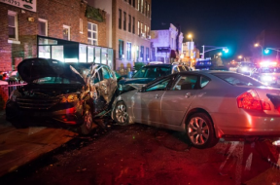
Did You Know?
According to the National Safety Council, traffic death rates are up to three times greater at night than during the day.
Driving at night is more dangerous because 90% of a driver's reaction depends on vision.

Slide 8
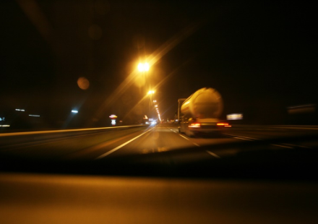
What are your eyes naturally attracted to in this picture?
The lights?
We call this the “Moth Syndrome”

Slide 9
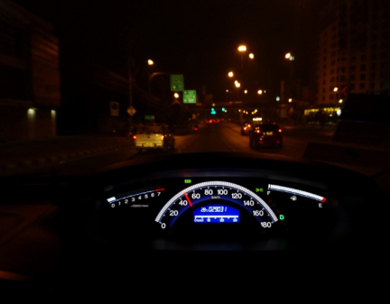
Visual skills such as depth perception, color recognition, and peripheral vision are limited at night. Can you identify the color of these cars?
Which ones are closer or farther away? Can you see the pavement markings ahead?

Slide 10
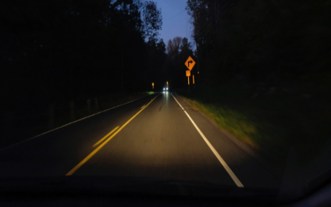
Don’t stare into the lights of an oncoming vehicle. Rather focus to the right while at the same time seeing what is to the left by using your side vision.
Try it now with this picture. Look to the right side of the road but use your side vision to maintain information to the left.

Slide 11
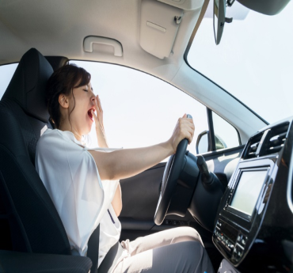
Another factor adding danger to night driving is fatigue. Fatigue is dangerous. If you are tired when driving, you are slower to react and are not as aware as you should be. Simply, your judgement will be impaired.
Who is at most risk to drive while fatigued?

Slide 12
At night, side vision is greatly reduced and it is difficult to determine speed of vehicles just by looking out into the intended path.
Can you think of some things that can help you see better at night?

Slide 13
At night, side vision is greatly reduced, and it is difficult to determine speed of vehicles just by looking out into the intended path.
Can you think of some things that can help you see better at night?
Make sure your windshield is clean inside and out
Make sure you do not have cloudy headlights
Look around. Don’t stare in a single direction
Don’t drive faster than your headlights allow you to see
Don’t blind other motorists by driving with your high beams on all the time
Maintain a larger following distance behind vehicles 5-6 seconds
Don’t wear sunglasses at night

Slide 14
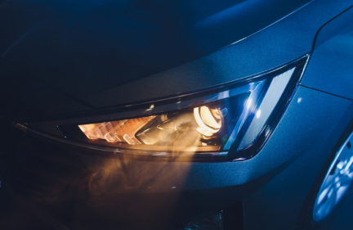
Check your lights to make sure they are working. To check, pull up to a garage door or building wall and flash them on and off.

Slide 15
Driving at Night-Special Considerations
To avoid being blinded by oncoming high beam lights, look ahead and towards the right shoulder of the road using your side vision to stay on track.
Use your high-beam lights when driving in rural areas and on open highways away from urban and metropolitan areas.
If you are driving with your high-beam lights on, you must dim them at least 500 ft. from any oncoming vehicle so you don't blind the oncoming driver.
Remember to use your low-beams if you are within 200-300 ft. of the vehicle you are following to avoid blinding the driver ahead of you.

Slide 16
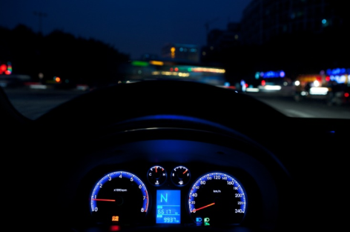
Why is it important to adjust your dashboard lights?

Slide 17

Avoid using your interior lights or do so in areas of little to no traffic so your eyes have time to readjust to the darkness.

Slide 18
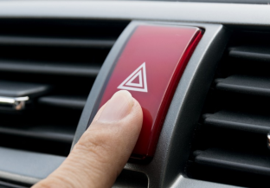
If you have car trouble at night, pull off the road as far as possible, turn on your hazard lights.
There is always a risk when getting out of your vehicle given that you are so close to oncoming traffic. Be very careful and don’t linger close to the moving traffic lane.
Set out flares or reflective triangles, well behind your vehicle, to warn drivers of your emergency position off the road.

Slide 19
Let’s review New York State restrictions regarding night
driving for those with a junior license.

Slide 20
Identify, List, and Discuss:
Special Factors to Consider for Residential Streets
Alternate street parking problems
State of emergency parking
Snow drifts near driveways/intersections
Slippery intersections due to puddles and leaves clogging drainage
Slippery intersections due to freezing sections of the road where vehicle heat melts the snow and it turns to ice
Salted intersections in winter makes for loose gravel in Spring
Low driving areas such as viaducts can flood

Slide 21
Identify Different Weather Conditions
As a group, develop a list of the different weather
conditions a driver will encounter.

Slide 22
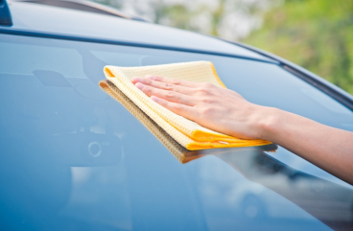
Having clean windows – inside and out; nothing hanging from your mirror and keeping the dash free of papers/items eliminates reflections.
Unobstructed windows in the front, the rear, and on the side windows is very important for good visibility.

Slide 23
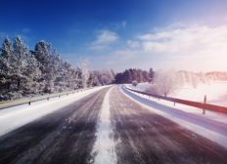

Sunny Days
Glare can reduce visibility in different ways.
Looking at the pictures to the right, you see that both days are sunny, but the days are in different seasons. What could you do to minimize the glare of the sun?
Did you know
The two most dangerous times of the day to drive are sunrise and sunset!

Slide 24
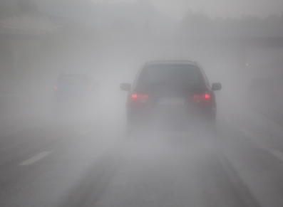
Fog
Why is fog dangerous? What should a driver do?

Slide 25
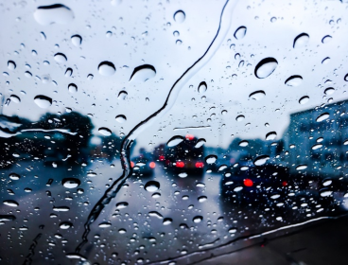
Rain
Why is rain dangerous? What should a driver do?

Slide 26
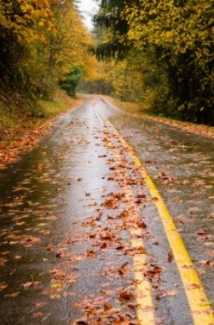
Reduced Traction
Traction is reduced on wet, snow, and iced roads.
Hydroplaning
Think of it as water skiing while driving
No ability to steer, brake, or stop
Don’t hit brakes, but instead lift foot from accelerator
Remember that wet leaves on the road can lead to especially slippery road conditions.

Slide 27
Downed Power Lines
Storms can lead to downed power lines
Never drive over a downed power line or anything in contact with them.
If you are in a vehicle that has come in contact with a downed power line, stay in the vehicle and call 9-1-1, unless you see fire or smoke.
If you are forced to leave the vehicle because of fire or smoke:
  Stand on the frame of the car and jump to the ground ensuring both feet land on the ground at the same time, while clearing the car (don’t hold on to the car)
  Shuffle your feet closely together ensuring that you don’t have any space between your feet with each shuffle. Take your time!
  Move more than 35 feet away from the vehicle

Slide 28
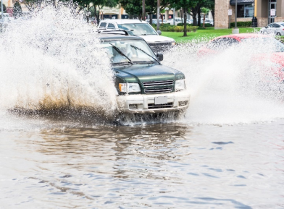
Flooding
Never drive through deep water. What should you do when roads are flooded?

Slide 29
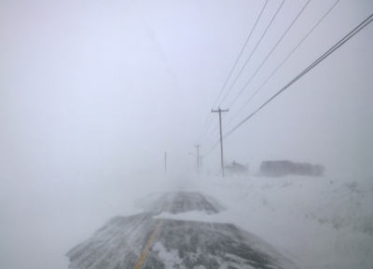
Snow, Ice, & Cold Weather
What makes driving in these conditions dangerous? What should drivers do?

Slide 30
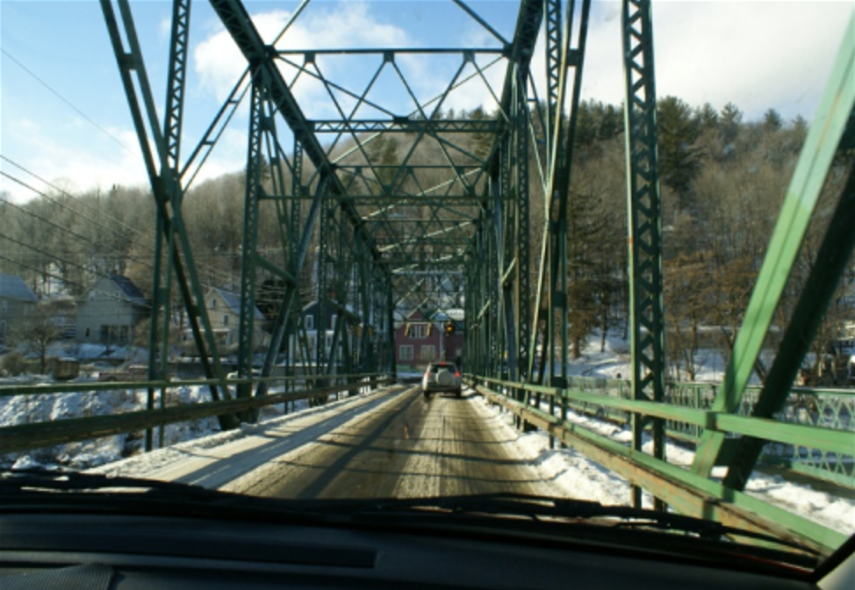
Why do bridges often freeze first during the winter?

Slide 31
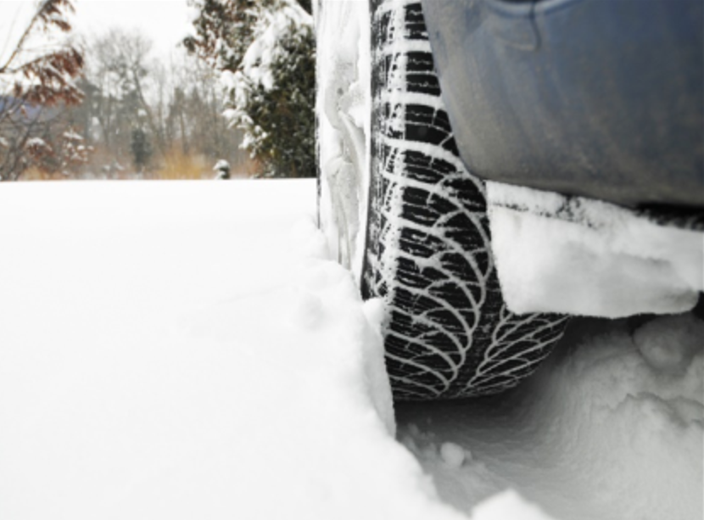
It is best to avoid driving in deep snow. How can you be prepared in case you get stuck in the snow?

Slide 32
True or False
T
T
___ Rain covered roadways create limited traction.
___ Use cruise control on slippery roads for control.
___ Increase following distance from other vehicles.
___ Use high-beams headlights to increase visibility to others.
___ Roads are most slippery when rain starts to fall.
___ You should drive in the tire tracks left by other vehicles.
___ Bald tires reduce the chance of hydroplaning.
___ A sign that the brakes are wet is the vehicle pulls to one side.
___ Estimate water depth by looking at parked vehicles.
___ If the windshield wipers must be used, turn off the headlights.
F
F
T
T
F
F
T
F

Slide 33
Evasive Actions
Use when encountering emergency events like skidding and vehicle failures
New technology assists with vehicle control

Slide 34
Evasive Steering
Steering around an obstacle is preferred to braking at speeds above 25 mph. Why?
Remember, in wet weather, sudden braking often leads to skids.
Acceptable Methods
Push-Pull/Hand-to-Hand method
Fixed hand steering method (shortcoming: arms may get locked together as you attempt to steer past 180 degrees, limiting ability to make further fine adjustments).

Slide 35
Evasive Braking
You may be forced in some emergency situations to brake quickly, if swerving to another space is not an option or you failed to identify an open space.
Use the heel-pivot method.
If you have ABS, apply steady direct pressure on the brake; if you do not have ABS, use squeeze braking (keep heel on floor and use toes to apply pressure to brake).

Slide 36
Evasive Acceleration
Sometimes speeding up to avoid a hazard is necessary (e.g. merging into an available spot)
Can you think of any other situations where you might have to evasively accelerate?

Slide 37
Skidding
Skidding occurs without warning.
Skidding can result from driving too fast and suddenly braking/ turning, braking on a slippery surface, or steering too quickly

Slide 38
Preventing Skidding
Often, just lifting your foot from the accelerator – without braking -- will slow the car down enough to gain control
If you apply the brakes, apply gradual, steady pressure. Avoid taking sudden actions
Slow down and drive according to conditions
Avoid sudden steering actions
Steer where you want the car to go

Slide 39
Vehicle Breakdowns
Often Occur without warning
Good vehicle maintenance can minimize vehicle breakdowns, but it is no guarantee as there are many dangers on the road, plus environmental dangers
If your vehicle breaks down, how can you be certain you are visible to other drivers?

Slide 40
Vehicle Indicator Light Meanings
Your vehicle can provide you with valuable information about performance, but ONLY if you know what indicator lights mean.
What are some especially important vehicle indicator lights?

Slide 41
Engine Failure
How will you know?
  May hear a loud bang, and the noise may continue
  May lose power to the engine although may still be able to drive
What should you do?
  Shift to NEUTRAL
  Search for a safe place off the road
  Put on your flashers to indicate that you are in trouble
  DO NOT BRAKE
  Carefully work your way over to the closest side of the road and pull off

Slide 42
Engine Overheating
How will you know?
  Temperature gauge will go into the “red zone”
  May start to see steam coming from under the hood
What to do?
  Turn off the AC system
  Turn on your heater
  Pull off the road if the temperature does not go down
  DO NOT OPEN THE RADIATOR CAP

Slide 43
Accelerator Failure
How will you know?
  The gas pedal will not move up or down
  The “RPM’s” may increase
  Vehicle may start to pick up speed
What should you do?
  Stay calm and shift to NEUTRAL
  May want to try pumping the gas pedal to see if it will respond
  Search for a safe place to get off the road on the right
  Steer smoothly/brake as gently as possible
  Pull off roadway
  Turn off vehicle

Slide 44
Brake Failure
How will you know?
  There is no resistance when you push on the brake pedal
  You have no brake fluid
  The brake light indicator may come on
What should you do?
  Stay calm
  Turn on your hazard lights to signal that something is wrong
  Shift your car into a lower gear to help slow it down
  Carefully work your way over to a safe place to stop
  Pump your brakes to try and get some pressure back into the system

Slide 45
Headlight Failure
What should you do should your headlights fail?
  Try using the opposite of the lights you are using. For example, if the low beams go out, switch to the high beams.
  If both the low beam and high beam lights are out, slow down and turn on your hazard lights
  If you absolutely have no lights, you need to pull to the side of the road and call for help.

Slide 46
Tire Failure
How will you know?
  You will hear a loud thudding sound
  Car will be lethargic in steering response
What should you do?
  Continue to look and move straight forward
  Turn your hazard lights on
  Maintain control of the steering wheel
  Deaccelerate carefully and smoothly
  Turn your right turn signal on
  Safely pull off the road and park the car
  If you are able to change the tire yourself, be sure to use flares or reflective triangles, so other drivers know you are on the side of the road).
  If needed, call for assistance.

Slide 47
Car Fire
How will you know?
  You will smell burning rubber and see smoke and possibly flames
What should you do?
  Remain calm
  Turn your hazard lights on
  Quickly steer the vehicle off the right side of the road
  Turn off the ignition
  Get everyone out of the car and get away from the vehicle
  Call 911 for help and allow the emergency professionals to extinguish the fire.

Slide 48
Vehicle Feature Learning Activity
List vehicle features and technology that can assist drivers in traction and steering control

Slide 49
Identifying and Using Equipment and Technology When the Weather and Lighting Conditions Change
Break up into 1 – 2 groups to identify and describe the following technologies. Each student group will then answer the Peer Teaching Assistive Technology Questions.
High mounted brake light
Back up lights
Turn signals both in rear and on side mirrors
Tinted windows
Sun visor – front and sides
High beams/low beams
Dashboard adjustment for controls/dimmer
Night mirror adjustment
EFI (Electronic Fuel Injection)
ESC (Electronic Stabilizing Control)
Remote starter
Emergency flashers
Defrost (front and rear)
Heater/air conditioner
External temperature control
Tire pressure gauge readings in vehicle

Slide 50
Peer Teaching: Assistive Technology Questions
How does this technology work?
What environments or conditions is it appropriate for?
What are the pros of using this technology?
What are the cons of using this technology?

Slide 51
References
National Safety Council Defensive Driving Course.

