Slide 1
Brain Injury Grand Rounds
BRAIN INJURY 101: UNDERSTANDING AND IDENTIFYING BRAIN INJURY
March 31, 2026

Slide 2


AGENDA
Introductions
Guest speaker presentations
Case discussion
Moderated by:
Andrea L. deRosas, MD
Medical Director, Bureau of Health Services
NYS Office of Mental Health

Slide 3

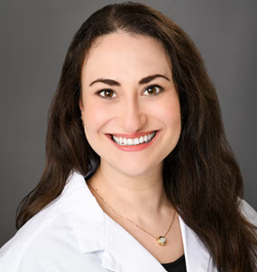
BRAIN INJURY 101: UNDERSTANDING AND INDENTIFYING BRAIN INJURY
Brian Im M.D.
Director of Brain Injury Rehabilitation Medicine
New York University, Rusk Rehabilitation
New York, NY
Jessica Rivetz M.D., M.S.
Brain Injury Staff Physiatrist
Sunnyview Rehabilitation Hospital
Schenectady, NY

Slide 4
WEBINAR PARTICIPATION
Please use the Q&A section for any questions
To turn on/off the live transcription, use the closed captions option on the bottom bar
This webinar is being recorded, and accreditation is only available for the live session

Slide 5
ACCREDITATION INFORMATION
Physicians:
This activity has been planned and implemented in accordance with the Accreditation Requirements and Policies of the Medical Society of the State of New York through the joint providership of the New York State Office of Mental Health’s Bureau of Psychiatric Services & Research Institute Support and the New York State Department of Health. The Bureau of Psychiatric Services & Research Institute Support is accredited by the Medical Society of the State of New York to provide continuing medical education for physicians.
The Bureau of Psychiatric Services & Research Institute Support designates this live activity for a maximum of 1 AMA PRA Category 1 Credits™. Physicians should claim only the credit commensurate with the extent of their participation in the activity.
The Bureau of Psychiatric Services & Research Institute Support relies upon planners and faculty participants to provide educational information that is objective and free of bias. In this spirit & in accordance with the Bureau of Psychiatric Services & Research Institute Support & MSSNY guidelines, all speakers & planners must disclose financial relationships with ineligible companies whose products, devices or services may be discussed in the CME content or may be perceived as a real or apparent conflict of interest. Any discussion of investigational or unlabeled use of a product will be identified.

Slide 6
ACCREDIATION INFORMATION
Social Work:
State of New York Office of Mental Health (OMH) is recognized by the New York State Education Department's State Board for Social Work as an approved provider of continuing education for licensed social workers #SW-0227. Licensed Master Social Workers (LMSWs) and Licensed Clinical Social Workers (LCSWs) who attend this class in its entirety will receive one contact hour towards renewal of their social work license.
Psychology:
State of New York Office of Mental Health is recognized by the New York State Education Department's State Board for Psychology as an approved provider of continuing education for licensed psychologists #PSY-0122. Licensed Psychologists who attend this class in its entirety will receive 1 contact hour toward renewal of their license.
CASAC:
This course is approved for CASAC/CPP/CPS Renewal clock hours.

Slide 7
ACCREDITATION INFORMATION
Nursing:
This nursing continuing professional development activity was approved by VTL Center for Professional Development, an accredited approver by the American Nurses Credentialing Center's Commission on Accreditation.
In order to obtain nursing contact hours, you must attend the entire program and complete/submit the evaluation.
No relevant financial relationships were identified for any member of the planning committee or any presenter/author of the program content.

Slide 8
The planners and presenters for this educational activity do not have any financial relationships to disclose with ineligible companies whose primary business is producing, marketing, selling, re-selling, or distributing healthcare products used by or on patients.
Disclosure Statements

Slide 9
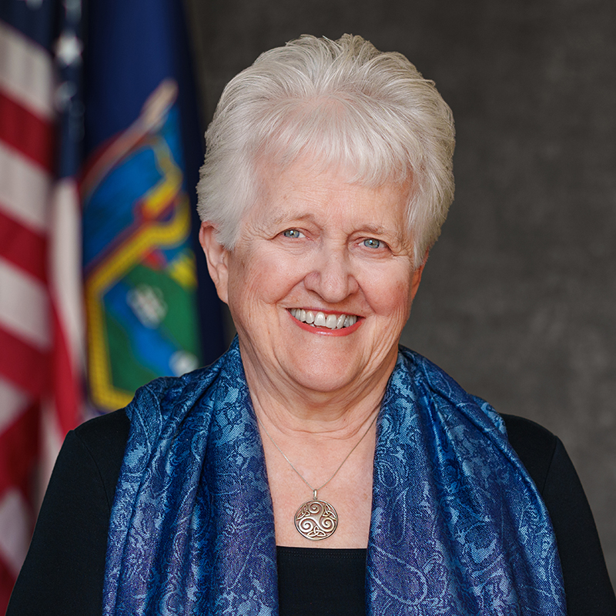
Dr. Ann Marie T. Sullivan, Commissioner of NYS Office of Mental Health
OPENING REMARKS
https://youtu.be/8Dg4BsfXOhA

Slide 10
OUTLINE AND OBJECTIVES
Definitions, Epidemiology, and Pathophysiology
Screening and Diagnosis
Symptoms & Sequelae, Recovery, and Prognosis
Case Discussion
Learning Objectives:
Learners will be able to identify types of brain injury and recognize their clinical signs.
Learners will be able to understand the pathophysiology and common symptomologies of brain injury

Slide 11
Definitions, Epidemiology, and Pathophysiology
Presented by: Dr. Brian Im

Slide 12
Definitions
Acquired Brain Injury
Traumatic Brain Injury
Anoxic/Hypoxic Brain Injury

Slide 13
Causes of Brain Injury include:
Trauma
Strokes
Spontaneous Brain Bleeds
Infection
Anoxia (Cardiac Arrest)
Hypoxia Ischemic
Neoplasm
Intracranial Surgery
Radiation Treatment
Structural abnormality
Hydrocephalus
Degenerative Neurological Disorders
Metabolic/Toxic Effects
Seizures
Notes:
Trauma (#1)
Strokes
Infection
Anoxia (Cardiac Arrest)
Hypoxia Ischemic
Neoplasm
Intracranial Surgery
Radiation Treatment
Structural abnormality (can include Congenital Malformations (Developmental):
Agenesis/Hypoplasia of the Corpus Callosum: Missing or under-developed connection between brain hemispheres.
Cortical Dysplasia/Malformation: Neurons fail to migrate to the proper location, causing irregular cortical folding.
Polymicrogyria: Excess, small folds (gyri) on the surface of the brain.
Chiari Malformation: Structural defects in the cerebellum.
Hydrocephalus/Ventriculomegaly: Accumulation of cerebrospinal fluid causing ventricles to enlarge.
Acquired Abnormalities:
Hippocampal Sclerosis: Shrinkage and scarring of the hippocampus, often causing epilepsy.
Atrophy: Degeneration of brain tissue often seen in dementia.
Lesions/Tumors: Arachnoid cysts, tumors, or vascular malformations.
Stroke or Trauma: Tissue damage causing permanent structural changes. )
Degenerative Neurological Disorders
Metabolic/Toxic Effects
Types of Structural Brain Abnormalities
Children's Wisconsin
Children's Wisconsin
+4

Slide 14
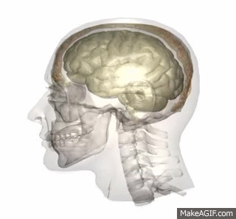
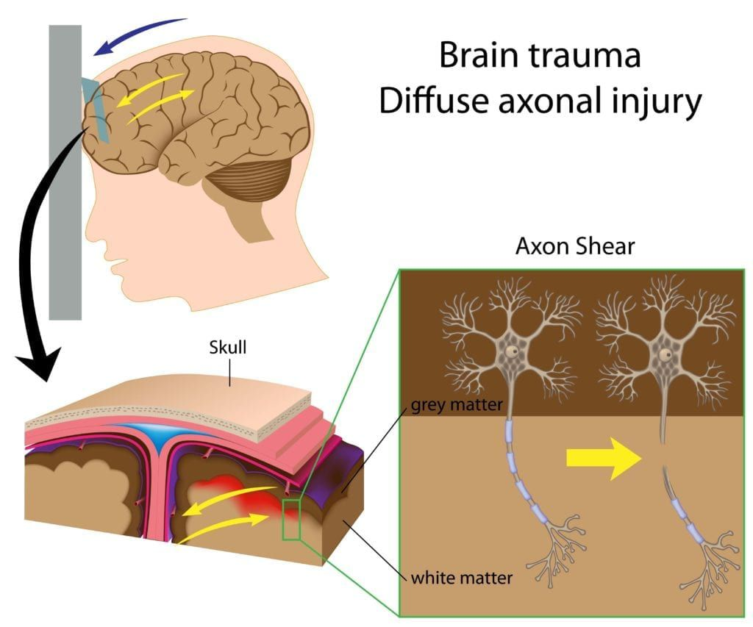
Mechanisms of Injury
Definitions in TBI
Primary injury (direct impact)
Intracranial hemorrhages or hematomas
  Epidural hematomas
  Subdural hematomas
  Subarachnoid hematomas
Intracerebral or intraventricular hematomas
Brain contusions and lacerations
Penetrating injury
Skull fractures
Cranial nerve damage
Diffuse axonal injury (DAI)
  Due to shearing forces resulting from linear and rotational acceleration and deceleration which puts strain on the brain!
  Occurs at gray white matter junction
  Not easily seen on imaging
Notes:
Primary injury (direct impact)
Linear and rotational accelerations of the head during impact
Acceleration puts strain on the brain!
Diffuse axonal injury (DAI)
Diffuse axonal injury (DAI) is unique to TBI
Axonal injury is the MCC of unconsciousness during and following the first 24 hrs of injury
2/2 shearing forces resulting from linear and rotational acceleration and deceleration
Occurs at GWM junction and can includes damage to the corpus callosum and the brainstem areas, depending on severity
Not easily seen on imaging because changes petechial hemorrhaging is often microscopic (unless looking at MRI SWI)
As such, the diagnosis is often not suspected until later when patients fail to recover neurologically as expected.
Not easily seen on imaging because changes petechial hemorrhaging is often microscopic
As such, the diagnosis is often not suspected until later when patients fail to recover neurologically as expected.
Initial injury - initial insult to brain architecture, usually due to trauma (falls, MVAs, etc.); also involves swelling, pressure
Secondary injury - subsequent cascade of biochemical changes, resulting in release of neurotoxins and excessive of neurotransmitters, causing further neuronal injury
This causes changes in behavior that can be tracked over days to weeks as the patient progresses in their medical course
Primary injury (direct impact)
Linear and rotational accelerations of the head during impact resulting in a combination of diffuse and focal injury
Diffuse axonal injury (DAI)
Occurs at grey/white matter junction and can include damage to the corpus callosum and the brainstem areas
Not easily seen on conventional imaging because changes (petechial hemorrhaging) are often microscopic
As such, the diagnosis is often not suspected until later when patients fail to recover neurologically as expected
Secondary injury
Metabolic changes that manifest weeks or months following injury
TBI Clinician Guideline (cdc.gov) / Diffuse axonal injury | Radiology Reference Article | Radiopaedia.org
•Primary injury (direct injury on impact)
•Current data suggest that both linear and rotational accelerations of the head during impact are primary risk factors
•Head acceleration is thought to result in strain patterns on brain tissue, which may cause injury to white matter tracts via DAI
•Diffuse axonal injury
•2/2 shearing forces resulting from rotational acceleration < deceleration
•Occurs at GWM junction (Watershed areas) and includes damage to the corpus callosum and the brainstem areas
•Non-contrast CT of the brain is routine in patients presenting with head injuries (as they’re good for acutely seeing macroscopic hemorrhage). Unfortunately, CT is not sensitive to subtle diffuse axonal injury (because it’s microscopic petechial hemorrhaging) and as such, some patients with relatively normal CT scans may have significant unexplained neurological deficit
•As such, the diagnosis is often not suspected until later when patients fail to recover neurologically as expected.
•Secondary injury
•Edema, free radicals, excitatory amino acids
•Neurons may undergo degeneration in the weeks or months after trauma (secondary axonotmesis).

Slide 15
Mechanisms of Injury
Definitions in TBI
Secondary injury
Cascade of biochemical changes → further neuronal injury
Occurs days to weeks after
Cerebral Swelling and Edema
Hypoxic-Ischemic Damage
Metabolic Damage
Notes:
Primary injury (direct impact)
Linear and rotational accelerations of the head during impact
Acceleration puts strain on the brain!
Diffuse axonal injury (DAI)
Diffuse axonal injury (DAI) is unique to TBI
Axonal injury is the MCC of unconsciousness during and following the first 24 hrs of injury
2/2 shearing forces resulting from linear and rotational acceleration and deceleration
Occurs at GWM junction and can includes damage to the corpus callosum and the brainstem areas, depending on severity
Not easily seen on imaging because changes petechial hemorrhaging is often microscopic (unless looking at MRI SWI)
As such, the diagnosis is often not suspected until later when patients fail to recover neurologically as expected.
Not easily seen on imaging because changes petechial hemorrhaging is often microscopic
As such, the diagnosis is often not suspected until later when patients fail to recover neurologically as expected.
Initial injury - initial insult to brain architecture, usually due to trauma (falls, MVAs, etc.); also involves swelling, pressure
Secondary injury - subsequent cascade of biochemical changes, resulting in release of neurotoxins and excessive of neurotransmitters, causing further neuronal injury
This causes changes in behavior that can be tracked over days to weeks as the patient progresses in their medical course
Primary injury (direct impact)
Linear and rotational accelerations of the head during impact resulting in a combination of diffuse and focal injury
Diffuse axonal injury (DAI)
Occurs at grey/white matter junction and can include damage to the corpus callosum and the brainstem areas
Not easily seen on conventional imaging because changes (petechial hemorrhaging) are often microscopic
As such, the diagnosis is often not suspected until later when patients fail to recover neurologically as expected
Secondary injury
Metabolic changes that manifest weeks or months following injury
TBI Clinician Guideline (cdc.gov) / Diffuse axonal injury | Radiology Reference Article | Radiopaedia.org
•Primary injury (direct injury on impact)
•Current data suggest that both linear and rotational accelerations of the head during impact are primary risk factors
•Head acceleration is thought to result in strain patterns on brain tissue, which may cause injury to white matter tracts via DAI
•Diffuse axonal injury
•2/2 shearing forces resulting from rotational acceleration < deceleration
•Occurs at GWM junction (Watershed areas) and includes damage to the corpus callosum and the brainstem areas
•Non-contrast CT of the brain is routine in patients presenting with head injuries (as they’re good for acutely seeing macroscopic hemorrhage). Unfortunately, CT is not sensitive to subtle diffuse axonal injury (because it’s microscopic petechial hemorrhaging) and as such, some patients with relatively normal CT scans may have significant unexplained neurological deficit
•As such, the diagnosis is often not suspected until later when patients fail to recover neurologically as expected.
•Secondary injury
•Edema, free radicals, excitatory amino acids
•Neurons may undergo degeneration in the weeks or months after trauma (secondary axonotmesis).

Slide 16
Mechanisms of Injury
Epidemiology: Costs of TBI
Approximately 2% of the U.S. population has a long-term or lifelong need for help to perform ADL’s as a result of a TBI, according to the CDC.
Direct and indirect costs of TBI?: ~$60 billion in the United States in 2000.
Notes:
The CDC previously estimated that at least 5.3 million Americans, approximately 2% of the U.S. population, had a long-term or lifelong need for help to perform ADL’s as a result of a TBI. (Other data states the figure is closer to 3.17 million when adjusted for mortality data)
Direct medical costs and indirect costs such as lost productivity of TBI totaled an estimated $60 billion in the United States in 2000.
Initial injury - initial insult to brain architecture, usually due to trauma (falls, MVAs, etc.); also involves swelling, pressure
Secondary injury - subsequent cascade of biochemical changes, resulting in release of neurotoxins and excessive of neurotransmitters, causing further neuronal injury
This causes changes in behavior that can be tracked over days to weeks as the patient progresses in their medical course
Primary injury (direct impact)
Linear and rotational accelerations of the head during impact resulting in a combination of diffuse and focal injury
Diffuse axonal injury (DAI)
Occurs at grey/white matter junction and can include damage to the corpus callosum and the brainstem areas
Not easily seen on conventional imaging because changes (petechial hemorrhaging) are often microscopic
As such, the diagnosis is often not suspected until later when patients fail to recover neurologically as expected
Secondary injury
Metabolic changes that manifest weeks or months following injury
TBI Clinician Guideline (cdc.gov) / Diffuse axonal injury | Radiology Reference Article | Radiopaedia.org
•Primary injury (direct injury on impact)
•Current data suggest that both linear and rotational accelerations of the head during impact are primary risk factors
•Head acceleration is thought to result in strain patterns on brain tissue, which may cause injury to white matter tracts via DAI
•Diffuse axonal injury
•2/2 shearing forces resulting from rotational acceleration < deceleration
•Occurs at GWM junction (Watershed areas) and includes damage to the corpus callosum and the brainstem areas
•Non-contrast CT of the brain is routine in patients presenting with head injuries (as they’re good for acutely seeing macroscopic hemorrhage). Unfortunately, CT is not sensitive to subtle diffuse axonal injury (because it’s microscopic petechial hemorrhaging) and as such, some patients with relatively normal CT scans may have significant unexplained neurological deficit
•As such, the diagnosis is often not suspected until later when patients fail to recover neurologically as expected.
•Secondary injury
•Edema, free radicals, excitatory amino acids
•Neurons may undergo degeneration in the weeks or months after trauma (secondary axonotmesis).

Slide 17
Epidemiology: TBI in the USA
TBI: Overview
At least 2.8 million TBI annually (likely an underestimate)
Prevalence:
Age:
    Highest incidence in persons 15-24 years and ≥75 years
    Additional peak in children ≤5 years
Sex: M > F
Most Common Causes of TBI:
  Falls (#1 cause of TBI, especially in the elderly)
  Firearm related suicide (#1 cause of TBI related deaths)
  MVA
  Violence/Assault
  Blast injury is a leading cause of TBI among active military personnel in war zones.
Notes:
At least 2.8 million TBIs occur annually
Likely an underestimate (excludes outpatients, those who don’t seek care (Esp athletes), and military/VA).
High-Risk Populations:
Age: Highest incidence in persons 15-24 years and ≥75 years, with an additional peak in children ≤5 years
Sex
Most Common Causes of TBI
Falls - #1 cause of TBI-related hospitalizations, esp in the elderly
MVA
Violence/Assault (13%) - 2nd MCC in young adults
Alcohol involvement: Associated with 50% of all TBIs
There were approximately 214,110 TBI-related hospitalizations in 2020 and 69,473 TBI-related deaths in 2021
This represents more than 586 TBI-related hospitalizations and 190 TBI-related deaths per day
These estimates do not include the many TBIs that are only treated in the emergency department, primary care, urgent care, or those that go untreated
People age 75 years and older had the highest numbers and rates of TBI-related hospitalizations and deaths
Males were nearly two times more likely to be hospitalized and three times more likely to die from a TBI than females
Traumatic brain injury (TBI) related data according to Center for Disease Control (CDC) data

Slide 18
The number reported with TBI underestimates the magnitude of the problem because the following are not included:
  TBIs undiagnosed or misdiagnosed
  Those treated solely within the armed forces medical system
  Those treated by private physicians
  Individuals who did not seek medical care
Notes:
18

Slide 19
Epidemiology: TBI in the USA
TBI: Overview
“Invisible epidemic"
  87% of older adults screening positive for TBI had never received a prior TBI diagnosis
  Particularly pronounced in substance use, incarcerated, and psychiatric disorder populations
Notes:
At least 2.8 million TBIs occur annually
Likely an underestimate (excludes outpatients, those who don’t seek care (Esp athletes), and military/VA).
High-Risk Populations:
Age: Highest incidence in persons 15-24 years and ≥75 years, with an additional peak in children ≤5 years
Sex
Most Common Causes of TBI
Falls - #1 cause of TBI-related hospitalizations, esp in the elderly
MVA
Violence/Assault (13%) - 2nd MCC in young adults
Alcohol involvement: Associated with 50% of all TBIs
There were approximately 214,110 TBI-related hospitalizations in 2020 and 69,473 TBI-related deaths in 2021
This represents more than 586 TBI-related hospitalizations and 190 TBI-related deaths per day
These estimates do not include the many TBIs that are only treated in the emergency department, primary care, urgent care, or those that go untreated
People age 75 years and older had the highest numbers and rates of TBI-related hospitalizations and deaths
Males were nearly two times more likely to be hospitalized and three times more likely to die from a TBI than females
Traumatic brain injury (TBI) related data according to Center for Disease Control (CDC) data

Slide 20
Epidemiology: The TBI-Substance Use Bidirectional Relationship:
Dramatically overrepresented in substance use populations
10-fold higher prevalence than the general population
TBI may increase vulnerability to further substance use
Individuals with TBI in substance use treatment show greater harm:
Higher overdose risk
More severe substance use problems
Increased use of high-risk substances (amphetamines, cocaine, fentanyl)
Riskier routes of administration
Bidirectional relationship also exists between TBI and psychiatric illness
Notes:
TBI is dramatically overrepresented in substance use populations. Among individuals seeking treatment for opioid use disorder, 48.7% have a history of at least one TBI, and 44.2% of those have experienced multiple TBIs.
This prevalence is approximately 10-fold higher than the general population.
55.8% of individuals with both TBI and OUD sustained their TBI BEFORE ever using opioids - suggesting TBI may increase vulnerability to substance use
Among those with TBI history, 90% had been prescribed opioid medication by a healthcare professional (vs lower rates in non-TBI patients)
TBI increases risk of developing new substance use disorders: 5-year incidence of new SUD post-TBI is 4.2%, with nicotine (2.4%), alcohol (1.1%), cannabis (0.9%), and opioids (0.4%) most common
Approximately 50% of those who develop SUD post-TBI manifest symptoms within 3 years of injury
Individuals with TBI in substance use treatment show greater harm:
Higher overdose risk
More severe substance use problems
Increased use of high-risk substances (amphetamines, cocaine, fentanyl)
Riskier routes of administration

Slide 21
Why This Matters
Diagnosis is critical for getting the right help
Functional outcomes
Treatment engagement
Risk of repeat TBI/ Relapse risk
Getting access to the right resources
Notes:
For case managers, social workers, and addiction counselors: Nearly half your clients likely have undiagnosed TBI that affects treatment engagement, relapse risk, and functional outcomes.
[6][12]
For primary care providers: Routine TBI screening in substance use populations is essential, as cognitive impairments from unrecognized brain injury undermine addiction treatment effectiveness.
[9][12]
For your complex case discussion: The bidirectional relationship means you must assess both whether prior TBIs contributed to opioid use AND whether the overdose caused new anoxic injury - these are distinct but often co-occurring problems in the same patient.

Slide 22
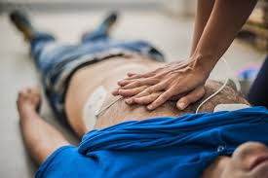
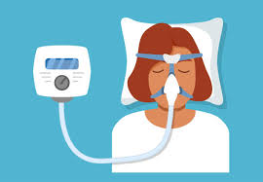
Definitions: Anoxic vs. Hypoxic-Ischemic Brain Injury
Anoxic Brain Injury
Hypoxic-Ischemic Brain Injury
Complete absence of oxygen delivery
Reduced oxygen delivery (hypoxia) and reduced blood flow (ischemia)
Notes:
Drug overdose (such as due to opiates or benzos) causes hypoxic (not purely anoxic) brain injury through respiratory depression
Cell death begins after 5-6 minutes of oxygen deprivation
The pathophysiology is distinct from cardiac arrest: progressive hypoxia precedes cardiac arrest, creating a period of "anoxic perfusion" with persistent glucose delivery that worsens acidosis and may lead to more severe cerebral edema and brain death compared to sudden cardiac causes
Brain injury is often not documented following non-fatal overdose - physicians may code peripheral neuropathy, respiratory distress, seizures, or psychiatric diagnoses without recognizing the underlying anoxic encephalopathy

Slide 23
Anoxic / Hypoxic-Ischemic Brain Injury
Causes include:
Heart attack (MI)
Substance use overdose
Strangulation
Respiratory failure
Diffuse brain injury
Watershed areas of the brain more susceptible to injury
Notes:
Drug overdose (such as due to opiates or benzos) causes hypoxic (not purely anoxic) brain injury through respiratory depression
Cell death begins after 5-6 minutes of oxygen deprivation
The pathophysiology is distinct from cardiac arrest: progressive hypoxia precedes cardiac arrest, creating a period of "anoxic perfusion" with persistent glucose delivery that worsens acidosis and may lead to more severe cerebral edema and brain death compared to sudden cardiac causes
Brain injury is often not documented following non-fatal overdose - physicians may code peripheral neuropathy, respiratory distress, seizures, or psychiatric diagnoses without recognizing the underlying anoxic encephalopathy

Slide 24
Diagnosis and Screening
Notes:
Drug overdose (such as due to opiates or benzos) causes hypoxic (not purely anoxic) brain injury through respiratory depression
Cell death begins after 5-6 minutes of oxygen deprivation
The pathophysiology is distinct from cardiac arrest: progressive hypoxia precedes cardiac arrest, creating a period of "anoxic perfusion" with persistent glucose delivery that worsens acidosis and may lead to more severe cerebral edema and brain death compared to sudden cardiac causes
Brain injury is often not documented following non-fatal overdose - physicians may code peripheral neuropathy, respiratory distress, seizures, or psychiatric diagnoses without recognizing the underlying anoxic encephalopathy

Slide 25


Indications for Medical Evaluation
Observable Signs
Not moving
Balance deficits
Confusion
Blank stare
Facial injury
Also GCS<15 or other focal neurological deficits warrant further medical evaluation
Neck pain or tenderness
Double vision
Weakness or sensory changes
Increasing or severe headache
Seizure
Loss of consciousness (LOC)
Worsening mental state or arousal
Vomiting
Agitation or restlessness

Slide 26
Defining TBI Severity
TBI Severity
TBI severity | GCS score | Length of LOC | Duration of PTA
Mild TBI | GCS 13-15 | LOC < 30 min | PTA < 24 hrs
Moderate TBI | GCS 9-12 | LOC 30 min - 24 hrs | PTA 1-7 days
Severe TBI | GCS 3-8 | LOC >24 hrs | PTA >7 days
*PTA=Post-Traumatic Amnesia
There is a Recent Shift Toward a More Comprehensive Classification Process for TBI
Notes:
*PTA=Post-Traumatic Amnesia - the period after injury during which patients have, most commonly, anterograde amnesia.

Slide 27
Diagnosis & Screening: Imaging
Non-contrast CT of the head is study of choice for initial acute TBI evaluation
  Relatively quick study
  Assesses for acute findings that require intervention
  Not always necessary
  Mild TBI cases often do not show positive findings
Notes:
Biomarkers such as n-acetylasparate (NAA) or S100B also being studied-hot topic.
May n
27

Slide 28
Altered Level of Consciousness
Coma
Unresponsive Wakefulness State
Minimally Conscious State
JFK Coma Recovery Scale – Revised
Scale used to assess for emergence from UWS to MCS
Notes:
28

Slide 29
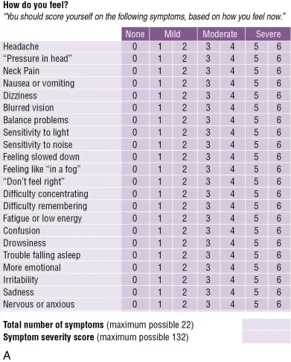
Diagnosis & Screening: Concussion
SAC Symptom Scale
Acute/Sideline Settings (within 72 hours):
SCAT6 for adults and adolescents ≥13 years
Child SCAT6 for children 8-12 years
Components: symptom evaluation, cognitive assessment (SAC), balance, neurological screening
Office/Outpatient Settings (>1 week post-injury):
SCOAT6 - identifies specific treatment targets: vestibular dysfunction, cervical issues, mental health concerns, sleep disorders
Echemendia, R. J., Meeuwisse, W., McCrory, P., Davis, G. A., Putukian, M., Leddy, J., Makdissi, M., Sullivan, S. J., Broglio, S. P., Raftery, M., Schneider, K., Kissick, J., McCrea, M., Dvořák, J., Sills, A., Aubry, M., Engebretsen, L., Loosemore, M., Fuller, G., ... Herring, S. (2017). Sport Concussion Assessment Tool - 5th Edition. British Journal of Sports Medicine, 51(11), 851-858. https://doi.org/10.1136/bjsports-2017-097506SCAT5
Notes:
Acute/Sideline Settings (within 72 hours):
SCAT6 for adults and adolescents ≥13 years
Immediate Assessment
Office Assessment
History
Symptom evaluation
Cognitive screen
Neurological screen
Balance examination
Delayed recall
Decision
Child SCAT6 for children 8-12 years
Components: symptom evaluation, cognitive assessment (SAC), balance, neurological screening

Slide 30
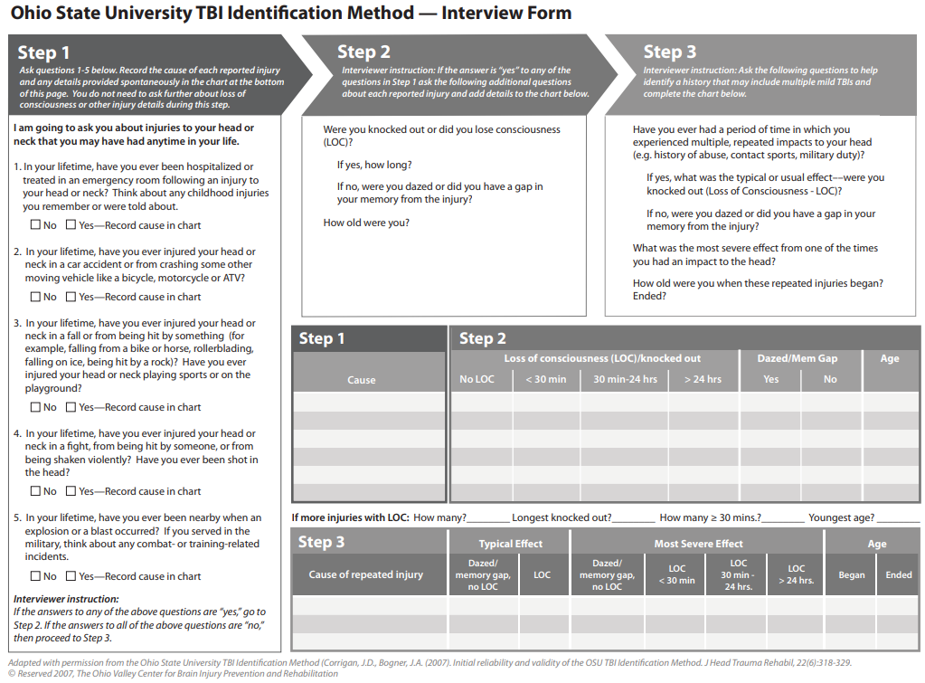
Diagnosis & Screening
Community Settings: Screening Tests for hx of TBI
OSU TBI-ID: For lifetime TBI history screening. Detects 50% more TBIs than brief screens. Specifically includes questions about loss of consciousness from drug overdose
Brain Injury Screening Questionnaire (BISQ): Structured questionnaire that characterizes incidence and severity of lifetime exposure to head trauma and TBI.
Brain Injury Screening Tool (BIST): 15-item tool with excellent validity for determining need for specialist referral
Notes:
Im
Community/Primary Care/Substance Use Treatment Settings:
OSU TBI-ID for lifetime TBI history screening
Detects 50% more TBIs than brief screens; 87% screening positive had never been diagnosed
Specifically includes questions about loss of consciousness from drug overdose

Slide 31


Symptoms & Sequelae, Recovery, and Prognosis
Presented by: Dr. Jessica Rivetz

Slide 32
Possible Medical/Neurological Complications Associated with Brain Injury
Increases in intracranial pressure (ICP)
Post-traumatic hydrocephalus (PTH)
Hypertension
Dysautonomia
Post-traumatic seizures
Deep venous thrombosis (DVT)
Malnutrition
Bowel related issues
Pressure ulcers
Endocrine dysfunction
Heterotopic ossification (HO)
Pathological laughter/crying
Depression and post-traumatic stress disorder (PTSD)
Urological dysfunction
Spasticity
Notes:
32

Slide 33
Common Problems after Brain Injury
Neurocognitive
    Attention/concentration
    Language
    Awareness
    Learning and Memory
    Visuospatial skills
    Executive skills
    Vision Changes
    Aspontaneity
    Loss of Drive or Initiative
    Inappropriate Social Responses
Psychological
    Mood changes
      Irritability
      Anxiety
      Depression
      Emotional Lability
      Apathy
    Personality changes
    Impulsivity
    Agitation
    Belligerence and Anger
    Paranoia
    Hallucination
    Restlessness
    Substance Use
Somatic
Headaches
Balance Problems
Sleep Problems
Dizziness
Noise Sensitivity
Light Sensitivity
Fatigue
Tinnitus
Nausea
Impaired Taste
Impaired Smell
Notes:
33
Headaches or neck pain that do not go away
Difficulty remembering, concentrating, or making decisions
Slowness in thinking, speaking, acting, or reading
Getting lost or easily confused
Feeling tired all of the time, having no energy or motivation
Mood changes
Changes in sleep patterns
Light-headedness, dizziness, or loss of balance
Nausea
Increased sensitivity to lights, sounds, or distractions
Blurred vision or eyes that tire easily
Loss of sense of smell or taste
Ringing in the ears

Slide 34
Long Term Effects of TBI
Decline in academic/professional performance
Loss of employment
Loss of driving
Decreased sense of independence and/or self worth
Major social, societal & family consequences
  Life-changing
  Misunderstood and under-diagnosed
Notes:
Decline in academic/professional performance
Loss of employment
Loss of driving
Decreased sense of independence
Major social, societal & family consequences
Life-changing
Misunderstood and under-diagnosed
Do not necessarily reflect ongoing physiological injury to the brain
Incorporates somatic, emotional, behavioral, and cognitive difficulties
34

Slide 35
Predictors of Brain Injury Recovery
Duration of Time in the Post-traumatic Amnesia State (PTA) is One of the Strongest Predictors of Outcome After TBI
Faster emergence from PTA = better prognosis
The Galveston Orientation and Amnesia Test (GOAT) is used to assess emergence from PTA
  Alternative: Orientation Log (O-LOG)
Injury Severity at Time of Initial Injury is Informative but Not a Reliable Measure of Prognosis
There is a shift toward a more comprehensive assessment to classify brain injury severity as opposed to GCS, LOC, and PTA alone
Notes:
35
Duration of Time in the Post-traumatic Amnesia State (PTA) is One of the Strongest Predictors of Outcome After TBI
The faster you emerge from PTA, the better the prognosis
The Galveston Orientation and Amnesia Test (GOAT) is used to assess emergence from PTA
Injury Severity at Time of Initial Injury is Informative but Not a Reliable Measure of Prognosis
There is a shift toward a more comprehensive assessment to classify brain injury severity as opposed to GCS, LOC, and PTA alone
Most commonly used predictor of outcomes is post-traumatic amnesia (PTA)
Defined by a state of confusion and disorientation following a TBI, characterized most commonly by anterograde amnesia
Longer durations of PTA are associated with worse outcomes
Assessment tools for evaluating PTA
Galveston Orientation and Amnesia Test (GOAT)
Assess orientation to person, place, time; recall of circumstances leading to hospitalization; the last preinjury and first postinjury memories
Orientation Log (O-LOG)
Focuses on orientation to place, time, and circumstance

Slide 36
Other Predictors of Brain Injury Recovery
Age
PMHX/PSHX
Premorbid conditions
MH history
h/o prior brain injuries
Socio Environmental factors
Social support
Premorbid functional level
Type of Damage
Focal vs. Diffuse;
Etiology
Traumatic vs. Atraumatic;
Hemorrhagic vs. Ischemic/Anoxic
Imaging findings (CT, MRI)
Severity of Damage
Disorder of Consciousness
Time since injury
Pupillary light reflex
Doll’s eye sign
Caloric testing
SSEP
Rate of Recovery
Notes:
36
Once a person suffers a concussion, he/she is
4X more likely to sustain a second one
Can lead to much more severe symptoms if
repeat concussion occurs before not fully
recovered from prior concussion
After several concussions, it takes less of a blow
to cause the injury and requires more time to
recover

Slide 37
Recovery from Concussion
In the general population, about 60% of people suffering from a concussion are better in 2-4 weeks.
Persistent post-concussive symptoms refers to symptoms >14 days in adults and >4 weeks in children.
About 80 to 90% of people are better in 2 to 3 months.
About 10 to 20% of people have symptoms which linger.
Notes:
.
37

Slide 38
Recovery from Mild TBI
Approximately 50% of patients with mild TBI do not attain full recovery by 12 months.
The strongest predictors of persistent symptoms are:
Cognitive symptoms (difficulty concentrating) - 3× increased odds
Pre-existing mental health conditions (anxiety, depression, sleep disorders)
Female sex
History of migraine
Previous psychiatric history
Assault-related injury
Previous head injury

Slide 39
Recovery from Moderate-Severe TBI
Most improvement occurs within the first weeks to months
Neurocognitive and functional improvement may continue for years, with more individuals improving than declining during first 5 years post-injury
Long-term recovery often incomplete among individuals with more severe injuries

Slide 40
Recovery from Anoxic Brain Injury
Prolonged Disorders of Consciousness (>28 days post-injury):
Among patients with severe anoxic brain injury and prolonged disorders of consciousness:
  26% mortality rate
  26% show clinical improvement
  17% recover full consciousness
Predictors of better outcomes:
  Younger age
  Baseline diagnosis of minimally conscious state (vs unresponsive wakefulness state)
  Higher Coma Recovery Scale scores
  Earlier admission to intensive rehabilitation
  Recovery possible even with malignant SEP results

Slide 41
Recovery from Anoxic Brain Injury
Cognitive Outcomes in Anoxic Injury Survivors:
Most cognitive recovery occurs in first 3 months, with minor improvements up to 12 months
30-50% have persistent cognitive impairment in chronic stage
Predominant deficits: verbal memory, learning ability, executive function, decreased processing speed, attention
Long-term Survival and Neurologic Recovery:
most functional recovery occurs within 6 months, BUT…
considerable variability exists… some experience clinically meaningful improvements in both functional and cognitive outcomes up to 2 years post-arrest
need for ongoing monitoring and rehabilitation.
Notes:
Cognitive Outcomes in Anoxic Injury Survivors:
Most cognitive recovery occurs in first 3 months, with minor improvements up to 12 months
30-50% have persistent cognitive impairment in chronic stage
Predominant deficits: verbal memory, learning ability, executive function, decreased processing speed, attention
Long-term Survival and Neurologic Recovery:
While most functional recovery occurs within 6 months, individual patients show considerable variability, with some experiencing clinically meaningful improvements in both functional and cognitive outcomes up to 2 years post-arrest, supporting the need for ongoing monitoring and rehabilitation.

Slide 42
Comparison: Anoxic vs Traumatic Brain Injury
Relative to TBI patients, those with anoxic brain injury:
Are referred later for rehabilitation
Make slower progress with poorer outcomes
Are more likely to require residential care
Have more severe cognitive impairments, particularly in visual memory and short-term memory

Slide 43
Rehabilitation Team
Physical Therapist
Occupational Therapist
Speech Language Pathologist
Recreational Therapist
Vocational Therapist
Social Worker
Care Manager
Counselors
Spiritual Care
Patient/Client
Family
Physiatrist
Rehab Nursing Staff
Neuropsychologist
Notes:
43

Slide 44
Rehabilitation
Vestibular PT
Occupational Therapy
- Gait and balance problems, dizziness
- Headache management
- Vision
- IADL/community activities
- Cognition
Neuropsyochology
- Comprehensive neurocog and psych testing
- Support/therapy
- Behavioral modifications
- Reasonable accommodations
Speech/Swallow Therapy
- Aphasia
- Dysarthria
- Dysphagia
- Cognition
Vocational Rehab
- Work/school
Notes:
Vestibular therapy/PT
Treats gait and balance problems, dizziness
Headache management
Occupational Therapy
Vision rehab
IADL/community retraining
Vocational Counseling
Work/school
Neuropsychology
Comprehensive neuropsych testing
Cognitive rehabilitation
Psychological support/Psychotherapy
Behavioral modification
Coordinates with schools and workplace

Slide 45

CASE DISCUSSION

Slide 46
CASE DISCUSSION
36 year old male with polysubstance abuse history, found down with difficulty breathing, EMS called.
Brain MRI consistent with diffuse injury.
S/p placement/insertion of tracheostomy and gastrostomy tubes.

Slide 47
REFERENCES
American Academy of Physical Medicine and Rehabilitation. (2018). BIAA non-lethal opioid overdose and acquired brain injury position statement [Endorsed by AAPM&R]. https://www.aapmr.org
Caine, D., & Watson, J. D. (2000). Neuropsychological and neuropathological sequelae of cerebral anoxia: A critical review. Journal of the International Neuropsychological Society, 6(1), 86-99.
Centers for Disease Control and Prevention. (2007). Nonfatal traumatic brain injuries from sports and recreation activities—United States, 2001–2005. Morbidity and Mortality Weekly Report, 56(29), 733-737. https://www.cdc.gov/mmwr/preview/mmwrhtml/mm5608a7.htm
Corrigan, J. D., & Bogner, J. (2007). Initial reliability and validity of the Ohio State University TBI Identification Method. The Journal of Head Trauma Rehabilitation, 22(6), 318-329. https://doi.org/10.1097/01.HTR.0000300227.67748.77
Cronberg, T., Greer, D. M., Lilja, G., Moulaert, V., Swindell, P., & Rossetti, A. O. (2020). Brain injury after cardiac arrest: From prognostication of comatose patients to rehabilitation. The Lancet Neurology, 19(7), 611-622.
Dams-O'Connor, K., Cantor, J. B., Brown, M., Dijkers, M. P., Spielman, L. A., & Gordon, W. A. (2014). Screening for traumatic brain injury: Findings and public health implications. The Journal of Head Trauma Rehabilitation, 29(6), 479-489. https://doi.org/10.1097/HTR.0000000000000099
Elovic, E., Baerga, E., Cuccurullo, S. J., Greiss, C., Thomas, A., Levine, J., & Malone, R. J. (2020). Traumatic brain injury. In S. J. Cuccurullo (Ed.), Physical medicine and rehabilitation board review (4th ed., pp. 55-100). Demos Medical.
Giacino, J. T., Ashwal, S., Childs, N., Cranford, R., Jennett, B., Katz, D. I., Kelly, J. P., Rosenberg, J. H., Whyte, J., Zafonte, R. D., & Zasler, N. D. (2002). The minimally conscious state. Neurology, 58(3), 349-353. https://doi.org/10.1212/wnl.58.3.349
Hoffer, M. E., Szczupak, M., Kiderman, A., Crawford, J., Murphy, S., & Marshall, K. (2016). Neurosensory symptom complexes after acute mild traumatic brain injury. PLoS One, 11(1), e0146039.
Levin, H. S., & Diaz-Arrastia, R. R. (2015). Diagnosis, prognosis, and clinical management of mild traumatic brain injury. The Lancet Neurology, 14(5), 506-517.
McLaren, J., Fradera, A., & Cullen, B. (2025). The reliability and validity of brief cognitive screening tools used in traumatic brain injury: A systematic review. Neuropsychological Rehabilitation, 35(1), 1-25.
Menon, D. K., Silverberg, N. D., Ferguson, A. R., Temkin, N., Stein, M. B., Whyte, J., Jain, S., Manley, G. T., & Yue, J. K. (2025). Clinical assessment on days 1-14 for the characterization of traumatic brain injury: Recommendations from the 2024 NINDS Traumatic Brain Injury Classification and Nomenclature Initiative Clinical/Symptoms Working Group. Journal of Neurotrauma, 42(1-2), 1-18.
Orr, T. J., Lesha, E., Kramer, A. H., Gallagher, C. N., & Hawryluk, G. W. J. (2024). Traumatic brain injury: A comprehensive review of biomechanics and molecular pathophysiology. World Neurosurgery, 181, 52-68.
Perkins, G. D., Callaway, C. W., Haywood, K., Neumar, R. W., Lilja, G., Rowland, M. J., Sawyer, K. N., Skrifvars, M. B., & Nolan, J. P. (2021). Brain injury after cardiac arrest. The Lancet, 398(10307), 1269-1278.
Peskine, A., Rosso, C., Picq, C., Caron, E., & Pradat-Diehl, P. (2010). Neurological sequelae after cerebral anoxia. Brain Injury, 24(5), 755-761.
Stocchetti, N., Carbonara, M., Citerio, G., Ercole, A., Skrifvars, M. B., Smielewski, P., Zoerle, T., & Menon, D. K. (2017). Severe traumatic brain injury: Targeted management in the intensive care unit. The Lancet Neurology, 16(6), 452-464.
Theadom, A., Hardaker, N., Bray, C., Hume, P., Starkey, N., Barker-Collo, S., & Feigin, V. L. (2021). The Brain Injury Screening Tool (BIST): Tool development, factor structure and validity. PLoS One, 16(3), e0247722.
Notes:
Severe Traumatic Brain Injury: Targeted Management in the Intensive Care Unit.
The Lancet. Neurology. 2017. Stocchetti N, Carbonara M, Citerio G, et al.
3.
Traumatic Brain Injury: A Comprehensive Review of Biomechanics and Molecular Pathophysiology.
World Neurosurgery. 2024. Orr TJ, Lesha E, Kramer AH, et al.
4.
Brain Injury After Cardiac Arrest.
Lancet. 2021. Perkins GD, Callaway CW, Haywood K, et al.
5.
Clinical Assessment on Days 1-14 for the Characterization of Traumatic Brain Injury: Recommendations From the 2024 NINDS Traumatic Brain Injury Classification and Nomenclature Initiative Clinical/­Symptoms Working Group.
Journal of Neurotrauma. 2025. Menon DK, Silverberg ND, Ferguson AR, et al.New
6.
Neurosensory Symptom Complexes After Acute Mild Traumatic Brain Injury.
PloS One. 2016. Hoffer ME, Szczupak M, Kiderman A, et al.
7.
Neuropsychological and Neuropathological Sequelae of Cerebral Anoxia: A Critical Review.
Journal of the International Neuropsychological Society : JINS. 2000. Caine D, Watson JD.
8.
Neurological Sequelae After Cerebral Anoxia.
Brain Injury. 2010. Peskine A, Rosso C, Picq C, Caron E, Pradat-Diehl P.
.
The Brain Injury Screening Tool (BIST): Tool Development, Factor Structure and Validity.
PloS One. 2021. Theadom A, Hardaker N, Bray C, et al.
13.
The Reliability and Validity of Brief Cognitive Screening Tools Used in Traumatic Brain Injury: A Systematic Review.
Neuropsychological Rehabilitation. 2025. McLaren J, Fradera A, Cullen B.New
14.
Diagnosis, Prognosis, and Clinical Management of Mild Traumatic Brain Injury.
The Lancet. Neurology. 2015. Levin HS, Diaz-Arrastia RR.
Brain Injury After Cardiac Arrest: From Prognostication of Comatose Patients to Rehabilitation.
The Lancet. Neurology. 2020. Cronberg T, Greer DM, Lilja G, et al.
BIAA Non-lethal Opioid Overdose and Acquired Brain Injury Position Statement – Endorsed by AAPM&R.
American Academy of Physical Medicine and Rehabilitation (2018). 2018. Diane Schirmer, Gary S. Seale, John D. Corrigan, Christopher G. CarterGuideline
- Elovic, E., Baerga, E., Cuccurullo, S. J., Greiss, C., Thomas, A., Levine, J., & Malone, R. J. (2020). 2. Traumatic Brain Injury. In Physical Medicine and Rehabilitation Board Review (4th ed., pp. 55–100). Book Chapter, Demos Medical.
- Giacino, J. T., Ashwal, S., Childs, N., Cranford, R., Jennett, B., Katz, D. I., Kelly, J. P., Rosenberg, J. H., Whyte, J., Zafonte, R. D., & Zasler, N. D. (2002). The minimally Conscious State. Neurology, 58(3), 349–353. https://doi.org/10.1212/wnl.58.3.349

Slide 48
RESOURCES
NYS DOH Traumatic Brain Injury
Behavioral Health Guide: Considerations for Best Practices for Children, Youth, and Adults with TBI
The Brain Injury Association of New York State
TBI Medicaid Waiver Program
Brainline
Take Charge of Your Brain Health!
Model Systems Knowledge Translation Center
Living with TBI: A Roadmap for Individuals with Traumatic Brain Injury

Slide 49
Next Session
Brain Injury Treatment: Psychopharmacology and Medical Interventions
April 21, 2026 10AM
Presenters: Dr. Brian Im and Dr. Jessica Rivetz
Register here: https://meetny-gov.webex.com/weblink/register/r31b4bcb661faaa00cf27024fc074f318

