Slide 1
Providing Feedback on the NYS Prevention Agenda for 2019-2024 Becoming the Healthiest State for People of All Ages
NYS Department of Health Office of Public Health Practice
February 26, 2018
Notes:
The Prevention Agenda 2019-2024 is the New York State health improvement plan for the next six years.
It builds on the current plan, the Prevention Agenda 2013-2018.
The revised vision for the updated plan is ‘Becoming the Healthiest State for People of All Ages,” which incorporates NYS’ goal for healthy aging.

Slide 2
Prevention Agenda 2013-2018
Goal is improved health status of New Yorkers and reduction in health disparities through increased emphasis on prevention.
Call to action to broad range of stakeholders to collaborate at the community level to assess local health status and needs; identify local health priorities; and plan, implement and evaluate strategies for local health improvement.
https://www.health.ny.gov/prevention/prevention_agenda/2013-2017/
Notes:
This slide summarizes the two major goals of the current Prevention Agenda for 2013-2018.
The first bullet refers to the overall goal of improving health status and reducing health disparities across the state by focusing on prevention.
The second bullet is a ‘call to action’ for local, collaborative needs assessments, identification of local health priorities, and taking action to address the priorities.

Slide 3
NYS Public Health and Health Planning Council’s Ad Hoc Committee to Lead the Prevention Agenda
Collaborative effort includes leaders from Healthcare, Academia, CBOs, Local Health Departments and other State Agencies including OMH and OASAS and new members Office for the Aging, Department of State and Agriculture and Markets
Provides feedback on vision, priorities, focus areas, interventions, objectives and indicators for tracking progress
Advises on how NYS can strengthen local action on Prevention Agenda priorities
Notes:
The Ad Hoc Committee to Lead the Prevention Agenda was established by the NYS Public Health and Health Planning Council to guide the planning and implementation of the Prevention Agenda.
You can see the logos for each of the member organizations on the slide.
This committee developed the current Prevention Agenda plan and is also responsible for leading the process to update the Agenda for the next six years.
That means that the Committee would like to hear from as many organizations as possible to ensure the new plan is meaningful across the state.

Slide 4
Timeline for Updating the Prevention Agenda for 2019-2024
February – April, 2018
Assess health status and demographic changes, progress on Prevention Agenda objectives and key challenges, progress on local action
Ad Hoc Committee members host meetings to obtain feedback
Individuals/organizations encouraged to complete survey to provide feedback.
May – September, 2018
Ad Hoc Committee will meet to finalize focus areas and goals based on stakeholder feedback
Committees will develop priority specific action plans
Already established committees will be used where possible
If organizations/individuals want to participate in priority specific efforts, contact:
prevention@health.ny.gov
October – December, 2018
Ad Hoc Committee with review and finalize Prevention Agenda 2019-2024 with the PHHPC
NYS will use updated Prevention Agenda to launch next cycle of local planning
Notes:
The timeline for the update is shown on this slide. There are many opportunities to participate in the development of this plan.
Between the end of February and April, Ad Hoc Committee members have been asked to host meetings with their individual member organizations to get their feedback.
A survey to solicit feedback can be completed by anyone who wishes to provide input – see the link: https://www.surveymonkey.com/r/2018-feedback
Once the priorities and focus areas have been finalized based on the feedback, committees will meet this summer to develop priority-specific plans.
Where possible, we will use existing committees to develop the plans. For example, the Maternal and Child Health Block Grant Advisory Committee will develop the plan for Promoting Healthy Women, Infants and Children.
If you want to participate in drafting priority-specific plans, please send an email to prevention@health.ny.gov to indicate your interest.

Slide 5
Updating the Prevention Agenda for 2019-2024
Prevention Agenda Update will be based on:
2018 NYS Health Assessment:
Changes in NYS demographics and health status since 2012
Progress to date on Prevention Agenda objectives, using Prevention Agenda dashboard
Considerations for how to address what influences health, including the social determinants of health, healthy aging and how to make better progress in addressing racial and ethnic disparities and socio-economic status
Considerations for how to strengthen local action including strength and diversity of local collaboration, implementation of evidence based interventions, and regular assessment of local progress
Feedback on proposed Focus Areas and Goals
Notes:
This presentation describes four elements that will inform the update of the current Prevention Agenda. The Ad Hoc Committee is seeking your feedback on each of these areas that are described in the slides that follow.

Slide 6
#1 2018 NYS Health Assessment
Notes:
This first source includes data about the health of New York residents. The 2018 Health Assessment is summarized in a set of slides about changes in demographics and health disparities. A complete set of slides is available here:

Slide 7
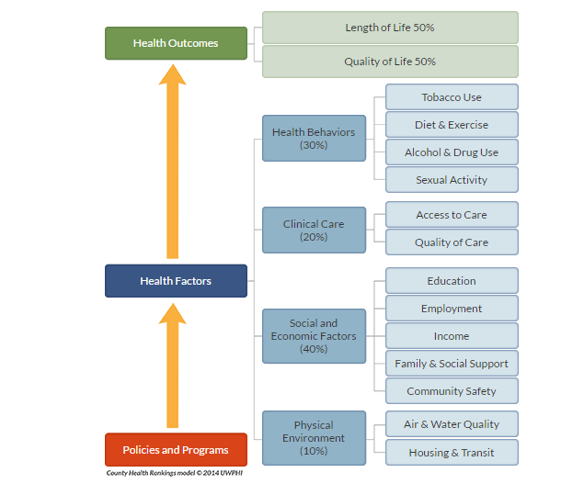
Framework for assessing and describing health status and what influences health
Notes:
The NYS Health Assessment includes data at the state and county level on demographic changes and health status, organized according to the County Health Rankings framework pictured here, which helps us better understand visually what influences health.
This picture describes the many factors that influence the health of a community. It is the framework that drives the Prevention Agenda:
Social and Economic factors including education, employment, family and social support, income and community safety,
Health behaviors including tobacco use, diet and exercise, alcohol and drug use, and sexual activity
Clinical care as measured by access and quality of care
Physical environment including the quality of air and water, as well as housing and transit

Slide 8
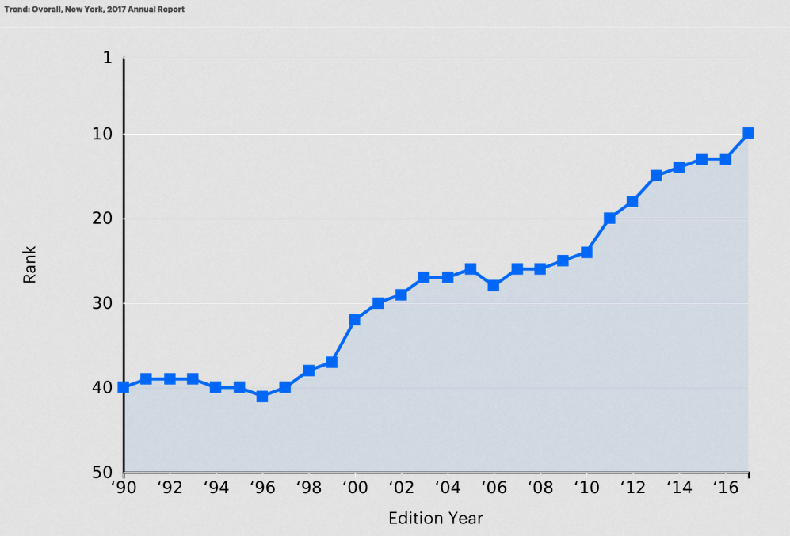
New York State Overall Ranking, America’s Health Rankings
NYS 2017 Rank = #10
Data Source: America’s Health Rankings
Notes:
First, the good news:
The health status of New Yorkers – as measured by the America’s Health Rankings – has greatly improved.
For nearly 3 decades, America’s Health Rankings has provided an annual summary of the nation’s health on a state-by-state basis by analyzing a comprehensive set of health, environmental and socioeconomic data to determine national health benchmarks and state rankings.
New York State’s rank has improved drastically in the last two decades. We are currently ranked 10th in the nation, up from 40th in 1990 and 26th in 2008, when the Prevention Agenda began.

Slide 9
NYS Health Assessment 2018 - Summary
The NYS population is aging and becoming more diverse.
Chronic disease continues to be a major burden including heart diseases, cancers, diabetes, and asthma.
We are making good progress in some maternal and infant health indicators including teen pregnancy and breastfeeding but more work to be done to address the disparities related to infant mortality, preterm birth, and maternal mortality.
We are on the path to end AIDS but have challenges reducing STDs as well as Hep C.
In the past several years, water quality has become a major issue that warrants attention.
Most importantly we have identified opioid overdose as a major issue that is contributing to declining life expectancy.
Notes:
But challenges remain. The health assessment compiled by the New York State Department of Health indicates that our state still faces challenges in each of the five Prevention Agenda priority areas, as summarized here.

Slide 10
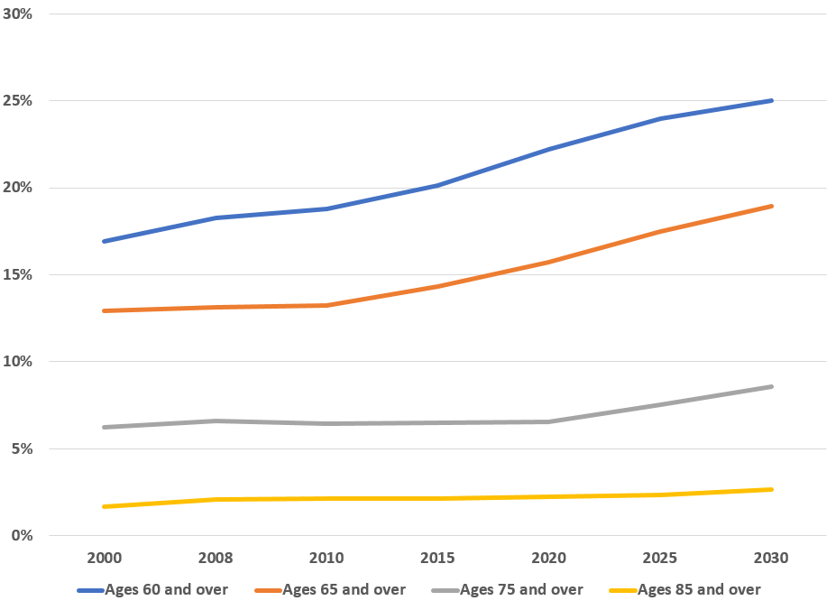
Percent of Population by Age Groups, New York State, 2000-2030*
Percent of Total Population
Population Trends | 2000 | 2008 | 2010 | 2015 | 2020 | 2025 | 2030
Total Population | 19,000,135 | 19,460,969 | 19,566,610 | 19,673,174 | 20,266,341 | 20,693,354 | 21,195,944
Ages 60 and over | 3,211,738 | 3,558,460 | 3,677,891 | 3,965,446 | 4,499,549 | 4,962,734 | 5,302,667
Ages 65 and over | 2,452,931 | 2,559,826 | 2,588,024 | 2,820,435 | 3,191,141 | 3,615,695 | 4,020,308
Ages 75 and over | 1,180,878 | 1,281,459 | 1,259,873 | 1,282,467 | 1,332,145 | 1,561,652 | 1,815,879
Ages 85 and over | 314,771 | 403,129 | 417,164 | 422,641 | 454,298 | 486,682 | 566,423
Disabled-----Ages 60 and over | 1,201,431 | 1,331,201 | 1,375,879 | 1,506,658 | 1,683,257 | 1,856,532 | 1,983,699
37 percent of those over 60 have or will have a disability.
Data Source: NYS Data Book, US Census 2015, *2020, 2025, 2030 date were projected by NYSOFA
Notes:
New York State’s population is the fourth largest in the United States. The current population of 19.7 million people increased from 19.5 million in 2010. That is an increase of 0.5 percent and is projected to keep growing. The age groups that are expected to see the most growth are those aged 60 and older, especially the population over 75 years of age. This increase is because people are living a bit longer and the aging of the Baby Boomers.
This slide shows the trends in population counts for residents ages 60 years and older including projections between 2020 and 2030.
The numbers in blue are for those individuals ages 60 and older with a disability – this number is about 1.5 million people, accounting for nearly 40 percent of the state’s population aged 60 and over. The number of residents 60 and older who have a disability is projected to be nearly 2 million by 2030.

Slide 11
Estimated Number of Deaths Due to Modifiable Factors, New York State, 2015
Note: Estimates were extrapolated using the results published in “Actual Causes of Death in the United States, 2000” JAMA, March 2004, 291 (10) and 2015 NYS Vital Records.
Notes:
In 2015, 47 percent of all deaths in New York State are attributable to eight modifiable factors (i.e., other than genetic causes). Tobacco use, poor diet, physical inactivity and alcohol consumption are the most common factors and are linked to behaviors that can be changed. Accidents involving motor vehicles and firearms, as well as unsafe sexual behaviors are the other causes of deaths associated with modifiable factors or behaviors. These factors are referred to as the ‘actual causes of death’ and are each addressed in the Prevention Agenda.

Slide 12
Index of Disparity for Public Health Priority Areas, New York State
*Rate age-adjusted to the 2000 US Population
Indicators are based on the most current data available and range between 2014 and 2016.
Notes:
Reducing and eliminating health disparities has been an explicit goal of the Prevention Agenda. Health disparities are differences in health outcomes and their causes among groups of people including racial and ethnic groups, as well as those with low socio-economic status.
The index in this figure estimates the total disparity attributable to racial and ethnic differences for each indicator of health. It shows that in New York State, the five health outcome areas with the largest racial and ethnic disparities are the HIV new case rate, asthma emergency department visit rate, gonorrhea case rate, teen pregnancy rate and assault-related hospitalizations.

Slide 13
Notes:
We also have disparities related to income, especially upstate where the population may not be racially or ethnically diverse. Income is an important social determinant of health.
This slide shows the 2017 County Health Rankings for health outcomes (orange dots) and the estimate for the percent of children in poverty (grey dots) in each county. Moving left to right, the same county’s dots are on top of each other. In the bottom left corner, the highest-ranked county ( Putnam - rank 1) – the county with the best health outcomes - has the lowest childhood poverty (7 percent), while the worst ranking county (Bronx) has the highest child hood poverty rate (43 percent). The overall pattern shows that counties with higher prevalence of childhood poverty also ranked worse on health outcomes.
Two examples of the association between income and health factors are obesity and smoking during pregnancy. Generally speaking, as household income increases, the prevalence of obesity decreases. The decrease in obesity with higher income may be due to more education, as well as a greater ability to pay for, and access, nutritious food and exercise opportunities.
When we look at smoking during pregnancy, we notice that women on Medicaid were more than twice as likely to smoke during the third trimester compared to those not on Medicaid.

Slide 14
Prevention Agenda Dashboard Measures Progress on 96 Statewide Outcome Indicators, Including Reductions in Health Disparities
Indicators (un-met)
Indicators (met)
As of June 2017
https://health.ny.gov/preventionagendadashboard
Notes:
This slide summarizes results shown in the Prevention Agenda Dashboard.
To track the state’s progress-to-date in achieving the objectives for the Prevention Agenda 2013-2018 plan, NYSDOH has been monitoring 96 statewide indicators for the five priority areas and one overall category to “Improve Health Status and Reduce Health Disparities,” shown here in the left-most bar.
As of June 2017, there were 22 indicators where the 2018 objectives were met. Some examples of these include: preventable hospitalization rate; assault-related hospitalization rate; heart attack hospitalization rate; newly diagnosed HIV case rate; teen pregnancy rate; and binge drinking rate among adults. Furthermore, the disparity in premature deaths between Hispanics and non-Hispanic Whites was significantly reduced.
Conditions such as obesity are linked to multiple determinants of health and, in many cases, reflect barriers to a healthy lifestyle caused by adverse social determinants of health. For these reasons, we don’t expect all these indicators to improve overnight, but of the 71 indicators with data that have not been met, 12 are significantly improving, with moderate improvement in 5 others.
Much more needs to be done, however, because 40 of the 71 indicators have stayed the same and 14 are going in the wrong direction. For additional information on progress in each priority area see:

Slide 15
#2 Considerations for Addressing Social Determinants of Health, Promoting Healthy Aging and Reducing Racial, Ethnic and Socioeconomic Disparities to Achieve Health Equity
Notes:
To improve our ability to achieve our Prevention Agenda goals, we want to focus the updated Prevention Agenda on promoting healthy aging, addressing social determinants of health, and reducing racial, ethnic and socioeconomic disparities.

Slide 16
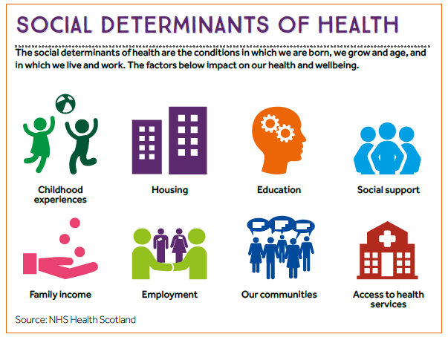
Notes:
The social determinants of health are the conditions in which we are born, grow and age, and in which we live and work including our communities, the housing we live in, the schools we attend, our access to social support, our socio-economic status, as well as our access to health services.
As shown on the earlier slide from County Health Rankings, 80% of health outcomes are attributable to these social determinants of health. To be successful in the Prevention Agenda, we need to identify and implement interventions that can impact these determinants.

Slide 17
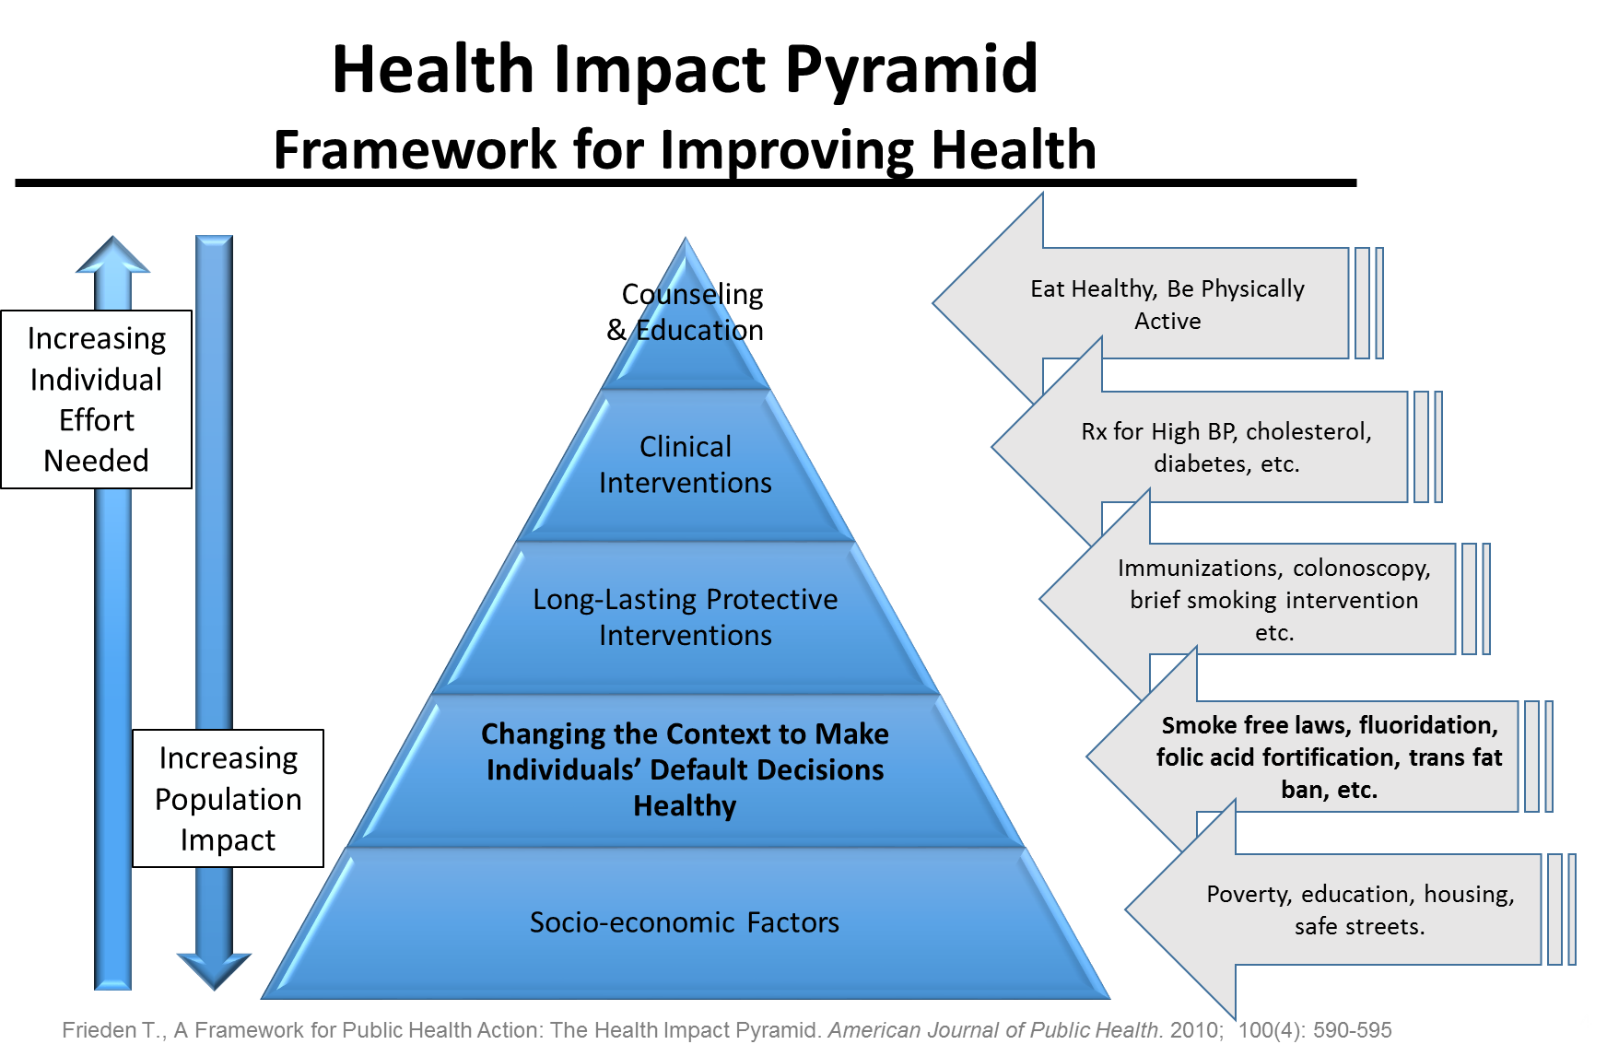
Notes:
The framework for the Prevention Agenda is the Health Impact Pyramid. We are focusing attention on the interventions at the bottom of the pyramid that can have the greatest impact on population health.
To focus attention on the factors that contribute most to health outcomes, the Prevention Agenda in 2013 prioritized interventions at the bottom of the pyramid that include evidence-based interventions and policies that change the context in which individuals make decisions about their health, with the goal of making the healthy decision the easy decision.

Slide 18
Health Across All Policies: A multi-sectoral approach to improving health
The New York Academy of Medicine, developed for the International Society for Urban Health. 2016.
Notes:
Another approach that is equally important is to focus on actions by government agencies and the private sector – beyond the traditional health sector – that are critical to addressing the social determinants of health.
Governor Cuomo has made a commitment to implementing a Health-Across-All-Policies approach, which includes public polices across sectors that systematically takes into account the health and health system implications of decisions, seeks synergies, and avoids harmful health impacts in order to improve population health and health equity.
The Health-Across-all-Policies approach emphasizes the consequences of public policies on health determinants and aims to improve the accountability of policy-makers for health impacts at all levels of policy-making.
In the updated Prevention Agenda we are increasing our emphasis on partnering with government and non-government agencies to help us adopt this approach.

Slide 20
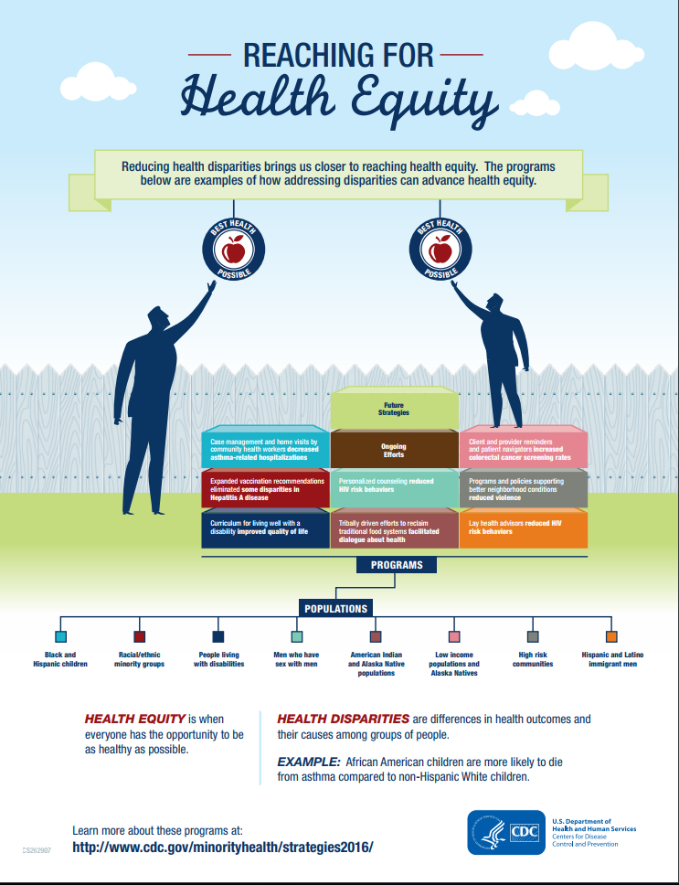
Notes:
Promoting health equity is an overarching goal of the Prevention Agenda. Our progress can be measured by the magnitude of health disparities that are ‘avoidable. unnecessary and unjust’. Health disparities are differences in health outcomes and their causes among groups of people including racial and ethnic groups, as well as those with low socioeconomic status.
We want the Prevention Agenda to include interventions that are effective in addressing health disparities such as some of these interventions highlighted by the Centers for Disease Control and Prevention.
Reducing health disparities will help us achieve health equity by producing the conditions in which everyone has the opportunity to be healthy.

Slide 21
#3 Progress on Local Prevention Agenda Action
Notes:
New York State also wants the updated Prevention Agenda to support strong, collaborative action on Prevention Agenda priorities at the local level.

Slide 22
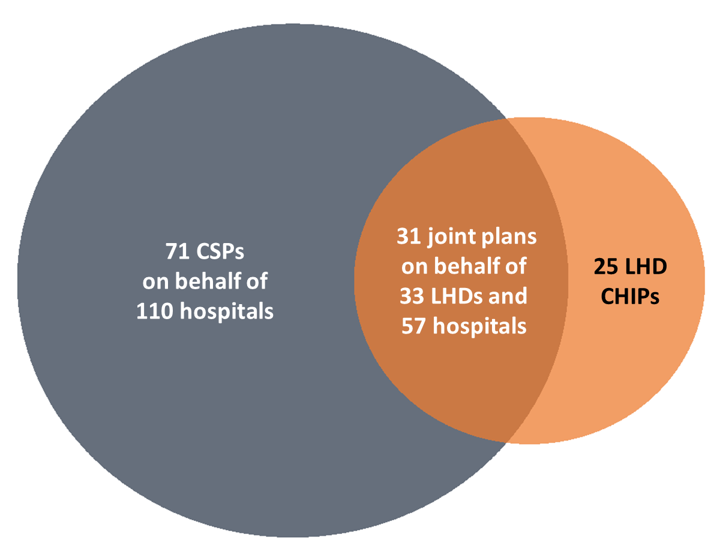
2016-2018 Collaborative Health Improvement Plans
127 plans by 58 LHDs and 167 Hospitals
Notes:
The New York State Prevention Agenda calls on local health departments and hospitals to collaborate with their community partners on the development of community health assessments and community service plans.
In addition to requiring collaboration, New York State requires that communities develop comprehensive plans that outline what organizations will do in the next three years to identify and address health challenges in their community.
While there was some collaboration early on, New York State has made great progress – to the point that more than half of the counties developed joint plans. In the communities where separate plans were provided, there was also strong evidence of collaboration.

Slide 23
Assuring the conditions for population health
Philanthropy
3%
Healthcare delivery system*
30%
Employers, business, and unions
5%
The media
Less than 1%
Academia
6%
Community-based health and human service agencies
17%
Other governmental agencies
9%
Governmental & non-governmental public health agencies
22%
Policymakers and elected officials
6%
Communities
2%
Participation in Local Partnerships by Key Sectors
*Includes health care across the continuum including primary care, insurers, hospitals, long term care, home care, hospice.
Adapted from: The Future of the Public’s Health in the 21st Century. IOM 2003
Notes:
New York State has also seen improvement in cross-sector collaboration. This diagram shows the kinds of organizations and percentages participating in partnerships to reduce chronic diseases. Local health departments and hospitals collaborated most often with other healthcare organizations, governmental and non-governmental public health agencies and organizations, and community-based health and human service organizations. Some important partner types are still missing from our cross-sector collaborations. That is one of the challenges we are asking you to help us address.

Slide 24
Implementing Evidence-Based Interventions
N = 579 interventions from 57 LHDs
N = 2210 interventions from 152 hospitals
N = 280 interventions from 43 LHDs
N = 952 interventions from 104 hospitals
Source: 2016-2018 Workplans
Notes:
The Prevention Agenda has recommended that Local Health Departments, hospitals and their partners select evidence-based interventions when developing and implementing their plans.
‘Evidence-based’ or ‘best-practice’ interventions are supported by a body of evidence that they are effective. Because evidence is limited for many public health interventions, we want to see interventions based on the best possible science, be multidisciplinary, and use sound planning and evaluation methods.
This slide shows examples of the interventions being implemented at the local level for two priorities: Prevent Chronic Disease and Promote Mental Health and Prevent Substance Abuse. The bar graphs show the percent of interventions that are considered to be ‘evidence-based or ‘best-practice’ interventions, and those that could be strengthened to become evidence-based. The remaining ones had no evidence to indicate they are best-practice interventions or we did not have enough information to classify them.
Over the six years of this Prevention Agenda cycle, we have seen a steady increase in the use of evidence-based interventions but would like to make more progress.

Slide 25
#4 Updated Vision and Proposed Cross-Cutting Principles, Priorities, Focus Areas and Goals
Notes:
The next set of slides summarizes the updated Vision, as well as proposed cross-cutting Principles, Priorities, Focus Areas and Goals. The Ad Hoc Committee has agreed on the new vision and keeping the same five priority areas. We would like your organization's feedback on the updated focus areas and goals and whether you think they help us address current health challenges, as well as support our goals for addressing the social determinants of health, promoting healthy aging across the lifespan, and reducing health disparities to achieve equity.

Slide 26
Updated Vision
New York is the Healthiest State
for People of all Ages
Notes:
The vision reflects where we want to be.
It captures an ambition to do the best we possibly can to improve the health of all New Yorkers.
And to progress from being ranked 10th in the most recent America’s Health Rankings by state.
It also reflects our appreciation for changes in demographics and the increasing number of older people living in New York State. We want to be the healthiest state for people of all ages.

Slide 27
Updated Cross-Cutting Principles
To improve health outcomes and promote equity, we will focus on prevention by:
Addressing social determinants of health
Incorporating a health-across-all-policies approach including upstream, “non-health” interventions and strategies in each priority area
Maximizing impact with evidence based interventions
Emphasizing healthy aging across the life cycle in each priority area
Strengthening collaboration across health and non-health agencies, between state and local agencies, among counties, cities and towns, and between public and private organizations
Notes:
The focus of the Prevention Agenda is on the factors that have the greatest influence on health, including the social determinants of health.
Social determinants of health are defined the conditions in which we are born, grow and age, and in which we live and work including our communities, the housing we live in, the schools we attend, our access to social support, our socio-economic status, as well as our access to health services.
To address them, we are incorporating a health across all policies approach which includes working with non health agencies and identifying interventions and strategies that are not health related to improve health. These are often called “upstream” interventions.
We want to maximize our impact by using evidence based interventions. When evidenced-based strategies are not available, “best practices” and “next practices” (those that may not have appeared in the peer-reviewed literature but which are generating good results and that we have confidence in) should be considered for utilization.
We want to include interventions that support healthy aging across the lifespan.
Collaborations and partnership must be broad and effective to make real change.

Slide 28
Updated Cross-Cutting Principles
Many factors that contribute to health are outside of the health care system, as depicted in the Population Impact Pyramid. The Prevention Agenda recognizes the critical role of health care providers in health improvement, with emphasis on actions at the community and environmental level to achieve Prevention Agenda objectives.
Within the healthcare setting, the Prevention Agenda includes strategies that increase access to care, foster more meaningful engagement with those getting care, and ensure linkages between public health and health care and between health care and available community resources.
Notes:
This slide points to how access to health care fits into the Prevention Agenda. As noted earlier we want to focus attention on prevention and the factors that contribute to health status that are outside of the health care setting. The Prevention Agenda does not include interventions to improve health care design or health care settings.
The Prevention Agenda does include strategies and interventions that can increase access to preventive care, support engagement of those getting care and improve linkages between health care and public health organizations as well as health care and community based organizations.

Slide 29
Updated Priorities
Prevent Chronic Diseases
Promote a Healthy and Safe Environment
Promote Healthy Women, Infants and Children
Prevent HIV/STDs, Vaccine-Preventable Diseases and Antimicrobial Resistance, and Healthcare-Associated Infections
Promote Well Being and Prevent Mental and Substance Use Disorders
Notes:
We are maintaining the five current priorities though have updated the titles of the last two to include attention to antimicrobial resistance and in the last one, to focus on well being in addition to prevention of mental and substance use disorders.

Slide 30
Proposed Focus Areas and Goals
Notes:
For each Priority, NYS Department of Health, Office of Mental Health and Office of Alcohol and Substance Abuse Services have proposed updated focus areas and goals for consideration, shown on the next five slides.

Slide 31
Prevent Chronic Diseases
2019-2024 Focus Areas | 2019-2024 Goals
Healthy Eating and Food Security | Increase access to healthy and affordable foods and beverages
 | Increase skills and knowledge to support healthy food and beverage choices
 | Reduce food insecurity
Physical Activity | Create community environments for physical activity
 | Promote school and child care environments for physical activity
 | Facilitate access to safe and accessible places for physical activity
Tobacco Prevention | Prevent initiation of tobacco use
 | Promote tobacco use cessation
 | Eliminate exposure to secondhand smoke
Chronic Disease Preventive Care and Management | Increase cancer screening rates
 | Increase early detection of cardiovascular disease, diabetes, prediabetes and obesity
 | Promote evidence-based care to manage chronic diseases
 | Improve chronic disease self-management skills
Unchanged from 2013
New or revised
Notes:
The focus areas of this priority have been updated to separate out healthy eating and food security and physical activity where as before there was one focus area on obesity.
Goals have been updated to feature key areas for intervention.

Slide 32
Promote a Healthy and Safe Environment
2019-2024 Focus Areas | 2019-2024 Goals
Injuries, Violence and Occupational Health | Reduce falls
 | Reduce violence
 | Reduce occupational injury and illness
 | Reduce traffic related injuries
Outdoor Air Quality | Reduce exposure to outdoor air pollutants
Climate and the Environment | Improve design and maintenance of the built environment
 | Promote healthy home environments
 | Assess and mitigate public health risks from hazardous exposures from contaminate sites
Water Quality | Ensure quality drinking water
 | Reduce potential public health risks associated with exposure to recreational water
Food and Consumer Products | Improve access to information about the presence of chemicals
 | Improve food safety management
Unchanged
New or revised
Notes:
This priority includes a new focus area related to food and consumer products and updates the climate and environment focus area.
There are new goals related to water quality to focus attention on some of the current challenges.

Slide 33
Promote Healthy Women, Infants, and Children
2019-2024 Focus Areas | 2019-2024 Goals
Maternal & Women’s Health | Increase use of primary and preventive health care services among women of reproductive age
 | Reduce maternal mortality & morbidity
Perinatal & Infant Health | Reduce infant mortality & morbidity
 | Increase breastfeeding
Child & Adolescent Health | Support and enhance children and adolescents' social-emotional development and relationships
 | Increase supports for children and youth with special health care needs
 | Reduce dental caries among children
Unchanged
New or revised
Notes:
This priority’s focus areas and goals have been updated to align with the state’s Title V Maternal and Child Health Block Grant plan, and to increase support on the health of women.

Slide 34
Prevent HIV/STDs, Vaccine-Preventable Diseases and Antimicrobial Resistance, and Healthcare-Associated Infections
2019-2024 Focus Areas | 2019-2024 Goals
Vaccine Preventable Diseases | Improve vaccination rates
Human Immunodeficiency Virus (HIV) | Decrease HIV morbidity
 | Increase viral suppression
Sexually Transmitted Diseases (STDs) | Begin to bend the STD curve
Hepatitis C Virus (HCV) | Increase the number of persons treated for HCV
 | Reduce the number of new HCV cases among people who inject drugs
Antibiotic Resistance and Healthcare-Associated Infections | Improve infection control in healthcare facilities
 | Reduce infections caused by multidrug resistant organisms and C. difficile
 | Reduce inappropriate antibiotic use
Unchanged
New or revised
Notes:
This priority area is focused on preventing infections, prioritizing attention on reducing vaccine-preventable diseases, HIV and STDs, Hepatitis C Virus, as well as antimicrobial resistance and healthcare-associated infections.

Slide 35
Promote Well Being and Prevent Mental and Substance Use Disorders
2019-2024 Focus Areas | 2019-2024 Goals
Promote Well-Being | Strengthen economic, education and community opportunities to promote well-being across the lifespan
 | Increase overall satisfaction with life for people of all ages
 | Increase support for people seeking help for mental, emotional and substance use disorders
Prevent Mental Emotional and Substance Use Disorders | Prevent underage drinking and excessive alcohol consumption by adults
 | Prevent opioid and other substance misuse and deaths
 | Prevent, reduce and address adverse childhood experiences (ACES)
 | Reduce the prevalence of major depressive episodes
 | Prevent suicides
 | Reduce tobacco use among adults who report poor mental health
Unchanged
New or revised
Notes:
This priority has a new title, focuses attention on well being, and a new focus on prevention of substance use disorders.
The focus area related to strengthening infrastructure has been removed. New York State supports the goal of strengthening infrastructure, but wants that effort to be linked to one of the specific goal areas listed here.

Slide 36
Questions to Consider
Notes:
New York State wants to hear from your organization and your members about the Prevention Agenda.

Slide 37
Questions for Consideration
Are the proposed focus areas and goals appropriate and the right ones to help address the current health challenges, reduce social determinants of health, promote our goals for healthy aging, and help reduce racial, ethnic and socioeconomic disparities to achieve health equity?
How can a diverse set of partners such as community-based organizations, media, academia, businesses, and/or other sectors be engaged at the local level?
To promote health-in-all-policies, how can policy-makers from non-health sectors be engaged at the local level?
How can NYS and localities make better progress in addressing racial, ethnic, and socioeconomic disparities?
How can NYS and localities address health for all ages?
What is needed to support communities to implement evidence-based interventions and measure short-term impacts?

Slide 38
Opportunities for Participation
Engage your members to provide feedback on vision, priorities, and proposed focus areas for the Prevention Agenda 2019-2024
Engage your members in providing feedback on how to strengthen local efforts to help us achieve our vision
Participate in priority-specific planning to develop updated plans
To indicate how you will participate, please contact us at:
prevention@health.ny.gov

