Slide 1

Trauma Injury Prevention Initiative: Fall Prevention Comprehensive Screening Project

Slide 3

Fall Prevention In Older Adults Project Goals
# 1: Sustainability
# 2: Standardize and deploy education resources
# 3: Develop ongoing working relationships with
institutional and community partners
# 4: Measure project effectiveness
# 5: Research

Slide 4

#1. Sustainability
Hardwire screening tool and prevention awareness into main stream healthcare system.
Deputize Others:
Integrate healthcare providers, institutional services, community partners.
Provide Support:
Support sustainability by providing education materials and systems to partners.

Slide 5
# 2: Standardize and Deploy Education Resources
Development of:
Falls Risk Assessment Tool
Falls Prevention in Older Adults Tool Kit
My Falls Free Plan
Comprehensive Screening Event to be held bi-annually at both Level I and Level II sites.
Open/Share materials and event organization with regional/state trauma partners.
2016 STEADI KIT for Primary Care Conference.
Video

Slide 6
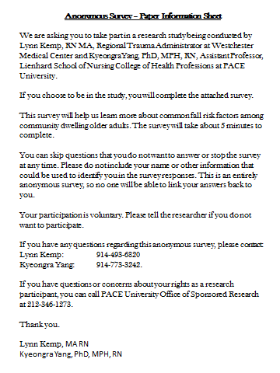
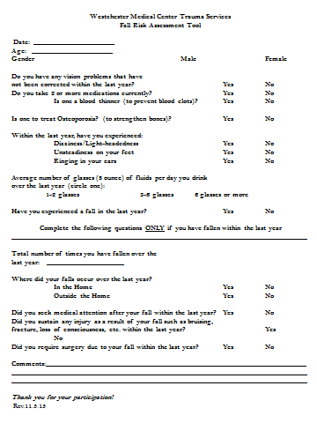
Fall Risk Assessment Tool

Slide 7
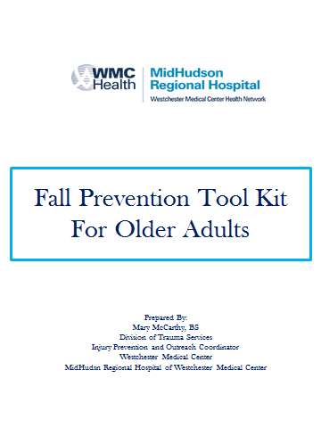
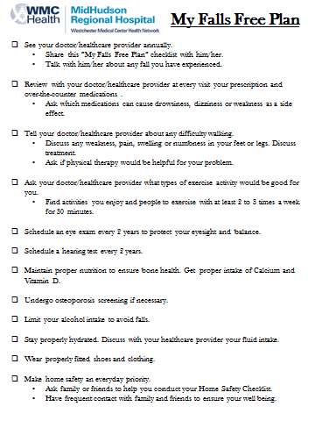
Fall Prevention In Older Adults Tool Kit “My Falls Free Plan”
Reduce Falls in Older Adults through Education and Empowerment
Tool Kit was assembled to offer individuals practical tools/recommendations to incorporate in their daily lives. Tools/recommendations that can be shared with healthcare provider, caregivers and family.
My Falls Free Plan is a very proactive tool individuals can use in their planning to reduce falls. Individuals are encouraged to actively share this plan with their healthcare provider, caregiver and family. Includes proactive steps/recommendations to reduce the opportunity for a fall.

Slide 8
Fall Prevention In Older Adults Tool Kit
Consists of 11 individual sheets including a
Overview and Welcome Letter/Mission Statement.
Incorporates “puzzle piece” theme that represents the multifactorial nature of falls.
My Falls Free Plan is the centerpiece of the packet and challenges the individual to proactively address risks associated with falls and to devise a long term plan to reduce falls.
Tool Kit focuses on practical elements necessary to reduce falls.
Remains a work in progress and can be modified to reflect institutional and demographic needs and resources.

Slide 9
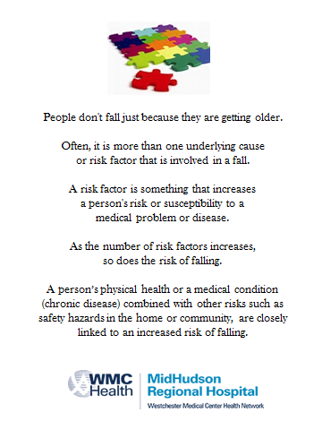
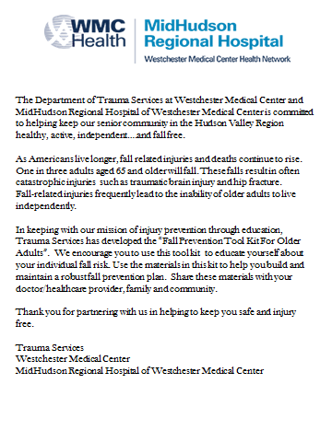
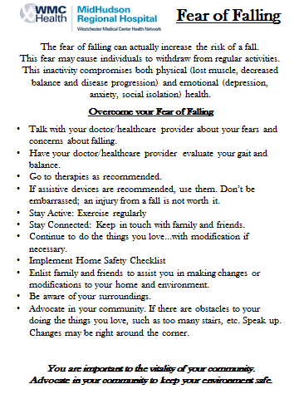
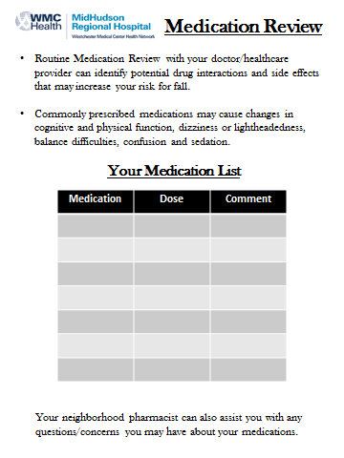
Fall Prevention in Older Adults Tool Kit

Slide 10
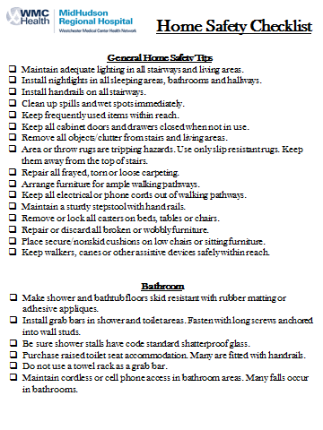
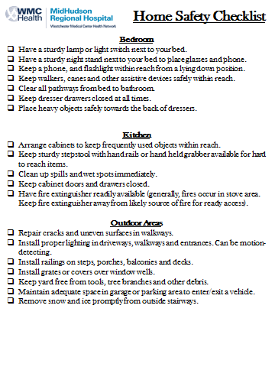
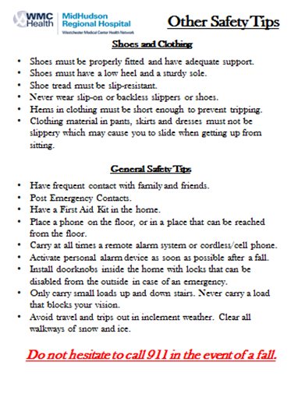
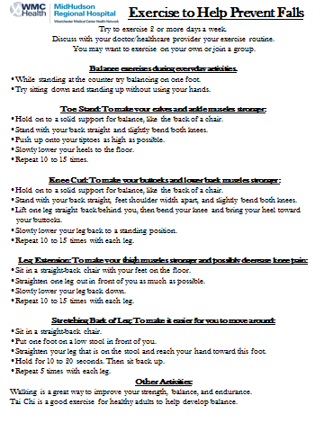
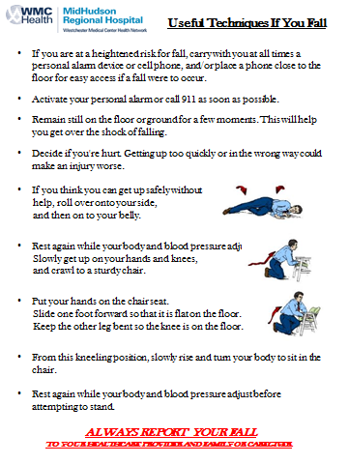
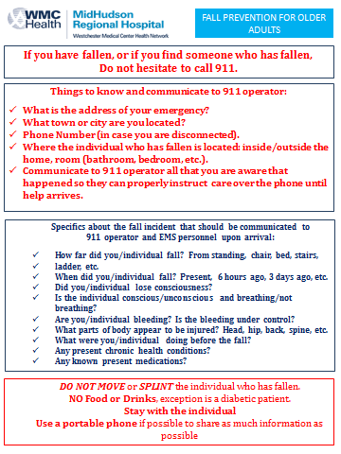
Fall Prevention In Older Adults Tool Kit (continued)

Slide 11
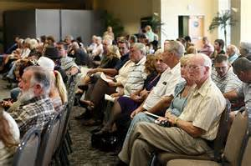
# 3: Develop ongoing working relationships with institutional and community partners
Expanded our approach from “dog and pony shows” to include:
Development of partnerships
Institutional Partners: Pharmacy, PT/OT, Nutrition……
Primary Care Physicians/Health Centers
Office of the Aging
EMS
Home Safety Collaborations
HG Page & Sons-”Falls in Older Adults Gift Registry”.
Technology based solutions
EMMI: Online, multimedia programs approach designed to empower people to become active in their care.
Public television cable programming
Greenburgh Cable Programming

Slide 12

# 4: Measure Project Effectiveness
Trauma Registry
Development of Regional Repository
Long-term Registry Analysis

Slide 13
# 5: Research
Development and validation of a Falls Risk Screening Tool used for research.
Distribute screening tool to partners and incorporate in all outreach activity.
Establish centralized repository for all falls risk data, including electronic reports.
Analysis and publish data/results collected

Slide 14
Event Planning, Screening Stations/Project Timeline
Puzzle Piece Mascot: Highlight the “multi-factorial” nature/risk factors associated with falls in older adults.
“Big Picture”: Communicate to providers, caregivers and those individuals at risk the institutional and community resources available to assist in reducing falls.
Pre-registration-Approximately 80 participants were preregistered (waiting list).
All participants complete fall survey.
All participants screened for risk at 10 stations.
All participants to be provided consult /recommendations at stations.
All participants who consent; risk profile sent to Healthcare provider.
Assessments collected and risk profile established.
Healthcare Provider Packets delivered to over 40 physicians.
Marketing-Multiple Media Outlets, Office of Aging, Falls Presentations, Flyer Distribution.

Slide 15
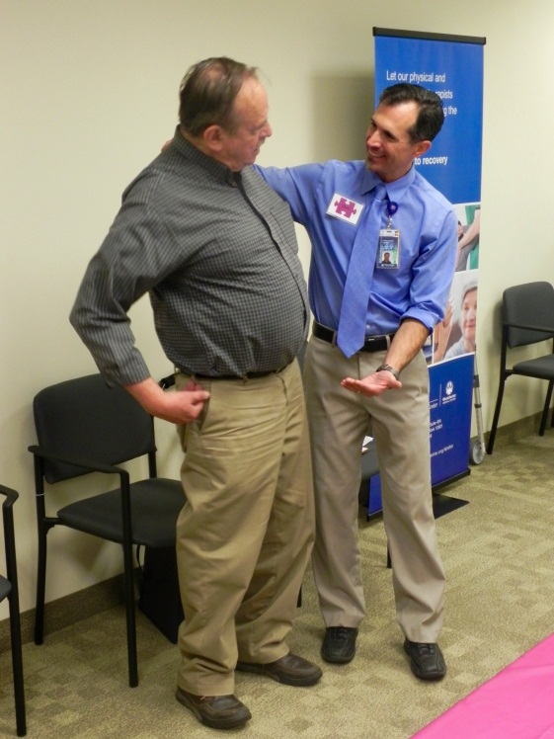
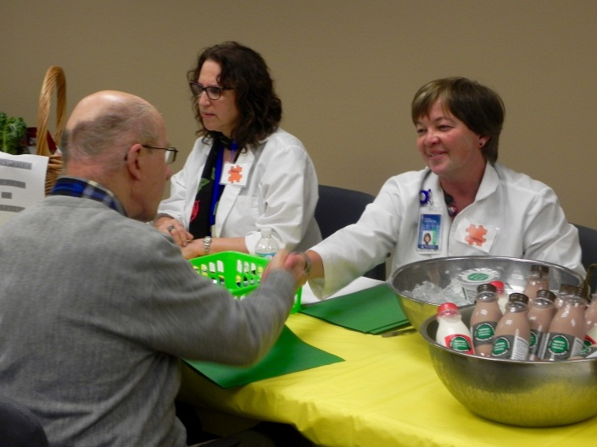
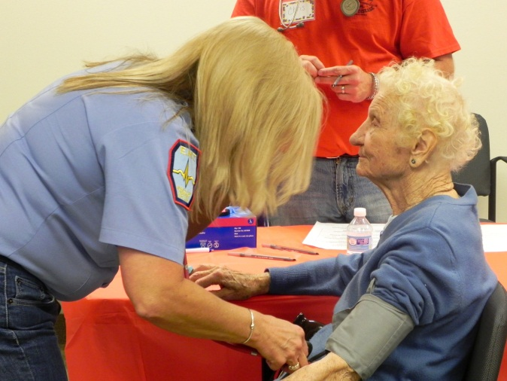
Screening Station Inclusion and Criteria
All assets to “share the stage”
for the consumer of education and resource in falls prevention.
Screening criteria must be “Evidence Based”
Poly-Pharmacy, Anticoagulant
CDC STEADI KIT (Stopping Elderly Accidents, Death and Injury)
TUG Test, 4-Stage Balance Test, 30 Second Chair Stand
Tai Chi

Slide 16
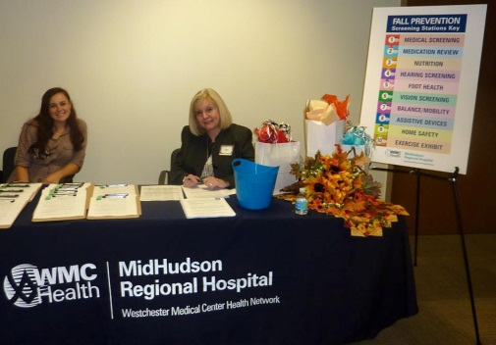
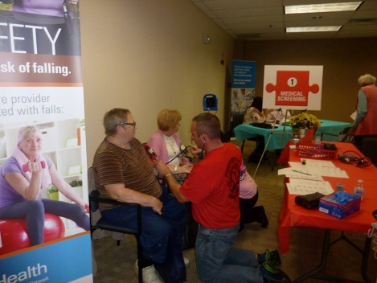
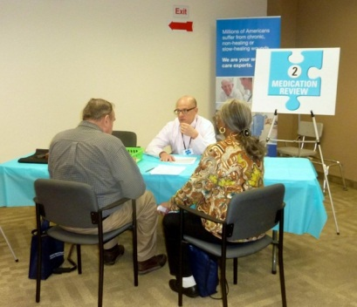
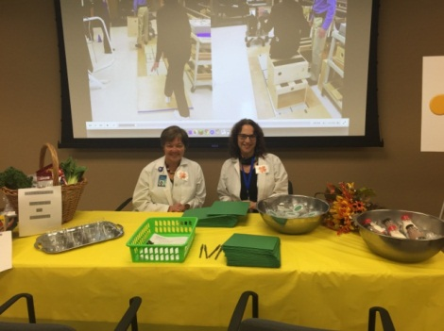
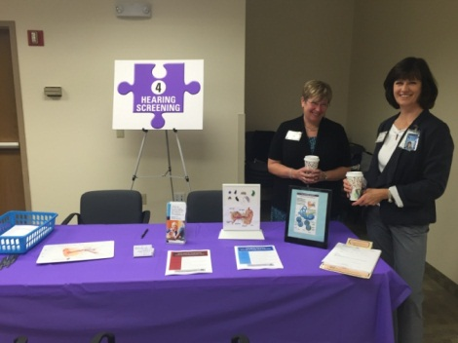
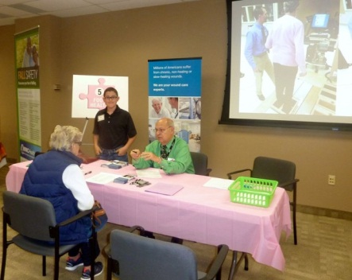
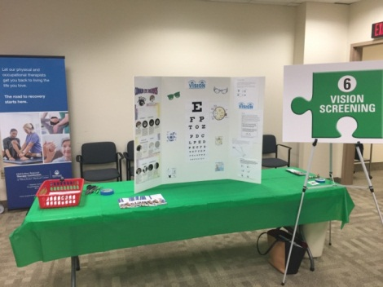
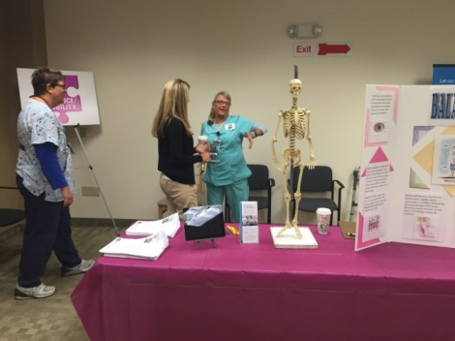
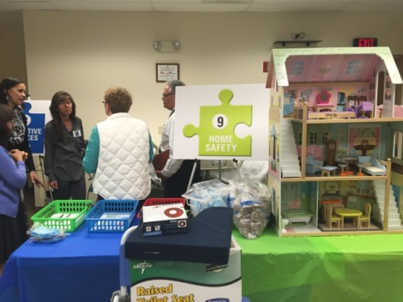
Registration
Medical Screening/Vital Signs:
Staffed by EMS
Pharmacy: Staffed
by Hospital Pharmacist
Nutrition Screening:
Staffed by Outpatient
Nutritionist
Hearing Screening:
Staffed by Audiologists
Foot Health: Staffed by
Independent Podiatrists
Vision Screening:
Staffed by OT
Balance and mobility:
Staffed by PT/OT
Home Safety:
Staffed by Home Care, PT/OT

Slide 17
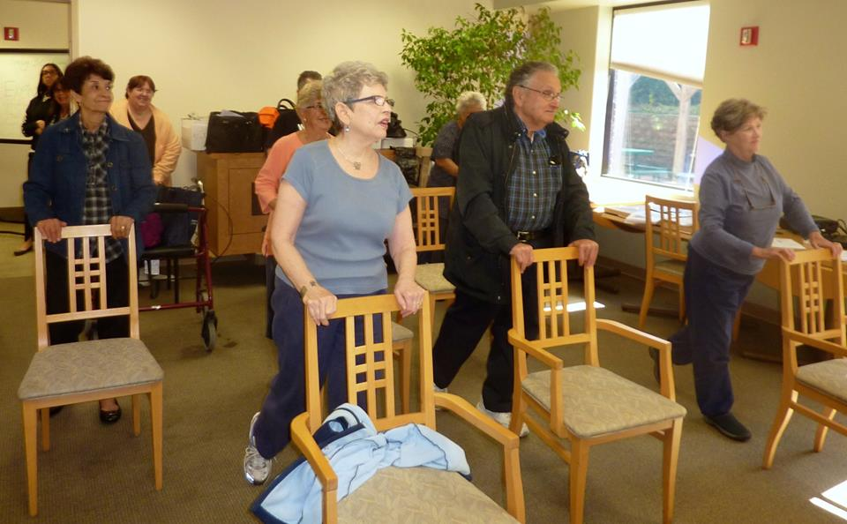
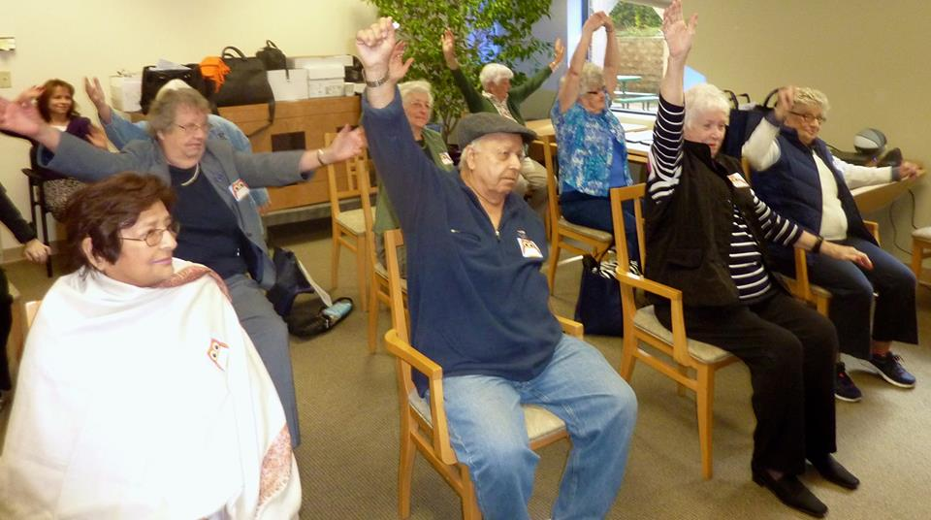
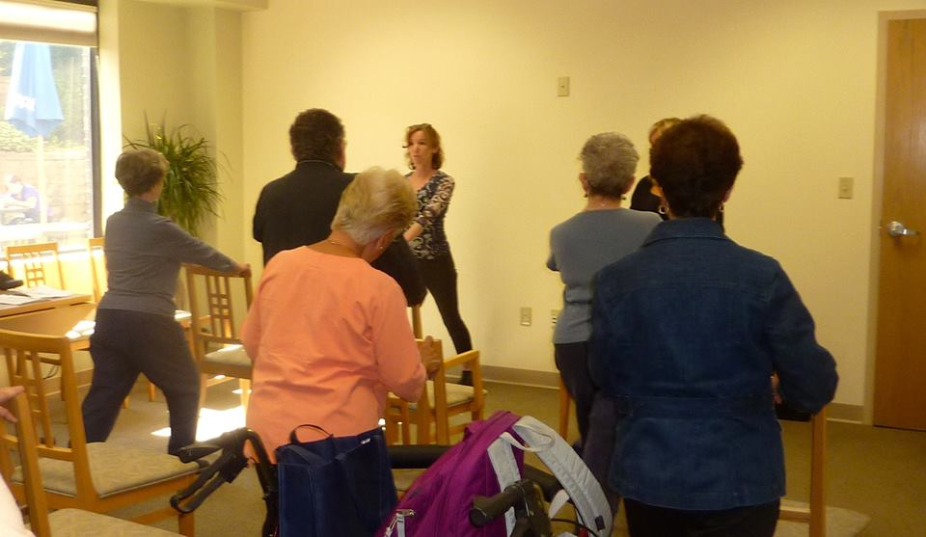
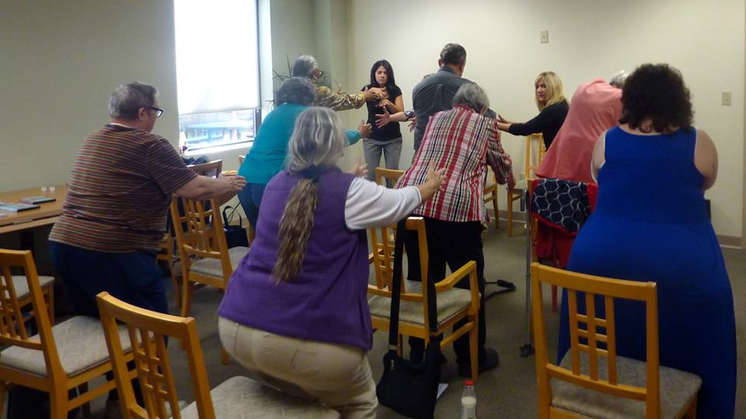
Chair Exercise Tai Chi Instruction
Instruction provided by community partners: YWCA, Office of Aging.

Slide 18
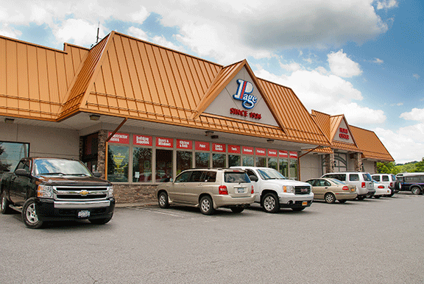
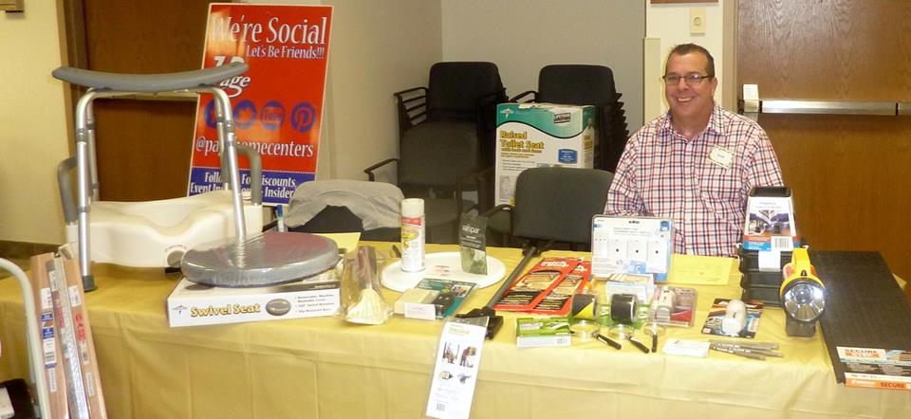
Home Safety Station HG Page & Sons Falls Prevention in Older Adults Gift Registry
MHRH Division of Trauma Services reached out to local hardware store, HG Page & Sons, to partner with them to create a “Home Safety Gift Registry-How to Prevent Falls in the Home”. The store participated in the event to showcase resources in their inventory that can reduce falls, and other home safety equipment available.
Event participants were instructed on how to make their homes safer by reducing tripping hazards, adding grab bars inside and outside the tub or shower and next to the toilet, adding railings on both sides of stairways, and improving the lighting in their homes, etc.

Slide 19
Post Event Data Collection
Information on each individual participant measurement collated into Excel
Information entered into SPSS for analysis

Slide 20


Post Event Follow-Up Forging Partnership with Healthcare Provider
HCP Mailing Included:
Cover Letter to Healthcare Provider
Individual Participant Screening Assessment Reports
MHRH Falls in Older Adults Resource Listing and recommendations.
CDC STEADI KIT for Primary Care
HCP Follow-Up Meeting with Trauma Injury Prevention and Outreach Coordinator

Slide 21
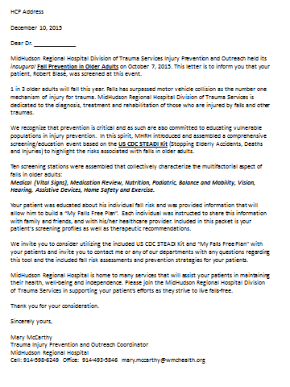

HCP Cover Letter to PCP My Falls Free Plan

Slide 22
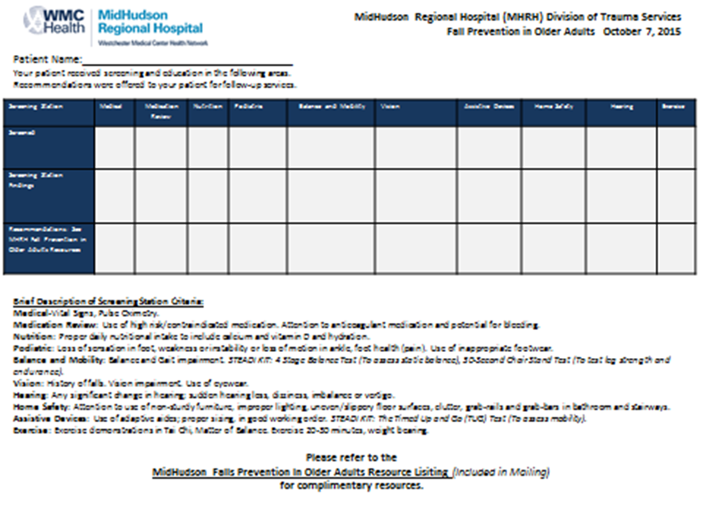
Screening Station Assessment, Recommendation/Referral

Slide 23
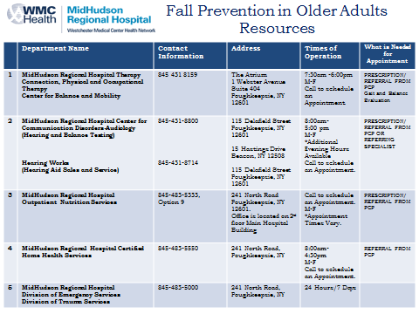
Resource Guide Development

Slide 24
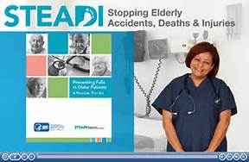
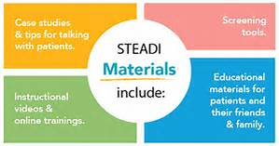
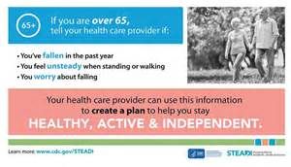
CDC STEADI KIT for Primary Care

Slide 25
2016 STEADI Kit for Primary Care Physician/Provider Educational Event
Identify Primary Care Physician Champion
Conference planning
Plan: To integrate falls prevention screening tool into routine primary care evaluations/H & P
Goal: To measure and increase awareness of fall potential of patients when considering medications, therapies, etc.
Identify fall risk and provide proactive strategies for prevention

Slide 26
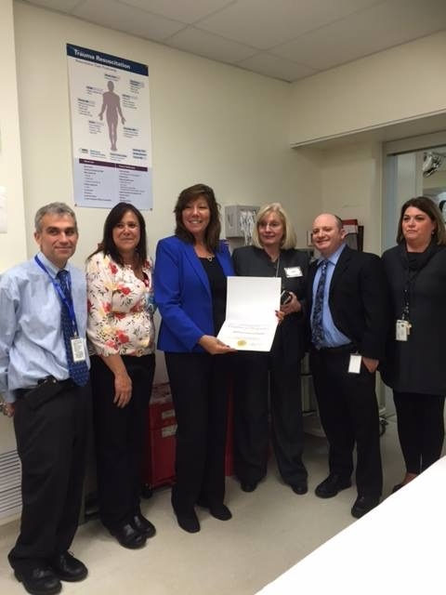
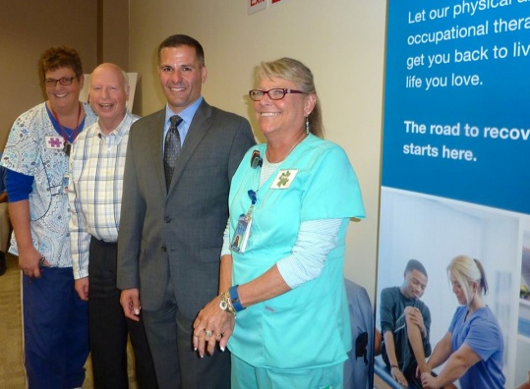
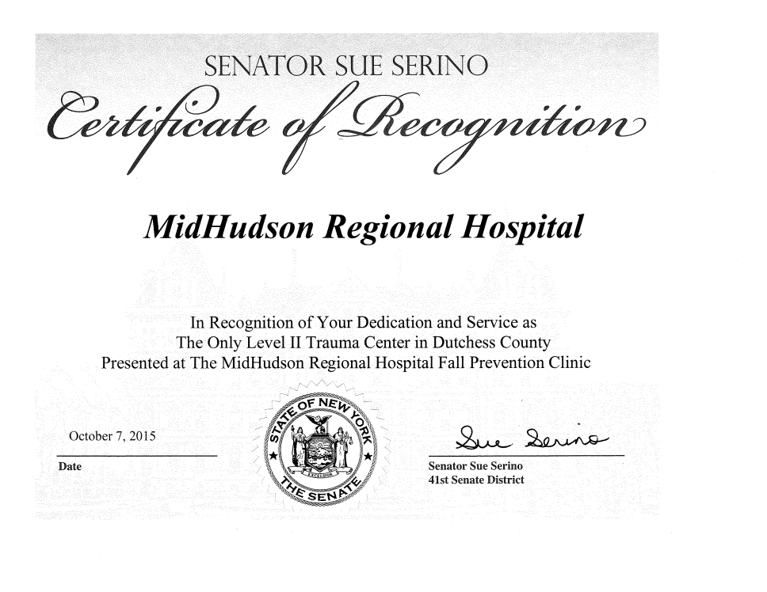
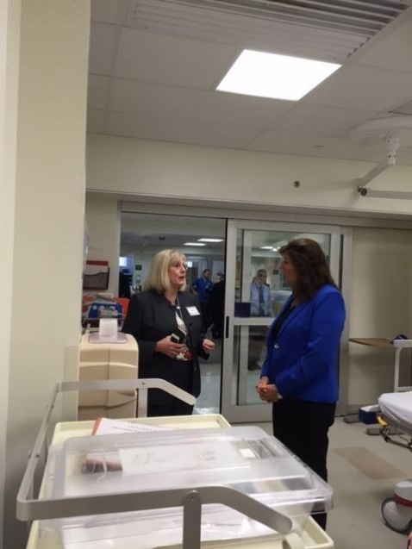
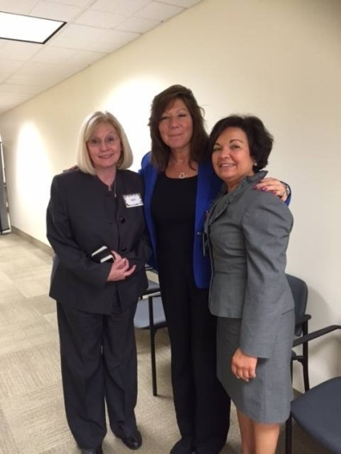
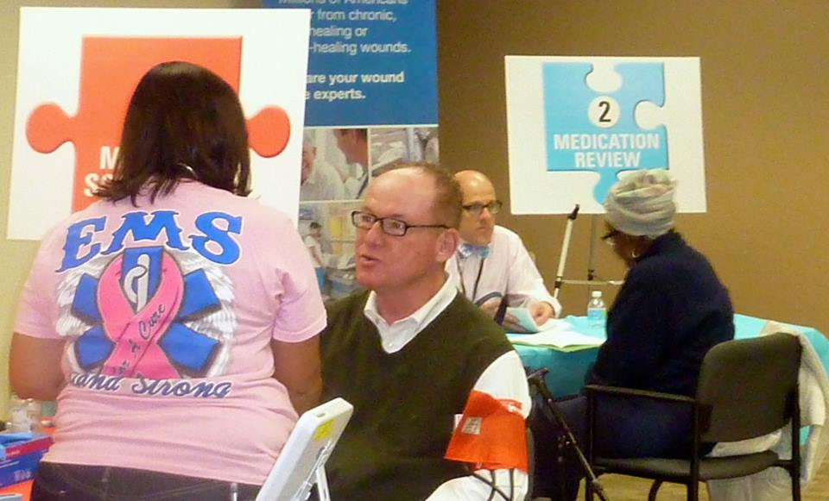
Legislative Partnership/Support Senator Sue Serino: 41St District of New York Dutchess County Executive Marcus Molinaro City of Poughkeepsie Mayor Rob Rollison

Slide 27
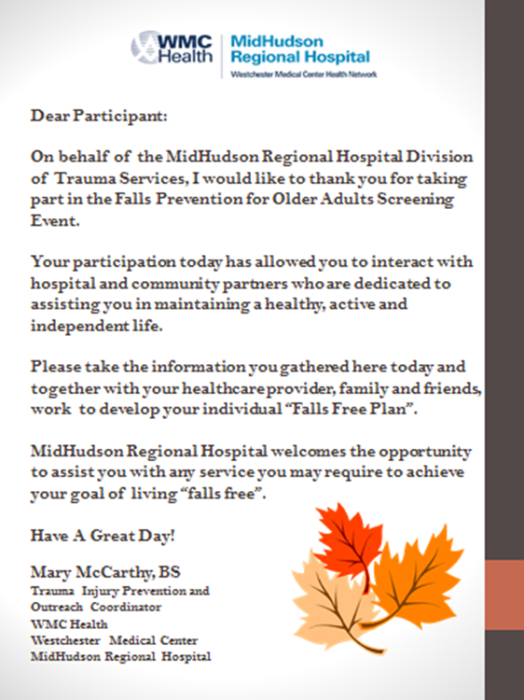
Questions???
Thank you for your attention!
WMC Trauma Injury Prevention and Outreach
Office: 914-493-5846
Cell: 914-598-6349

